Slide 1
IGCSE FM Algebraic Manipulation
Dr J Frost (jfrost@tiffin.kingston.sch.uk)
Objectives: (from the specification)
Last modified: 25th April 2016

Slide 2
What makes this Further-Mathsey?
This is another one of those “technically all GCSE, but just harder” type topic.
Algebraic fractions may require prior factorisation before multiplying/dividing.
Solve equations involving sum/difference of two algebraic fractions.
Harder changing the subject questions (often involving fractions).

Slide 3
RECAP: Simplifying Algebraic Fractions
AQA Set 2 Paper 2 Q10
Simplify fully $\frac{9x^{3}−16x}{6x+8}$
?
$$=\frac{x\left(9x^{2}−16\right)}{2\left(3x+4\right)}=\frac{x\left(3x+4\right)\left(3x−4\right)}{2\left(3x+4\right)}=\frac{x\left(3x−4\right)}{2}$$
Test Your Understanding:
Simplify fully $\frac{x^{2}+3x+2}{x^{3}−x}$
$$=\frac{\left(x+2\right)\left(x+1\right)}{x\left(x^{2}−1\right)}=\frac{\left(x+2\right)\left(x+1\right)}{x\left(x+1\right)\left(x−1\right)}=\frac{x+2}{x\left(x−1\right)}$$
?
Simplify fully $\frac{2x^{2}−xy−y^{2}}{x^{2}y−xy^{2}}$
$$=\frac{\left(2x+y\right)\left(x−y\right)}{xy\left(x−y\right)}=\frac{2x+y}{xy}$$
?

Slide 4

RECAP: Adding/Subtracting Algebraic Fractions
?
$$\frac{1}{x}+\frac{2}{y}=\frac{y}{xy}+\frac{2x}{xy} \\ =\frac{2x+y}{xy}$$
$$\frac{1}{x}+\frac{1}{x+1}=\frac{x+1}{x\left(x+1\right)}+\frac{x}{x\left(x+1\right)} \\ =\frac{2x+1}{x\left(x+1\right)}$$
$$1+\frac{2}{x}=\frac{x}{x}+\frac{2}{x}=\frac{x+2}{x}$$
As with normal fractions, you need a common denominator.
?
?

Slide 5

Harder Examples
?
$$\frac{2x+1}{x^{2}−1}+\frac{1}{x−1}=\frac{2x+1}{\left(x+1\right)\left(x−1\right)}+\frac{1}{x−1} \\ =\frac{2x+1}{\left(x+1\right)\left(x−1\right)}+\frac{x+1}{\left(x+1\right)\left(x−1\right)} \\ =\frac{3x+2}{\left(x+1\right)\left(x−1\right)}$$
$$\frac{1}{x^{2}−x}+\frac{1}{xy−y}=\frac{1}{x\left(x−1\right)}+\frac{1}{y\left(x−1\right)} \\ =\frac{y}{xy\left(x−1\right)}+\frac{x}{xy\left(x−1\right)} \\ =\frac{x+y}{xy\left(x−1\right)}$$
Bro Hint: Factorise the denominators first where applicable.
?

Slide 6
Test Your Understanding
?
$$\frac{2}{x^{2}−4}+\frac{1}{x+2}=\frac{2}{\left(x+2\right)\left(x−2\right)}+\frac{1}{x+2} \\ =\frac{2}{\left(x+2\right)\left(x−2\right)}+\frac{x−2}{\left(x+2\right)\left(x−2\right)} \\ =\frac{x}{\left(x+2\right)\left(x−2\right)}$$
$$\frac{x}{x^{2}+5x−6}−\frac{6}{x^{2}−x}=\frac{x}{\left(x+6\right)\left(x−1\right)}−\frac{6}{x\left(x−1\right)} \\ =\frac{x^{2}}{x\left(x+6\right)\left(x−1\right)}−\frac{6\left(x+6\right)}{x\left(x+6\right)\left(x−1\right)} \\ =\frac{x^{2}−6x−36}{x\left(x+6\right)\left(x−1\right)}$$
?

Slide 7
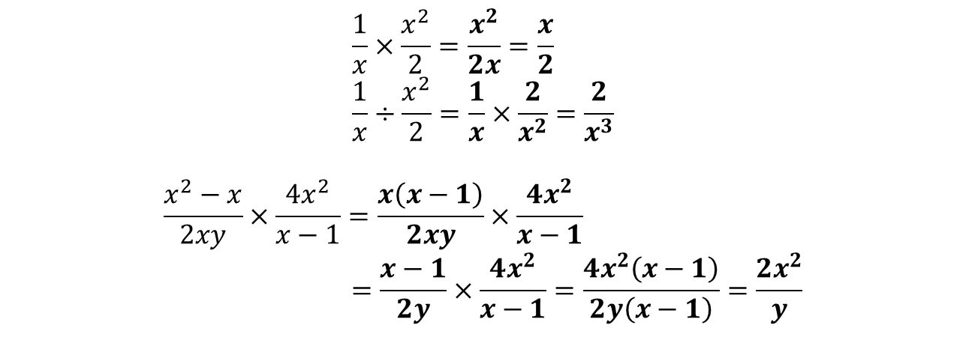
Multiplying and Dividing
?
$$\frac{1}{x}×\frac{x^{2}}{2}=\frac{x^{2}}{2x}=\frac{x}{2} \\ \frac{1}{x}÷\frac{x^{2}}{2}=\frac{1}{x}×\frac{2}{x^{2}}=\frac{2}{x^{3}}$$
$$\frac{x^{2}−x}{2xy}×\frac{4x^{2}}{x−1}=\frac{x\left(x−1\right)}{2xy}×\frac{4x^{2}}{x−1} \\ =\frac{x−1}{2y}×\frac{4x^{2}}{x−1}=\frac{4x^{2}\left(x−1\right)}{2y\left(x−1\right)}=\frac{2x^{2}}{y}$$
?
?
AQA Set 1 Paper 1 Q10
Bro Tip: Just factorise first.
$$=\frac{\left(3x−7\right)\left(x+2\right)}{\left(3x+2\right)\left(3x−2\right)}÷\frac{x+2}{x\left(3x+2\right)} \\ =\frac{\left(3x−7\right)\left(x+2\right)}{\left(3x+2\right)\left(3x−2\right)}×\frac{x\left(3x+2\right)}{x+2}=\frac{x\left(3x−7\right)}{3x−2}$$
?

Slide 8
Test Your Understanding
?
1
$$\frac{x^{2}+4x}{x^{2}−1}÷\frac{x+4}{x+1}=\frac{x\left(x+4\right)}{\left(x+1\right)\left(x−1\right)}×\frac{x+1}{x+4} \\ =\frac{x}{x−1}$$
?
2
$$\frac{2x^{2}−x−6}{16x^{2}−25}÷\frac{x−2}{4x^{2}−5x}=\frac{\left(2x+3\right)\left(x−2\right)}{\left(4x+5\right)\left(4x−5\right)}÷\frac{x−2}{x\left(4x−5\right)} \\ =\frac{\left(2x+3\right)\left(x−2\right)}{\left(4x+5\right)\left(4x−5\right)}×\frac{x\left(4x−5\right)}{x−2} \\ =\frac{x\left(2x+3\right)}{4x+5}$$

Slide 9
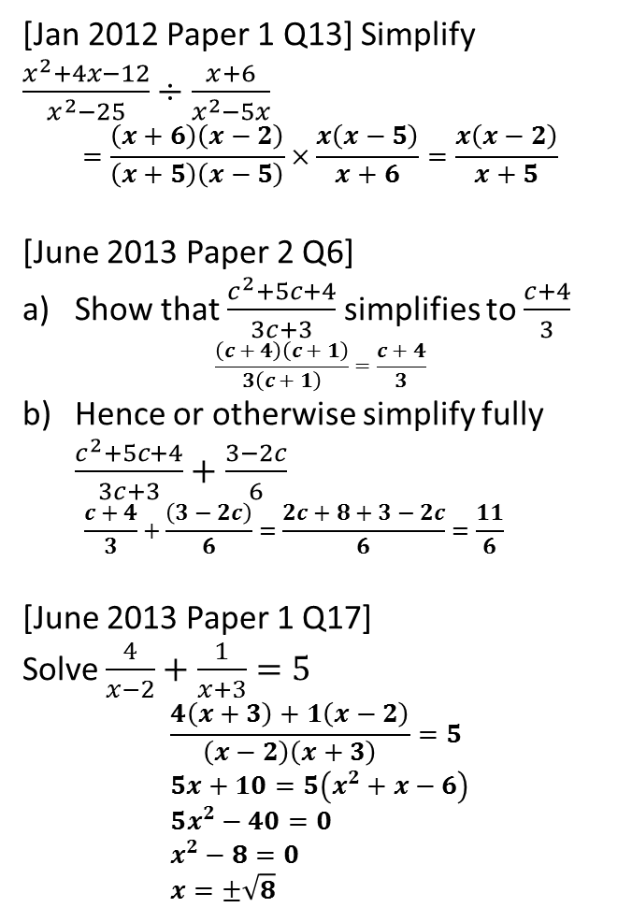
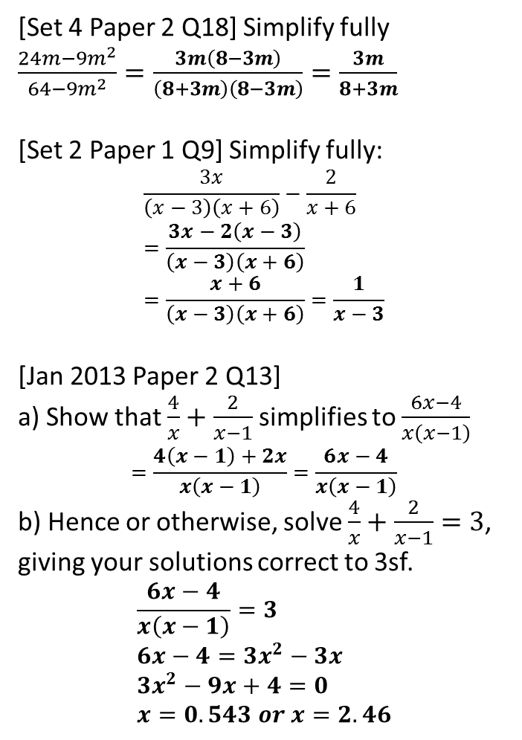
Exercise 1
1
[Set 4 Paper 2 Q18] Simplify fully $\frac{24m−9m^{2}}{64−9m^{2}}=\frac{3m\left(8−3m\right)}{\left(8+3m\right)\left(8−3m\right)}=\frac{3m}{8+3m}$
[Set 2 Paper 1 Q9] Simplify fully:
$$\frac{3x}{\left(x−3\right)\left(x+6\right)}−\frac{2}{x+6} \\ =\frac{3x−2\left(x−3\right)}{\left(x−3\right)\left(x+6\right)} \\ =\frac{x+6}{\left(x−3\right)\left(x+6\right)}=\frac{1}{x−3}$$
[Jan 2013 Paper 2 Q13]
a) Show that $\frac{4}{x}+\frac{2}{x−1}$ simplifies to $\frac{6x−4}{x\left(x−1\right)}$
$$=\frac{4\left(x−1\right)+2x}{x\left(x−1\right)}=\frac{6x−4}{x\left(x−1\right)}$$
b) Hence or otherwise, solve $\frac{4}{x}+\frac{2}{x−1}=3$, giving your solutions correct to 3sf.
$$\frac{6x−4}{x\left(x−1\right)}=3 \\ 6x−4=3x^{2}−3x \\ 3x^{2}−9x+4=0 \\ x=0.543 or x=2.46$$
4
[Jan 2012 Paper 1 Q13] Simplify $\frac{x^{2}+4x−12}{x^{2}−25}÷\frac{x+6}{x^{2}−5x}$
$$=\frac{\left(x+6\right)\left(x−2\right)}{\left(x+5\right)\left(x−5\right)}×\frac{x\left(x−5\right)}{x+6}=\frac{x\left(x−2\right)}{x+5}$$
[June 2013 Paper 2 Q6]
Show that $\frac{c^{2}+5c+4}{3c+3}$ simplifies to $\frac{c+4}{3}$ $\frac{\left(c+4\right)\left(c+1\right)}{3\left(c+1\right)}=\frac{c+4}{3}$
Hence or otherwise simplify fully $\frac{c^{2}+5c+4}{3c+3}+\frac{3−2c}{6}$ $\frac{c+4}{3}+\frac{\left(3−2c\right)}{6}=\frac{2c+8+3−2c}{6}=\frac{11}{6}$
[June 2013 Paper 1 Q17] Solve $\frac{4}{x−2}+\frac{1}{x+3}=5$
$$\frac{4\left(x+3\right)+1\left(x−2\right)}{\left(x−2\right)\left(x+3\right)}=5 \\ 5x+10=5\left(x^{2}+x−6\right) \\ 5x^{2}−40=0 \\ x^{2}−8=0 \\ x=±\sqrt{8}$$
?
?
2
5
?
?
3
?
?
6
?
?

Slide 10

Changing the Subject
The example from earlier:
?
$$\frac{12}{y}=\frac{12−x}{3x}$$
$$36x=y\left(12−x\right) \\ 36x=12y−xy \\ 36x+xy=12y \\ x\left(36+y\right)=12y \\ x=\frac{12y}{36+y}$$
Can you think of some general strategies that might help with changing the subject questions?
Combine any fractions being added/subtracted.
If fraction(s), multiply through by the denominator(s).
Cross-multiplication.
‘Swapsie tricks’! $a−x=b → a−b=x$ $\frac{a}{x}=b → \frac{a}{b}=x$
Collect subject on one side to factorise out.
?
?
?
?
?
?
?
?
?
?

Slide 11

More Examples
Make $n$ the subject of $p=\frac{an+2}{n−a}$
$$p\left(n−a\right)=an+2 \\ pn−ap=an+2 \\ pn−an=ap+2 \\ n\left(p−a\right)=ap+2 \\ n=\frac{ap+2}{p−a}$$
?
Solve $\frac{4}{x}+\frac{5}{x+1}=2$
$$\frac{4\left(x+1\right)+5x}{x\left(x+1\right)}=2 \\ 4\left(x+1\right)+5x=2x\left(x+1\right) \\ 9x+4=2x^{2}+2x \\ 0=2x^{2}−7x−4 \\ \left(2x+1\right)\left(x−4\right)=0 \\ x=−\frac{1}{2} or x=4$$
?

Slide 12


Test Your Understanding
Make $t$ the subject of $\frac{1}{2}+\frac{2}{t}=\frac{1}{x}$
?
$$\frac{t+4}{2t}=\frac{1}{x} \\ xt+4x=2t \\ 4x=2t−xt \\ 4x=t\left(2−x\right) \\ \frac{4x}{2−x}=t$$
Make $q$ the subject of $4=\frac{3q+r}{r−aq}$
$$4r−4aq=3q+r \\ 3r=3q+4aq \\ 3r=q\left(3+4a\right) \\ q=\frac{3r}{3+4a}$$
?

Slide 13
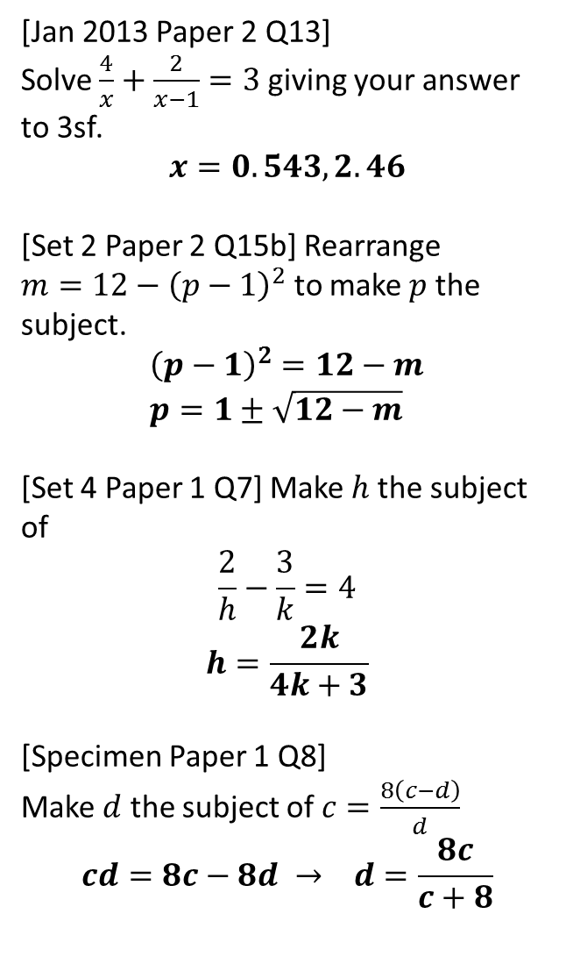
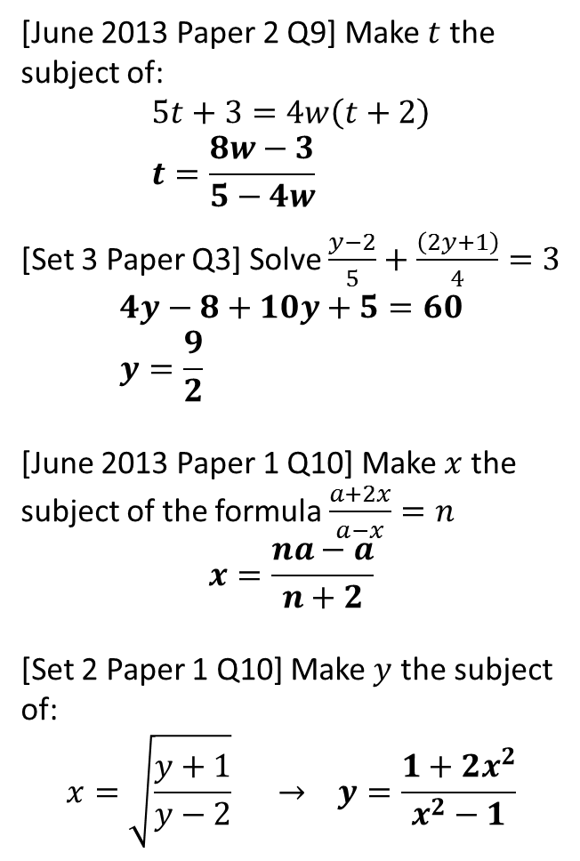
Exercise 2
5
[Jan 2013 Paper 2 Q13] Solve $\frac{4}{x}+\frac{2}{x−1}=3$ giving your answer to 3sf.
$$x=0.543, 2.46$$
[Set 2 Paper 2 Q15b] Rearrange $m=12−{\left(p−1\right)}^{2}$ to make $p$ the subject.
$${\left(p−1\right)}^{2}=12−m \\ p=1±\sqrt{12−m}$$
[Set 4 Paper 1 Q7] Make $h$ the subject of
$$\frac{2}{h}−\frac{3}{k}=4$$
$$h=\frac{2k}{4k+3}$$
[Specimen Paper 1 Q8]
Make $d$ the subject of $c=\frac{8\left(c−d\right)}{d}$
$$cd=8c−8d → d=\frac{8c}{c+8}$$
1
[June 2013 Paper 2 Q9] Make $t$ the subject of:
$$5t+3=4w\left(t+2\right) \\ t=\frac{8w−3}{5−4w}$$
[Set 3 Paper Q3] Solve $\frac{y−2}{5}+\frac{\left(2y+1\right)}{4}=3$
$$4y−8+10y+5=60 \\ y=\frac{9}{2}$$
[June 2013 Paper 1 Q10] Make $x$ the subject of the formula $\frac{a+2x}{a−x}=n$
$$x=\frac{na−a}{n+2}$$
[Set 2 Paper 1 Q10] Make $y$ the subject of:
$$x=\sqrt{\frac{y+1}{y−2}} → y=\frac{1+2x^{2}}{x^{2}−1}$$
?
?
6
2
?
?
3
7
?
?
4
?
8
?

