Slide 1
IGCSEFM :: Differentiation
jfrost@tiffin.kingston.sch.uk
www.drfrostmaths.com @DrFrostMaths
Last modified: 30th August 2017

Slide 2
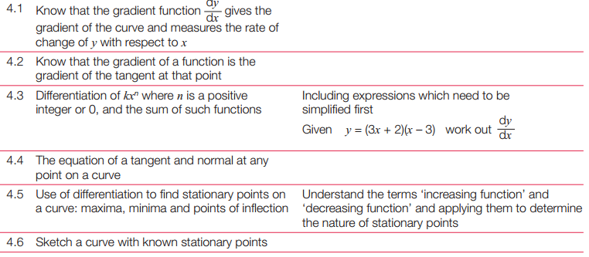
Chapter Overview
1:: Find the derivative of polynomials.
2:: Find equations of tangents and normal to curves.
If $y=3x^{2}+\sqrt{x}$, find $\frac{dy}{dx}$
The point $P\left(3,9\right)$ lies on the curve $C$ with equation $y=x^{2}$. Determine the equation of the tangent to $C$ at the point $P$.
3:: Identify increasing and decreasing functions.
4:: Find and understand the second derivative $\frac{d^{2}y}{dx^{2}}$ or $f^{′′}\left(x\right)$
Find the range of values for which $f\left(x\right)=x^{3}−x$ is increasing.
If $y=x^{4}−3x^{2}$ determine $\frac{d^{2}y}{dx^{2}}$
5:: Find stationary points and determine their nature.
AQA IGCSEFM Specification:
Find the stationary points of $y=x^{3}−x$ and state whether each is a maximum or minimum point.

Slide 3
What actually is gradient?
How would you describe gradient in words?
?
It is the rate at which something changes.
i.e. What the $y$ variable changes by per unit increase in $x$.
Exam Note: A question might use the phrase “the rate of change of $y$ with respect to $x$” instead of “the gradient”.
We’re often concerned with rates in maths/Science.
e.g. Speed is the rate at which distance is changing.
Acceleration is the rate at which speed is changing.
$$m$$
1

Slide 4
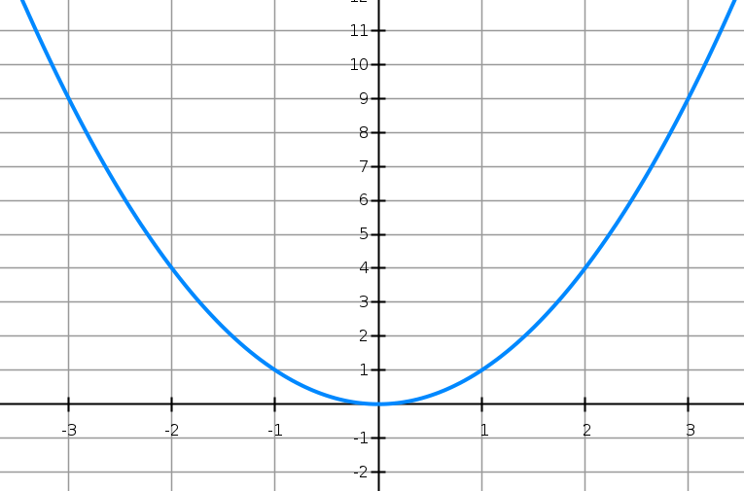
Gradient Function
For a straight line, the gradient is constant:
At GCSE, you found the gradient of a curve at a particular point by drawing a tangent.
$$m=6$$
$$m=−6$$
$$y=x^{2}$$
$$y=3x+2$$
$$m=3$$
$$m=−4$$
$$m=4$$
$$m=−2$$
$$m=2$$
$$m=0$$
However, for a curve the gradient varies. We can no longer have a single value for the gradient; we ideally want an expression in terms of $x$ that gives us the gradient for any value of $x$ (unsurprisingly known as the gradient function).
$$x$$ | -3 | -2 | -1 | 0 | 1 | 2 | 3
Gradient | -6 | -4 | -2 | 0 | 2 | 4 | 6
?
?
?
?
?
?
?
By looking at the relationship between $x$ and the gradient at that point, can you come up with an expression, in terms of $x$ for the gradient?
$$Gradient Function=2x$$
?

Slide 5
Finding the Gradient Function
The question is then: Is there a method to work out the gradient function without having to draw lots of tangents and hoping that we can spot the rule?
To approximate the gradient on the curve $y=x^{2}$ when $x=5$, we could pick a point on the curve just slightly to the right, then find the gradient between the two points:
As the second point gets closer and closer, the gradient becomes a better approximation of the true gradient:
$$y=x^{2}$$
?
$$\left(6,36\right)$$
?
$$11$$
$$\left(5.01,25.1001\right)$$
$$1$$
$$0.01$$
$$0.1001$$
$$\left(5,25\right)$$
$$\left(5,25\right)$$
?
?
?
$$m=\frac{Δy}{Δx}=\frac{11}{1}=11$$
$$m=\frac{0.1001}{0.01}=10.01$$
The actual gradient when $x=5$ is 10, so this approximation is damn close!

Slide 6
Finding the Gradient Function
This gives us a numerical method to get the gradient at a particular $x$, but doesn’t give us the gradient function in general. Let’s use exactly the same method, but keep $x$ general, and make the ‘small change’ (which was previously 0.01) ‘$h$’:
$$y=x^{2}$$
?
?
As always, gradient is change in $y$ over change in $x$.
$$\left(x+h,{\left(x+h\right)}^{2}\right)$$
$$gradient=\lim_{h→0}{\frac{{\left(x+h\right)}^{2}−x^{2}}{h}} \\ =\lim_{h→0}{\frac{2xh+h^{2}}{h}} \\ =\lim_{h→0}\left(2x+h\right) \\ =2x$$
?
$$?$$
$$\left(x,x^{2}\right)$$
?
$$?$$
?
The lim means “the limit of the following expression as $h$ tends towards 0”.
For example, $\lim_{x→∞}\left(\frac{1}{x}\right)=0$, because as $x$ “tends towards” infinity, the “limiting” value of the expression is 0.
?
The $h$ disappears as $h$ tends towards 0, i.e. we can effectively treat it as 0 at this point.
And voila, we got the $2x$ we saw earlier!

Slide 7
Finding the Gradient Function
The gradient function, or derivative, of the curve $y=f(x)$ is written as $f′(x)$ or $\frac{dy}{dx}$.
$$f^{′}\left(x\right)=\lim_{h→0 }{\frac{f\left(x+h\right)−f\left(x\right)}{h}}$$
The gradient function can be used to find the gradient of the curve for any value of $x$.
Notation Note:
Whether we use $\frac{dy}{dx}$ or $f′(x)$ for the gradient function depends on whether we use $y=$ or $f\left(x\right)=$ to start with:
$$y=x^{2} → \frac{dy}{dx}=2x \\ f\left(x\right)=x^{2} → f^{′}\left(x\right)=2x$$
Note: You do not need to know differentiation ‘by first principles’ until A Level. We will shortly see a quicker way to find the gradient function.
“Leibniz’s notation”
“Lagrange’s notation”
Advanced Notation Note:
Rather than $h$ for the small change in $x$, the formal notation is $δx$. So actually:
$$f^{′}\left(x\right)=\lim_{δx→0 }{\frac{f\left(x+δx\right)−f\left(x\right)}{δx}}$$
So we in fact have 3 symbols for “change in”!
$Δx$: any change in $x$ (as seen before: $m=\frac{Δy}{Δx}$)
$δx$: a small change in $x$
$dx$: an infinitesimally small change in $x$
There’s in fact a third way to indicate the gradient function, notation used by Newton: (but you won’t use at IGCSEFM)
$$y=x^{2} → \dot{y}=2x$$
So the estimated gradient using some point close by was $\frac{δy}{δx}$, but in the ‘limit’ as $δx→0$, $\frac{δy}{δx}→\frac{dy}{dx}$

Slide 8
Example
The point $A$ with coordinates $\left(4,16\right)$ lies on the curve with equation $y=x^{2}$.
At point $A$ the curve has gradient $g$.
Show that $g=\lim_{h→0}\left(8+h\right)$
Deduce the value of $g$.
a
?
$$g=\lim_{h→0}{\frac{f\left(4+h\right)−f\left(4\right)}{h}} \\ =\lim_{h→0}{\frac{{\left(4+h\right)}^{2}−4^{2}}{h}} \\ =\lim_{h→0}{\frac{16+8h+h^{2}−16}{h}} \\ =\lim_{h→0}{\frac{8h+h^{2}}{h}} \\ =\lim_{h→0}\left(8+h\right)$$
$$g=8$$
Use the “differentiation by first principles” formula.
Function is $f\left(x\right)=x^{2}$
As $h→0$, clearly the limiting value of $8+h$ is 8.
b
?

Slide 9
Just for your interest…
Why couldn’t we just immediately make $h$ equal to 0 in $\lim_{h→0}{\frac{{\left(x+h\right)}^{2}−x^{2}}{h}}$ ?
$\frac{0}{0}$ is known as an indeterminate form. Whereas we know what happens with expressions like $\frac{1}{0}$ (i.e. its value tends towards infinity), indeterminate forms are bad because their values are ambiguous, and prevent $lim$ expressions from being evaluated.
Consider $\frac{0}{0}$ for example: 0 divided by anything usually gives 0, but anything divided by 0 is usually infinity. We can see these conflict.
If we just stick $h=0$ in straight away:
$$\lim_{h→0}{\frac{{\left(x+0\right)}^{2}−x^{2}}{0}}=\lim_{h→0}{\frac{0}{0}}$$
Wait, uh oh…
Thankfully, when indeterminate forms appear in $lim$ expressions, there are variety of techniques to turn the expression into one that doesn’t have any indeterminate forms.
One simple technique, that worked in our example, is to expand and simplify. This gave us $\lim_{h→0}\left(2x+h\right)$ and $2x+0$ clearly is fine. Other techniques are more advanced.
This is important when sketching harder functions: http://www.drfrostmaths.com/resources/resource.php?rid=163
Can you guess some other indeterminate forms, i.e. expressions whose value is ambiguous?
$$\frac{0}{0} \frac{∞}{∞} 0×∞ ∞−∞ 0^{0} 1^{∞} ∞^{0}$$
?
ME-WOW!

Slide 10
Differentiating $x^{n}$
Thankfully, there’s a quick way to differentiate terms of the form $x^{n}$ (where $n$ is a constant) with having to use first principles every time:
If $y=ax^{n}$ then $\frac{dy}{dx}=nax^{n−1}$ (where $a,n$ are constants)
i.e. multiply by the power and reduce the power by 1
Examples:
?
$$y=x^{5} → \frac{dy}{dx}=5x^{4}$$
Power is 5, so multiply by 5 then reduce power by 5.
$$f(x)=x^{\frac{1}{2}} → f^{′}\left(x\right)=\frac{1}{2}x^{−\frac{1}{2}}$$
The power need not be an integer!
Remember to use $f^{′}\left(x\right)$ not $\frac{dy}{dx}$
?
Why would it be incorrect to say that $y=2^{x}$ differentiates to $\frac{dy}{dx}=x 2^{x−1}$?
The rule only works when the base is $x$ and the power is a constant. Neither is true here! Note that $x^{n}$ is “a power of $x$” whereas $2^{x}$ is an exponential term (which you will encounter more in Chp14), and therefore differentiate differently. You will learn how to differentiate exponential terms in Year 2.
$$y={2x}^{6} → \frac{dy}{dx}=12x^{5}$$
?
?
$$f\left(x\right)=\frac{x}{x^{4}}=x^{−3} → f^{′}\left(x\right)=−3x^{−2}$$
?
?
$$y=\sqrt{x^{6}}=x^{3} → \frac{dy}{dx}=3x^{2}$$
?
?

Slide 11
Test Your Understanding
?
$$y=x^{7} → \frac{dy}{dx}=7x^{6}$$
1
$$y=3x^{10} → \frac{dy}{dx}=30x^{9}$$
?
2
$$f\left(x\right)=\frac{x^{\frac{1}{2}}}{x^{2}}=x^{−\frac{3}{2}} → \frac{dy}{dx}=−\frac{3}{2}x^{−\frac{5}{2}}$$
?
?
3
$$y=ax^{a} → \frac{dy}{dx}=a^{2}x^{a−1}$$
?
4
?
?
$$f(x)=\sqrt{49x^{7}}=7x^{\frac{3}{2}} → f′(x)=\frac{21}{2}x^{\frac{1}{2}}$$
5

Slide 12
Differentiating Multiple Terms
Differentiate $y=x^{2}+4x+3$
First thing to note:
If $y=f\left(x\right)+g\left(x\right)$ then $\frac{dy}{dx}=f^{′}\left(x\right)+g^{′}\left(x\right)$
i.e. differentiate each term individually in a sum/subtraction.
$$\frac{dy}{dx}=2x+4$$
?
?
?
$$y=4x=4x^{1}$$
Therefore applying the usual rule:
$$\frac{dy}{dx}=4x^{0}=4$$
Alternatively, if you compare $y=4x$ to $y=mx+c$, it’s clear that the gradient is fixed and $m=4$.
$$y=3=3x^{0}$$
Therefore applying the usual rule:
$$\frac{dy}{dx}=0x^{−1}=0$$
Alternatively, if you sketch $y=4$, the line is horizontal, so the gradient is 0.

Slide 13
Quickfire Questions
?
$$y=2x^{2}−3x → \frac{dy}{dx}=4x−3$$
1
?
2
$$y=4−9x^{3} → \frac{dy}{dx}=−27x^{2}$$
?
$$y=5x+1 → \frac{dy}{dx}=5$$
3
?
$$y=ax → \frac{dy}{dx}=a$$
4
(where $a$ is a constant)
?
$$y=6x−3+px^{2} → \frac{dy}{dx}=6+2px$$
5
(where $p$ is a constant)

Slide 14
Harder Example
Let $f\left(x\right)=4x^{2}−8x+3$
Find the gradient of $y=f\left(x\right)$ at the point $\left(\frac{1}{2},0\right)$
Find the coordinates of the point on the graph of $y=f\left(x\right)$ where the gradient is 8.
Find the gradient of $y=f\left(x\right)$ at the points where the curve meets the line $y=4x−5$.
a
$$f^{′}\left(x\right)=8x−8$$
When $f^{′}\left(\frac{1}{2}\right)=8\left(\frac{1}{2}\right)−8−4$
?
Remember that the ‘gradient function’ allows you to find the gradient for a particular value of $x$.
b
$$8=8x−8 \\ x=2 \\ y=4{\left(2\right)}^{2}−8\left(2\right)+3=3$$
Point is $\left(2,3\right)$
This example is important!
Previously you used a value of $x$ to get the gradient $f^{′}\left(x\right)$. This time we’re doing the opposite: using a known gradient $f^{′}\left(x\right)$ to get the value of $x$. We therefore substitute $f^{′}\left(x\right)$ for 8.
?
Once you have your $x$, you need to work out $y$.
Ensure you use the correct equation!
c
First find point of intersection:
$$4x^{2}−8x+3=4x−5$$
Solving, we obtain: $x=1$ or $x=2$
When $x=1, f^{′}\left(1\right)=0$
When $x=2, f^{′}\left(2\right)=8$
?

Slide 15
Test Your Understanding
Let $f\left(x\right)=x^{2}−4x+2$
Find the gradient of $y=f\left(x\right)$ at the point $\left(1,−1\right)$
Find the coordinates of the point on the graph of $y=f\left(x\right)$ where the gradient is 5.
Find the gradient of $y=f\left(x\right)$ at the points where the curve meets the line $y=2−x$.
a
$$f^{′}\left(x\right)=2x−4$$
When $f^{′}\left(1\right)=2\left(1\right)−4=−2$
?
$$5=2x−4 \\ x=\frac{9}{2} \\ y={\left(\frac{9}{2}\right)}^{2}−4\left(\frac{9}{2}\right)+2=\frac{17}{4}$$
Point is $\left(\frac{9}{2},\frac{17}{4}\right)$
b
?
$$x^{2}−4x+2=2−x$$
Solving: $x=0$ or $x=3$
When $x=0, f^{′}\left(0\right)=−4$
When $x=3, f^{′}\left(3\right)=2$
c
?

Slide 16
Exercise 1
1
For each of the following, find the gradient function $\frac{dy}{dx}$, and hence find the gradient of the tangent to the curve when $x=2$
$$y=2x^{5} → \frac{dy}{dx}=10x^{4}, m=160 \\ y=7x^{3} →\frac{dy}{dx}=21x^{2}, m=84 \\ y=3x+4 →\frac{dy}{dx}=3 , m=3 \\ y=2x+x^{2} →\frac{dy}{dx}=2+2x, m=6 \\ y=2x^{3}+x^{−1} → \frac{dy}{dx}=6x^{2}−x^{−2}, m=23\frac{3}{4} \\ y={\frac{1}{2}x}^{−2} →\frac{dy}{dx}=−x^{−3} , m=−\frac{1}{8} \\ y=2πx^{2}−1 →\frac{dy}{dx}=4πx , m=8π$$
The tangent to the curve $y=x^{3}+2x^{2}−x$ has gradient 6. Determine the possible values of $x$.
$$\frac{dy}{dx}=3x^{2}+4x−1=6 \\ 3x^{2}+4x−7=0 \left(3x+7\right)\left(x−1\right)=0 \\ x=−\frac{7}{3} or x=1$$
3
For the curve $y=x^{2}+x−2$, determine:
The gradient of the tangent to the curve at the point $\left(1,0\right)$ $\frac{dy}{dx}=2x+1$ $m=2\left(1\right)+1=3$
The point on the curve where the gradient is 5. $2x+1=4$ $x=2$ $y=2^{2}+2−2=4$ $\left(2,4\right)$
Find the points on the curve $y=\frac{1}{3}x^{3}+x^{2}−4x$ where the gradient is 11.
$$\frac{dy}{dx}=x^{2}+2x−4=11 \\ x=3 or x=−5 \\ y=6 or y=\frac{10}{3}$$
?
a
?
?
b
?
c
?
d
?
?
e
?
f
?
g
4
2
?
?

Slide 17
Finding equations of tangents
Find the equation of the tangent to the curve $y=x^{2}$ when $x=3$.
We want to use $y−y_{1}=m\left(x−x_{1}\right)$ for the tangent (as it is a straight line!). Therefore we need:
A point $\left(x_{1},y_{1}\right)$
The gradient $m$.
Gradient function: $\frac{dy}{dx}=2x$
Gradient when $x=3$: $m=6$
$y$-value when $x=3$: $y=9$
So equation of tangent:
$$y−9=6\left(x−3\right)$$
?
?
?
tangent
$$(3,?)$$
?

Slide 18
Finding equations of normals
Find the equation of the normal to the curve $y=x^{2}$ when $x=3$.
The normal to a curve is the line perpendicular to the tangent.
Equation of tangent (from earlier):
$$y−9=6(x−3)$$
Therefore equation of normal:
$$y−9=−\frac{1}{6}\left(x−3\right)$$
normal
tangent
?
$$(3,9)$$
Fro Exam Tip: A very common error is for students to accidentally forget whether the question is asking for the tangent or for the normal.

Slide 19
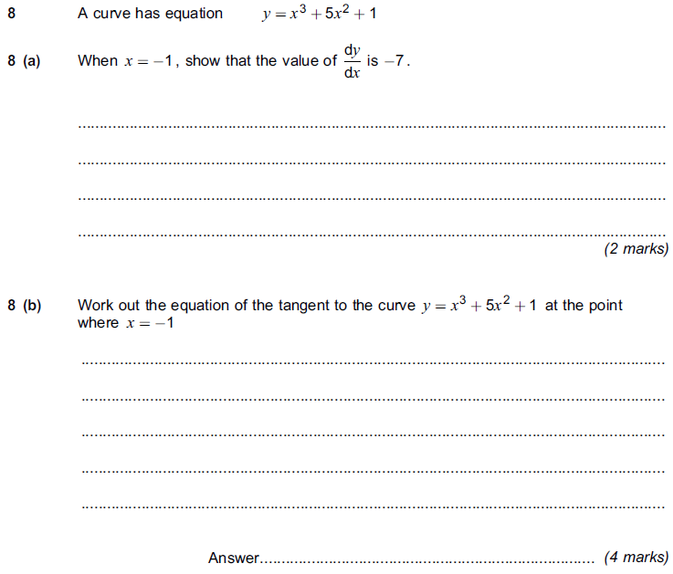
Test Your Understanding
AQA IGCSEFM June 2012 Paper 1
(Q1 on provided sheet)
$$\frac{dy}{dx}=3x^{2}+10x \\ m=3{\left(−1\right)}^{2}+10\left(−1\right)=3−10=−7$$
?
?
At $x=−1$, $y={\left(−1\right)}^{3}+5{\left(−1\right)}^{2}+1$ $$=−1+5+1=5$$
Therefore:
$$y−5=−7\left(x+1\right)$$

Slide 20
Exercise 2
(questions on worksheet)
1
[IGCSEFM June 2012 Paper 1 Q8] A curve has equation $y=x^{3}+5x^{2}+1$ (a) When $x=−1$, show that the value of $\frac{dy}{dx}$ is -7. $$\frac{dy}{dx}=3x^{2}+10x \\ m=3{\left(−1\right)}^{2}+10\left(−1\right)=−7$$ (b) Work out the equation of the tangent to the curve $y=x^{3}+5x^{2}+1$ at the point where $x=−1$.
$$y={\left(−1\right)}^{3}+5{\left(−1\right)}^{2}+1=5 \\ y−5=−7(x+1)$$
[IGCSEFM June 2013 Paper Q8] A curve has equation $y=x^{4}−5x^{2}+9$ (a) Work out $\frac{dy}{dx}$. $\frac{dy}{dx}=4x^{3}−10x$ (b) Work out the equation of the tangent to the curve at the point where $x=2$ Give your answer in the form $y=mx+c$
$$y=2^{4}−5{\left(2\right)}^{2}+9=5 \\ m=4{\left(2\right)}^{3}−10\left(2\right)=12 \\ y−5=12\left(x−2\right) \\ y=12x−19$$
3
[IGCSEFM Set Paper 1 Q11] Show that the tangents to the curve $y=x^{3}+3x^{2}+3x+1$ at $x=1$ and $x=−3$ are parallel.
$$\frac{dy}{dx}=3x^{2}+6x+3$$
At $x=1$, $\frac{dy}{dx}=3+6+3=12$
At $x=−3$, $\frac{dy}{dx}=27−18+3=12$
Same gradient therefore parallel.
[IGCSEFM Set 1 Paper 2 Q17] Work out the equation of the normal to the curve $y=2x^{3}−x^{2}+1$ at the point (1, 2). Give your answer in the form $y=mx+c$.
$$\frac{dy}{dx}=6x^{2}−2x \\ m=6−2=4 \\ m_{T}=−\frac{1}{4} \\ y−2=−\frac{1}{4}\left(x−1\right) \\ y=−\frac{1}{4}x+\frac{9}{4}$$
?
?
4
?
2
?
?
?

Slide 21
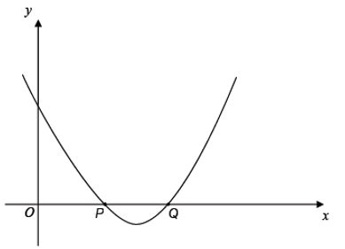
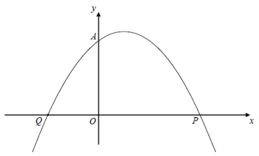
Exercise 2
(questions on worksheet)
[IGCSEFM Set 2 Paper 1 Q15] The graph shows a sketch of $y=(x−2)(x−3)$. The curve intersects the $x$-axis at $P$ and $Q$.
Show that the tangents at $P$ and $Q$ are perpendicular.
$$y=x^{2}−5x+6 \\ \frac{dy}{dx}=2x−5$$
At $x=2$, $\frac{dy}{dx}=4−5=−1$
At $x=3$, $\frac{dy}{dx}=6−5=1$
$−1×1=−1$ therefore the lines are perpendicular.
6
[IGCSEFM Set 4 Paper 2 Q20] A sketch of the curve $y=(x+1)(2−x)$ is shown. $A\left(0,2\right), P(2,0)$ and $Q$ are points on the curve.
(a) Write down the coordinates of point $Q$. (b) Show that the normal to the curve at $A$ intersects the curve again at $P$.
(a) $Q\left(−1,0\right)$ $P\left(2,0\right)$
(b) $y=−x^{2}+x+2$
$$\frac{dy}{dx}=−2x+1$$
At $x=0$, $m=1$ $∴m_{N}=−1$
$$y−2=−1\left(x−0\right) \\ y=−x+2$$
At $x=2,$ $0=−2+2 0=0$
Thus $P$ is on the line $y=−x+2$
5
?
?

Slide 22
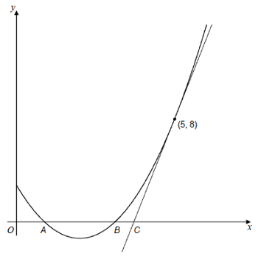
Exercise 2
(questions on worksheet)
7
[IGCSEFM Specimen Paper 2 Q22] The diagram shows the graph of $y=x^{2}−4x+3$ The curve cuts the $x$-axis at the points $A$ and $B$. The tangent to the curve at the point (5,8) cuts the $x$-axis at the point $C$.
Show that $AB=3BC$.
$$y=\left(x−1\right)\left(x−3\right) \\ ∴ A\left(1,0\right) B(3,0)$$
$$\frac{dy}{dx}=2x−4$$
At $\left(5,8\right),\frac{dy}{dx}=2(5)−4=6$
Equation of tangent: $y−8=6(x−5)$
When $y=0$: $−8=6\left(x−5\right)$ $$x=−\frac{4}{3}+5=\frac{11}{3}$$
$$AB=3−1=2 \\ BC=\frac{11}{3}−3=\frac{2}{3} \\ 3BC=3×\frac{2}{3}=2=AB$$
?

Slide 23
Increasing and Decreasing Functions
A function can also be increasing and decreasing in certain intervals.
$$\left(2,3\right)$$
What do you think it means for a function to be an ‘increasing function’?
$$\left(4,−1\right)$$
Increasing for $x≤2$
?
?
?
! An increasing function is one whose gradient is always at least 0.
$f^{′}\left(x\right)≥0$ for all $x$.
Decreasing for $$2≤x≤4$$
Increasing for $x≥4$
We could also write “$f\left(x\right)$ is decreasing in the interval $[2,4]$”
$[a,b]$ represents all the real numbers between $a$ and $b$ inclusive.
It would be ‘strictly increasing’ if $f\left(x\right)>0$ for all $x$, i.e. is not allowed to go horizontal.

Slide 24
Examples
Show that the function $f\left(x\right)=x^{3}+6x^{2}+21x+2$ is increasing for all real values of $x$.
Find the interval on which the function $f\left(x\right)=x^{3}+3x^{2}−9x$ is decreasing.
?
?
$$f\left(x\right)=x^{3}+3x^{2}−9x \\ f^{′}\left(x\right)=3x^{2}+6x−9$$
$$f^{′}\left(x\right)≤0 \\ 3x^{2}+6x−9≤0 \\ x^{2}+2x−3≤0 \\ \left(x+3\right)\left(x−1\right)≤0 \\ −3≤x≤1$$
So $f(x)$ is decreasing for $−3≤x≤1$
$$f^{′}\left(x\right)=3x^{2}+12x+21$$
$$f^{′}\left(x\right)=3\left(x^{2}+4x+7\right) \\ =3{\left(x+2\right)}^{2}+9$$
${\left(x+2\right)}^{2}≥0$ for all real $x$,
$∴3{\left(x+2\right)}^{2}+9≥0$ for all real $x$
$∴f(x)$ is an increasing function for all $x$.
Fro Tip: To show a quadratic is always positive, complete the square, then indicate the squared term is always at least 0.

Slide 25
Test Your Understanding
Show that the function $f\left(x\right)=x^{3}+16x−2$ is increasing for all real values of $x$.
Find the interval on which the function $f\left(x\right)=x^{3}+6x^{2}−135x$ is decreasing.
?
?
$$f^{′}\left(x\right)=3x^{2}+16$$
$x^{2}≥0$ for all real $x$
$∴3x^{2}+16≥0$ for all real $x$.
Therefore $f(x)$ is an increasing function for all real $x$.
$$f^{′}\left(x\right)=3x^{2}+12x−135 \\ f^{′}\left(x\right)≤0 \\ ∴3x^{2}+12x−135≤0 \\ x^{2}+4x−45≤0 \\ \left(x+9\right)\left(x−5\right)≤0 \\ −9≤x≤5$$
So $f(x)$ is decreasing for $−9≤x≤5$

Slide 26
Exercise 3
4
$$y=x^{3}−7x^{2}−5x$$
Determine the values of $x$ for which $y$ is increasing.
$$\frac{dy}{dx}=3x^{2}−7x^{2}−5x≥0 \\ \left(3x+1\right)\left(x−5\right)≥0 \\ x≤−\frac{1}{3} or x≥5$$
Show that $f\left(x\right)=x^{3}−9x^{2}+39x−4$ is an increasing function for all values of $x$.
$$f^{′}\left(x\right)=3x^{2}−18x+39 \\ =x^{2}−6x+13={\left(x−3\right)}^{2}+4$$ ${\left(x−3\right)}^{2}≥0$ for all $x$ $∴f^{′}\left(x\right)≥0$ for all $x$.
[AQA IGCSEFM June 2012 Paper 2 Q20] For what values of $x$ is $y=150x−2x^{3}$ an increasing function?
$$\frac{dy}{dx}=150−6x^{2}≥0 \\ 6x^{2}−150≤0 x^{2}−25≤0 \\ −5≤x≤5$$
[Set 4 Paper 1 Q10] $y=10−8x−x^{3}$ for all values of $x$. Show that $y$ is a decreasing function for all values $x$.
$$\frac{dy}{dx}=−8−3x^{2}$$ $−3x^{2}≤0$ for all $x$ therefore $\frac{dy}{dx}≤0$ for all $x$. Therefore $y$ is decreasing for all $x$.
$$y=\frac{1}{3}x^{3}+3x^{2}+10x+1$$
Find $\frac{dy}{dx}$ $\frac{dy}{dx}=x^{2}+6x+10$
By completing the square, hence show that this function is increasing for all $x$. $={\left(x+3\right)}^{2}+1$ Since ${\left(x+3\right)}^{2}≥0$ for all $x$, $\frac{dy}{dx}≥0$ for all $x$.
$$f\left(x\right)=x^{2}+3x+5$$
Find $f^{′}\left(x\right) f^{′}\left(x\right)=2x+3$
Hence or otherwise, determine the values of $x$ for which $f(x)$ is increasing. $2x+3≥0$ $x≥−\frac{3}{2}$
$$y=x^{2}−x+2$$
Determine the values of $x$ for which $y$ is decreasing.
$$\frac{dy}{dx}=2x−1≤0 \\ x≤\frac{1}{2}$$
1
?
?
?
5
?
2
?
6
?
?
3
?
7
?

Slide 27
Stationary/Turning Points
A stationary point is where the gradient is 0, i.e. $f^{′}\left(x\right)=0$.
Local maximum
$$f^{′}\left(x\right)=0$$
Fro Note: It’s called a ‘local’ maximum because it’s the function’s largest output within the vicinity. Functions may also have a ‘global’ maximum, i.e. the maximum output across the entire function. This particular function doesn’t have a global maximum because the output keeps increasing up to infinity. It similarly has no global minimum, as with all cubics.
Local minimum
$$f^{′}\left(x\right)=0$$
Find the coordinates of the turning points of $y=x^{3}+6x^{2}−135x$
?
$$\frac{dy}{dx}=3x^{2}+12x−135=0 \\ x^{2}+4x−45=0 \\ \left(x+9\right)\left(x−5\right)=0 \\ x=−9 or x=5$$
When $x=5, y=5^{3}+6\left(5^{2}\right)−135\left(5\right)=−400 → \left(5,−400\right)$
When $x=−9, y={\left(−9\right)}^{3}+6{\left(−9\right)}^{2}−135\left(−9\right)=972 → (−9,972)$

Slide 28
More Examples
Find the least value of
$$f\left(x\right)=x^{2}−4x+9$$
Find the turning point of
$$y=\sqrt{x}−x$$
Spec Note: For IGCSEFM, the powers will always be positive integers, not fractional.
? Method 1: Differentiation
?
Method 1: Differentiation
$$f^{′}\left(x\right)=2x−4=0 \\ x=2 \\ f\left(2\right)=2^{2}−4\left(2\right)+9=5$$
So 5 is the minimum value.
$$y=x^{\frac{1}{2}}−x \\ \frac{dy}{dx}=\frac{1}{2}x^{−\frac{1}{2}}−1=0 \\ \frac{1}{2}x^{−\frac{1}{2}}=1 \\ x^{−\frac{1}{2}}=2 → \frac{1}{\sqrt{x}}=2 \\ \sqrt{x}=\frac{1}{2} → x=\frac{1}{4}$$
When $x=\frac{1}{4}$,
$$y=\sqrt{\frac{1}{4}}−\frac{1}{4}=\frac{1}{4}$$
So turning point is $\left(\frac{1}{4},\frac{1}{4}\right)$
? Method 2: Completing the Square
Method 2: Completing the square
$$f\left(x\right)={\left(x−2\right)}^{2}+5$$
Therefore the minimum value of $f(x)$ is 5, and this occurs when $x=2$.
Fro Note: Method 2 is only applicable for quadratic functions. For others, differentiation must be used.

Slide 29
Points of Inflection
There’s a third type of stationary point (that we’ve encountered previously):
A point of inflection is where the curve changes from convex concave (or vice versa).
$$f^{′}\left(x\right)=0$$
concave
convex
(the same terms used in optics!)
Technically we could label these either way round depending on where we view the curve from. What’s important is that the concavity changes.
i.e. the line curves in one direction before the point of inflection, then curves in the other direction after.
Fro Side Note: Not all points of inflection are stationary points, as can be seen in the example on the right.
$$f^{′}\left(x\right)≠0$$

Slide 30
How do we tell what type of stationary point?
Method 1: Look at gradient just before and just after point.
Local Maximum
Gradient just before | Gradient at maximum | Gradient just after
+ve | 0 | +ve
?
?
?
Point of Inflection
Gradient just before | Gradient at p.o.i | Gradient just after
+ve | 0 | +ve
Local Minimum
Gradient just before | Gradient at minimum | Gradient just after
-ve | 0 | +ve
?
?
?
?
?
?

Slide 31
How do we tell what type of stationary point?
Method 1: Look at gradient just before and just after point.
Find the stationary point on the curve with equation $y=x^{4}−32x$, and determine whether it is a local maximum, a local minimum or a point of inflection.
? Turning Point
$$\frac{dy}{dx}=4x^{3}−32=0 \\ x=2 ∴ y=−48$$
Stationary point is $\left(2,−48\right)$
?
Strategy: Find the gradient for values just before and after $x=2$. Let’s try $x=1.9$ and $x=2.1$.
? Determine point type
 | $$x=1.9$$ | $$x=2$$ | $$x=2.1$$
Gradient | $$−4.56$$ | $$0$$ | $$5.04$$
Shape
Looking at the shape, we can see that $\left(2,−48\right)$ is a minimum.

Slide 32
Test Your Understanding
Show that one of the stationary points of the curve with equation $y=x^{3}+3x^{2}−45x$ is $\left(3,−81\right)$, and determine whether it is a maximum, a minimum or a point of inflection.
?
$$\frac{dy}{dx}=3x^{2}+6x−45=0 \\ x^{2}+2x−15=0 \\ \left(x+5\right)\left(x−3\right)=0 \\ x=−5 or x=3$$
When $x=3, y=3^{3}−3\left(3^{2}\right)−45\left(3\right)=−81$
When $x=2.9$, $\frac{dy}{dx}=−2.37$ which is negative.
When $x=3.1,\frac{dy}{dx}=2.43$ which is positive
Therefore a minimum point.

Slide 33
Points of Inflection and Increasing Functions
There’s one point squirreled away deep in the specification:
Find the turning point of $y=x^{3}−6x^{2}+12x−3$
Write $\frac{dy}{dx}$ in the form $a{\left(x+b\right)}^{2}$
Hence, explain why your turning point is a point of inflection.
$$\frac{dy}{dx}=3x^{2}−12x+12=0 \\ x^{2}−4x+4=0 \\ {\left(x−2\right)}^{2}=0 → x=2 \\ y=2^{3}−6{\left(2\right)}^{2}+12\left(2\right)−3=5 \\ \left(2,5\right)$$
$$\frac{dy}{dx}=3{\left(x−2\right)}^{2}$$
As ${\left(x−2\right)}^{2}≥0$ for all $x$, the gradient is positive except at $x=2$.
a
?
The idea is that a curve with a maximum or minimum point is never an increasing or decreasing function:
The turning point must therefore be a point of inflection:
b
?
c
?

Slide 34
Sketching Graphs
In the past we’ve used features such as intercepts with the axes in order to sketch graphs.
Now we can also find stationary/turning points!
By first finding the stationary points, sketch the graph of $y=x^{3}−3x^{2}$
? Turning Points
? Graph
$$y=3x^{2}−6x=0 \\ x^{2}−2x=0 \\ x\left(x−2\right)=0$$
Turning points:
$$x=0 → y=0 \\ x=2 → y=−4$$
We could also find roots:
$$x^{3}−3x^{2}=0 \\ x^{2}\left(x−3\right)=0 \\ ∴x=0 or x=3$$
$$y$$
$$x$$
$$3$$
$$(2,−4)$$

Slide 35
Test Your Understanding
By finding the turning points, sketch the graph of $y=x^{3}−27x$
?
$$y$$
$$\frac{dy}{dx}=3x^{2}−27=0 \\ x^{2}−9=0 \\ x=±3$$
When $x=3 → y=−54$ When $x=−3 → y=54$
$$\left(−3,54\right)$$
$$x$$
$$\left(3,−54\right)$$

Slide 36
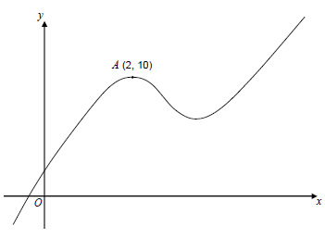
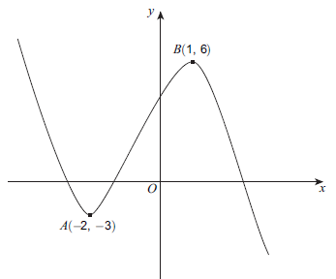
Exercise 4
(Questions on worksheet provided)
2
[June 2013 Paper 2 Q8] A sketch of $y=f\left(x\right)$ is shown. There are stationary points at $A$ and $B$.
(a) Write down the equation of the tangent to the curve at $A$. $y=−3$ (b) Write down the equation of the normal to the curve at $B$. $x=−2$ (c) Circle the range of values of $x$ for which $f\left(x\right)$ is an increasing function. $$x<−2, −2<x<1, −3<x<6 \\ x>1$$
$$−2<x<1$$
1
[Set 4 Paper 2 Q22] A sketch of $y=f\left(x\right)$, where $f(x)$ is a cubic function, is shown.
There is a maximum point at $A\left(2,10\right)$. (a) Write down the equation of the tangent to the curve at $A$. $y=10$ (b) Write down the equation of the normal to the curve at $A$. $x=2$ (c) Circle the word that describes the cubic function when $x<2$. positive negative increasing decreasing increasing
?
?
?
?
?
?

Slide 37
Exercise 4
3
[Set 2 Paper 2 Q12] A curve has equation $$y=x^{3}−9x^{2}+24x−16$$
(a) Work out $\frac{dy}{dx}$ $=3x^{2}−18x+24$ (b) Work out the coordinates of the two stationary points on the curve.
$$3x^{2}−18x+24=0 \\ x^{2}−6x+8=0 \\ \left(x−4\right)\left(x−2\right)=0 \\ x=4 → y=0 \\ x=2 → y=4$$
[Set 1 Paper 2 Q14] (a) Work out the stationary points on the curve $y=x^{3}−12x$. (b) Sketch the curve $y=x^{3}−12x$
$$\frac{dy}{dx}=3x^{2}−12=0 \\ x=2 → y=−16 \\ x=−2 → y=16$$
Roots: When $y=0, x\left(x^{2}−12\right)=0$ $$∴x=0 or x=+\sqrt{12} or x=−\sqrt{12}$$
5
[Set 3 Paper 1] A curve has equation $$y=4x^{3}+6x^{2}+3x+5$$ Work out the coordinates of any stationary points on this curve and determine their nature.
$$\frac{dy}{dx}=12x^{2}+12x+3=0 \\ 4x^{2}+4x+1=0 \\ {\left(2x+1\right)}^{2}=0 \\ x=−\frac{1}{2} → y=\frac{9}{2} \left(−\frac{1}{2},\frac{9}{2}\right)$$ We can justify that this is an inflection point either by:
a) Seeing that gradient at $x=−0.6$ and $−0.4$ are both positive or
b) Using the fact that ${\left(2x+1\right)}^{2}≥0$ for all $x$ to show that the function is an increasing one.
?
?
?
4
?
$$y$$
$$\left(−2,16\right)$$
$$x$$
$$\left(2,−16\right)$$

Slide 38
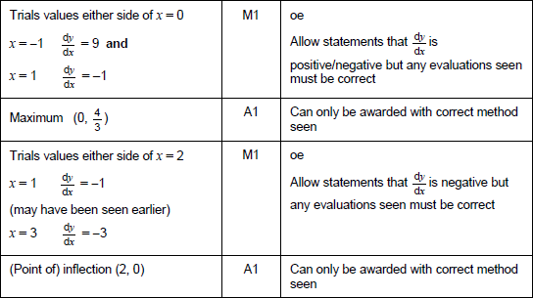
Exercise 4
6
[Specimen Paper 1 Q13] (a) Work out the coordinates of the stationary point for the curve $y=x^{2}+3x+4$. (b) Explain why $x^{2}+3x+4=0$ has no real solutions.
$$\frac{dy}{dx}=2x+3=0 \\ x=−\frac{3}{2} → y=\frac{7}{4}$$
The minimum point is above the $x$-axis, so the curve never crosses/touches the $x$-axis.
[Jan 2013 Paper 1 Q13] $y=2x^{3}−12x^{2}+24x−11$ (a) Work out $\frac{dy}{dx}$, giving your answer in the form $\frac{dy}{dx}=a{\left(x−b\right)}^{2}$, where $a$ and $b$ are integers. (b) Hence, or otherwise, work out the coordinates of the stationary point of $$y=2x^{3}−12x^{2}+24x−11$$
(c) Explain how you know that this stationary point is a point of inflection.
$$\frac{dy}{dx}=6x^{2}−24x+24 \\ =6\left(x^{2}−4x+4\right) \\ =6{\left(x−2\right)}^{2}$$
$$6{\left(x−2\right)}^{2}=0 → x=2 → y=5$$
Since $6{\left(x−2\right)}^{2}≥0$ for all $x$, function is increasing, so stationary point is a point of inflection.
8
[June 2012 Paper 2 Q23] The curve $y=f(x)$ is such that $$\frac{dy}{dx}=−x{\left(x−2\right)}^{2}$$ The stationary points of the curve are at $\left(0,\frac{4}{3}\right)$ and $\left(2,0\right)$. Determine the nature of each stationary point. You must show your working.
?
7
?
?

