Slide 1
IGCSE Indices
Dr J Frost (jfrost@tiffin.kingston.sch.uk)
Objectives: Recap the basic laws of indices. Raise a term to a power. Use laws of indices backwards, e.g. solve $x^{\frac{3}{2}}=\frac{1}{27}$
Last modified: 16th August 2015

Slide 2
RECAP :: Basic Laws of Indices
AQA Specimen 2
Write $\frac{a^{\frac{1}{2}}×a^{\frac{3}{2}}}{{\left(a^{3}\right)}^{4}}$ as a single power of $a$.
$$\frac{a^{2}}{a^{12}}=a^{−10}$$
?
$$a^{11}×b^{6}×c=a^{9}×b^{10}$$
Write $c$ in terms of $a$ and $b$.
Give your answer in its simplest form.
?
$$c=\frac{a^{9}×b^{10}}{a^{11}×b^{6}}=a^{−2}×b^{4}$$

Slide 3
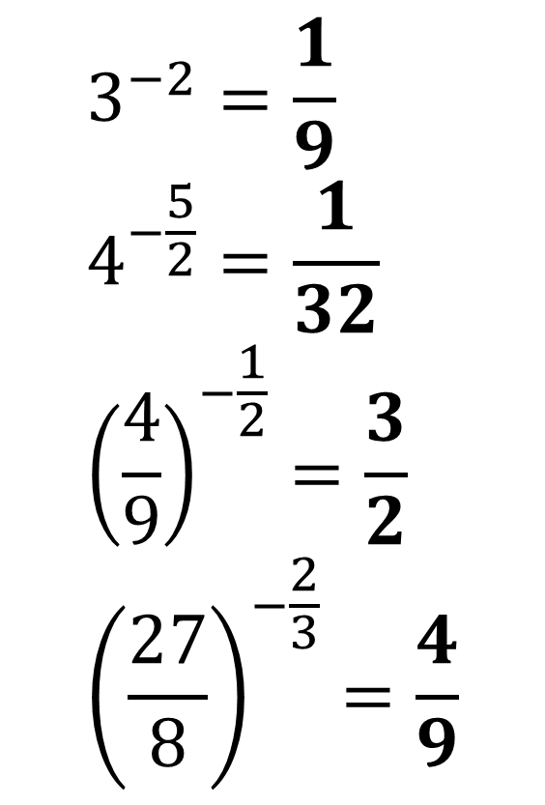
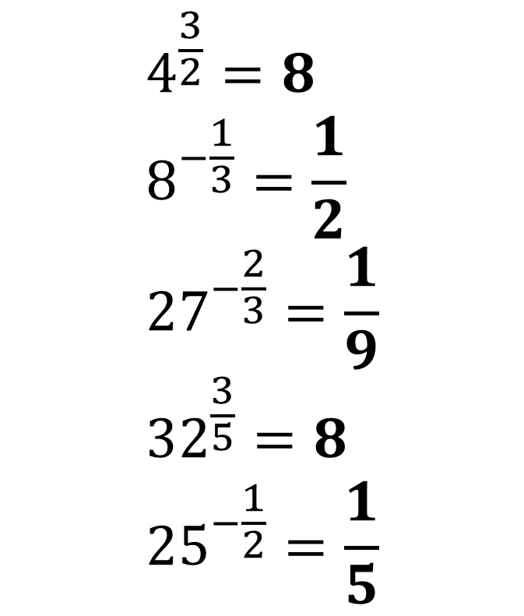
RECAP :: Basic Laws of Indices
?
?
$$4^{\frac{3}{2}}=8 \\ 8^{−\frac{1}{3}}=\frac{1}{2} \\ {27}^{−\frac{2}{3}}=\frac{1}{9} \\ {32}^{\frac{3}{5}}=8 \\ {25}^{−\frac{1}{2}}=\frac{1}{5}$$
$$3^{−2}=\frac{1}{9} \\ 4^{−\frac{5}{2}}=\frac{1}{32} \\ {\left(\frac{4}{9}\right)}^{−\frac{1}{2}}=\frac{3}{2} \\ {\left(\frac{27}{8}\right)}^{−\frac{2}{3}}=\frac{4}{9}$$
?
?
?
?
?
?
?

Slide 4


Law of Indices Backwards
Solve $x^{\frac{3}{4}}=27$
The ‘thinking backwards’ method
The ‘cancelling the power’ method.
(DO THIS!)
If I had some number to the power of $\frac{3}{4}$, what would I do to it?
Find the 4th root then cube it.
So going backwards from 27:
Cube root: 3
Raise to the power of 4: 81
What power should I raise both sides of the equation to ‘cancel’ the $\frac{3}{4}$ power?
$${\left(x^{\frac{3}{4}}\right)}^{\frac{4}{3}}={27}^{\frac{4}{3}} \\ x={27}^{\frac{4}{3}} \\ x=81$$
?
?

Slide 5


Further Examples
Solve $x^{−\frac{2}{3}}=2\frac{7}{9}$
Solve $y^{−3}=3\frac{3}{8}$
?
?
$$x^{−\frac{2}{3}}=\frac{25}{9} \\ x={\left(\frac{25}{9}\right)}^{−\frac{3}{2}}=\frac{27}{125}$$
$$y^{−3}=\frac{27}{8} \\ y={\left(\frac{27}{8}\right)}^{−\frac{1}{3}}=\frac{2}{3}$$

Slide 6
Test Your Understanding
Solve $x^{\frac{2}{3}}=9$
?
$$x=9^{\frac{3}{2}}=27$$
Solve $x^{−\frac{3}{2}}=\frac{8}{27}$
?
$$x={\left(\frac{8}{27}\right)}^{−\frac{2}{3}}=\frac{9}{4}$$

Slide 7
RECAP :: Single terms to a power
Simplify ${\left(3x^{2}y^{3}\right)}^{2}$
?
$$9x^{4}y^{6}$$
Simplify ${\left(9x^{4}y\right)}^{\frac{1}{2}}$
?
$$3x^{2}y^{\frac{1}{2}}$$

Slide 8
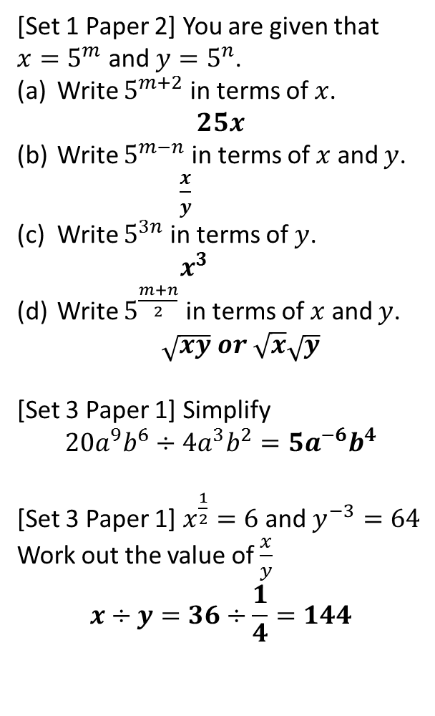
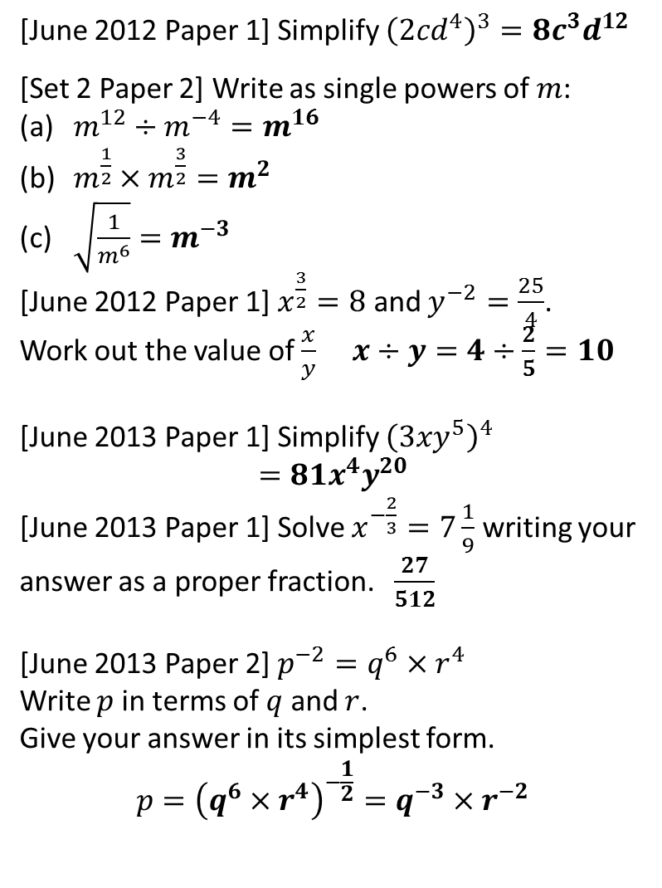
Exercises
?
1
[June 2012 Paper 1] Simplify ${\left(2cd^{4}\right)}^{3}=8c^{3}d^{12}$
[Set 2 Paper 2] Write as single powers of $m$:
$m^{12}÷m^{−4}=m^{16}$
$m^{\frac{1}{2}}×m^{\frac{3}{2}}=m^{2}$
$\sqrt{\frac{1}{m^{6}}}=m^{−3}$
[June 2012 Paper 1] $x^{\frac{3}{2}}=8$ and $y^{−2}=\frac{25}{4}$.
Work out the value of $\frac{x}{y}$ $x÷y=4÷\frac{2}{5}=10$
[June 2013 Paper 1] Simplify ${\left(3xy^{5}\right)}^{4}$ $$=81x^{4}y^{20}$$
[June 2013 Paper 1] Solve $x^{−\frac{2}{3}}=7\frac{1}{9}$ writing your answer as a proper fraction. $\frac{27}{512}$
[June 2013 Paper 2] $p^{−2}=q^{6}×r^{4}$
Write $p$ in terms of $q$ and $r$.
Give your answer in its simplest form.
$$p={\left(q^{6}×r^{4}\right)}^{−\frac{1}{2}}=q^{−3}×r^{−2}$$
7
[Set 1 Paper 2] You are given that $x=5^{m}$ and $y=5^{n}$.
Write $5^{m+2}$ in terms of $x$. $25x$
Write $5^{m−n}$ in terms of $x$ and $y$. $\frac{x}{y}$
Write $5^{3n}$ in terms of $y$. $x^{3}$
Write $5^{\frac{m+n}{2}}$ in terms of $x$ and $y$. $\sqrt{xy} or \sqrt{x}\sqrt{y}$
[Set 3 Paper 1] Simplify
$$20a^{9}b^{6}÷4a^{3}b^{2}=5a^{−6}b^{4}$$
[Set 3 Paper 1] $x^{\frac{1}{2}}=6$ and $y^{−3}=64$
Work out the value of $\frac{x}{y}$
$$x÷y=36÷\frac{1}{4}=144$$
2
?
?
?
?
?
3
?
?
?
4
?
8
?
5
?
9
6
?
?

