Slide 1
GCSE: Surds
Dr J Frost (jfrost@tiffin.kingston.sch.uk) www.drfrostmaths.com
Last modified: 19th November 2019

Slide 2
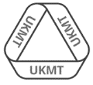
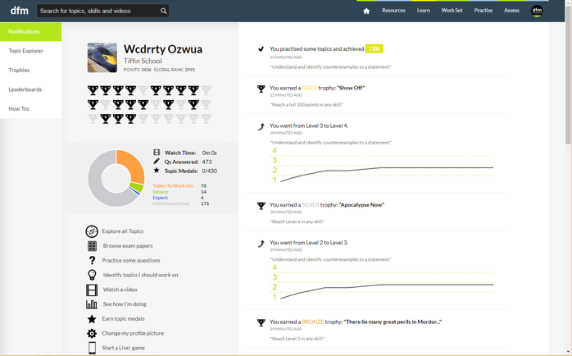
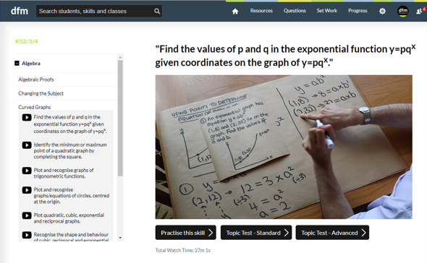
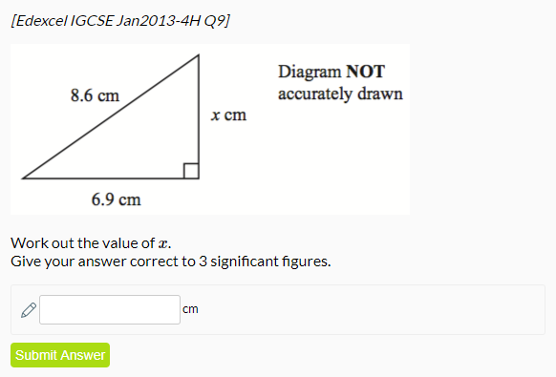
www.drfrostmaths.com
Everything is completely free.
Why not register?
Register now to interactively practise questions on this topic, including past paper questions and extension questions (including UKMT).
Teachers: you can create student accounts (or students can register themselves), to set work, monitor progress and even create worksheets.
With questions by:
Dashboard with points, trophies, notifications and student progress.
Questions organised by topic, difficulty and past paper.
Teaching videos with topic tests to check understanding.

Slide 3
Types of numbers
!
Real numbers are any possible decimal or whole number.
Real Numbers
Rational Numbers
Irrational Numbers
are all numbers which can be expressed as some fraction involving integers (whole numbers), e.g. $\frac{1}{4}$, $3\frac{1}{2}$, -7.
are real numbers which are not rational.

Slide 4
Types of numbers
Activity: Copy out the Venn diagram, and put the following numbers into the correct set.
Real numbers
Rational numbers
3
0.7
Integers
π
.
1.3
√2
-1
3
4
√9
e
Edwin’s exact height (in m)
(Click the blue boxes above)

Slide 5
What is a surd?
Vote on whether you think the following are surds or not surds.
$$\sqrt{2}$$
✗
Not a surd
✓
Surd
$$\sqrt{9}$$
✓
Not a surd
✗
Surd
✗
Not a surd
✓
$$\sqrt{5}$$
Surd
$$\sqrt{\frac{1}{4}}$$
✓
Not a surd
✗
Surd
✗
Not a surd
✓
$$\sqrt[3]{7}$$
Surd
Therefore, can you think of a suitable definition for a surd?
A surd is a root of a number that cannot be simplified to a rational number.
?

Slide 6
Laws of Surds
The only two things you need to know this topic…
?
$$\sqrt{a}×\sqrt{b}=\sqrt{ab}$$
$$\frac{\sqrt{a}}{\sqrt{b}}=\sqrt{\frac{a}{b}}$$
?
Basic Examples:
$$\sqrt{\frac{1}{9}}=\frac{1}{3}$$
?
?
$$\sqrt{3}×\sqrt{2}=\sqrt{6}$$
?
$$\sqrt{4x^{2}}=\sqrt{4}\sqrt{x^{2}}=2x$$

Slide 7
Simplifying Surds
?
?
$$\sqrt{8}=\sqrt{4}\sqrt{2}=2\sqrt{2}$$
Bro Tip: Find the largest square factor of the number, and put that first.
Could we somehow use $\sqrt{ab}=\sqrt{a}\sqrt{b}$ to break the 8 up in a way that one of the surds will simplify?
?
$$\sqrt{27}=\sqrt{9}\sqrt{3}=3\sqrt{3}$$
?
$$\sqrt{32}=\sqrt{16}\sqrt{2}=4\sqrt{2}$$
$$2\sqrt{50}=2\sqrt{25}\sqrt{2}=10\sqrt{2}$$
?
$$4\sqrt{12}=4\sqrt{4}\sqrt{3}=8\sqrt{3}$$
?

Slide 8
Test Your Understanding
?
$$\sqrt{75}=\sqrt{25}\sqrt{3}=5\sqrt{3}$$
?
$$\sqrt{20}=\sqrt{4}\sqrt{5}=2\sqrt{5}$$
$$\sqrt{48}=\sqrt{16}\sqrt{3}=4\sqrt{3}$$
?
$$3\sqrt{200}=3\sqrt{100}\sqrt{2}=30\sqrt{2}$$
?
$$5\sqrt{45}=5\sqrt{9}\sqrt{5}=15\sqrt{5}$$
?

Slide 9
Multiplying Surds
?
$$\sqrt{3}×\sqrt{5}=\sqrt{15} \\ 2×\sqrt{3}=2\sqrt{3} \\ \sqrt{5}×3=3\sqrt{5} \\ \sqrt{2}×\sqrt{8}=\sqrt{16}=4 \\ \sqrt{3}×\sqrt{3}=\sqrt{9}=3$$
?
Bro Tip: Be very careful in observing whether both of the terms are surds or just one is.
?
?
?
Bro Tip: Just multiply the non-surdey things first, then the surdey things.
?
$$2\sqrt{3}×2\sqrt{5}=4\sqrt{15}$$
$$3\sqrt{2}×3\sqrt{2}=18$$
?
$$\sqrt{18}×4\sqrt{2}=24$$
?

Slide 10
Test Your Understanding
?
$$6×\sqrt{7}=6\sqrt{7} \\ \sqrt{5}×\sqrt{6}=\sqrt{30} \\ \sqrt{2}×2=2\sqrt{2} \\ 5\sqrt{3}×4\sqrt{3}=60 \\ 3×4\sqrt{3}=12\sqrt{3} \\ {\left(3\sqrt{5}\right)}^{2}=45 \\ 5\sqrt{8}×2\sqrt{2}=40 \\ 2\sqrt{2}×3\sqrt{6}=6\sqrt{12}=6\sqrt{4}\sqrt{3}=12\sqrt{3}$$
?
?
?
?
?
?
?

Slide 11
Exercise 1
1
Simplify the following:
$$\sqrt{8}=2\sqrt{2} \\ \sqrt{18}=3\sqrt{2} \\ \sqrt{50}=5\sqrt{2} \\ \sqrt{80}=4\sqrt{5} \\ \sqrt{72}=6\sqrt{2}$$
Simplify the following:
$$5\sqrt{80}=20\sqrt{5} \\ 2\sqrt{125}=10\sqrt{5} \\ 8\sqrt{12}=16\sqrt{3} \\ 3\sqrt{72}=18\sqrt{2} \\ 2\sqrt{28}=4\sqrt{7}$$
Simplify the following:
$$\sqrt{3}×\sqrt{2}×\sqrt{5}=\sqrt{30} \\ \sqrt{27}×\sqrt{3}=9 \\ 4\sqrt{3}×2=8\sqrt{3} \\ 5×2\sqrt{5}=10\sqrt{5} \\ 2\sqrt{2}×2\sqrt{2}=8 \\ 7\sqrt{3}×2\sqrt{5}=14\sqrt{15} \\ 6\sqrt{3}×2\sqrt{3}=36$$
4
Simplify the following:
$$\sqrt{8}×3\sqrt{2}=12 \\ \sqrt{27}×2\sqrt{3}=18 \\ 3\sqrt{18}×\sqrt{2}=18 \\ 2\sqrt{12}×3\sqrt{3}=36$$
Express the following as a single square root
(hint: do the steps of simplification backwards!)
$$3\sqrt{2}=\sqrt{9}\sqrt{2}=\sqrt{18} \\ 2\sqrt{5}=\sqrt{4}\sqrt{5}=\sqrt{20} \\ 5\sqrt{7}=\sqrt{175} \\ 4\sqrt{3}=\sqrt{48}$$
Express the following as a single square root:
$$a\sqrt{b}=\sqrt{a^{2}b} \\ 2\sqrt{k}=\sqrt{4k}$$
a
?
a
?
b
?
?
b
c
?
c
?
d
?
d
?
e
?
5
2
a
?
b
?
c
?
?
a
?
d
?
b
e
?
c
?
3
d
?
a
?
b
?
6
c
?
?
d
?
a
?
e
?
b
f
?
g
?

Slide 12
Adding Surds
$$\sqrt{3}+\sqrt{3}=2\sqrt{3}$$
?
Think of it as “if I have one lot of $\sqrt{3}$ and I add another lot of $\sqrt{3}$, I have two lots of $\sqrt{3}$”.
It’s just how we collect like terms in algebra, e.g. $x+x=2x$
?
$$2\sqrt{5}+\sqrt{5}=3\sqrt{5} \\ 7\sqrt{7}+7\sqrt{7}=14\sqrt{7} \\ \sqrt{2}+\sqrt{8}=\sqrt{2}+2\sqrt{2} \\ =3\sqrt{2} \\ 3\sqrt{12}+\sqrt{27}=3\sqrt{4}\sqrt{3}+\sqrt{9}\sqrt{3} \\ =6\sqrt{3}+3\sqrt{3} \\ =9\sqrt{3}$$
?
?
?

Slide 13
Test Your Understanding
$$\sqrt{3}+\sqrt{3}+\sqrt{3} =3\sqrt{3} \\ \sqrt{8}+\sqrt{18} =2\sqrt{2}+3\sqrt{2}=5\sqrt{2} \\ 2\sqrt{5}+2\sqrt{20} =2\sqrt{5}+8\sqrt{5} \\ =10\sqrt{5} \\ 3\sqrt{48}+\sqrt{12} =12\sqrt{3}+2\sqrt{3} \\ =14\sqrt{3}$$
?
?
?
?

Slide 14
Brackets and Surds
?
$$\sqrt{2}\left(3+\sqrt{2}\right)=3\sqrt{2}+2$$
?
$$\left(\sqrt{2}+1\right)\left(\sqrt{2}−1\right)=2+\sqrt{2}−\sqrt{2}−1=1$$
$$\left(\sqrt{8}+3\right)\left(\sqrt{2}+5\right)=\sqrt{16}+5\sqrt{8}+3\sqrt{2}+15 \\ =4+5\sqrt{4}\sqrt{2}+3\sqrt{2}+15 \\ =19+10\sqrt{2}+3\sqrt{2} \\ =19+13\sqrt{2}$$
?
$${\left(\sqrt{5}−2\right)}^{2}=\left(\sqrt{5}−2\right)\left(\sqrt{5}−2\right) \\ =5−2\sqrt{5}−2\sqrt{5}+4 \\ =9−4\sqrt{5}$$
?

Slide 15
Test Your Understanding
?
$$\sqrt{5}\left(2+\sqrt{3}\right) =2\sqrt{5}+\sqrt{15} \\ \left(1+\sqrt{3}\right)\left(2+\sqrt{3}\right) =5+3\sqrt{3} \\ \left(\sqrt{8}−1\right)\left(\sqrt{2}+3\right) =1+5\sqrt{2} \\ {\left(3−2\sqrt{5}\right)}^{2} =29−12\sqrt{5}$$
?
?
?
$$Area=6+5\sqrt{3}$$
?
$$3+\sqrt{3}$$
$$1+3\sqrt{3}$$

Slide 16
Exercise 2
1
Simplify the following:
$$\sqrt{8}+\sqrt{18}=5\sqrt{2} \\ \sqrt{12}−\sqrt{3}=\sqrt{3} \\ \sqrt{20}+\sqrt{45}=5\sqrt{5} \\ \sqrt{3}+\sqrt{12}+\sqrt{27}=6\sqrt{3} \\ \sqrt{300}−\sqrt{48}=6\sqrt{3} \\ 2\sqrt{50}+3\sqrt{32}=22\sqrt{2}$$
Expand and simplify the following, leaving your answers in the form $a+b\sqrt{c}$
$$\sqrt{3}\left(2+\sqrt{3}\right)=2\sqrt{3}+3 \\ \left(\sqrt{3}+1\right)\left(2+\sqrt{3}\right)=5+3\sqrt{3} \\ \left(\sqrt{5}−1\right)\left(2+\sqrt{5}\right)=3+\sqrt{5}$$
$$\left(\sqrt{7}+1\right)\left(2−2\sqrt{7}\right)=−12 \\ {\left(2−\sqrt{3}\right)}^{2}=7−4\sqrt{3}$$
3
Expand and simplify:
$$\left(2−\sqrt{8}\right)\left(2+\sqrt{2}\right)=−2\sqrt{2} \\ \left(3+\sqrt{27}\right)\left(4−\sqrt{3}\right)=3+9\sqrt{3} \\ \left(2\sqrt{2}+5\right)\left(4+\sqrt{18}\right)=32+23\sqrt{2} \\ \left(\sqrt{8}+\sqrt{18}\right)\left(\sqrt{32}−\sqrt{50}\right)=−10$$
$${\left(\sqrt{2}+1\right)}^{2}−{\left(\sqrt{2}−1\right)}^{2}=4\sqrt{2} \\ {\left(\sqrt{3}+2\right)}^{2}−{\left(\sqrt{3}−2\right)}^{2}=8\sqrt{3}$$
Determine the area of :
a
?
a
?
b
?
b
?
c
?
c
?
d
?
?
d
e
?
e
?
f
?
f
?
2
4
$$\sqrt{3}$$
b
c
a
$$\sqrt{5}$$
$$\sqrt{5}−1$$
$$4+3\sqrt{5}$$
$$6−\sqrt{5}$$
a
?
$$2+\sqrt{3}$$
b
?
$$\sqrt{5}+3$$
c
?
$$A=1+\sqrt{5}$$
$$A=5+5\sqrt{5}$$
$$A=2\sqrt{3}+3$$
?
?
d
?
?
e
?
5
$$P$$
Find the length of $PQ$.
(Using Pythagoras)
$$PQ=\sqrt{22}$$
$$\sqrt{7}−2$$
?
$$\sqrt{7}+2$$
$$Q$$

Slide 17
Rationalising The Denominator
Here’s a surd. What could we multiply it by such that it’s no longer an irrational number?
?
?
$$\sqrt{5}×\sqrt{5}=5$$
$$\frac{1}{\sqrt{2}}×\frac{\sqrt{2}}{\sqrt{2}}=\frac{\sqrt{2}}{2}$$
?
?
In this fraction, the denominator is irrational. ‘Rationalising the denominator’ means making the denominator a rational number.
What could we multiply this fraction by to both rationalise the denominator, but leave the value of the fraction unchanged?
Bro Side Note: There’s two reasons why we might want to do this:
For aesthetic reasons, it makes more sense to say “half of root 2” rather than “one root two-th of 1”. It’s nice to divide by something whole!
It makes it easier for us to add expressions involving surds.

Slide 18
More Examples
$$\frac{3}{\sqrt{2}}=\frac{3\sqrt{2}}{2}$$
$$\frac{6}{\sqrt{3}}=\frac{6\sqrt{3}}{3}=2\sqrt{3}$$
$$\frac{8}{\sqrt{10}}=\frac{8\sqrt{10}}{10}=\frac{4\sqrt{10}}{5}$$
$$\frac{10}{\sqrt{5}}=\frac{10\sqrt{5}}{5}=2\sqrt{5}$$
$$\frac{7}{\sqrt{7}}=\frac{7\sqrt{7}}{7}=\sqrt{7}$$
?
Test Your Understanding:
?
$$\frac{12}{\sqrt{3}}=4\sqrt{3}$$
$$\frac{2}{\sqrt{6}}=\frac{\sqrt{6}}{3}$$
$$\frac{4\sqrt{2}}{\sqrt{8}}=\frac{16}{8}=2$$
?
?
?
?
?
?

Slide 19
Further Maths! :: More Complex Denominators
You’ve seen ‘rationalising a denominator’, the idea being that we don’t like to divide things by an irrational number.
But what do we multiply the top and bottom by if we have a more complicated denominator?
$$\frac{1}{\sqrt{2}+1}×\frac{\sqrt{2}−1}{\sqrt{2}−1}=\frac{\sqrt{2}−1}{1}=\sqrt{2}−1$$
?
?
We basically do the same but with the sign reversed (this is known as the ‘conjugate’). That way, we obtain the difference of two squares. Since $\left(a+b\right)\left(a−b\right)=a^{2}−b^{2}$, any surds will be squared and thus we’ll end up with no surds in the denominator.

Slide 20
More Examples
$$\frac{3}{\sqrt{6}−2}×\frac{\sqrt{6}+2}{\sqrt{6}+2}=\frac{3\sqrt{6}+6}{2}$$
You can explicitly expand out $\left(\sqrt{6}−2\right)\left(\sqrt{6}+2\right)$ in the denominator, but remember that $\left(a−b\right)\left(a+b\right)=a^{2}−b^{2}$ so we get $6−4=2$
Just remember: ‘difference of two squares’!
?
?
$$\frac{4}{\sqrt{3}+1}×\frac{\sqrt{3}−1}{\sqrt{3}−1}=\frac{4\sqrt{3}−4}{2}=2\sqrt{3}−2$$
?
?
?
?
?
$$\frac{3\sqrt{2}+4}{5\sqrt{2}−7}×\frac{5\sqrt{2}+7}{5\sqrt{2}+7}=\frac{30+21\sqrt{2}+20\sqrt{2}+28}{1} \\ =58+41\sqrt{2}$$

Slide 21
Test Your Understanding
Rationalise the denominator and simplify
$$\frac{4}{\sqrt{5}−2}$$
?
$$8+4\sqrt{5}$$
Rationalise the denominator and simplify
$$\frac{2\sqrt{3}−1}{3\sqrt{3}+1}$$
AQA FM June 2013 Paper 1
Solve $y\left(\sqrt{3}−1\right)=8$
Give your answer in the form $a+b\sqrt{3}$ where $a$ and $b$ are integers.
?
$$\frac{2\sqrt{3}−1}{3\sqrt{3}+1}×\frac{3\sqrt{3}−1}{3\sqrt{3}−1} \\ =\frac{18−2\sqrt{3}−3\sqrt{3}+1}{27−1} \\ =\frac{19−5\sqrt{3}}{26}$$
?
$$y=\frac{8}{\sqrt{3}−1}×\frac{\sqrt{3}+1}{\sqrt{3}+1} \\ =\frac{8\sqrt{3}+8}{2}=4+4\sqrt{3}$$

Slide 22
Exercise 3
1
Rationalise the denominator and simplify the following:
$$\frac{1}{\sqrt{5}+2}=\sqrt{5}−2$$
$$\frac{\sqrt{3}}{\sqrt{3}−1}=\frac{3+\sqrt{3}}{2}$$
$$\frac{\sqrt{5}+1}{\sqrt{5}−2}=7+3\sqrt{5}$$
$$\frac{2\sqrt{3}−1}{3\sqrt{3}+4}=2−\sqrt{3}$$
$$\frac{5\sqrt{5}−2}{2\sqrt{5}−3}=4+\sqrt{5}$$
2
Expand and simplify:
$$\left(\sqrt{5}+3\right)\left(\sqrt{5}−2\right)\left(\sqrt{5}+1\right)=4$$
Rationalise the denominator, giving your answer in the form $a+b\sqrt{3}$.
$$\frac{3\sqrt{3}+7}{3\sqrt{3}−5}=31+18\sqrt{3}$$
Solve $x\left(4−\sqrt{6}\right)=10$ giving your answer in the form $a+b\sqrt{6}$.
$$x=\frac{10}{4−\sqrt{6}}=4+\sqrt{6}$$
Solve $y\left(1+\sqrt{2}\right)−\sqrt{2}=3$
$$y=\frac{3+\sqrt{2}}{1+\sqrt{2}}=2\sqrt{2}−1$$
Simplify:
$$\frac{\sqrt{a+1}−\sqrt{a}}{\sqrt{a+1}+\sqrt{a}}=2a+1−2\sqrt{a}\sqrt{a+1}$$
?
?
a
3
?
b
?
c
?
4
?
?
d
?
5
e
?
6
?

Slide 23
A final super hard puzzle
Solve $\frac{\sqrt[4]{9}}{\sqrt[5]{27}}=\sqrt[x]{3}$
N
$$\frac{\sqrt[4]{3^{2}}}{\sqrt[5]{3^{3}}}=\frac{{\left(3^{2}\right)}^{\frac{1}{4}}}{{\left(3^{3}\right)}^{\frac{1}{5}}}=\frac{3^{\frac{1}{2}}}{3^{\frac{3}{5}}}=3^{−\frac{1}{10}}$$
But $\sqrt[x]{3}=3^{\frac{1}{x}}$
$$∴\frac{1}{x}=−\frac{1}{10} → x=−10$$
?

