Slide 1
3.1.4 Impact of external influences
a) PESTLE (political, economic, social, technological, legal and environmental)
b) The changing competitive environment
c) Porter’s Five Forces

Slide 2
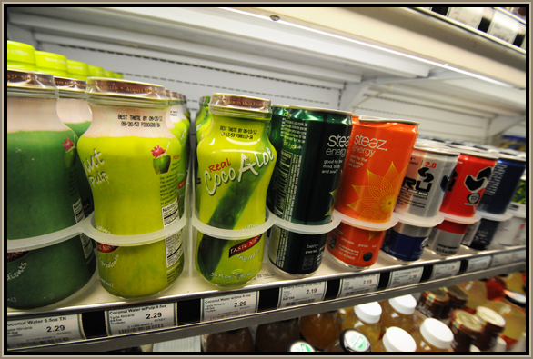
Starter
You buy a can of coke every morning. You go to your usual shop and they have run out of coke. What do you have instead?
Notes:
This will get students to start talking about substitute products which comes up in the Porter’s 5 forces model, how does Coke deal with these new entrants, are their high barriers? No, but Coke heavily advertises and builds a strong brand to prevent you from switching to a substitute…

Slide 3
External influence defined
An external influence is any factor outside of the business that has an impact on normal trading

Slide 4

PESTLE analysis

Slide 5

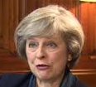
PESTLE analysis
This is a business analysis tool that aims to look at external factors and how they may have an impact on the business
This aids strategic and tactical decision making, objective setting and helps a business to reach its goals.
Political, Economic, Social, Technological, legal and environmental
Starbucks example PESTLE analysis here

Slide 6
Political
P
A business may be affected by politics in the UK or even politics across the world, here are a few of the largest impacts;
  A change in government, BBC article here
  Government laws; minimum wage
  Brexit and new trading blocs post-Brexit
  Tax rates (e.g. increase in VAT here)
  Tariffs (when importing into the UK)

Slide 7
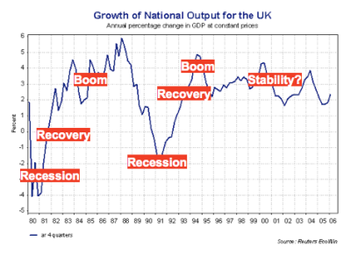
Economic
E
A business should analyse how they may be affected by
  An increase in interest rates here
  An increase in inflation
  Unemployment rates video here
  Recession
  The business cycle

Slide 8

Social
S
A business should analyse how they may be affected by changes in social factors
  A change in demographics and its impact on products produced and markets, here
  Culture mix changes in the UK, here
  Social trends e.g. Vaping here

Slide 9

Technological
T
A business could examine the impact of new technologies on their operations, for example;
  Automation, new robotics and how it can improve productivity
  Innovations in the industry
  Research and development in the industry
  New computer systems
  Trading online

Slide 10

Legal
A business should assess how they may be impacted by changes in legislation for example;
  Health and safety at work act in terms of PPE and regulations, Guardian article here
  Data protection Act, article here
  Sale of Goods Act
  Sex Discrimination Act

Slide 11

Environmental
E
A business could analyse their environmental challenges that may face the business;
  Climate change, caused by farming, see article here
  Weather (e.g. in farming and tourism)
  Sustainable production and CSR
  Disappearance of wildlife, article here

Slide 12
PESTLE and Porters 5 forces

Slide 13
Porter’s 5 forces
In 1985 Porter argued that there were 5 forces (or factors) which determine the profitability of an industry.
    Bargaining power of suppliers
    Bargaining power of customers
    Threat of new entrants
    Threat of substitutes
    Rivalry among existing businesses

Slide 14
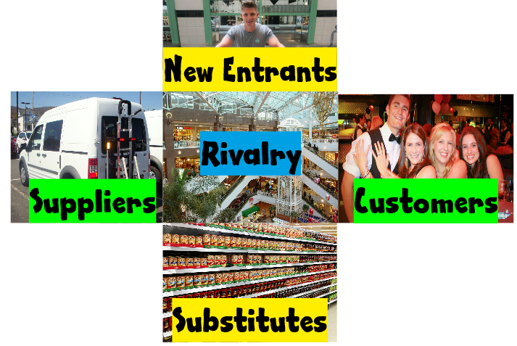

Porter’s 5 Forces
Threat of new entrants to the market
Bargaining power of suppliers
Threat of substitute products or services
Bargaining power of customers

Slide 15
Bargaining power of suppliers and customers
Bargaining power of suppliers;
  Limit power of suppliers by looking for new suppliers
  Backward vertical integration and merge or takeover the supplier
Bargaining power of customers;
  Make it too expensive for a customer to switch
  Forward vertically integrate

Slide 16
Threat of new entrants and substitutes
Threat of new entrants;
  Create barriers to entry to prevent new entrants
  Heavily advertise to build strong brands
Threat of substitutes;
  Continuously invest in R&D and develop patents
  Buy up patents of rivals and shelve to prevent product production

Slide 17
Rivalry amongst existing firms in the industry
In a very competitive market place there may be a great deal of rivalry, example might be UK supermarkets, retail clothing companies.
The intensity of this rivalry will have an impact on the business that is trying to trade, it may mean:
Larger businesses trying to buy up rivals through horizontal integration
Businesses continuously introducing new products to the market
Businesses in the market having to heavily advertise to maintain market share

Slide 18
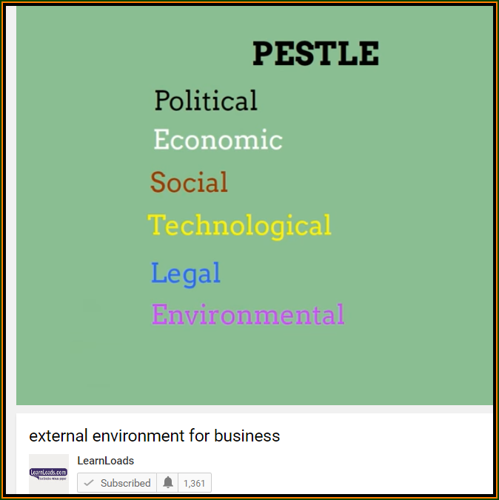
Revision video 1

Slide 19
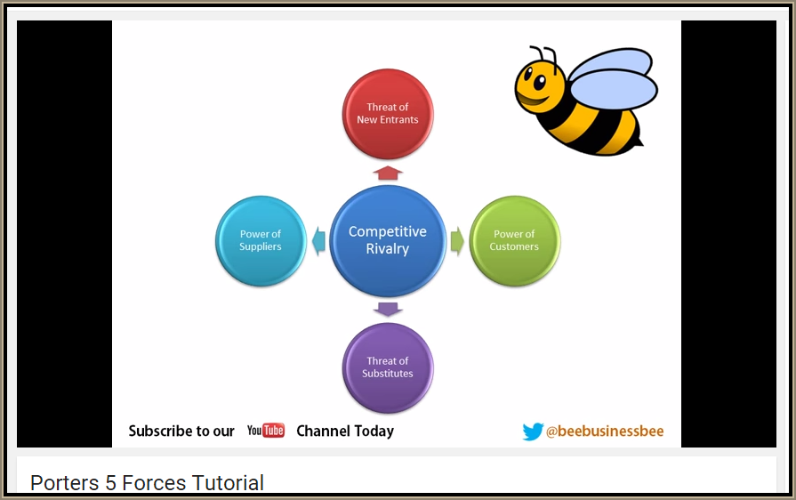
Revision video 2

Slide 20
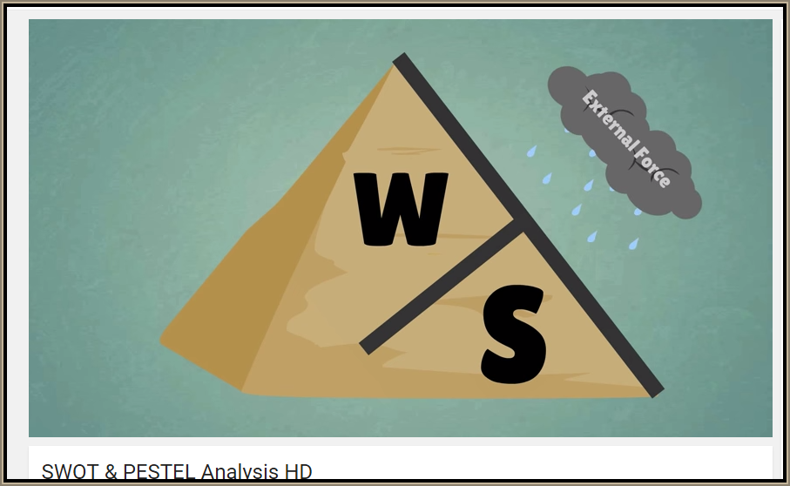
Revision video 3

Slide 21

Sample Edexcel A2 questions

Slide 22
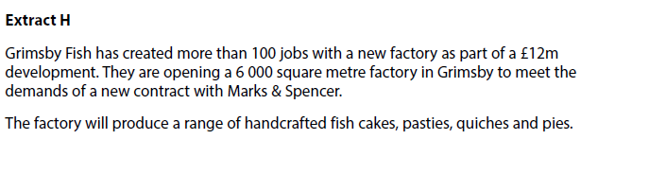
Case study for question 1

Slide 23
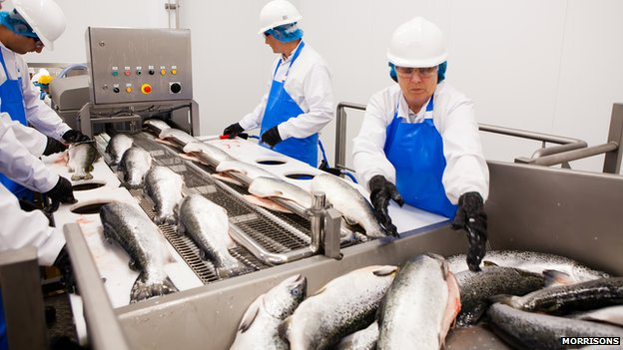
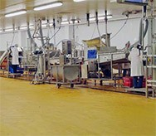
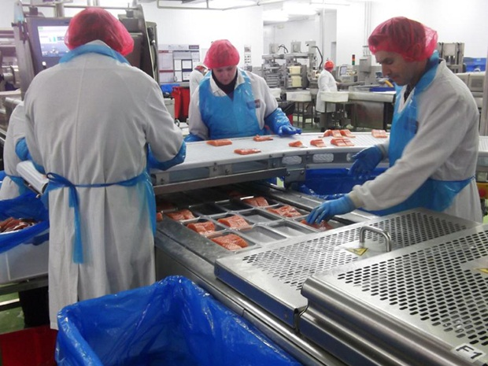
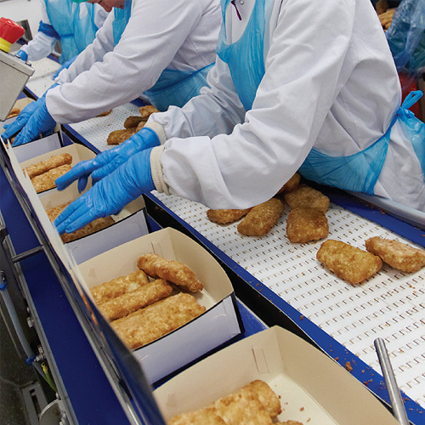
Why is technological change important? Consider productivity…
What technology might be involved in making fish products?

Slide 24

Sample question 1
Knowledge 2
Application 2
Analysis
3
Evaluation
3

Slide 25
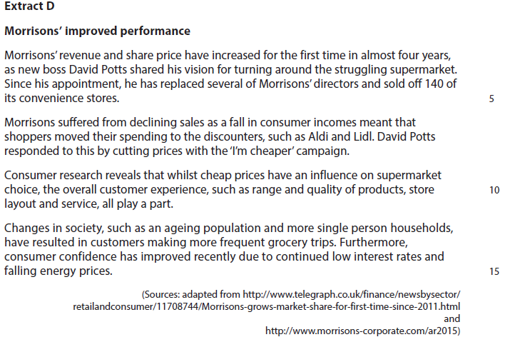
Case study for question 2

Slide 26

Sample question 2
Knowledge 2
Application 2
Analysis
3
Evaluation
3

