Slide 1
Community Service
Key Question: What is community service?

Slide 2
Definition
Community service – a punishment where criminals have to do unpaid work to make up for their crime
Community payback = community service

Slide 3
Types of crime
Watch the video: https://www.youtube.com/watch?v=Rekq8wsojO4
What crimes led to the two offenders getting community service?
A magistrate – a type of judge for minor crimes
Probation officer – someone who works with prisoners to see if they should be released early for good behaviour

Slide 4
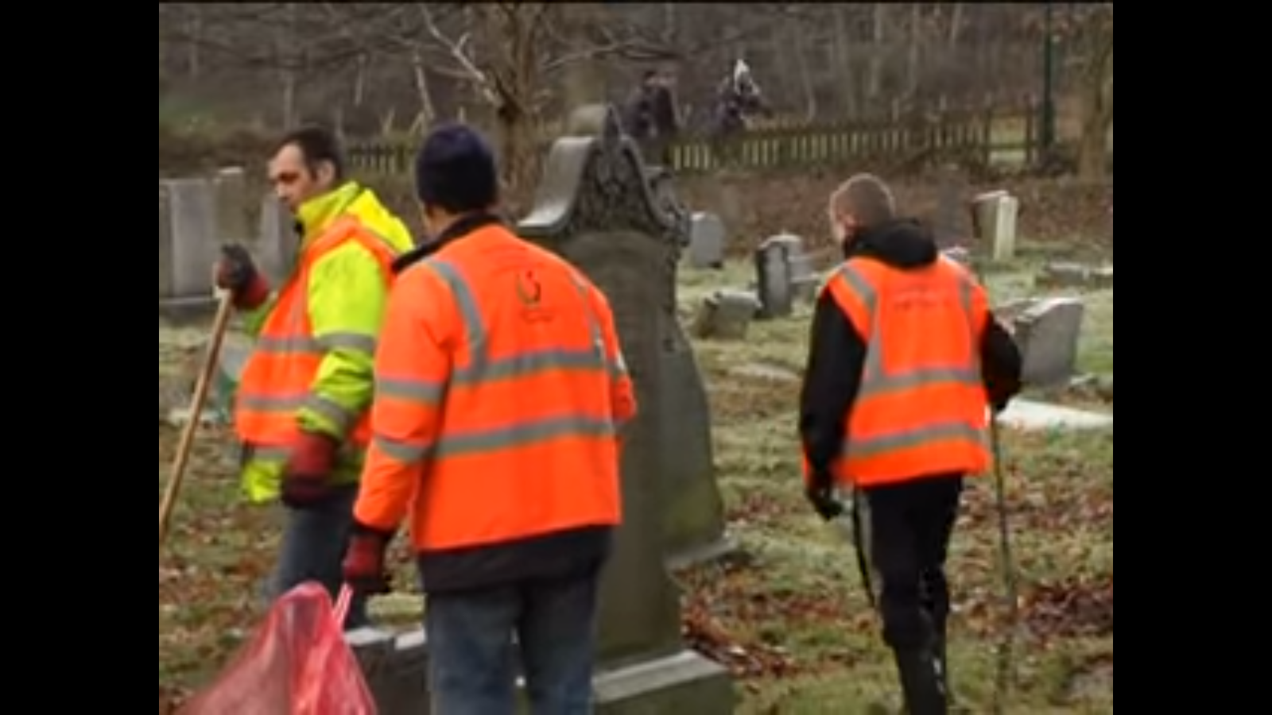
Manchester
Watch the video: https://www.youtube.com/watch?v=CkhPTDSBw7A
When did community service start in the UK?
What tasks are mentioned?
How does community service help others?

Slide 5
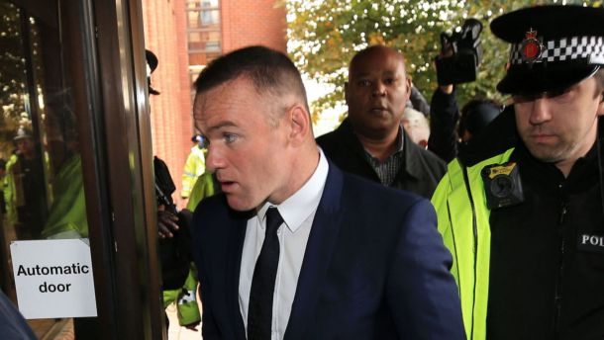
Wayne Rooney
In 2017 Wayne Rooney was found guilty of being three times over the drink-driving limit.
Fined £300,000 (two weeks’ wages)
2 year driving ban
120 hours of community service.

Slide 6
Aims
Which aim of punishment is community service for?
Is there more than one aim?
Extension:
‘Community service is a better punishment than prison?’
Do you agree? [… etc. ] 12 marks

