Slide 1
Aims of Punishment
Key Question.
Why do we punish criminals in different ways?
To begin… link the crime with the punishment...
On the sheet you will be given complete the first two columns noting down the most appropriate punishment/s (sometimes criminals are given more than one punishment), with reasons for your choices.

Slide 2
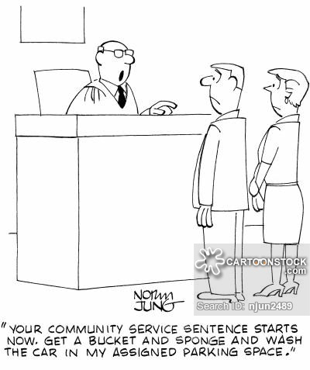
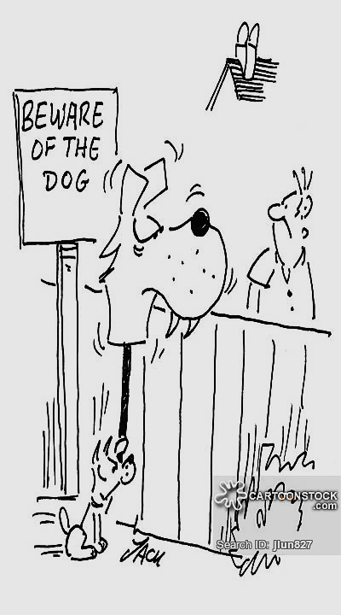
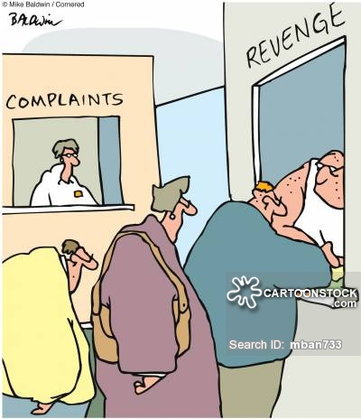
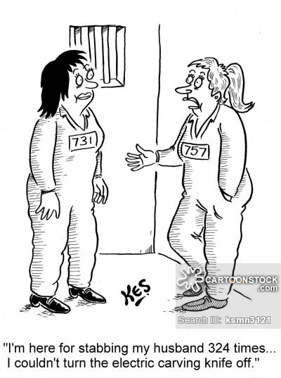
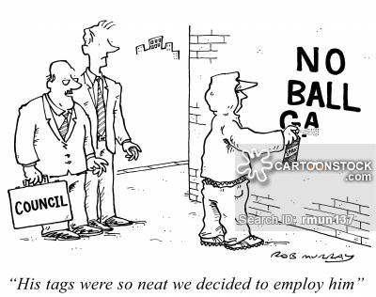
Aims of Punishment
Read, match and respond...
Read the information on the cards about the aims of punishment. Match the descriptions to the ‘Aims’. Use the pictures you will be given to identify and explain five of the aims of punishment.

Slide 3
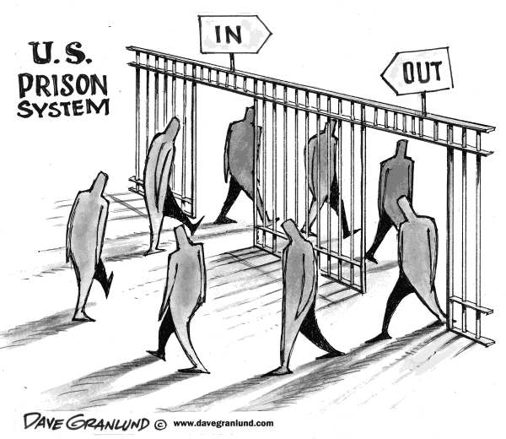
Aims of Punishment
Show understanding and add…
On the table from your starter task complete the last column adding the aim of punishment that matches the punishment given for the crimes committed.
Read and respond...
Read the information on the sheet about the aims of punishment. Complete the tasks.

Slide 4
Aims of Punishment
Evaluate...
‘The most effective aim of punishment is deterrence’.
Evaluate this statement. In your answer, you:
Should give reasoned arguments in support of this statement
Should give reasoned arguments to support a different point of view
Should refer to religious arguments
May refer non-religious arguments
Should reach a justified conclusion. (12 marks)

