Slide 1
BUDDHIST
CRIME + PUNISHMENT
A.M.D.G
Notes:
A Powerpoint from TES modified by MHa

Slide 2
Buddhists have strict rules that all should follow to live a good life and be free of punishment.

Slide 3

The Eightfold Path
Right
Viewpoint
Right
Thought
Right
Concentration
Right
Awareness
Right
Speech
Right
Effort
Right
Action
Right
Living

Slide 4
Starter (in the front of your book)
Glue in all loose sheets.
Give a practical example of what each of the 8 ideas of the Eightfold Path means (e.g. right awareness would mean not clouding your mind with drink and drugs). If you can’t think of an answer for one then skip it and come back to it.

Slide 5
Starter (in the back of your book)
From memory, write out:
  The Noble Eightfold Path;
  The Five Precepts;
  The Four Noble Truths.

Slide 6
Right Viewpoint – The correct way of looking at life.
Right Thought – Thinking only good, unselfish things.
Right Speech - Saying only nice things.
Right Action – Not doing bad things, like killing, stealing or lying.

Slide 7
Right Living – Having a good job that does not harm others.
Right Effort – Training yourself to avoid bad things.
Right Awareness – controlling your mind to see everything the right way.
Right Concentration – training your mind to not wander using meditation.

Slide 8
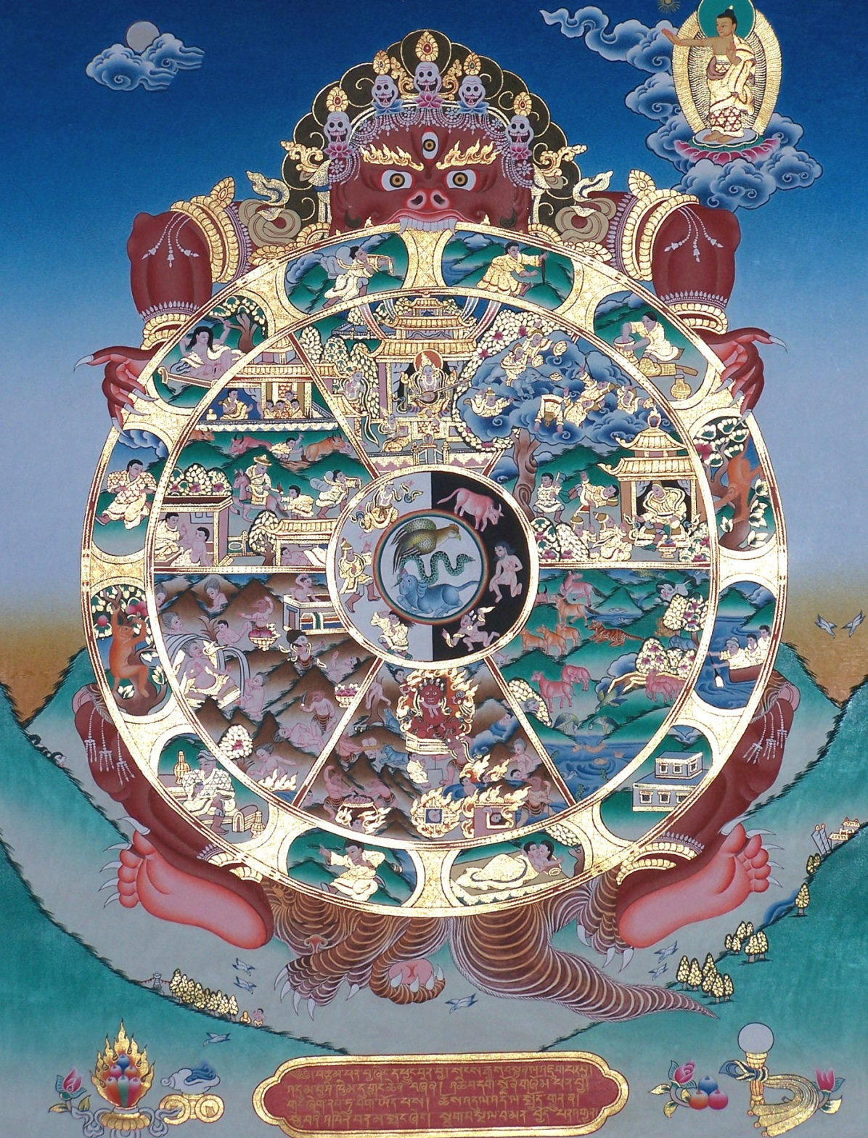
Samsara and the Wheel of Life
Notes:
To be done in conjunction with fill in photocopied sheet Buddhist Crime Samsara Worksheet on Wheel of Life.

Slide 9
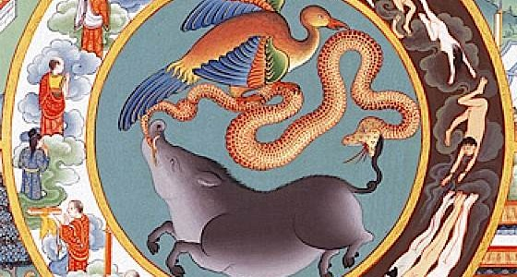
Three poisons

Slide 10

Buddhism is not primarily concerned with sin – instead they focus why people suffer.
The roots of all evil are:
GREED
(lobha)
IGNORANCE
(avijja)
HATRED
(dosa)

Slide 11
The Law of Karma

Slide 12
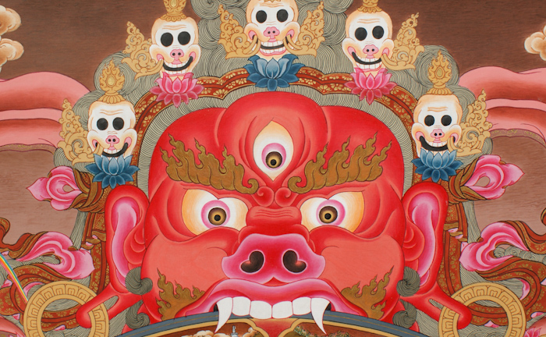
Yama – Lord of Death

Slide 13
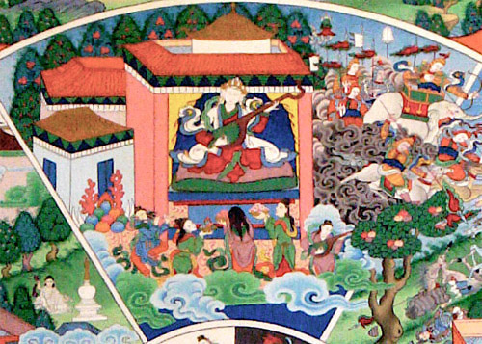
The realm of the devas

Slide 14

The realm of asuras

Slide 15
Animal realm

Slide 16
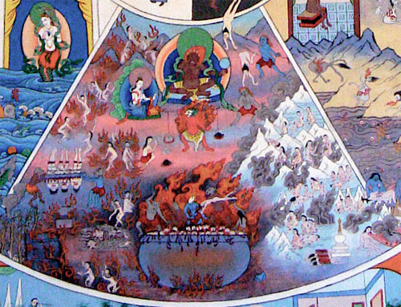
Hell

Slide 17
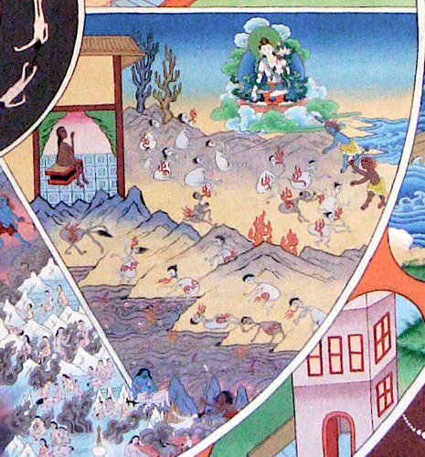
The realm of the pretas

Slide 18
The realm of humans

Slide 19
Buddha and moksha

Slide 20

Karma – some crimes bring their own punishment

Slide 21
Different things can cloud our mind
UNAWARENESS
LACK OF WISDOM
FALSE VIEWS

Slide 22
Buddhists say…
Every good motive contributes towards enlightenment
You should uphold the law…
Karma is key…
You reap what you sow
Bad actions = bad karma and rebirth in a lower form

Slide 23
Theories of Punishment
Buddhists have a system of rewards and punishments for good and bad actions.
Buddhists emphasise the need to protect criminals for creating more bad karma for themselves…
Protection
Reformation
Deterrence

Slide 24

Retribution
Retribution is bad!
A punishment that deliberately destroys another being implies there is no way the person can learn from their mistakes.
What punishments would this rule out?

Slide 25

It is the
and
that needs to be changed.

Slide 26
CAPITAL PUNISHMENT
Some Buddhists are not opposed to the threat of the death penalty if it is the last resort.
What alternatives can you think of?
Others believe nothing can excuse taking a life.

Slide 27
‘ A bad person is someone who hasn’t discovered their potential for good. ’
Do you agree? Why / why not?

