Slide 1
Religion and Racism
Key Question.
What do Buddhists and Christians think about racism?
Starter Task.
Key terms crossword.

Slide 2
Religion & Racism
DLOs.
To understand what racism is.
To explain what can cause racism
To be able to answer exam questions on attitudes to racism.
Watch & answer...
Which groups of people does the immigration officer select ‘at random’ to interview?
Give some examples of stereotypes in the clip.
How does the immigration officer try to get his interviewee to ‘prove’ his Britishness?
https://www.youtube.com/watch?v=dCk6fSQ21rY

Slide 3
Religion and Racism
Causes of Racism (pages 52 & 53 of the text book).
Explain, briefly what stereotyping is. Make sure you use the following words in your explanation; education; ignorance; fear. Give an example of a group of people who might be stereotyped.
Explain scapegoating. In your explanation include the following words; blaming; Nazis; Jews.
Explain how upbringing can lead to prejudice. Use the following words in your explanation; parents; peers.

Slide 4
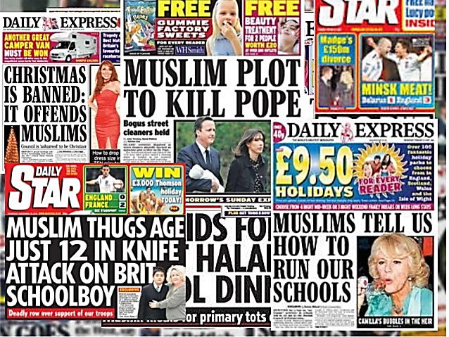
Religion and Racism
Causes of Racism.
I
iIf these were the only news headlines you read what would your opinion of Muslims be?
Would this be correct? Explain reasons for your answer.

Slide 5
Religion and Racism
Causes of Racism (pages 53).
Explain, using an example of how a bad experience could lead to prejudice.
Effects of Racism (pages 53).
Explain how prejudice can affect an individual.
Give examples of where prejudice has affected the following groups of people;
Jews; Tutsis; Black people.
3. Briefly explain one of these
examples.
Other Prejudices.
Either as a list or spider diagram note down other types of prejudice.

Slide 6
Religion and Racism
Review - Exam Questions.
Give two examples of what religious believers would see as causes of racism. (2 marks).
2. Use one Buddhist and one Christian teaching to explain
religious attitudes to racism. (5 marks)

