Slide 1
Religious Attitudes to the
Law & Human Rights
Key Question;
What are religious attitudes to Human Rights?
Starter – quick quiz;
Answer the questions on the Lesson 3 Starter Quiz.docx sheet.
If stuck, you can look up the information in the previous two lessons in the Y9 Moodle page. https://moodle.beverleyhigh.net/course/view.php?id=420

Slide 2
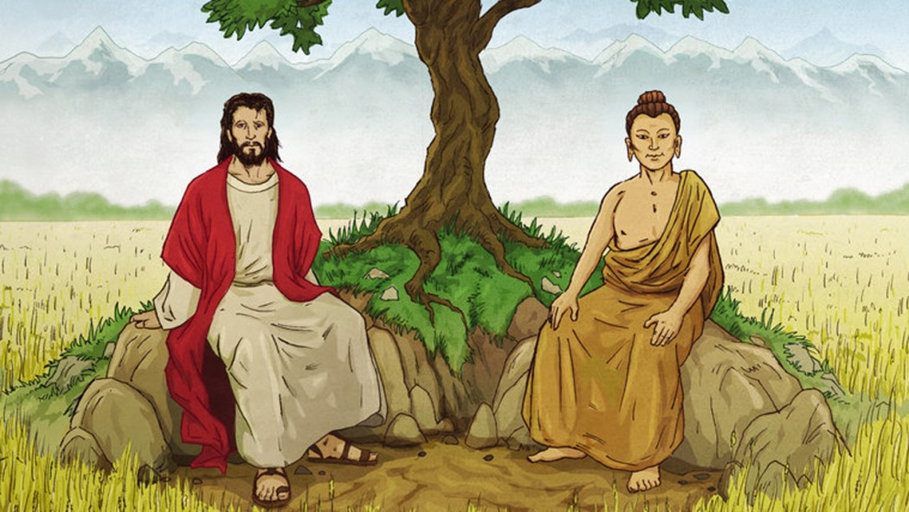
Religious Attitudes to the Law & Human Rights
DLOs;
To know what Buddhists and Christians think about the Law and human Rights
To show links between religious teachings and what religious people do when people are treated unjustly.
To have justified the importance of human rights.

Slide 3
Religious Attitudes to the Law & Human Rights
Open the Lesson 3 Religion and Human Rights.docx and read the section on Buddhism. Also, watch the short video about a protester (linked on the right here) and answer the questions below.
Things to do – Read about Buddhism and Human Rights;
Explain how some Tibetans have had their Human Rights denied.
Give examples of how Tibetans have protested against the Chinese occupation.
Explain why Buddhists think it is important to support the Law and Human Rights.
Why do Buddhists think it is important to help people who are not getting their human rights?
https://www.youtube.com/watch?v=m1xAH5nuVYs

Slide 4
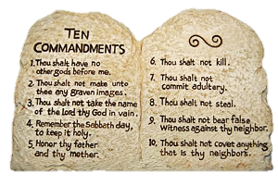
Religious Attitudes to the Law & Human Rights
Things to do – Read about Christianity and Human Rights;
Explain, using the quotation on the sheet, explain Christian attitudes to the law.
On the last page of the sheet you will be given note down Human Rights that link to the Ten Commandments. (Fill in the table.)
Explain why Christians believe that all humans should have rights.

Slide 5
Religious Attitudes to the Law & Human Rights
Review - Exam Questions;
Give two examples of what religious believers would see as a violation of human rights. (2 marks)
Describe the work of a religious believer who has worked to gain human rights. (4 marks)
Explain different attitudes in contemporary British society to human rights. You must refer to religious views in your answer. You may also refer to non-religious views. (5 marks)

