Slide 1
Rights and Responsibilities
Key Question;
What is the connection between Human Rights and responsibilities?
Starter Task
Note down the key terms –
Rights; Responsibilities.
DLOs;
To recognise that with Rights come Responsibilities.
To show understanding of the consequences of not having human rights.
To have evaluated the importance of Human Rights.

Slide 2
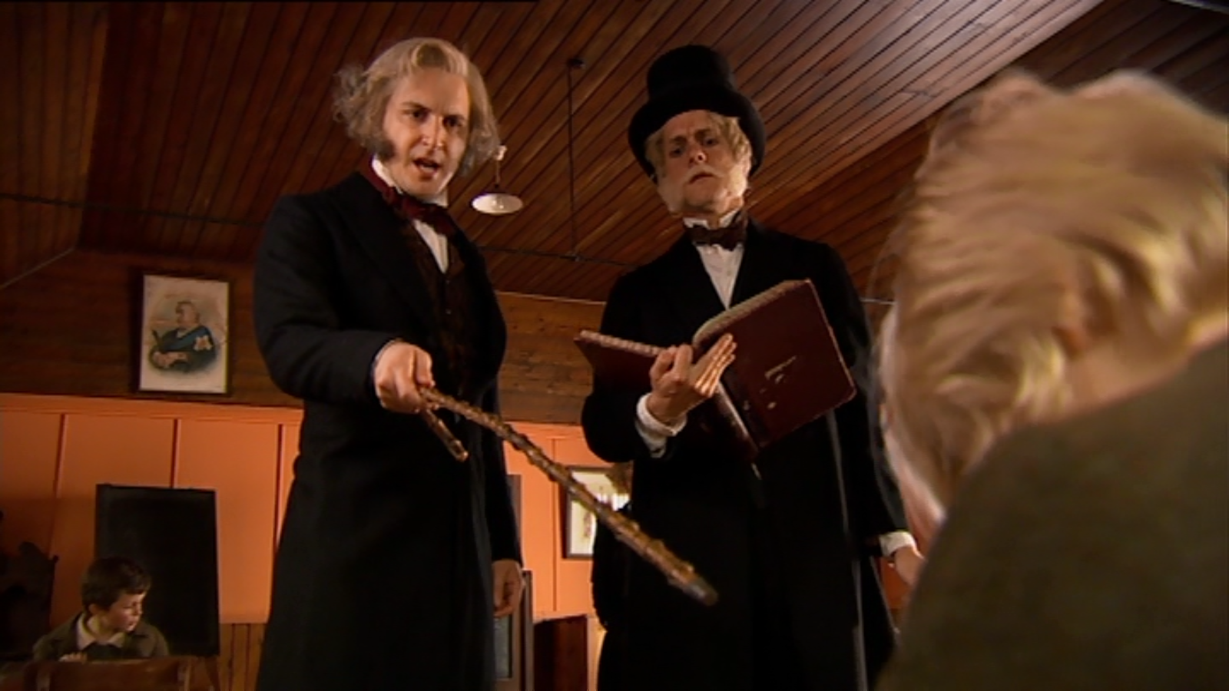
Historical (Lack of) Rights
Task 1
Watch the 4 min. clip of Victorian children at work and school.
List three ways in which children were harmed at work.
When was this abolished?
Name at least two punishments at school.
Which human rights were denied to children?
Extension
‘’Physical punishment of children is reasonable.’
Give reasons why some people would agree.
Give reasons why some people would disagree.
Give your own view with reasons.
Notes:
Horrible Histories Series 1 Episode 9 from 2 min 22 sec until after the school sketch – lasts 3½ min.

Slide 3
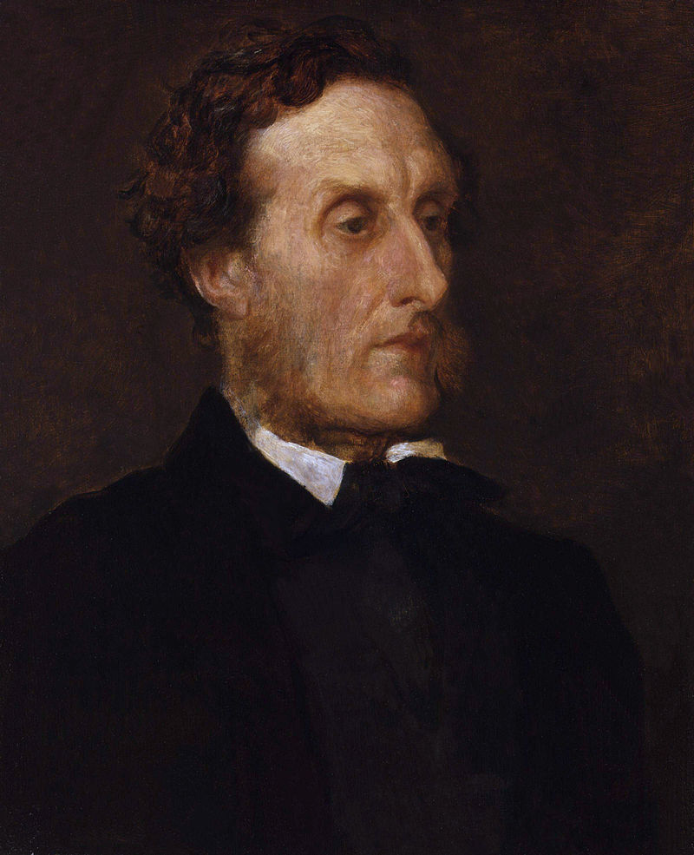
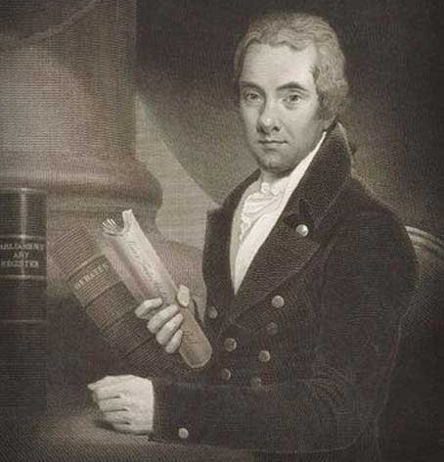
Rights and Responsibilities
Task 2
Read in the info sheet about how the UK Parliament has developed the rights of people in the past.
Note down some of the laws that improved peoples lives.
Lord Shaftesbury
1801-1885
Watch the 3-minute video on William Wilberforce.
https://www.youtube.com/watch?v=eLU182rj0pA
William Wilberforce
1759-1833

Slide 4
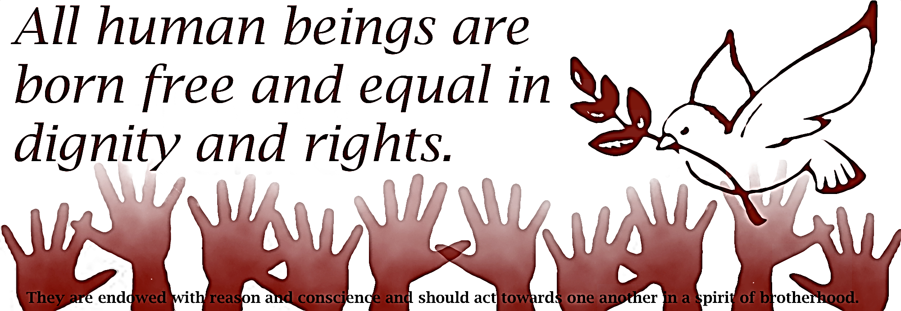
Rights and Responsibilities
Task 3
Read in the info sheet about ‘Responsibilities’.
Complete the table linking the rights we have to the responsibilities of having these rights.
Task 4 (exam question)
Give two examples of what religious believers would see as violation of the Human Rights.

Slide 5
Rights and Responsibilities
Review/Reflect
‘The worst Human Rights abuse is not allowing people to have a Right to an Education’.
Do you agree? Give reasons for your answer, showing you
have thought about different points of view.
You should explain several different arguments, including
reasons and examples.
Extension
You will need to include religious beliefs/teachings in this
kind of question. Can you suggest what religious arguments
might be for and/or against this statement?

