Slide 1
IGCSE FM Trigonometry II
Dr J Frost (jfrost@tiffin.kingston.sch.uk)
Objectives: (from the specification)
Last modified: 21st April 2016

Slide 2
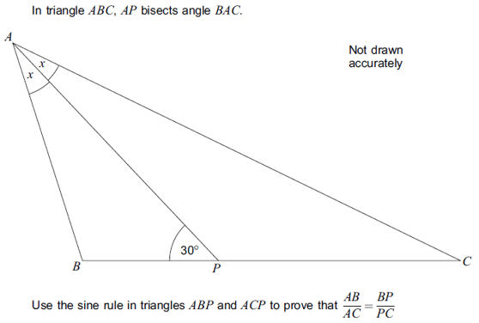
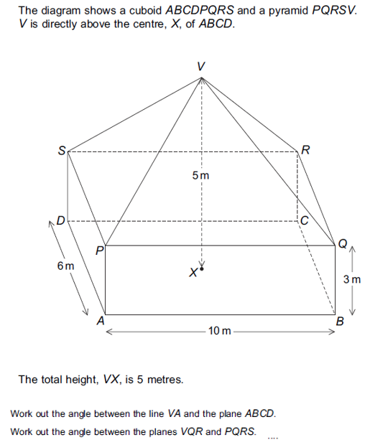
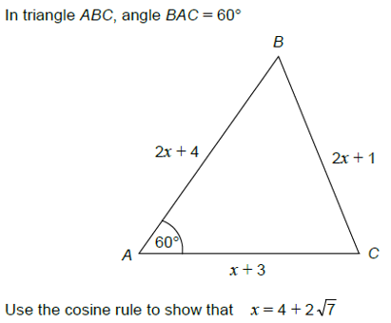
What makes this topic Further Maths-ey?
Technically this chapter requires no new knowledge since GCSE.
Harder questions to do with sine/cosine rule (e.g. proofs or algebraic/surd sides)
Harder 3D Pythagoras (e.g. angles between planes and between lines and planes)

Slide 3
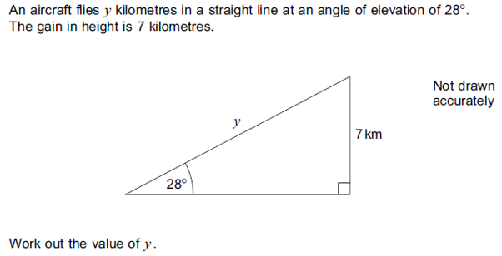
Basic Trigonometry Recap
June 2012 Paper 2 Q10
?
You always do sin/cos/tan of the angle, not the $\frac{7}{y}$.
$$\sin{28°}=\frac{7}{y} \\ y=\frac{7}{\sin{28°}}=14.91°$$
?
Always check your answer looks sensible. We expect $y$ to be a lot longer than 7 because the angle is shallow.

Slide 4
More Examples
1
2
$$A$$
$$1$$
$$4\sqrt{2}+10$$
$$θ$$
$$B$$
$$3$$
$$30°$$
$$x$$
$$D$$
$$C$$
Find $x$.
$$\cos{30°}=\frac{x}{4\sqrt{2}+10} \\ \frac{\sqrt{3}}{2}=\frac{x}{4\sqrt{2}+10} \\ \sqrt{3}\left(4\sqrt{2}+10\right)=2x \\ x=\frac{\sqrt{3}\left(4\sqrt{2}+10\right)}{2} \\ x=\frac{4\sqrt{6}+10\sqrt{3}}{2} \\ x=2\sqrt{6}+5\sqrt{3}$$
?
Determine $\cos{θ}$ $\cos{θ}=\frac{1}{3}$
Hence determine the length $BC$. Using triangle $ACD$: $\cos{θ}=\frac{3}{AC} \frac{1}{3}=\frac{3}{AC} AC=9$ $BC=9−1=8$
?
If a fraction on each side (and nothing else), cross multiply.
?

Slide 5
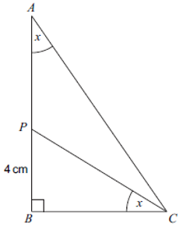
Test Your Understanding
June 2013 Paper 1 Q3
2
$ABC$ is a right-angled triangle. $P$ is a point on $AB$.
$$\tan{x}=\frac{2}{3}$$
$$2\sqrt{2}−1$$
$$45°$$
$$x$$
Find $x$.
$$\sin{45°}=\frac{x}{2\sqrt{2}−1} \\ \frac{1}{\sqrt{2}}=\frac{x}{2\sqrt{2}−1} \\ 2\sqrt{2}−1=x\sqrt{2} \\ x=\frac{2\sqrt{2}−1}{\sqrt{2}} \\ x=\frac{4−\sqrt{2}}{2}$$
?
a) Work out the length of $BC$.
$$\tan{x}=\frac{4}{BC} \\ \frac{2}{3}=\frac{4}{BC} → 2BC=12, BC=6$$
b) Work out the length of $AP$.
Using triangle $ABC$: $\tan{x}=\frac{BC}{AB}$ $$\frac{2}{3}=\frac{6}{AB} → 2AB=18 → AB=9 \\ AP=9−4=5cm$$
?
Rationalise denominator by multiplying top and bottom by $\sqrt{2}$.
?

Slide 6
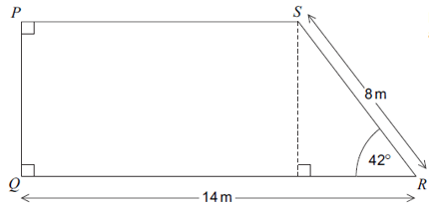
Exercise 1
NO CALCULATORS
3
4
Show that $p$ is an integer.
2
Find the exact value of $x$.
?
1
$$p=6$$
$$2\sqrt{3}+4$$
$$x$$
$$10+2\sqrt{3}$$
$$p$$
$$x$$
$$5\sqrt{2}$$
$$45°$$
$$x$$
$$30°$$
$$45°$$
$$60°$$
$$x=5$$
?
$$\sqrt{8}+\sqrt{2}$$
?
$$x=5+\sqrt{3}$$
$$x=3+2\sqrt{3}$$
?
7
$$C$$
4
$$B$$
5
Determine the area of triangle $ABC$, giving your answer in the form $p+q\sqrt{3}$.
6
Work out the area of trapezium $PQRS$
$$P$$
$$Q$$
12
$$3+\sqrt{3}$$
7
$$x$$
$$30°$$
$$A$$
[AQA Mock Papers]
a) Using $ΔABC$, find $\tan{x}$. $=\frac{1}{3}$
b) Work out the length of $PQ$ $=\frac{7}{3}$
?
?
$$p=9+6\sqrt{3}$$
?

Slide 7
3D Pythagoras
The key here is identify some 2D triangle ‘floating’ in 3D space.
You will usually need to use Pythagoras twice.
Find the length of diagonal connecting two opposite corners of a unit cube.
$$\sqrt{3}$$
Determine the height of this pyramid.
?
?
$$\sqrt{2}$$
$$1$$
2
$$\sqrt{3}$$
$$\sqrt{2}$$
$$\sqrt{2}$$
$$1$$
$$\sqrt{2}$$
2
$$1$$
We obtained the $\sqrt{2}$ by using Pythagoras on the base of the cube.
2

Slide 8
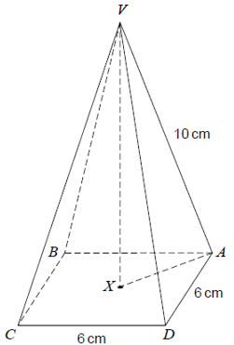
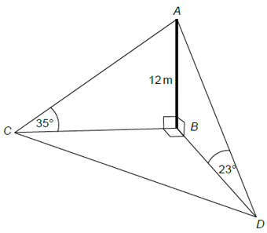
Test Your Understanding
AQA Mock Set 4 Paper 2
AQA Mock Set 1 Paper 2
1
A pyramid has a square base $ABCD$ of sides 6cm. Vertex $V$, is directly above the centre of the base, $X$.
Work out the height $VX$ of the pyramid.
$$XA=\frac{1}{2}\sqrt{6^{2}+6^{2}}=3\sqrt{2} \\ VX=\sqrt{{10}^{2}−{\left(3\sqrt{2}\right)}^{2}} \\ =\sqrt{100−18} \\ =\sqrt{82}$$
2
The diagram shows a vertical mast, $AB$, 12 metres high. Points $B, C, D$ are on a horizontal plane.
Point $C$ is due West of $B$.
Calculate $CD$
Calculate the bearing of $D$ from $C$ to the nearest degree
?
a) $$BC=\frac{12}{\tan{35}}=17.137776 \\ BD=\frac{12}{\tan{23°}}=28.270228 \\ CD=\sqrt{{17.1…}^{2}+{28.2…}^{2}} \\ =33.06m$$
b) $90°+\tan^{−1}\left(\frac{28.27}{17.14}\right)$ $$=149°$$
?
?

Slide 9
Angles between lines and planes
A plane is:
A flat 2D surface (not necessary horizontal).
?
When we want to find the angle between a line and a plane, use the “drop method” – imagine the line is a pen which you drop onto the plane. The angle you want is between the original and dropped lines.
$$θ$$
Click for
Bromanimation

Slide 10
Angles between two planes
To find angle between two planes:
Use ‘line of greatest slope’* on one plane, before again ‘dropping’ down.
* i.e. what direction would be ball roll down?
?
line of greatest slope
$$θ$$
$$B$$
Example:
Find the angle between the plane $ABCD$ and the horizontal plane.
$$θ=\sin^{−1}\left(\frac{3}{6}\right)=30°$$
$$6cm$$
$$C$$
$$3cm$$
line of greatest slope
$$A$$
?
$$θ$$
$$D$$

Slide 11
Further Example
$$E$$
Find the angle between the planes $BCE$ and $ABCD$.
2
$$\sqrt{2}$$
We earlier used Pythagoras to establish the height of the pyramid. Why would it be wrong to use the angle $∠ECO$?
$EC$ is not the line of greatest slope.
$$D$$
$$C$$
$$\sqrt{2}$$
$$O$$
2
?
$$A$$
2
$$B$$
$$E$$
? Solution
? Suitable diagram
$$\sqrt{2}$$
$$D$$
$$C$$
$$θ=\tan^{−1}\left(\frac{\sqrt{2}}{1}\right)=54.7°$$
$$θ$$
$$O$$
1
From $E$ a ball would roll down to the midpoint of $BC$.
$$A$$
$$B$$

Slide 12
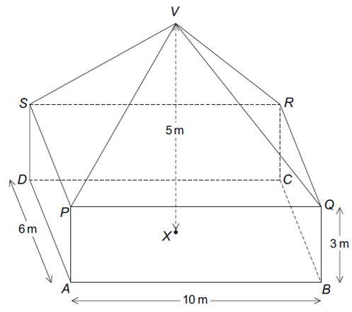
Test Your Understanding
Jan 2013 Paper 2 Q23
The diagram shows a cuboid $ABCDPQRS$ and a pyramid $PQRSV$. $V$ is directly above the centre $X$ of $ABCD$.
a) Work out the angle between the line $VA$ and the plane $ABCD$. (Reminder: ‘Drop’ $VA$ onto the plane) $$AX=\frac{1}{2}\sqrt{6^{2}+{10}^{2}}=\sqrt{34} \\ ∠VAX=\tan^{−1}\left(\frac{5}{\sqrt{34}}\right)=40.6°$$
b) Work out the angle between the planes $VQR$ and $PQRS$.
$$\tan^{−1}\left(\frac{2}{5}\right)=21.8°$$
?
?

Slide 13
Exercise 2
1
A cube has sides 8cm. Find:
a) The length $AB$. $8\sqrt{3}$
b) The angle between $AB$ and the horizontal plane. $35.3°$
2
A radio tower 150m tall has two support cables running 300m due East and some distance due South, anchored at $A$ and $B$. The angle of inclination to the horizontal of the latter cable is $50°$ as indicated.
?
?
$$B$$
$$8$$
$$150m$$
$$C$$
$$A$$
$$300m$$
$$50°$$
$$8$$
$$A$$
$$B$$
a) Find the angle between the cable attached to $A$ and the horizontal plane. $\tan^{−1}\left(\frac{150}{300}\right)=26.6°$
b) Find the distance between $A$ and $B$. 325.3m
?
?

Slide 14
Exercise 2
$$I$$
3
4
$$E$$
$$J$$
$$G$$
$20$cm
$$H$$
$$12m$$
$$F$$
$$E$$
$$8m$$
$$D$$
$$C$$
$$M$$
$$D$$
$$X$$
$$C$$
$24$cm
$$7m$$
$$A$$
$$24m$$
$$B$$
$$A$$
$24$cm
$$B$$
A school buys a set of new ‘extra comfort’ chairs with its seats pyramid in shape. $X$ is at the centre of the base of the pyramid, and $M$ is the midpoint of $BC$.
By considering the triangle $EBC$, find the length $EM$. 16cm
Hence determine the angle between the triangle $EBC$ and the plane $ABCD$. $\cos^{−1}\left(\frac{12}{16}\right)=41.4°$
Frost Manor is as pictured, with $EFGH$ horizontally level.
a) Find the angle between the line $AG$ and the plane $ABCD$. $\tan^{−1}\left(\frac{8}{25}\right)=17.7°$
b) Find the angle between the planes $FGIJ$ and $EFGH$. $\tan^{−1}\left(\frac{4}{12}\right)=18.4°$
?
?
?
?

Slide 15
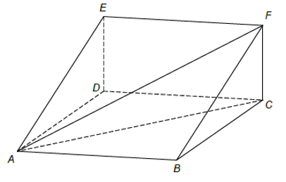
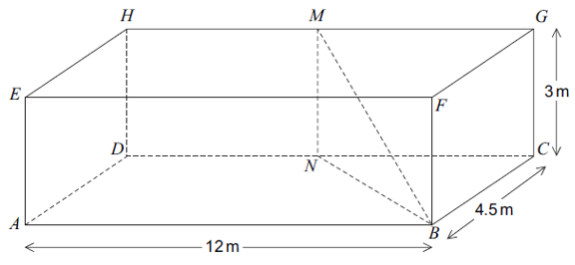
Exercise 2
5
[June 2013 Paper 2] $ABCDEFGH$ is a cuboid. $M$ is the midpoint of $HG$. $N$ is the midpoint of $DC$.
Show that $BN=$ 7.5m
Work out the angle between the line $MB$ and the plane $ABCD$. $\tan^{−1}\left(\frac{3}{7.5}\right)=21.8°$
Work out the obtuse angle between the planes $MNB$ and $CDHG$. $180−\tan^{−1}\left(\frac{4.5}{6}\right)=143.1°$
6
[Set 3 Paper 2] The diagram shows part of a skate ramp, modelled as a triangular prism.
$ABCD$ represents horizontal ground. The vertical rise of the ramp, $CF$, is 7 feet. The distance $BC=24$ feet.
?
?
You are given that $gradient=\frac{vertical rise}{horizontal distance}$
a) The gradient of $BF$ is twice the gradient of $AF$. Write down the distance $AC$. 48
b) Greg skates down the ramp along $FB$. How much further would he travel if he had skated along $FA$. $$FB=25 AF=48.51 48.51−25=23.51$$
?
?

Slide 16
Exercise 2
7
$$I$$
8
$$2$$
$$2$$
$$G$$
$$3$$
$$H$$
$$5m$$
$$F$$
$$E$$
$$3$$
$$2m$$
$$D$$
$$4$$
$$C$$
$$4$$
$$4m$$
$$A$$
$$8m$$
$$B$$
A ‘truncated pyramid’ is formed by slicing off the top of a square-based pyramid, as shown. The top and bottom are two squares of sides 2 and 4 respectively and the slope height 3.
Find the angle between the sloped faces with the bottom face.
$$\cos^{−1}\left(\frac{1}{\sqrt{8}}\right)=69.3°$$
a) Determine the angle between the line $AI$ and the plane $ABCD$.
$$\tan^{−1}\left(\frac{5}{2\sqrt{5}}\right)=48.2°$$
b) Determine the angle between the planes $FHI$ and $EFGH$.
$$\tan^{−1}\left(\frac{3}{4}\right)=36.9°$$
?
?
?

Slide 17
Exercise 2
$$C$$
N
$$5$$
$$D$$
$$4$$
$$B$$
$$3$$
$$X$$
$$A$$
a) $X$ is a point on $AB$ such that $XC$ is the line of greatest slope on the triangle $ABC$. Determine the length of $AX$.
By Pythagoras $AC=\sqrt{34}$, $BC=\sqrt{41}$ and $AB=5$. If $AX=x$, then $XB=5−x$. Then $CX$ can be expressed in two different ways:
$$CX=\sqrt{34−x^{2}}=\sqrt{41−{\left(5−x\right)}^{2}}$$
Solving: $CX=\frac{4}{5}$
b) Hence determine $DX$. $\sqrt{34−{0.8}^{2}}=\frac{\sqrt{834}}{5}=5.776$
c) Hence find the angle between the planes $ABC$ and $ABD$. $\tan^{−1}\left(\frac{5}{5.776}\right)=40.88$
?
?
?

Slide 18
Sine/Cosine Rule Recap
$$65°$$
$$8$$
$$10$$
$$x$$
$$α$$
$$40°$$
$$45°$$
$$5$$
?
Sine rule angle, but this time angle unknown, so put as numerator.
$$\frac{\sin{α}}{10}=\frac{\sin{40}}{8} \\ \sin{α}=\frac{10\sin{40}}{8} \\ α=53.5°$$
We have two angle-side pairs involved, so use sine rule.
$$\frac{x}{\sin{45}}=\frac{5}{\sin{65}} \\ x=\frac{5}{sin65}×\sin{45} \\ x=3.90$$
?

Slide 19
Sine/Cosine Rule Recap
$$x$$
$$5$$
$$α$$
$$1$$
$$2.5$$
$$40°$$
$$6$$
$$2$$
?
All three sides involved (and unknown side opposite known angle), so cosine rule.
$$x^{2}=5^{2}+6^{2}−\left(2×5×6×\cos{40}\right) \\ x=3.88$$
Again, all three sides involved so cosine rule.
$$2^{2}=1^{2}+{2.5}^{2}−\left(2×1×2.5×\cos{α}\right) \\ 4=7.25−5\cos{α} \\ 5\cos{α}=7.25−4 \\ \cos{α}=\frac{3.25}{5} α=49.5°$$
?

Slide 20
Area of Non Right-Angled Triangles Rrecap
3cm
Area = 0.5 x 3 x 7 x sin(59)
= 9.00cm²
?
59°
7cm
!
Area = $\frac{1}{2}a b\sin\left(C\right)$
Where C is the angle wedged between two sides a and b.

Slide 21
Test Your Understanding
Q1
Q2
$$90m$$
Q3
$$4.6$$
$$27$$
$$80°$$
$$130°$$
$$θ$$
$$15$$
$$11$$
$$40°$$
$$60m$$
$$x$$
$$12$$
$x=41.37$
b) $Area=483.63$
$$Perimeter \\ =286.5m$$
?
$$θ=122.8°$$
?
?
?
Q5
Q6
$$7$$
$$5$$
Q4
$$z$$
$$7$$
$$30°$$
$$61°$$
$$11$$
$$α$$
$$α$$
$$20°$$
$$x$$
$$18$$
$$11$$
?
$$x=7.89 \\ Area=17.25$$
?
?
$$α=147.5°$$
Your calculator will say $32.5°$, but it’s clearly an obtuse angle. Remember that $\sin\left(x\right)=\sin\left(180−x\right)$
$$α=17.79° \\ z=26.67 \\ Area=73.33$$
?
?
?
(Hint: cosine rule is not good here as $x$ is not opposite known angle)

Slide 22
Where it gets more Further Maths-ey…
You will frequently encounter either algebraic or surd sides.
The approach is exactly the same as before.
?
$${\left(2x+1\right)}^{2}={\left(x+3\right)}^{2}+{\left(2x+4\right)}^{2}−2\left(2x+4\right)\left(x+3\right)\cos{60} \\ 4x^{2}+4x+1=x^{2}+6x+9+4x^{2}+16x+16−2\left(2x^{2}+10x+12\right)\frac{1}{2} \\ 4x^{2}+4x+1=x^{2}+6x+9+4x^{2}+16x+16−2x^{2}−10x−12 \\ 4x^{2}+4x+1=3x^{2}+12x+13 \\ x^{2}−8x−12=0 \\ x=\frac{8±\sqrt{64−\left(4×1×−12\right)}}{2}=4±2\sqrt{7}$$
(But $x=4−2\sqrt{7}$ would lead to side of $2x+1$ being negative)

Slide 23
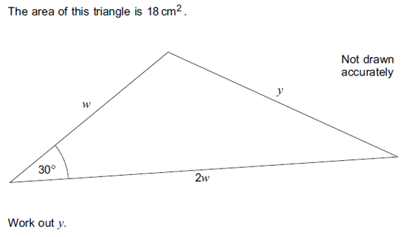
Another Example
Jan 2013 Paper 2 Q20
?
$$18=\frac{1}{2}×w×2w×\sin{30} \\ 18=\frac{1}{2}w^{2} → w=6 \\ y^{2}=6^{2}+{12}^{2}−\left(2×6×12×\cos{30}\right) \\ y=7.44 cm$$
Use $Area=\frac{1}{2}ab\sin{C}$
Can now use cosine rule.

Slide 24
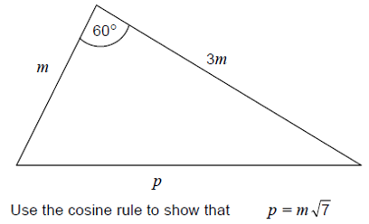
Test Your Understanding
AQA Set 4 Paper 1
Frost Special
$$2x$$
$$x\sqrt{6}$$
$$p^{2}=m^{2}+{\left(3m\right)}^{2}−\left(2×m×3m×\cos{60}\right) \\ =m^{2}+9m^{2}−3m^{2} \\ =7m^{2} \\ p=m\sqrt{7}$$
$$60°$$
?
$$x+3$$
Determine the value of $x$.
$${\left(x\sqrt{6}\right)}^{2}={\left(2x\right)}^{2}+{\left(x+3\right)}^{2}−2\left(2x\right)\left(x+3\right)\cos{60} \\ 6x^{2}=4x^{2}+x^{2}+6x+9−2x^{2}−6x \\ 3x^{2}−9=0 \\ x^{2}−3=0 → x=\sqrt{3}$$
?

Slide 25
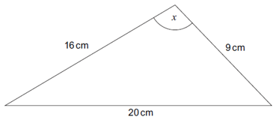
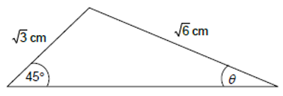
Exercise 3
1
[June 2012 Paper 2 Q13] Work out angle $x$.
3
$$x+1$$
$$x$$
$$60°$$
$$2x−1$$
?
$$x=102.64°$$
Use the cosine rule to determine $x$.
?
$${\left(x+1\right)}^{2}=x^{2}+{\left(2x−1\right)}^{2}−2x\left(2x−1\right)\cos{60} \\ … \\ x=\frac{5}{2}$$
2
Here is a triangle. Work out $θ$.
?
$$θ=30°$$

Slide 26
Exercise 3
4
5
$$3x$$
$$\sqrt{2}$$
$$y$$
$$θ$$
$$45°$$
$$30°$$
$$\sqrt{3}$$
$$2x$$
The angle $θ$ is obtuse. Determine $θ$.
$$\frac{\sin{θ}}{\sqrt{3}}=\frac{\sin{45}}{\sqrt{2}} \\ \sin{θ}=\frac{\sqrt{3}}{2} \\ θ=180−60°=120°$$
(Remember that $\sin\left(x\right)=\sin\left(180−x\right)$)
Given that the area of the triangle is 24cm². Find the values of $x$ and $y$.
$$\frac{1}{2}×3x×2x×\sin{30}=24 \\ \frac{3}{2}x^{2}=24 \\ x^{2}=36 → x=6 \\ y=9.69 cm$$
?
?

Slide 27
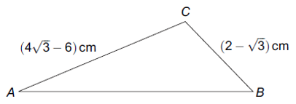
Exercise 3
6
[June 2012 Paper 1] Triangle ABC has an obtuse angle at C. Given that $\sin{A}=\frac{1}{4}$, use triangle $ABC$ to show that angle $B=60°$
?
$$\frac{\sin{B}}{4\sqrt{3}−6}=\frac{\sin{A}}{2−\sqrt{3}}=\frac{0.25}{2−\sqrt{3}} \\ \sin{B}=\frac{1}{4}\left(\frac{4\sqrt{3}−6}{2−\sqrt{3}}\right) \\ =\frac{1}{4}\left(\frac{\left(4\sqrt{3}−6\right)\left(2+\sqrt{3}\right)}{\left(2−\sqrt{3}\right)\left(2+\sqrt{3}\right)}\right)=\frac{1}{4}\left(\frac{2\sqrt{3}}{1}\right)=\frac{\sqrt{3}}{2} \\ B=\sin^{−1}\left(\frac{\sqrt{3}}{2}\right)=60°$$

Slide 28
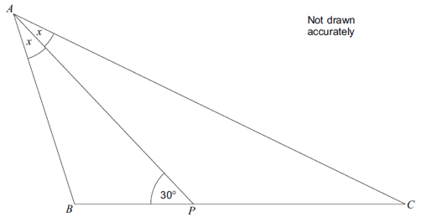
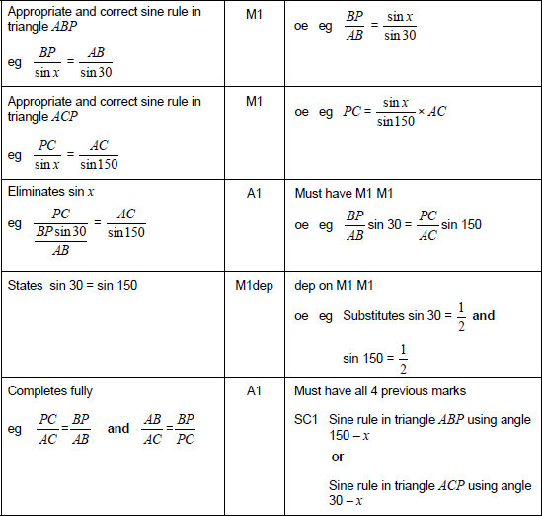
Exercise 3
7
?
June 2013 Paper 2 Q23
In triangle $ABC$, $AP$ bisects angle $BAC$.
Use the sine rule in triangles $ABP$ and $ACP$ to prove that $\frac{AB}{AC}=\frac{BP}{PC}$.

