Slide 1
Meditation: Visualisation
A.M.D.G
Notes:
A Powerpoint from TES modified by MHa

Slide 2
Starter (in the back of your book)
From memory, write out:
  The Noble Eightfold Path;
  The Five Precepts;
  The Four Noble Truths.

Slide 3

The Eightfold Path
Right
Viewpoint
Right
Thought
Right
Concentration
Right
Mindfulness
Right
Speech
Right
Effort
Right
Action
Right
Living

Slide 4
Right Viewpoint – The correct way of looking at life.
Right Thought – Thinking only good, unselfish things.
Right Speech - Saying only nice things.
Right Action – Not doing bad things, like killing, stealing or lying.

Slide 5
Right Living – Having a good job that does not harm others.
Right Effort – Training yourself to avoid bad things.
Right Mindfulness – controlling your mind to see everything the right way.
Right Concentration – training your mind to not wander using meditation.

Slide 6
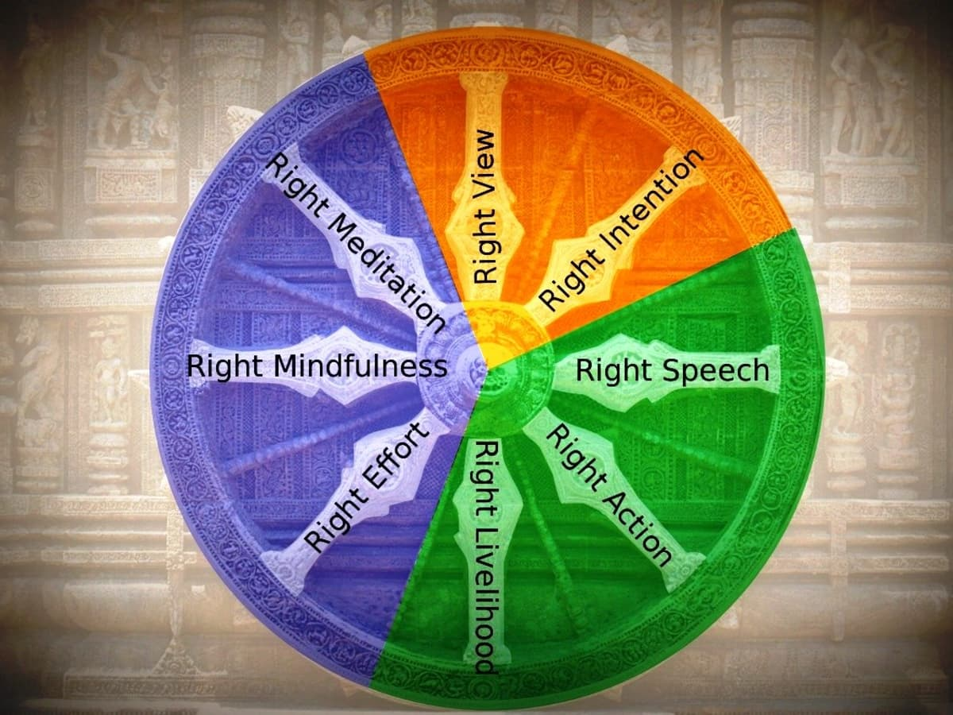

Slide 7
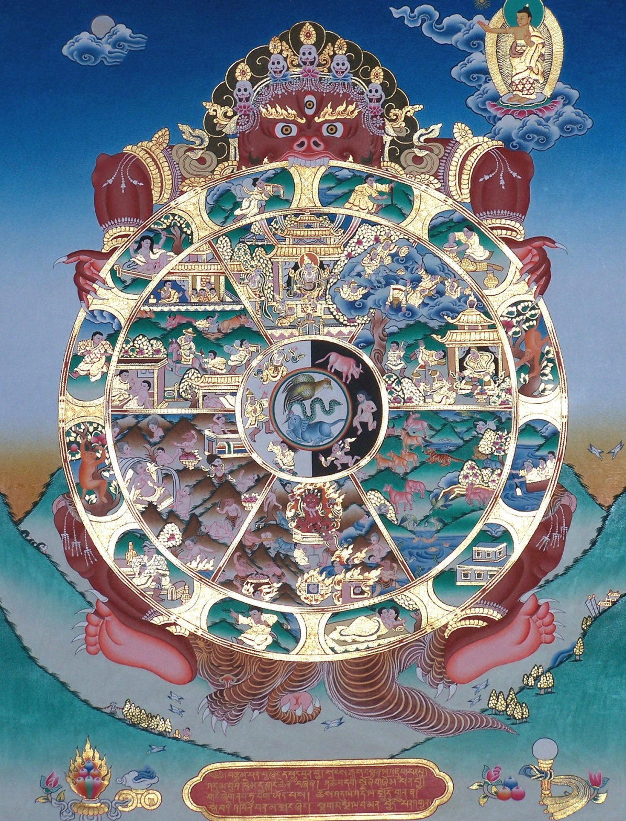
Samsara and the Wheel of Life
Notes:
To be done in conjunction with fill in photocopied sheet Buddhist Crime Samsara Worksheet on Wheel of Life.

Slide 8
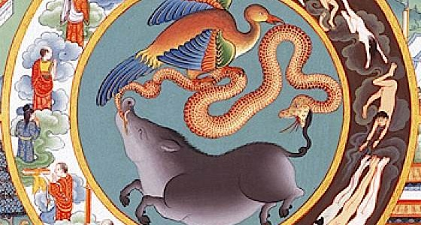
Three poisons

Slide 9
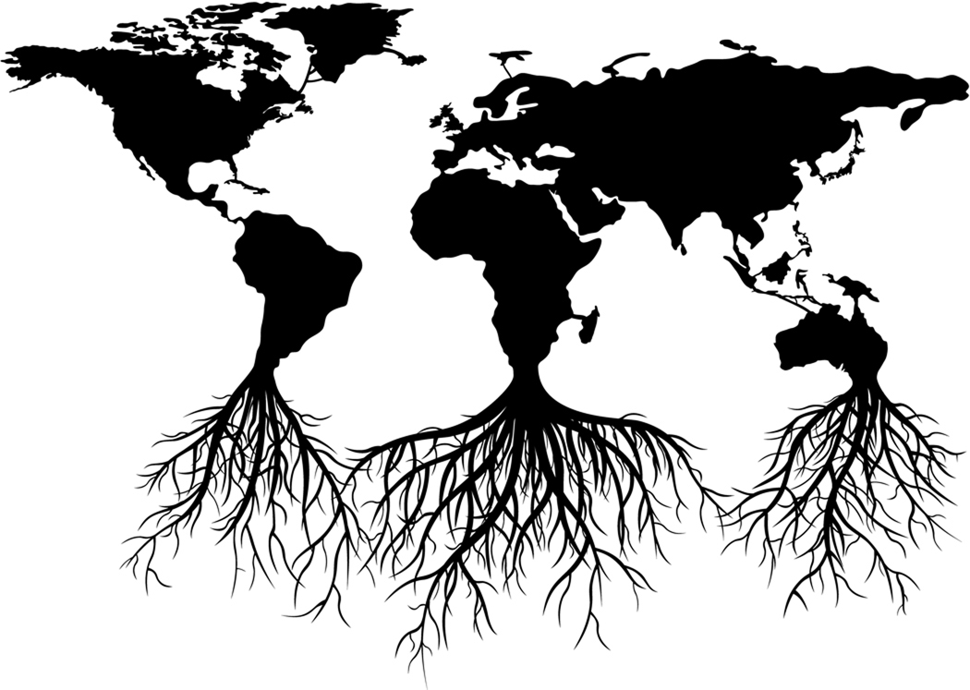
Buddhism is not primarily concerned with sin – instead they focus why people suffer.
The roots of all evil are:
GREED
(lobha)
IGNORANCE
(avijja)
HATRED
(dosa)

Slide 10
The Law of Karma

Slide 11
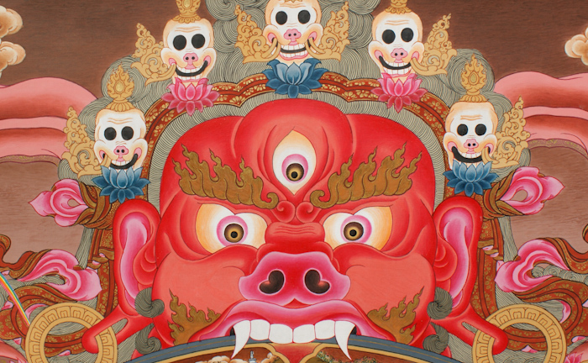
Yama – Lord of Death

Slide 12
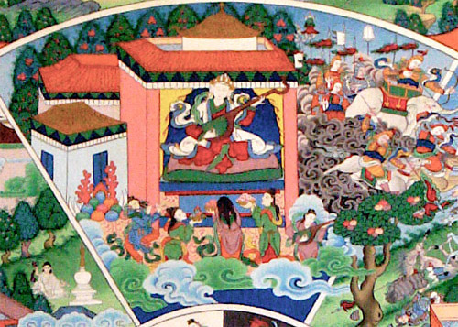
The realm of the devas

Slide 13

The realm of asuras

Slide 14
Animal realm

Slide 15
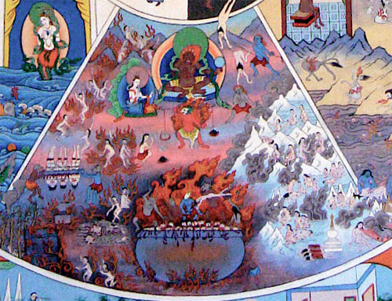
Hell

Slide 16
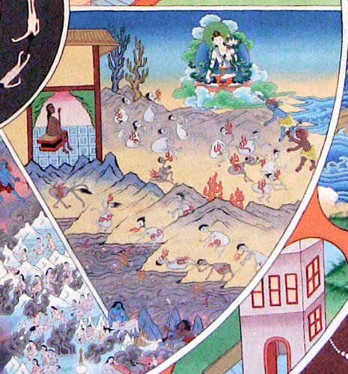
The realm of the pretas

Slide 17
The realm of humans

Slide 18
Buddha and moksha

Slide 19
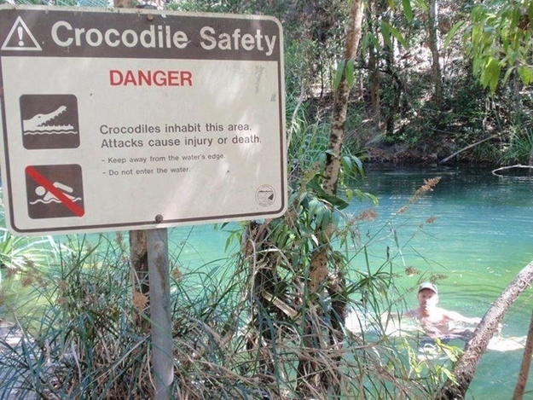
Karma – some crimes bring their own punishment

Slide 20
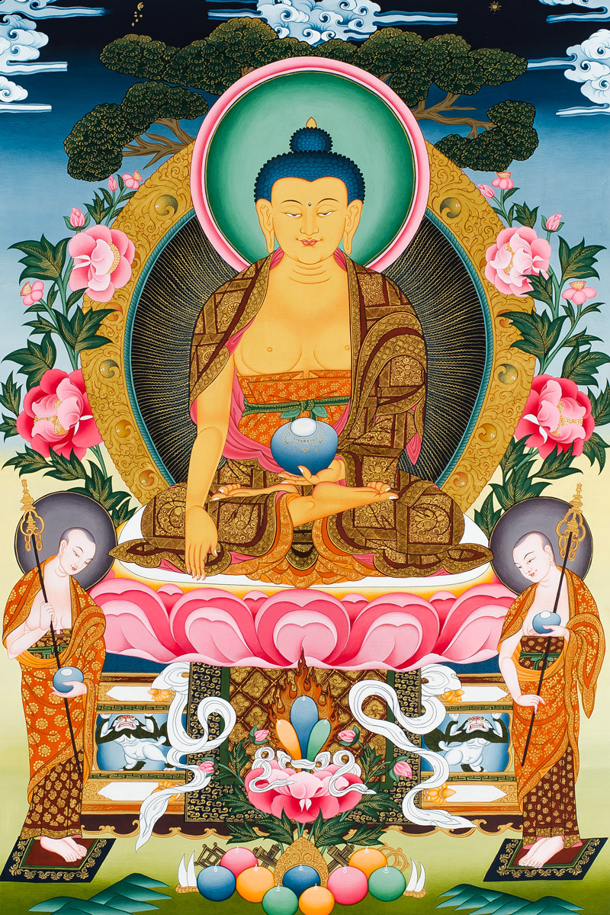
Thangka
Shakyamuni Buddha (same person as Siddhartha Gautama)

Slide 21
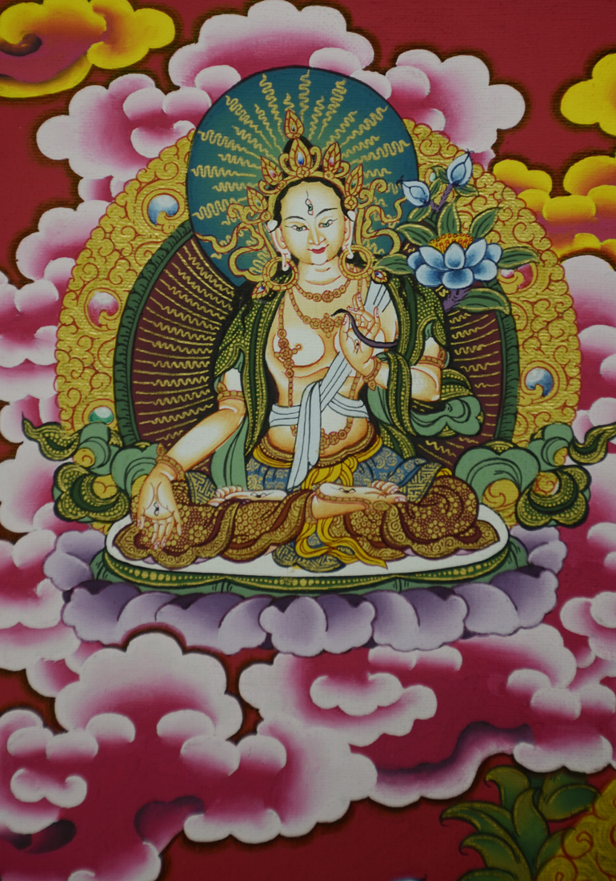
Thangka
Avalokiteshvara is a revered Bodhisattva in Mahayana Buddhism, known for his boundless compassion.

Slide 22
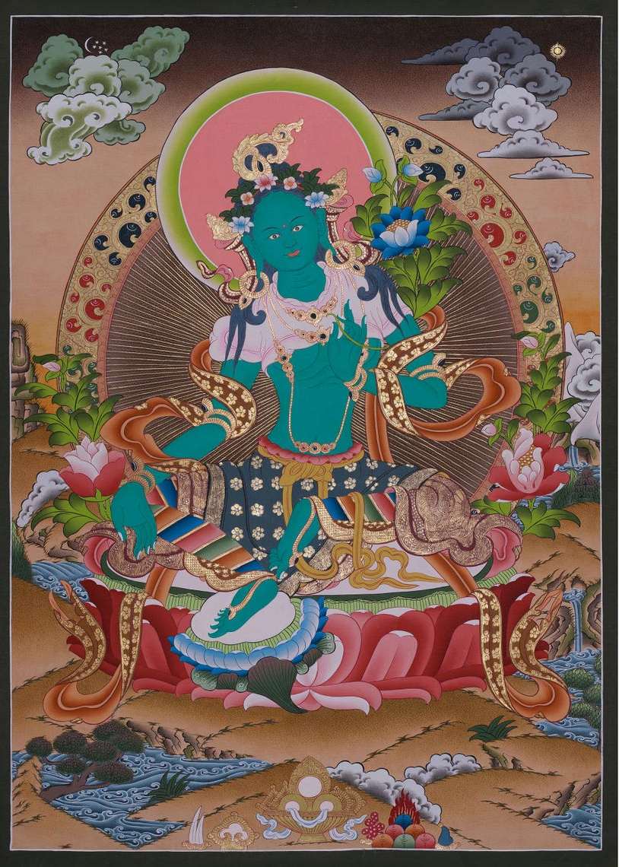
Thangka
Green Tara
‘Mother of liberation’

Slide 23
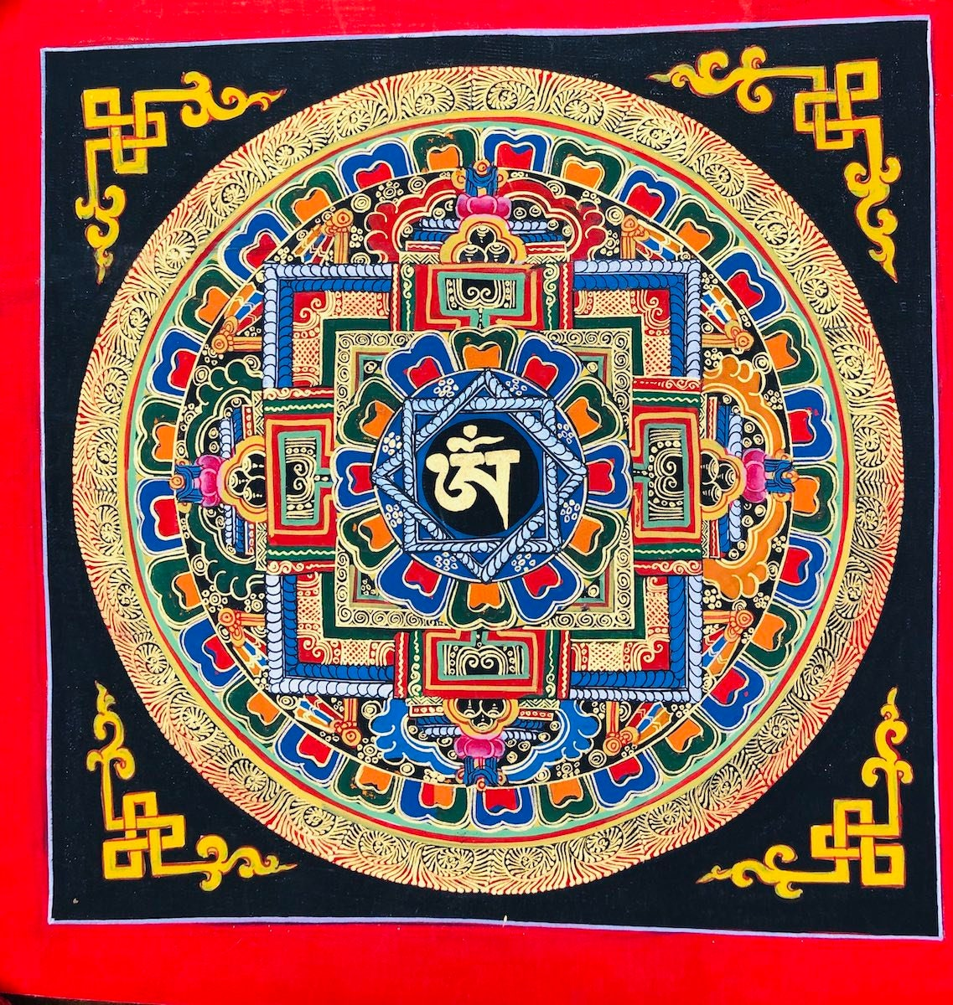
Mandala

