Slide 1



The BIG Idea
3.5.1 Interpretation of financial statements
Today we will:
a) Statement of comprehensive income (profit and loss account):
o key information
o stakeholder interest
b) Statement of financial position (balance sheet)
o key information
o stakeholder interest
Notes:
Students identify key words to underline

Slide 2
3.5.1 Interpretation of financial

Slide 3
Starter:
Describe the purpose of a trading and profit and loss account
Describe the purpose of a balance sheet

Slide 4
Ratio Analysis
Company A has made £100m profit
Company B has made £50m profit.
Which company is performing best?

Slide 5
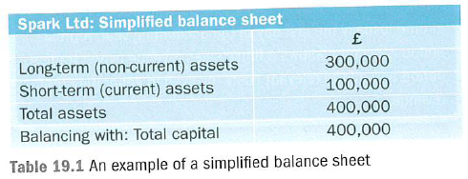
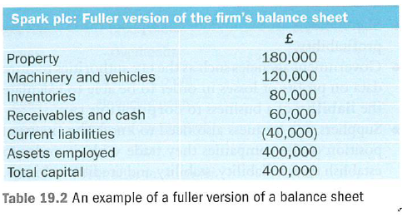
Capital employed

Slide 6
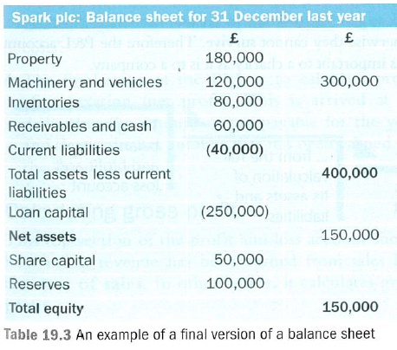
= Capital employed

Slide 7
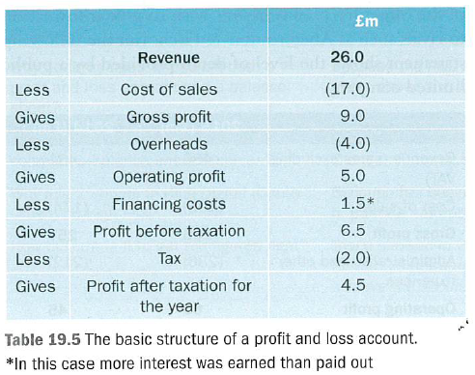

Slide 8
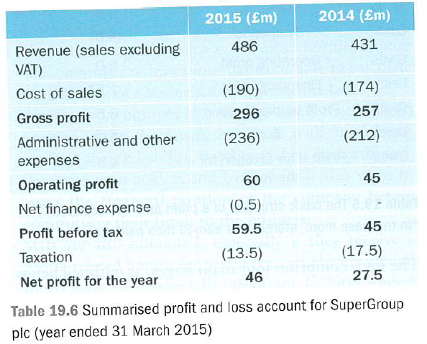

Slide 9
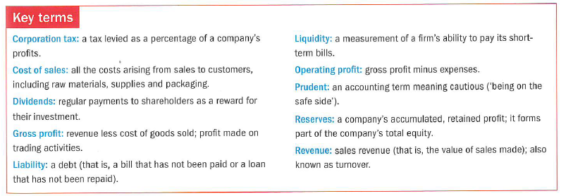

Slide 10
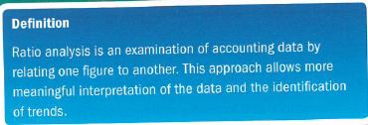
The BIG Idea
3.5.2 Ratio analysis
Today we will:
a) Calculate:
o Gearing ratio
o Return on capital employed (ROCE)
b) Interpret ratios to make business decisions
Notes:
Students identify key words to underline

Slide 11
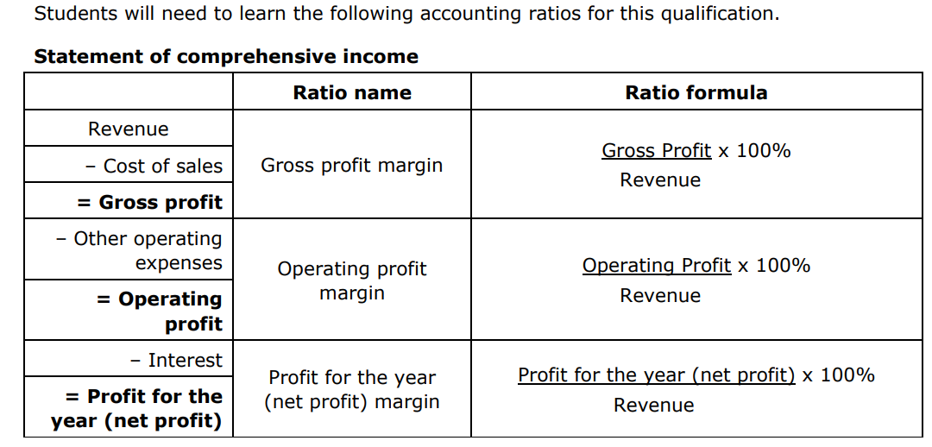

Slide 12
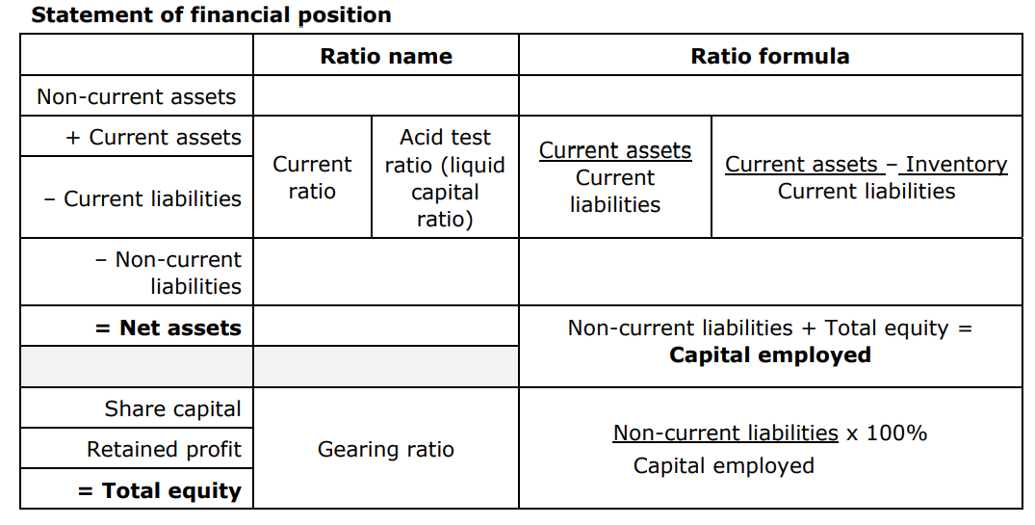

Slide 13
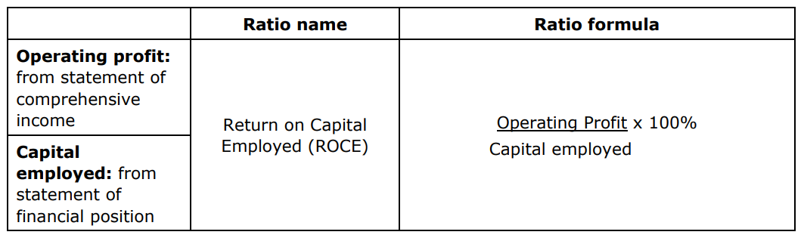

Slide 14
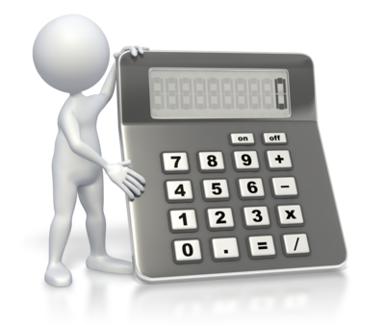
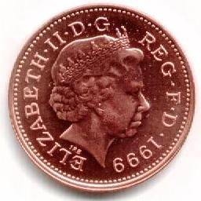
Ratio Analysis
There are 3 broad categories of ratios used:
PROFITABILITY RATIOS
These compare the profits of the business with sales, assets and the capital employed in the business
LIQUIDITY RATIOS
These measure how easily a business could meet its short-term debts or liabilities
GEARING RATIOS
These measure the degree to which a business is relying on long-term loans. They reflect of a business’s financial strategy

Slide 15

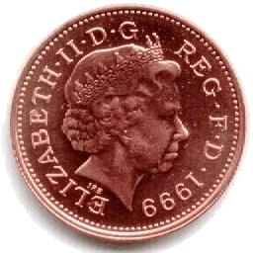
The Current Ratio
Calculated using the following formula:
Current Assets
=
Current Ratio
Current Liabilities
It measures the ability of a business to pay it’s debts over the next year
The answer is given as a ratio
A figure between 1.5 and 2 would be seen as normal – but it does vary across industries
Calculating Current Ratio
A firm has current liabilities of £4,500, whilst current assets are worth £9,000.
It’s current ratio would therefore be:
£9,000
= 2:1
£4,500
This means that for every £1 the
business owes, it has £2 worth of assets that can be used to pay.

Slide 16
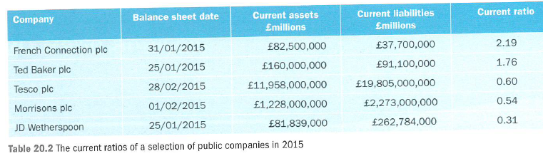

Slide 17

The Acid Test Ratio
Calculated using the following formula:
Current Assets - Stock
=
Acid Test Ratio
Current Liabilities
It measures the ability of a business to pay it’s debts immediately
  Hence stock is not included as it may not be in a saleable state
A figure of around 1 is seen as normal – but it varies across industries
Calculating The Acid Test Ratio
A firm has current liabilities of £4,500, whilst current assets are worth £9,000,
of which £4,000 is in the form of stocks. It’s current ratio would therefore be:
£9,000-£4,000
= 1.11
£4,500
This means that for every £1 owed the
Business has £1.11 worth of assets that can be used to pay immediately.

Slide 18
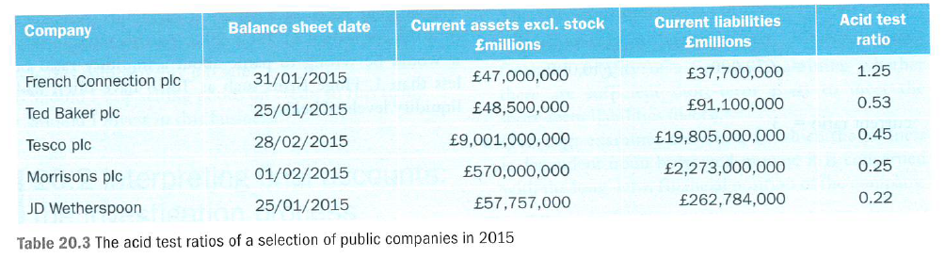

Slide 19
The Gearing Ratio
Calculated using the following formula:
non – current liabilities
x 100
=
Gearing Ratio
Capital Employed
This measures how reliant a firm is on borrowed money
A high gearing means higher interest costs
This may affect
  The value of dividends paid to shareholders
  The ability to obtain more borrowed funds
Calculating The Gearing Ratio
A firm has loan capital of £50,000, whilst the total capital employed is £250,000.
It’s gearing ratio would therefore be:
£50,000
X 100 = 20%
£250,000
This means that for every £1 invested
in the firm 20 pence of it is borrowed.

Slide 20
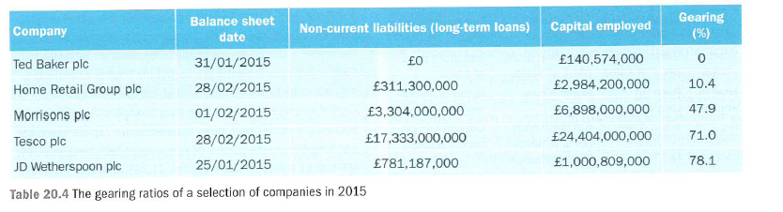

Slide 21
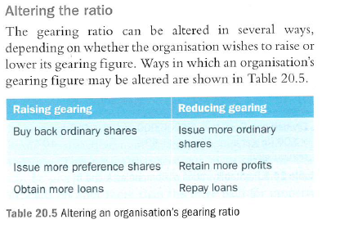

Slide 22
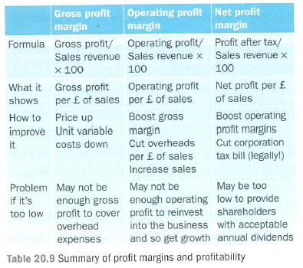

Slide 23
The Gross Profit Margin
Calculated using the following formula:
Gross Profit Margin
(GPM)
Gross Profit
x 100
=
Sales Revenue
This compares gross profit with the value of sales
A higher percentage figure is better
It can be improved by:
  Increasing turnover relative to costs
  A relative decrease in costs
Calculating GPM
A firm is making gross profit of £15,000 on sales of £45,000.
It’s GPM would therefore be:
£15,000
x 100 = 33.33%
£45,000
This means that for every £1 of sales
the business makes 33.33 pence gross profit.

Slide 24
The Operating Profit Margin
Calculated using the following formula:
Operating Profit Margin
Operating Profit
x 100
=
Sales Revenue
This compares net profit with the value of sales
A higher percentage figure is better
It is used to:
  Compare performance over time
  Assess how well overhead costs are being managed
Calculating OPM
A firm is making operating profit of £13,000 on sales of £45,000.
It’s GPM would therefore be:
£13,000
x 100 = 28.9%
£45,000
This means that for every £1 of sales
the business makes 11.11 pence net profit, which can be compared with the GPM .

Slide 25
The Net Profit Margin
Calculated using the following formula:
Net Profit Margin
(NPM)
Net Profit
x 100
=
Sales Revenue
This compares net profit with the value of sales
A higher percentage figure is better
It is used to:
  Compare performance over time
  Assess how well overhead costs are being managed
Calculating NPM
A firm is making gross profit of £5,000 on sales of £45,000.
It’s GPM would therefore be:
£5,000
x 100 = 11.11%
£45,000
This means that for every £1 of sales
the business makes 11.11 pence net profit, which can be compared with the GPM .

Slide 26
Return On Capital Employed (ROCE)
Calculated using the following formula:
Return on Capital Employed (ROCE)
Operating Profit
x 100
=
Capital Employed
This compares operating profit to the amount of
money in the business
A higher percentage figure is better
It can be compared with:
  Previous figures
  Alternative investments , e.g. bank rates
Calculating ROCE
A firm has £250,000 capital, and is making an operating profit of £6,250.
It’s ROCE would therefore be:
£13,000
x 100 = 5.2%
£250,000
This means that for every £1 invested
in the business it makes 2.5 pence net profit.

Slide 27
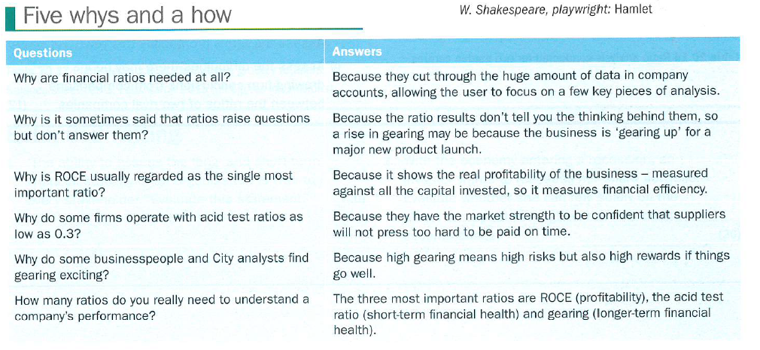

Slide 28
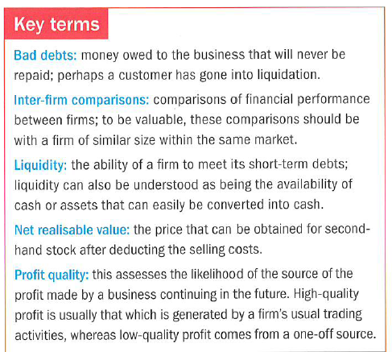

Slide 29



The Limitations Of Ratio Analysis
Differences In Accounting Techniques
Having Sufficient Data
Changes In The
External Environment
It is important to ensure that any comparison is “like-for-like”.
Firms may use different accounting principles
One set of ratio data is of little use on it’s own. In order to be meaningful it requires comparison with
- historical data
- similar firms
When making comparisons any changes in the external environment should be considered (i.e. changes in the economy)

Slide 30
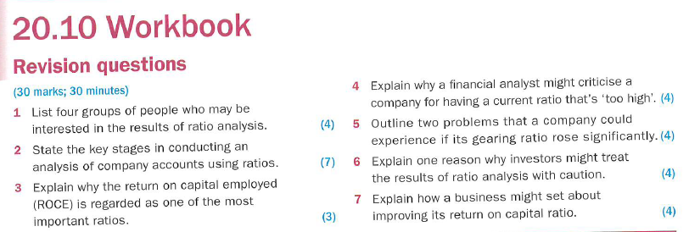

Slide 31
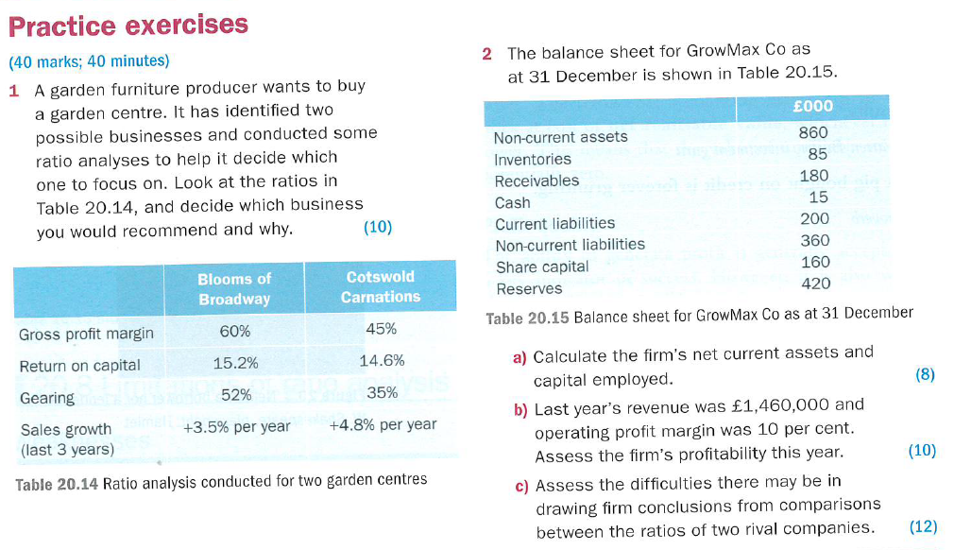

Slide 32
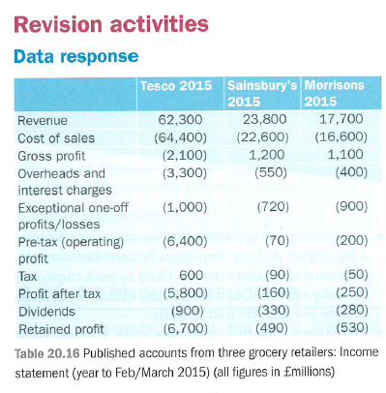
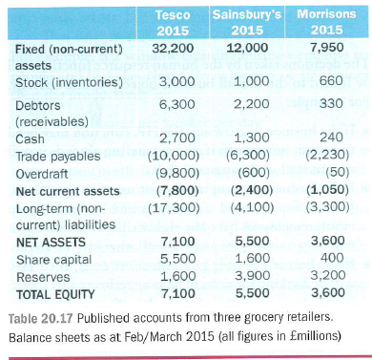
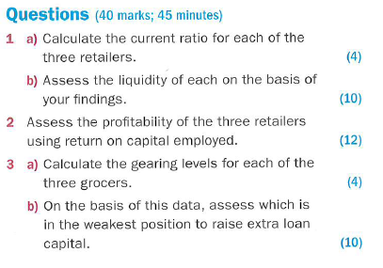

Slide 33
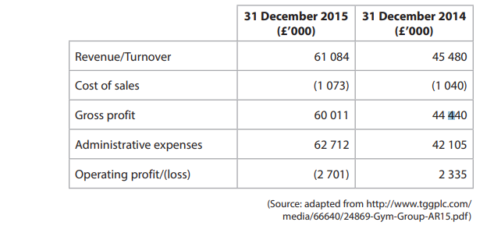
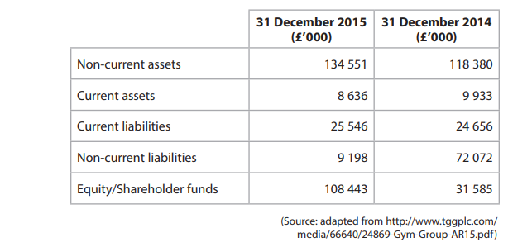

Slide 34
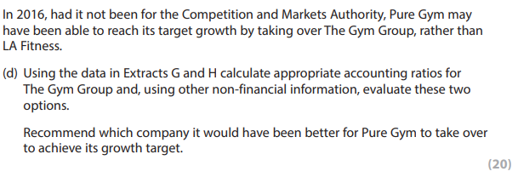

Slide 35
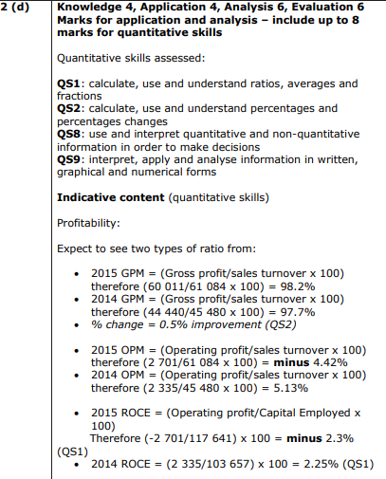

Slide 36
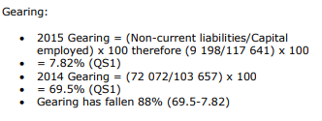

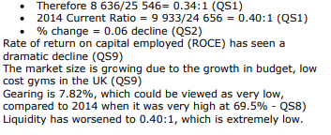

Slide 37
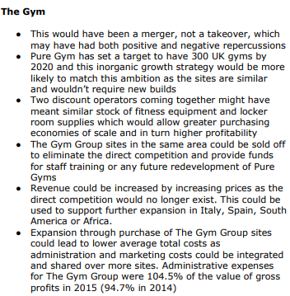

Slide 38
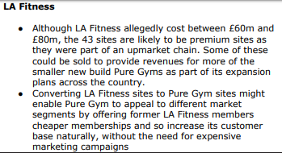
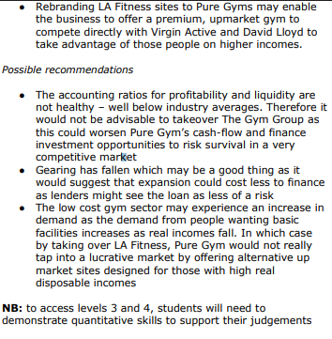

Slide 39
