Slide 1
Motivation
Starter – What motivates you?
Is money your only sources of motivation?
List your top 3 sources of motivation!

Slide 2
Learning Objectives
Know the 3 theories of Maslow, Herzberg and Taylor
Be able to compare and contrast the 3 theories
Understand how financial and non financial methods can help to motivate workers

Slide 3





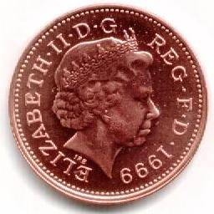
Motivation
MOTIVATION is the reason for doing something
  Businesses will be motivated to meet their objectives
However, motivating workers is not straightforward
  Since workers are motivated by different things:
To Be With Others
For A Sense Of Status
To Earn Money
To Prevent Boredom
To Satisfy Ambition

Slide 4





Why Is Motivation Important?
Motivated workers will…
Demotivated workers will…
  Be loyal – reducing labour turnover costs
  Be enthusiastic and offer ideas
  Arrive early and take few days off
  Work hard – leading to increased productivity
  Better customer service – increasing sales
  Have high rates of absenteeism
  Arrive late
  Produce fewer products
  Produce poor quality products
  Be more careless – so have more accidents
  Be slow to react to requests from management
  Not stay long – creating high staff turnover

Slide 5
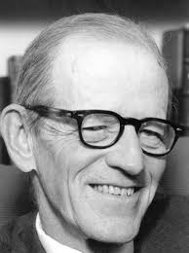
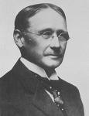


Motivation in Theory
The problem of keeping workers happy has been a problem for businesses for a long time
This has led to a number of people producing theories as to what keeps workers motivated
The main ones are:
Elton Mayo
Hawthorne Experiment
Taylor’s Scientific Management
Maslow's Hierarchy of Needs
Herzberg's Two Factor Theory

Slide 6
Taylor
“In our scheme, we do not ask the initiative of our men. We do not want any initiative. All we want of them is to obey the orders we give them, do what we say, and do it quick”.
F.W. Taylor `The principle of Scientific Management`
Summarise the thinking behind this statement.

Slide 7

Taylor’s Scientific Management
F.W. Taylor (1856-1917) used his “scientific approach” to analyse the efficient management of workers
He carried out his scientific management technique as shown:
Taylor therefore believed that workers were motivated solely by money
  He promoted the idea of “A fair day’s pay for a fair day’s work”
Scientific Management:
  Select workers to perform a task
  Observe them, and noting the key elements
  Record the time taken to do each part of the task
  Identify the quickest method
  Train all workers to use the quickest way
  Supervise workers to
  ensure they use this
  method
  Pay workers on
  the basis of
  results

Slide 8

Are Taylor’s Ideas Valid?
Many of Taylor’s ideas were originally adopted by businesses
  Henry Ford being the most famous!
However, his ideas became less popular after the 1960’s for a number of reasons:
  Not all workers are there for the money!
    He ignored the social needs of workers
  His “best-method” ideas would not suit all workers or all industries
    Not all workers are the same, yet Taylor assumes they are
  His approach treats workers like machines
    So staff become bored
  The piece-rate system of payment is not always appropriate
    It can lead to problems with quality

Slide 9
Maslow
`Direction and control are of limited value in motivating people whose important needs are social and egotistic`.
Summarise the thinking behind this statement.

Slide 10
Maslow’s Hierarchy of Needs
Self Realisation
(fulfilment)
Self-Esteem
(strength, self respect, confidence, status)
Social Needs (belonging, friendship, contact)
Safety Needs (security, physical safety)
Physiological Needs (food, shelter, warmth)
Maslow (1908 – 1970) believed that the reason people go to work changes
He created a hierarchy
  Which he believed people would work up
Describe the business implications of this hierarchy of needs.

Slide 11
Maslow’s levels of human need | Business implications
Physical needs, e.g. food, shelter and warmth | Pay levels and working conditions
Safety Needs, (security, physical safety, freedom form anxiety) | Job security, a clear job role/description, clear lines of accountability (only one boss)
Social Needs, (belonging, friendship, contact) | Team working, communications, social facilities
Self-Esteem, (strength, self respect, confidence, status) | Status, recognition for achievement, power, trust
Self Realisation, (self-fulfilment; `to become everything that one is capable of becoming`, - Maslow) | Scope to develop new skills and meet new challenges, and to develop one’s full potential

Slide 12

Problems of Maslow’s Approach
Maslow was primarily studying human behaviour
  So he was not concentrating on the effect on businesses
In practice there are a number of problems with Maslow’s approach:
  Some levels of the hierarchy do not exist for everyone
    Some may achieve higher levels before achieving lower ones
  Some rewards fit into more than one level
    E.g. money
  Self-actualisation is never
  permanently achieved
    Since people will change their goals
  It can be difficult to recognise which
  level an individual is on

Slide 13



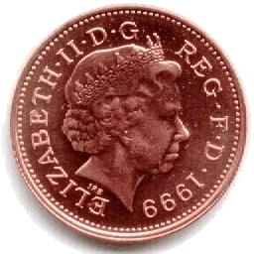
Herzberg’s Two Factor Theory
Frederick Herzberg (1923-2000) asked 200 workers what motivated them
From this he developed his Two-Factor Theory
  He identified 2 things that would affect worker performance:
    Motivation Factors
      Incentives which encourage staff to work harder
    Hygiene Factors
      Things that need to be in place to prevent demotivation
What motivates you to come to work?
Rubbish daytime TV
Motivation Factors
Hygiene Factors
Include things such as:
Include things such as:
Promotion opportunities
Recognition
Satisfactory levels of pay
Good working conditions

Slide 14
Herzberg two factor theory
Motivators (can create positive satisfaction) | Hygiene factors(can create job dissatisfaction)
Achievement | Company policy and administration (the rules, paperwork and red tape)
Recognition for achievement | Supervision (especially being over-supervised)
Meaningful, interesting work | Pay
Responsibility | Interpersonal relations (with supervisors, peers, or even customers)
Advancement (psychological, not just for a promotion) | Working conditions
To what extent do you agree with the categorisations above?.
`Motivators and hygiene factors are equally importa, but for different reasons`. F Herzberg

Slide 15
Herzberg - movement and motivation
Movement occurs when somebody does something.
Motivation is when they want to do something.
He accepted that financial incentives `bribes` could be used to boost productivity, but would never fully stimulate people to give of their best. People would do just enough to achieve the bonus.
Incentivising people to work harder at a task they found unsatisfying would build up resentment, which could backfire on the employer in the long run.
Piece rate would achieve movement but, by reinforcing worker behaviour, would make them inflexible and resistant to change.

Slide 16
Job enrichment
Herzberg was popular with businesses because he also came up with solutions for improving motivation.
Job enrichment `giving people the opportunity to use their ability`. For a job to be enriched it needed:
  A complete unit of work - contradicts Taylor’s division of labour
  Direct feedback - enable the worker to judge whether they have done a good job – no need for quality inspection by a supervisor or annual appraisal (too long to wait)
  Direct communication - communicate directly - not via a supervisor. `In industry there’s too much communication. And of course it’s passive .. But if people are doing idiot jobs they really don’t give a damn` F Herzberg

Slide 17
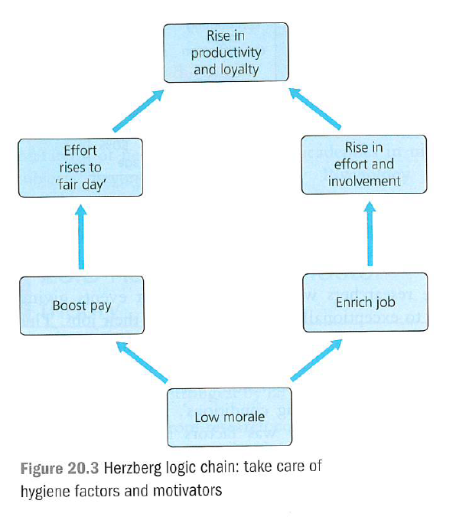

Slide 18

The Implications of Herzberg
Herzberg’s ideas are linked to job enrichment
  This means that workers are motivated by:
    Being involved in the production of a complete unit
    Receiving feedback on their performance
    Being given a range of different tasks to complete
  However improvements in hygiene factors will not motivate workers
However there are a number of issues
with Herzberg’s ideas:
  Providing job enrichment can be very expensive
  He only used a very small sample
    So statistically it may be unreliable
    Indeed other surveys have obtained very
    different results

Slide 19
Elton Mayo – Hawthorne Experiment
Mayo believed that workers are not just concerned with money but could be better motivated by having their social needs met whilst at work (something that Taylor ignored).
Mayo introduced the Human Relations School of thought, which focused on managers taking more of an interest in the workers, treating them as people who have worthwhile opinions and realising that workers enjoy interacting together.

Slide 20
Mayo’s conclusions
The women gained satisfaction from the freedom and control over their working environment.
Six women became a team and the team gave itself wholeheartedly and spontaneously to co-operation.
Group norms (expectation so one another) are crucial and may be influenced more by informal than official group leaders.
Communication between workers and managers influences morale and output.
Workers are affected by the degree of interest shown in them by their managers; the influence of this upon motivation is known as `the Hawthorne effect`.

Slide 21
Elton Mayo (1930’s-1950’s) – Human Relations School
Mayo concluded that workers are best motivated by:
Better communication between managers and workers
Greater manager involvement in employees working lives
Working in groups or teams
His theory most closely fits in with a paternalistic style of management.

Slide 22
Key summary for Mayo:
Workers motivated by having social needs met
Workers should work in teams
Managers should have greater involvement in employee's working life
More two-way communication between managers and workers

Slide 23
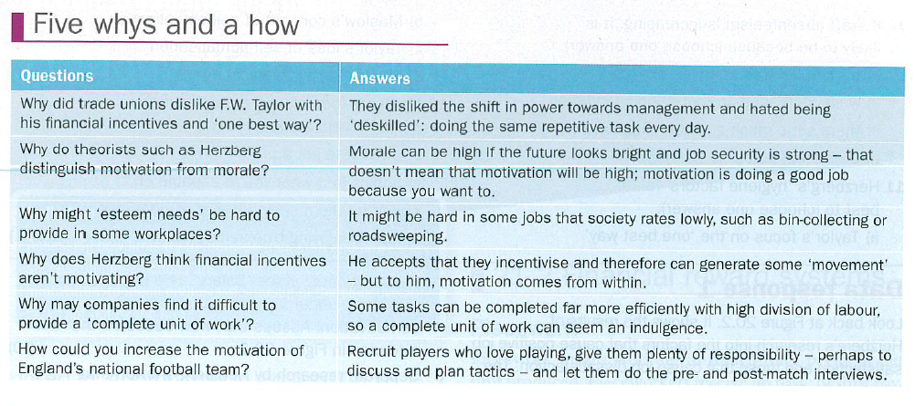

Slide 24
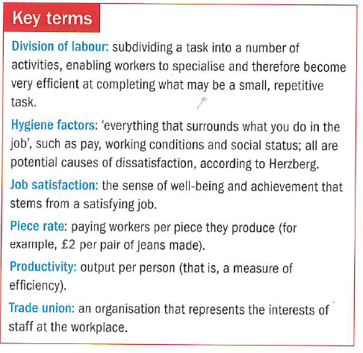

Slide 25
REVIEW QUESTIONS
Which features of the organisation of a McDonald’s could be described as Taylorite?
Explain the meaning of the term `economic man`
Explain how workers in a bakery may be affected by a change from salary to piece rate
Which two levels of Maslow's hierarchy could be called `lower order needs`?
Describe in your own words why maslow organised the needs into a hierarchy
State three business implications of Maslow’s work on human needs
Herzberg believes pay does not motivate, but is important. Why?
How do motivators differ from hygiene factors?
What is job enrichment? How is it achieved?

Slide 26
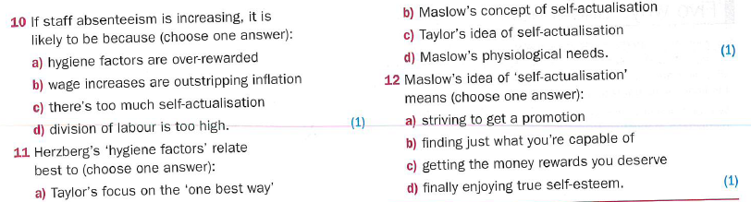

Slide 27
Extended writing
Followers of F.W. Taylor and Professor Herzberg each set about increasing the motivation of teachers. Evaluate which would be most successful. (20 marks)

Slide 28
