Slide 1



The BIG Idea
3.2.3 Organic growth
Think about…
a) Distinction between inorganic and organic growth
b) Methods of growing organically
c) Advantages and disadvantages of organic growth
Notes:
Students identify key words to underline

Slide 2
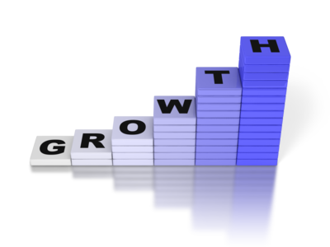




Definition
Organic growth comes from within the business, either form rising customer demand, or from the company launching successful new products or outlets
Employing More People
Opening More Branches
Increasing Sales
Increasing Profit

Slide 3
Organic (or internal) growth involves expansion from within a business, for example by expanding the product range, or number of business units and location.
Organic growth builds on the business’ own capabilities and resources. For most businesses, this is the only expansion method used.
Organic growth involves strategies such as:
- Developing new product ranges
- Launching existing products directly into new international markets (e.g. exporting)
- Opening new business locations – either in the domestic market or overseas
- Investing in additional production capacity or new technology to allow increased output and sales volumes

Slide 4
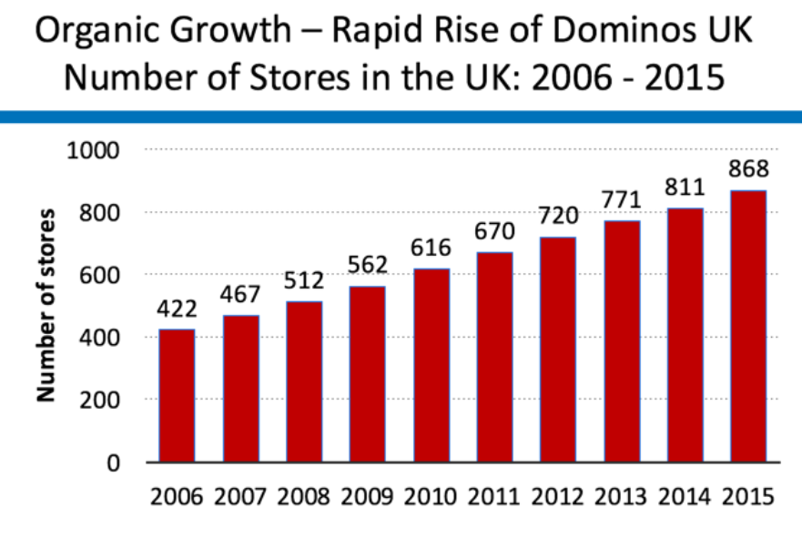
Examples of successful organic growth

Slide 5
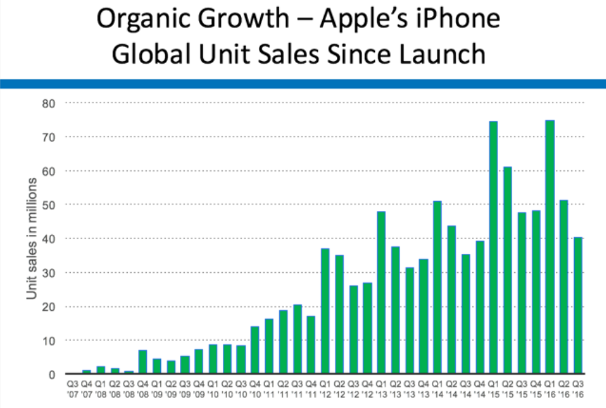

Slide 6
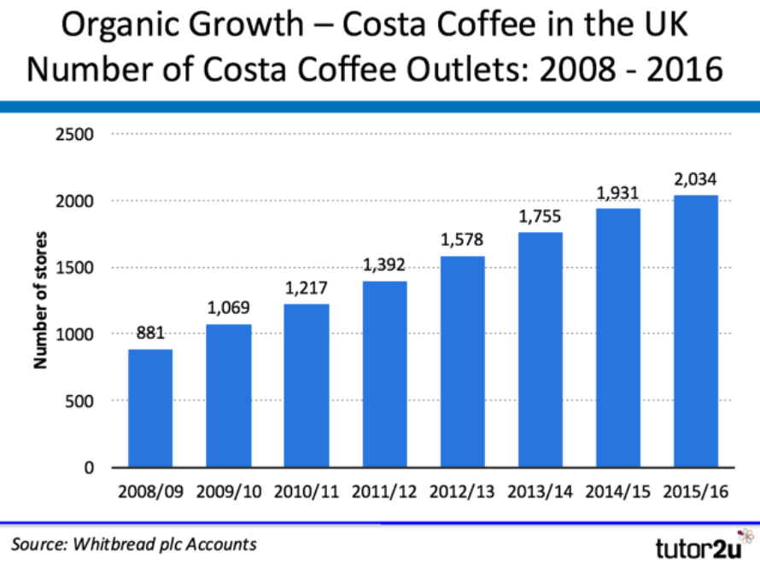

Slide 7
Benefits and Drawbacks of Organic Growth
Benefits:
Less risk than external growth (e.g. takeovers)
Can be financed through internal funds (e.g. retained profits)
Builds on a business’ strengths (e.g. brands, customers)
Allows the business to grow at a more sensible rate
Drawbacks:
Growth achieved may be dependent on the growth of the overall market
Hard to build market share if business is already a leader
Slow growth – shareholders may prefer more rapid growth
Franchises (if used) can be hard to manage effectively
Lack of scale economies can be a disadvantage
Products with short product life cycles – organic growth may mean that a business is too slow to seize the opportunity before it reaches the mature phase.

Slide 8
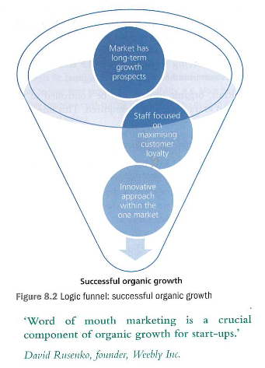

Slide 9
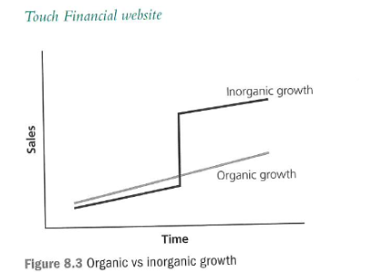

Slide 10
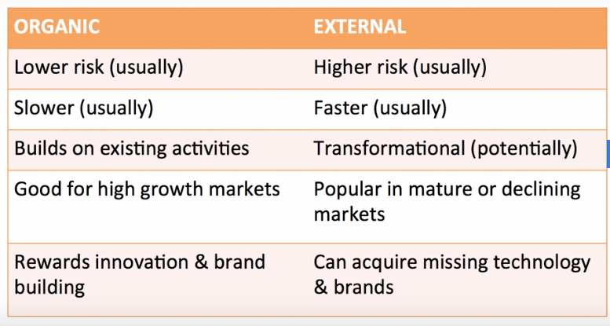

Slide 11
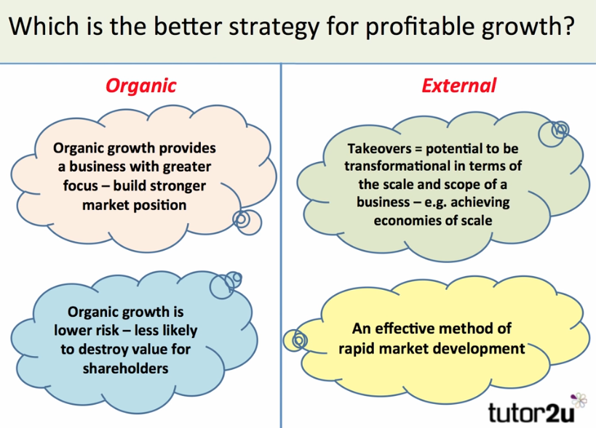

Slide 12
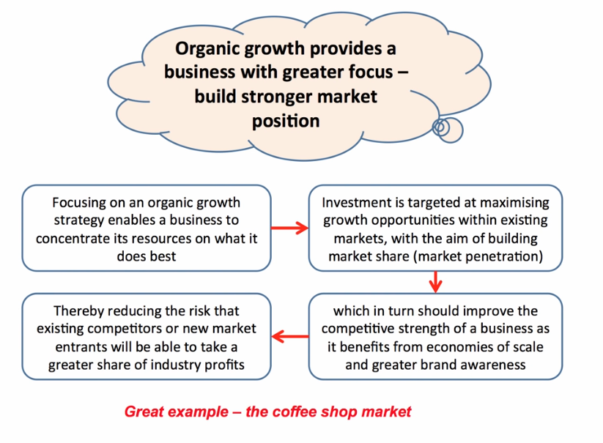

Slide 13
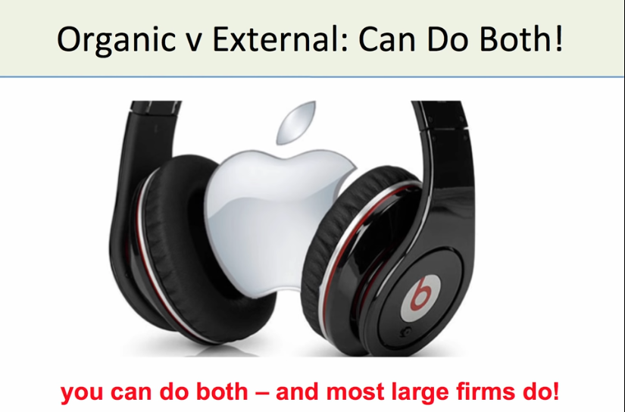

Slide 14
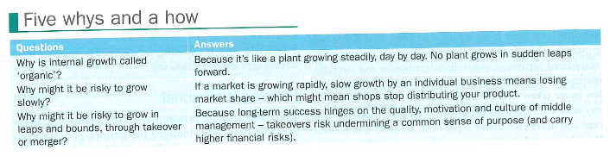
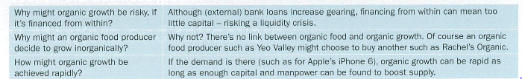
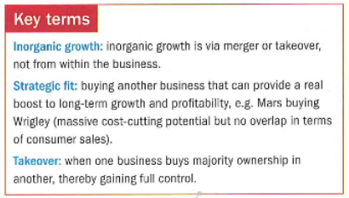

Slide 15
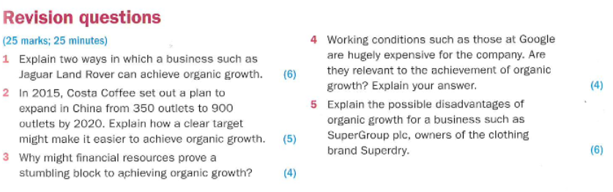

Slide 16
