Slide 1
1.4.2 Recruitment, selection and training
a) Recruitment and selection process: o internal versus external recruitment
b) Costs of recruitment, selection and training
c) Types of training:
  o induction
  o on-the-job
  o off-the-job

Slide 2
Definition
Recruitment (and selection) means filling job vacancies by defining the job, attracting suitable candidates and selecting those best suited to fill it. Training means work-related education, where employees learn new skills or develop the skills they already possess.

Slide 3



The Recruitment Process
There are a number of stages involved in recruiting staff:
Identify Vacancy
Make Job Offer
Write Job Description
Select Best Candidate
Write Person Specification
Interview
Advertise The Job
Shortlist Candidates
Send Out Application Forms
Receive Applications
  At some point references will be taken – but the timing of this can vary

Slide 4

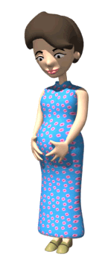

Identifying a Vacancy
Businesses should know how many staff are required to operate efficiently
  They may need to recruit new workers for a number of reasons:
Increased
Sales
Some Staff
Leave
Staff get
promoted
Staff have
temporary
absence

Slide 5
Job Description
This document is written by the employer
It should contain:
  Title of job
  Responsibilities
  Place in the hierarchy
    Who you report to
    Who you are responsible for
  Working conditions
    Pay
    Hours
    Location
Will be used to appraise
performance
Sample Job Description
Job Title | Credit Control Clerk
Accountable to: | Accounts Manager
Location | Accounts Department at Head Office
Duties and Responsibilities | Maintain and Monitor 150 Credit Accounts Liaison with the debt collection agency Attendance at County Court
Hours of Work | 37.5 hours per week (Overtime as required)
Rates of Pay | £19,500 PA

Slide 6
Person Specification
Explain why the Job description is produced before the person specification.
This document is written by the employer
It should contain a profile of the personal qualities required including:
  Educational Qualifications
  Professional Qualifications
  Previous Experience
  General skills
    IT skills
    Driving Licence
When writing these it is important that they do not DISCRIMINATE against certain people
Sample Person Specification
Criteria | Essential | Desirable
Skills and Abilities | Keyboard Skills | Working knowledge of fax machines and photocopiers
Knowledge | Knowledge of MS Windows | Knowledge of MS Office Packages
Qualification, Education and Training | Four GCSEs at C or above | GCSE to include English and Maths
Experience | Familiar with office environment | One years office experience
Other Requirements | Punctual | Well motivated

Slide 7



Recruiting Internally
By Law ALL jobs must be advertised
However, this can be done within the business
Advantages
Disadvantages
Cheaper than External Methods
Fresh ideas are not brought into the company
The candidate knows the Business and how it operates, so does not need induction training
Other employees may feel resentful, which could create problems – especially when a former colleague becomes a boss!
It motivates employees as they can see opportunities for job progression

Slide 8
Recruiting Externally
Jobs are often advertised outside the business
Advantages
Disadvantages
Brings in fresh and new ideas that may drive the company forward, or give it a greater competitive edge
It is an expensive process
De-motivates workers as they feel there is lack of promotion opportunity within the organisation
Attracts many more candidates than internal methods, thus may find a better person for the job

Slide 9
Advertising the Job
Outline a situation in which each of the following places would be used to advertise a vacancy.
Vacancies can be advertised in a number of places:
The method chosen will depend on the candidate desired
Job Centres
Internally
(Via notice Boards and Journals)
Local
Newspapers
The Internet
Advertising the Job
Firm’s own website
National Newspapers
Local Shop
Window
Exexutive search consultants

Slide 10




Interviews
What does a typical job interview look like in a secondary school?
How might it differ for different levels of seniority?
These are normally conducted by one of these three methods:
One Person Interview
Two Day Interview
Group Interview
Where candidates are interviewed by more than 1 person
Senior roles may involve interviews lasting more than a day
This involves candidates being interviewed individually
When on interview you may be required to complete:
Tests
Role Play
Group Activities
Used to assess
  Aptitude
  IQ Tests
  Psychometrics
Often used to find out how people react in certain situations
Useful when staff need to work with customers
Used to assess
  Teamwork skills
  Listening skills
  Reactions when under pressure

Slide 11
Testing and profiling
Aptitude tests measures the level of ability of a candidate such as, for example, ICT skills.
Psychometric profiling examines personality and attitudes – for example, whether the candidate works well under pressure or is an effective team player
Firm’s may wan to employ a balanced mix of different personality types

Slide 12
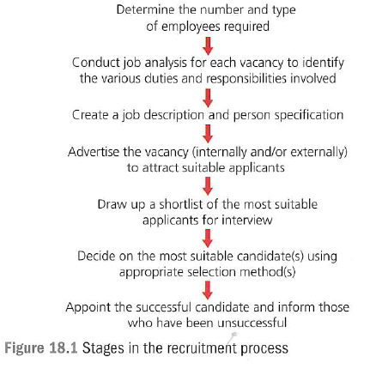
Assessment centres
Allow for in depth assessment of a candidate’s suitability by subjecting them to role plays and simulations over a number of days.

Slide 13

Make Job Offer
A candidate may be appointed on condition of
    Suitable references being obtained
    A medical examination
    Completion of a probationary period
A Contract of Employment should be issued
  This is a legal document which contains
    Legal name of Employer
    Address of Employment
    Legal name of Employee
    Date Employment began
    Employees Pay
    Hours of Work
    Holiday Entitlement
    Job Title

Slide 14
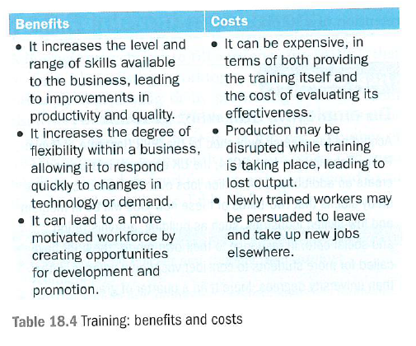
Training

Slide 15

Training
Once recruited staff may need to be trained
  Training should be an ongoing process for ALL workers
Training is expensive, so it is important that it is:
  Planned
    To meet the needs of the workers
  Interesting
    Otherwise staff will switch off
  Reviewed
    To improve for the future
Updating Skills
Multi-Skilling
Motivation
Upgrading Skills
Necessary where new techniques or machinery are used
To provide a more flexible workforce who can do more than one job
Training helps employees feel valued which should motivate them
Staff may be trained to develop their skills – e.g for future promotion

Slide 16
Induction
Training aimed at introducing new employees to a business and its procedures.
Describe why induction training is provided and what problems can it help to overcome?

Slide 17
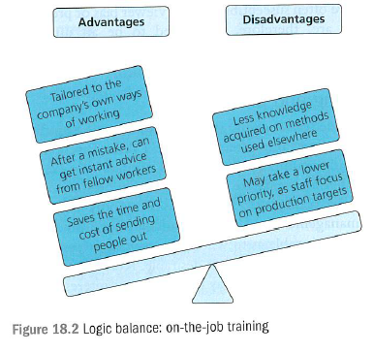
On the job training
Employees are not required to leave the workplace and receive instruction while carrying out the job

Slide 18
Off the job training
Employees leave the workplace in order to receive instruction.
It could be provided by an external training provider or at a company owned training facility.

Slide 19
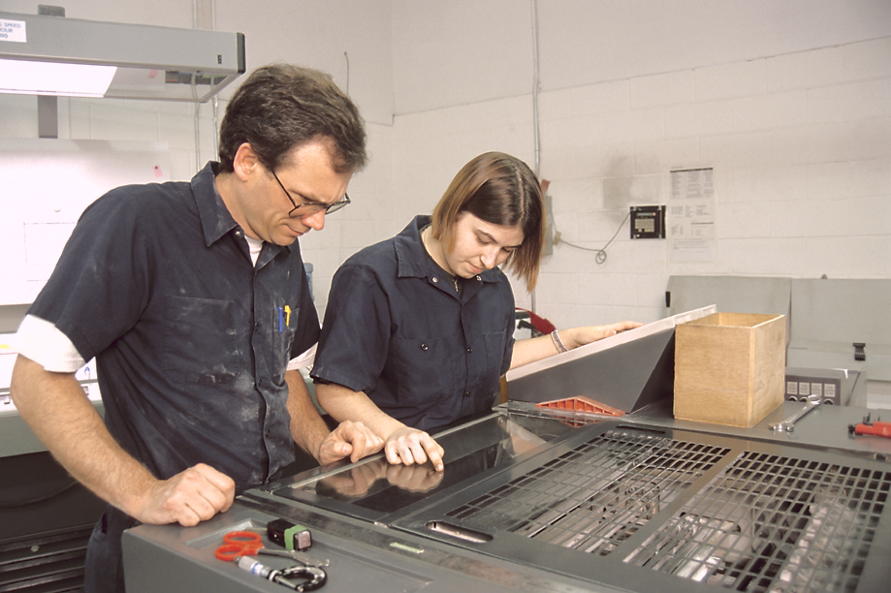

Types Of Training
How would a new till operator be trained? Explain your selection.
Outline the arguments for and against initial teacher training being conducted in schools or via university
There are two ways in which training can be carried out:
On-The-Job
Off-The-Job
Where training takes place at the usual place of work
Training may use:
  Observation
    Watching someone else
  Mentoring
    Working alongside experienced staff
  Coaching
    Setting objectives and then providing assistance to meet them
Where the worker is not doing their usual job
It can be delivered:
  Internally using the firm’s own staff
    Often at training centres
  Externally by specialists
    Often at a college

Slide 20
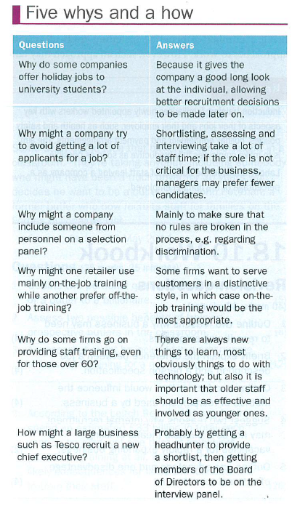

Slide 21
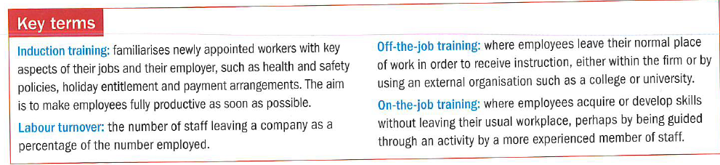
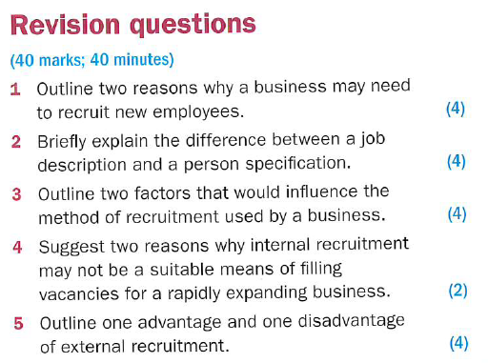
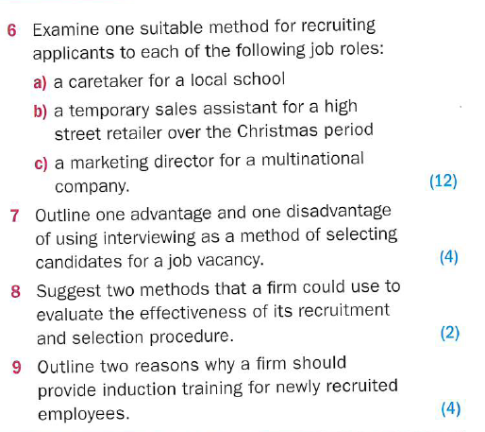

Slide 22
