Slide 1
Marketing strategy
Marketing strategies appropriate for different types of market:
mass markets
niche markets
business to business (B2B) and business to consumer (B2C) marketing
Consumer behaviour – how businesses develop customer loyalty

Slide 2
Marketing strategy
Definition – marketing strategy is a carefully evaluated plan for future marketing activity that balances company objectives, available resources and market opportunities. It is implemented through the marketing mix.

Slide 3
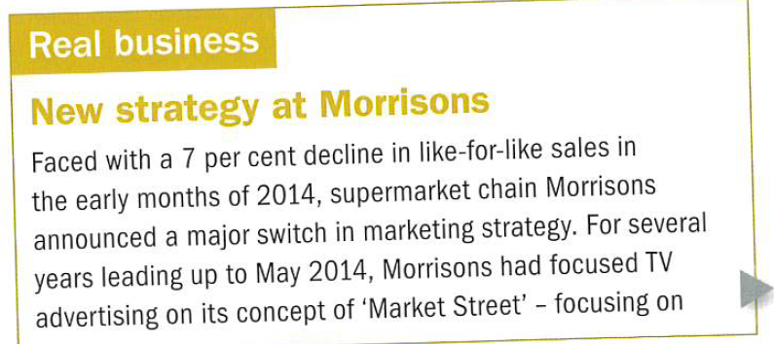
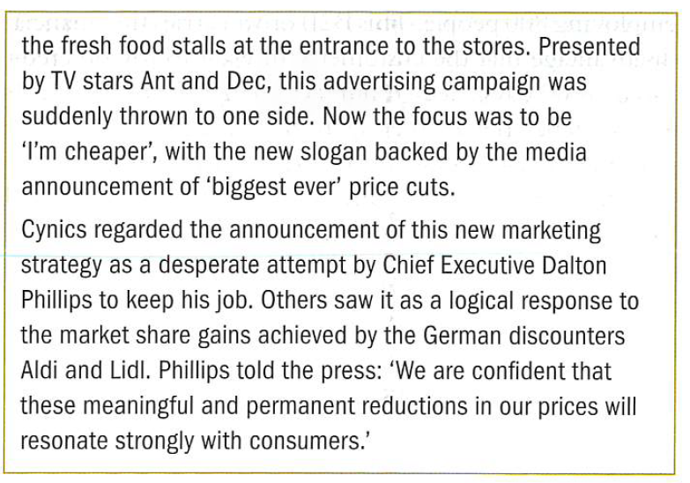
Why have Morrisons adopted
this new marketing strategy?

Slide 4


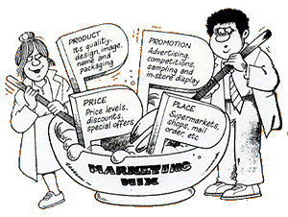
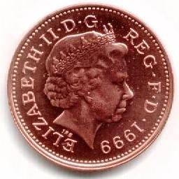
Forming A Marketing Strategy
A marketing strategy designed to achieve the marketing objectives can now be developed
The marketing strategy should consider:
The Target Market
The Marketing Mix
The Strengths Of The Business

Slide 5

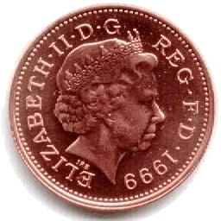
Mass Vs Niche Marketing
I’m in a
I’m in a
Mass
Market
Niche
Market
Targets a very
small segment
of a market
  E.g.
    Local restaurants
Sales will be
lower, but prices
will be higher
Appeals to the whole market
  E.g.
    Pepsi
It requires high sales volumes and low prices

Slide 6
Marketing strategy for mass markets
If a brand succeeds in a mass market, it can enjoy:
  Distribution levels of close to 100% ( all shops want to stock your product)
  Control over advertising and promotion (retailers cannot force the market leader's hand)
  A degree of control over pricing, though it can never get too greedy – because it is the mass market

Slide 7




Advantages & Disadvantages of Operating in a Mass Market
Operating in a mass market has a number of advantages and disadvantages:
Advantages
Disadvantages
Able to benefit from Economies of Scale
Increased competition
Less risky – since business is not dependent upon one small segment of a market
Difficult to appeal to individual consumers
Sales revenues are usually higher
Fixed capital costs are usually high – due to the need for large factories and expensive machinery

Slide 8
Marketing strategy for niche markets
Marketing within niche markets needs a patient approach. Customers within niche markets are often experts on the product category and can be very choosy. A lot of effort is needed to reinforce the distinctive characteristics of each product.
Ben & Jerry’s combination of quirky flavours and social responsibility has helped to differentiate itself for Haagen Dazs.

Slide 9
Advantages & Disadvantages of Operating in a Niche Market
Operating in a niche market has a number of advantages and disadvantages:
Advantages
Disadvantages
Less competition
Products can be tailor-made to meet the needs of a customer, e.g wedding cakes
There are fewer potential customers!
Profits are likely to be lower whilst prices will be higher
Less likely to be left with out-dated stock since fewer units are produced at a time
If too successful the niche might be targeted by bigger competitors

Slide 10
Marketing strategy for B2C
Every element in the mix should be coordinated towards delivering a marketing strategy that fits with its marketing objectives
Whether it is a product or service the consumer expects a reality that conforms to the image and therefore delivers value for money.
The image is often central to the proposition

Slide 11
Marketing strategy for B2B
B2B means selling to other businesses, be they retail distributors or businesses that have no direct connection with the public, such as a chemical refinery or a sawmill.
Consumers often buy with a lot emotion.
Businesses tend to buy the best product for the best price with the best and most reliable service.
B2B order are often sold on credit (cash flow impact)

Slide 12
B2B and the marketing mix
Goods sold are often perceived to be homogeneous – price will be most important element in the mix.
Manufacturers associated with quality will tend to prioritise product quality in the mix.
Nissan uses lean production methods and want suppliers to deliver on a JIT basis – place will be most important element in the mix.
Supermarkets often require producer/suppliers to fund regular price or `BOGOF` promotions. Promotion will be most important element in the mix.

Slide 13
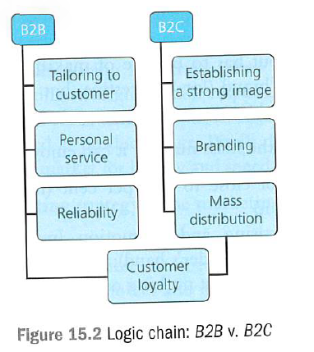
B2B and the marketing mix

Slide 14
Key terms
Homogeneous goods - these have no points of differentiation and therefore each one is the same as every other (making competition focus on price).
Product differentiation – the extent to which consumers perceive your brand as being different from others.

Slide 15
