Slide 1
The BIG Idea
3.1.4 Impact of External Influences
Think about…
The changing competitive environment
Porter’s Five Forces
Notes:
Students identify key words to underline

Slide 2
Who is Martin Shkreli - 'the most hated man in America'?
Video link
He's been called a "morally bankrupt sociopath", a "scumbag" a "garbage monster" and "everything that is wrong with capitalism." And those are some of the tamer comments.
His company recently acquired the rights to Daraprim. Developed in the 1950s, the drug is the best treatment for a relatively rare parasitic infection called toxoplasmosis. People with weakened immune systems, such as Aids patients, have come to rely on the drug, which until recently cost about $13.50 (£8.80) a dose.
But Mr Shkreli announced he was raising the price to $750 a pill. The more than 5,000% increase and his brash defence of the decision has made him a pariah among patients-rights groups, politicians and hundreds of Twitter users.
Describe how the ownership of drug patents can help to strengthen the power of suppliers when selling to customers.

Slide 3
Introduction & Background - the Nature of Industry Competition
Every market or industry is different. Take any selection of industries and you should be able to find differences between them in terms of:
Size (e.g. sales revenue, volumes, numbers of customers)
Structure (e.g. the number of brands and competitors)
Distribution channels (how the product gets from producer to final consumer)
Customer needs and wants (the basis of marketing segmentation)
Growth (the rate of growth and which businesses are growing faster or slower than the market)
Product life cycle (the stage of the life cycle for the industry as a whole and for products and brands within it)
Alternatives for the consumer (e.g. substitute products)

Slide 4
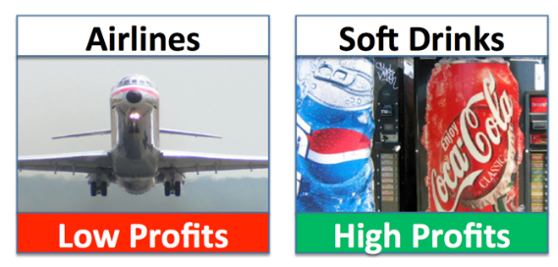

Slide 5
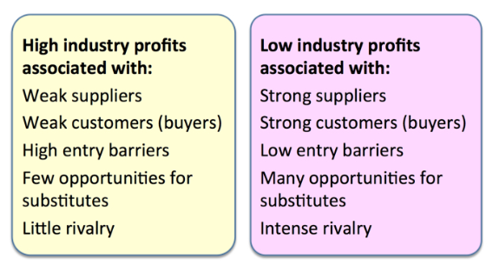
How can each of the factors identified below can help to maintain low levels of profits over time. Provide examples
How can each of the factors identified below can help to maintain high levels of profits over time. Provide examples

Slide 6
Why do airlines make so little profit (and such big losses)? Several factors include:
Very intensive competitor rivalry – mainly on price
Low barriers to entry – lots of new airlines who want to set up
Suppliers of aircraft & equipment are powerful – can charge high margins
Customers have lots of substitute options – e.g. rail, car
High fixed costs – airline losses rise significantly if revenues fall only slightly since it costs roughly the same to fly half-empty planes as full ones

Slide 7
Why are profits so high in the soft drinks market? The answer is mainly that:
Customers and suppliers have little power – Pepsi has many millions of individual consumers, and thousands of retail distributors none of whom has much influence over the business
There is high brand awareness & loyalty = less consumer desire for substitutes
High barriers to entry – how do you enter a market dominated by Coca-Cola and Pepsi?

Slide 8
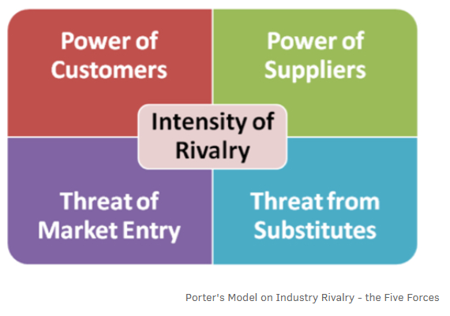

Slide 9
1.Threat of New Entrants
If new entrants move into an industry they will gain market share & rivalry will intensify
The position of existing firms is stronger if there are barriers to entering the market
If barriers to entry are low then the threat of new entrants will be high, and vice versa
Barriers to entry are, therefore, very important in determining the threat of new entrants. An industry can have one or more barriers.

Slide 10
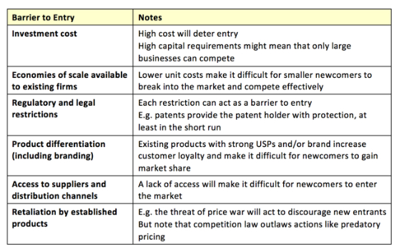
The following are common examples of successful barriers:

Slide 11
What makes an industry easy or difficult to enter?
Explain how each of the above factors to the left combine to make it easier for new entrants to the market.
Explain how each of the above factors to the right, combine to make it more difficult for new entrants to the market.

Slide 12
2. Bargaining Power of Suppliers
If a firm's suppliers have bargaining power they will:
Exercise that power
Sell their products at a higher price
Squeeze industry profits
If the supplier forces up the price paid for inputs, profits will be reduced. It follows that the more powerful the customer (buyer), the lower the price that can be achieved by buying from them.

Slide 13
Suppliers find themselves in a powerful position when:
There are only a few large suppliers
The resource they supply is scarce
The cost of switching to an alternative supplier is high
The product is easy to distinguish and loyal customers are reluctant to switch
The supplier can threaten to integrate vertically
The customer is small and unimportant
There are no or few substitute resources available

Slide 14
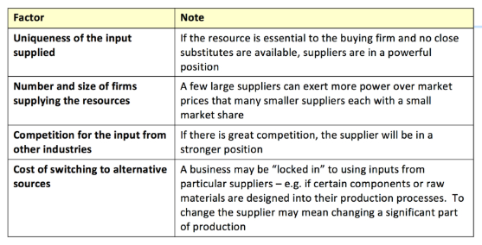
Just how much power the supplier has is determined by factors such as:

Slide 15
3. Bargaining Power of Customers
Powerful customers are able to exert pressure to drive down prices, or increase the required quality for the same price, and therefore reduce profits in an industry.
A great example in the UK currently is the dominant grocery supermarkets which exert great power over supplier firms.
Explain how the relative bargaining power of Tesco and farmers (milk, meat etc) will affect negotiations over prices?
The NHS is a monopsonistic buyer of pharmaceutical drugs in the UK. What is the likely impact on USA pharmaceutical firms when trying to sell products to the UK market?

Slide 16
Several factors determine the bargaining power of customers, including:

Slide 17
4. Threat of Substitute Products
A substitute product can be regarded as something that meets the same need. Substitute products are produced in a different industry – but crucially satisfy the same customer need. If there are many credible substitutes to a firm's product, they will limit the price that can be charged and will reduce industry profits.
The extent of the threat depends upon
The extent to which the price and performance of the substitute can match the industry's product
The willingness of customers to switch
Customer loyalty and switching costs
If there is a threat from a rival product the firm will have to improve the performance of their products by reducing costs and therefore prices and by differentiation.
Do businesses want customers to have lots of substitutes available? Explain your answer.

Slide 18
5. Overall Degree of Competitive Rivalry
If there is intense rivalry in an industry, it will encourage businesses to engage in
Price wars (competitive price reductions),
Investment in innovation & new products
Intensive promotion (sales promotion and higher spending on advertising)
All these activities are likely to increase costs and lower profits.

Slide 19
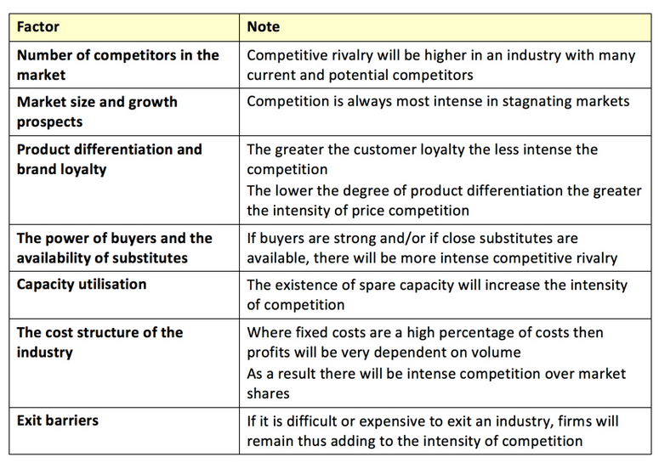
Several factors determine the degree of competitive rivalry; the main ones are:
Explain how each of these factors combine to determine the degree of competitive rivalry.

Slide 20
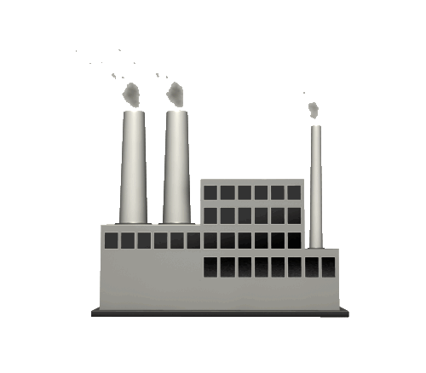
Porter’s Five Forces Model
The Power of Buyers
The Threat of New Competitors
The Threat of Substitutes
Buyers are more powerful when:
There are few of them
Products are standardised
The threat is greater when:
The market is profitable
There are few barriers to entry
The threat is greater when:
Substitution is easy for buyers
The degree of customer loyalty
The Power of Suppliers
The Degree of Rivalry
Suppliers are more powerful when:
There are few of them
Supplies are scarce
Rivalry is likely to be more intense if:
There are a large number of firms
There is little market growth

Slide 21
Strategies To Deal With The 5 Forces
The Power of Buyers
The Threat of New Competitors
The Threat of Substitutes
Try to reduce buyer power through:
Forward integration
Use of long-term tie-in contracts
Create barriers to entry, possibly by:
Patenting products and processes
Promotional activity
Nullify impact of substitutes using:
Reducing costs to reduce prices
Spoiling techniques
Differentiation
The Power of Suppliers
The Degree of Rivalry
Try to reduce supplier power by:
Backward integration
Refrain from being dependent on them
Reduce the direct rivalry by:
Forming “agreements”
Product differentiation

Slide 22
Competition Vs Co-operation
Co-operation is becoming increasingly common within business strategies
Although firms must be careful to operate within competition law
Co-operation can occur between:
Competitors, who may:
Sub-contract
Undertake joint sales, purchasing or marketing
Carry out joint research
Undertake mutually beneficial commercial activities
Buyers and suppliers
E.g. Retailers may develop close working relationships with local suppliers

Slide 23
Changing Strategy
It may become necessary to change the strategy that a business has adopted
There are three common reasons for this:
Political
Legal
Other
Changes in the law may mean that a business has to adopt a different approach to the way things are done
Any political changes, e.g. a new government may lead to a change in the environment that the firm is operating in
There are many other external factors that may lead to change e.g. Changes in technology, the economy, or the market

Slide 24
Strategic Analysis: Michael Porter’s Five Forces UK Short-Break Holiday Industry
Threats of Substitution (Low)
People like to go on holiday!
Stay at home and camp in the garden?
Spend disposable income on some other leisure activity such as joining a golf club or on different priorities such as housing, education or consumer durables
Customer Power (High)
Very easy to switch brands
Market is price sensitive within each segment, but customers have less power during school holidays
Customers can determine market trends (e.g. short breaks to European cities)
Luxury segment is brand conscious
Supplier Power (Low)
Numerous, diluted suppliers
Concession and construction based on finite term contracts
Easy for short-break operators to switch suppliers if they want to because there is limited supplier differentiation
Rivalry of Industry Competitors (Low/Medium)
Consolidated market with few large players
Sustainable competitive advantage through innovation
Threat of New Entrants (Low)
High entry barriers (planning permission) and high entry costs
Long lead times to establish a new holiday village
Importance of economies of scale for large operators

Slide 25
Key terms
Competitive advantage – the factors that enable a business to sustain a profitable position in a competitive market.
Substitutes – rival products such as Galaxy and Cadbury’s Dairy Milk; many customers are happy to substitute one for the other.

Slide 26
Netflix case study - - Porter's Five Forces in action
Link

