Slide 1



The BIG Idea
2.5 External influences
Today we will:
2.5.1 Economic influences
a) The effect on businesses of changes in:
the business cycle
inflation (the rate of inflation, the Consumer Prices Index)
exchange rates (appreciation, depreciation)
interest rates
taxation and government spending
Notes:
Students identify key words to underline

Slide 2
Starter
Define
  GDP
  RPI
  CPI
  ER

Slide 3
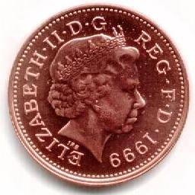
Managing The Economy
The state of the economy has implications for businesses
Governments have a range of economic objectives, which will usually include:
STABLE EXCHANGE RATES
Ensures that the country remains competitive
Economic Objectives
List objectives in order of importance and explain your decision!
Why do we need to prioritise?
ECONOMIC GROWTH
Should be
sustainable
INFLATION
Should be low and stable
UNEMPLOYMENT
Should be as low as possible

Slide 4
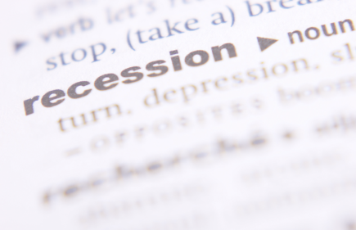
What is Economic Growth?
Economic growth occurs when:
This means that output (business production) is increasing
Output is measured by
An economy produces more products or services in one year than it did in the previous year
G
ross
D
omestic
P
roduct

Slide 5
How Can Economic Growth Be Managed?
There are two tools which can be used to manage the level of economic growth:
INTEREST RATES
GOVERNMENT SPENDING
Show the cost of borrowing money
Higher interest rates mean:
  People borrow less
  People save more
    So spending falls
Lower interest rates have the opposite effect
  So are likely to encourage growth
By spending money the government can create demand
But governments have no money of their own
  So any spending must be financed by:
    Borrowing
    Or higher taxes
  Which can cause problems for businesses

Slide 6
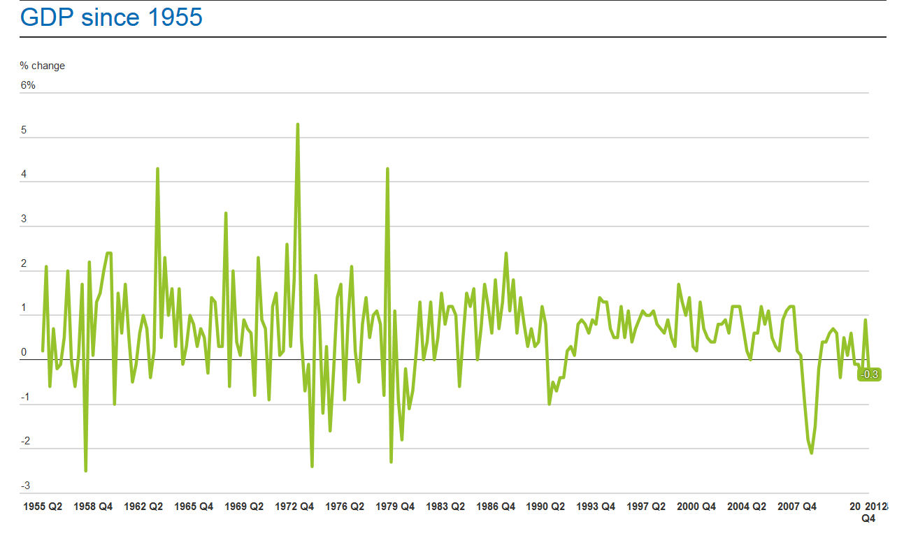
What has been the recent story?

Slide 7
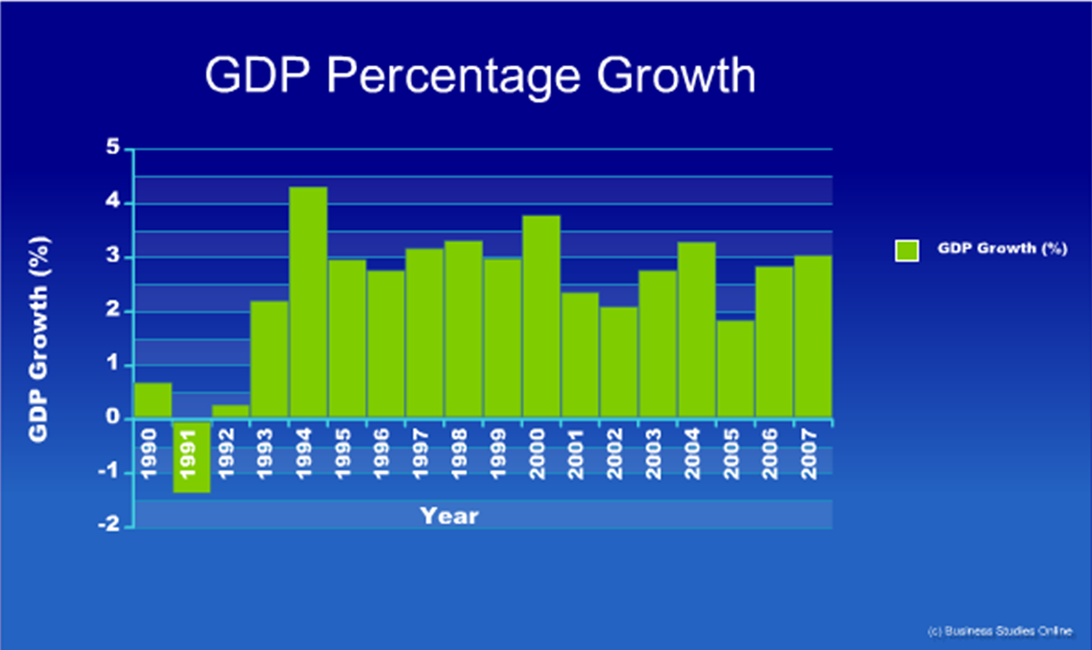
UK Economic Growth
Data Source: www.statistics.gov.uk

Slide 8
Draw a diagram – The Business Cycle
Boom
Economic activity
Recovery
General trend over time
Boom
Recession
Slump
Slump
Time

Slide 9
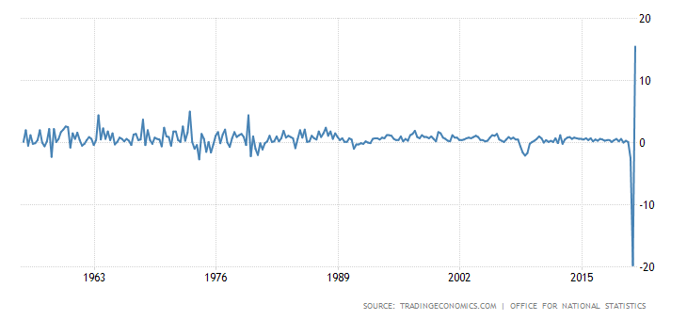
United Kingdom GDP Growth Rate

Slide 10


Economic Growth and Businesses
Most firms benefit if the economy is growing because they experience:
  Increased sales
  Opportunities to expand
  Increased security
BUT
If the economy grows too quickly, spending increases faster than production
This means demand increases faster than supply
This will result in increased prices - or inflation!
Are all businesses equally affected by changes in economic growth?
Tesco's/Pawn brokers/Estate agents
Draw a diagram of Economic cycle and describe what happens at each stage.
Is Economic Growth always desirable?
Consider some of the consequences!!

Slide 11
Unemployment
Unemployment can be defined as:
It can be measured in two ways:
  Claimant Count Measure
    The number of people claiming Jobseekers’ Allowance
  Labour Force Survey
    Large scale sample of employment status of thousands of households
    Unemployed must have actively sought work in the previous four weeks
    This method has become preferred since it is recognised by ILO and allows fair comparisons.
People who are able, available, willing, and actively seeking work, but who are not employed
If people are not working or unemployed, what could be their reasons for being inactive?

Slide 12
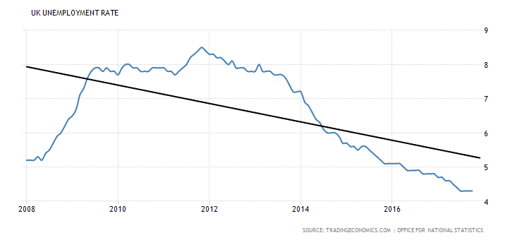
UK Unemployment
Explain the increase in unemployment between 2008 - 2010
Explain the decrease in unemployment between 2012 - 2017
Data Source: www.statistics.gov.uk

Slide 13
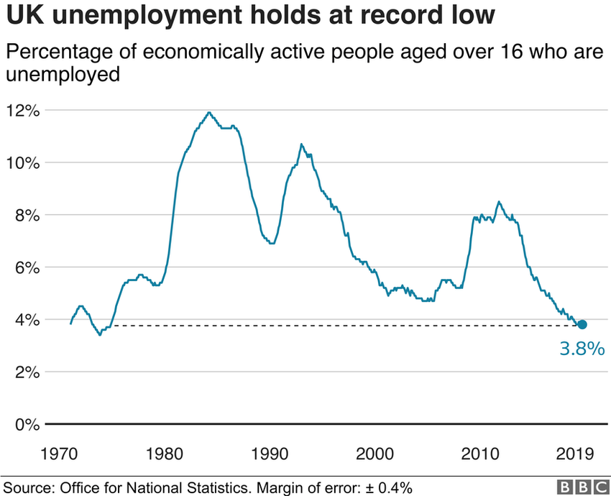

Slide 14
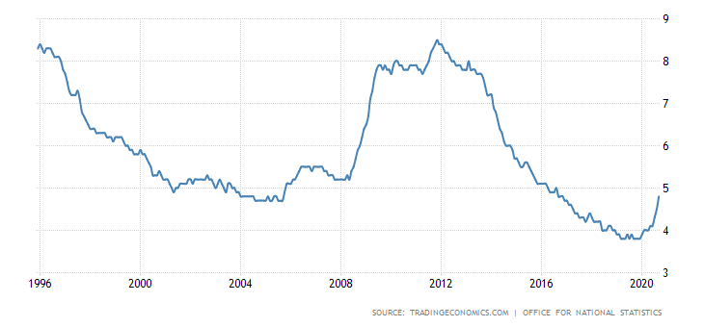
United Kingdom Unemployment Rate
Explain the increase in unemployment between during 2020

Slide 15


The Effects of Unemployment
Unemployment can have good and bad effects on businesses:
Effects of Unemployment
Good
Bad
More people looking for work
Greater choice when recruiting
May be able to pay lower wages
People have less money to spend
So they will buy less (demand will fall)
Profits may fall if lost sales revenue can’t be replaced
What are the main causes of unemployment?
Provide an example for each!

Slide 16
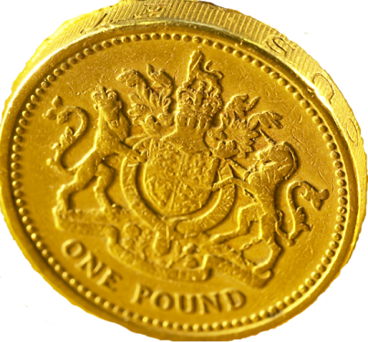
Inflation
Inflation is a general and sustained increase in prices
  In other words its when things get more expensive!
It is quoted as a percentage
  E.g. annual inflation of 5% means that on average:
    Something that cost £1 last year will now cost £1.05
A rise in prices means that people are worse off UNLESS their income increases by the same percentage
So low and stable inflation will help businesses

Slide 17
Measures of Inflation
Consumer Price Index (CPI)
  This was adopted in January 2004 as the official measure of UK inflation
  It is a standardised measure of price inflation used to
  compare the inflation performance of countries inside
  the European Union
Retail Price Index (RPI)
  The traditional measure of UK inflation
  (known as the "Headline Rate“)
  RPIX "Underlying Rate” - Excludes Mortgage Payments
Producer Price Inflation (PPI)
  Also known as factory gate inflation

Slide 18
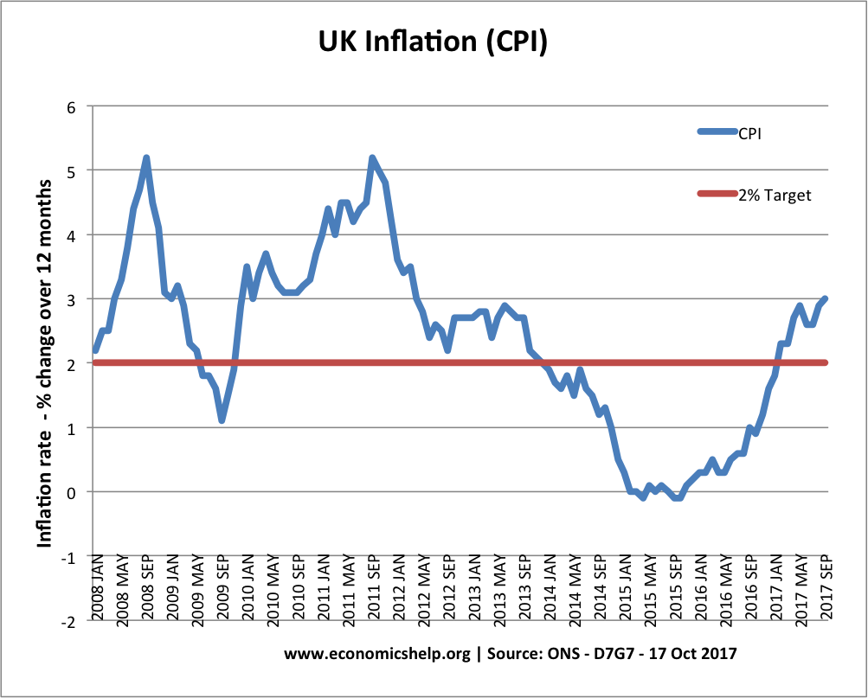

Slide 19
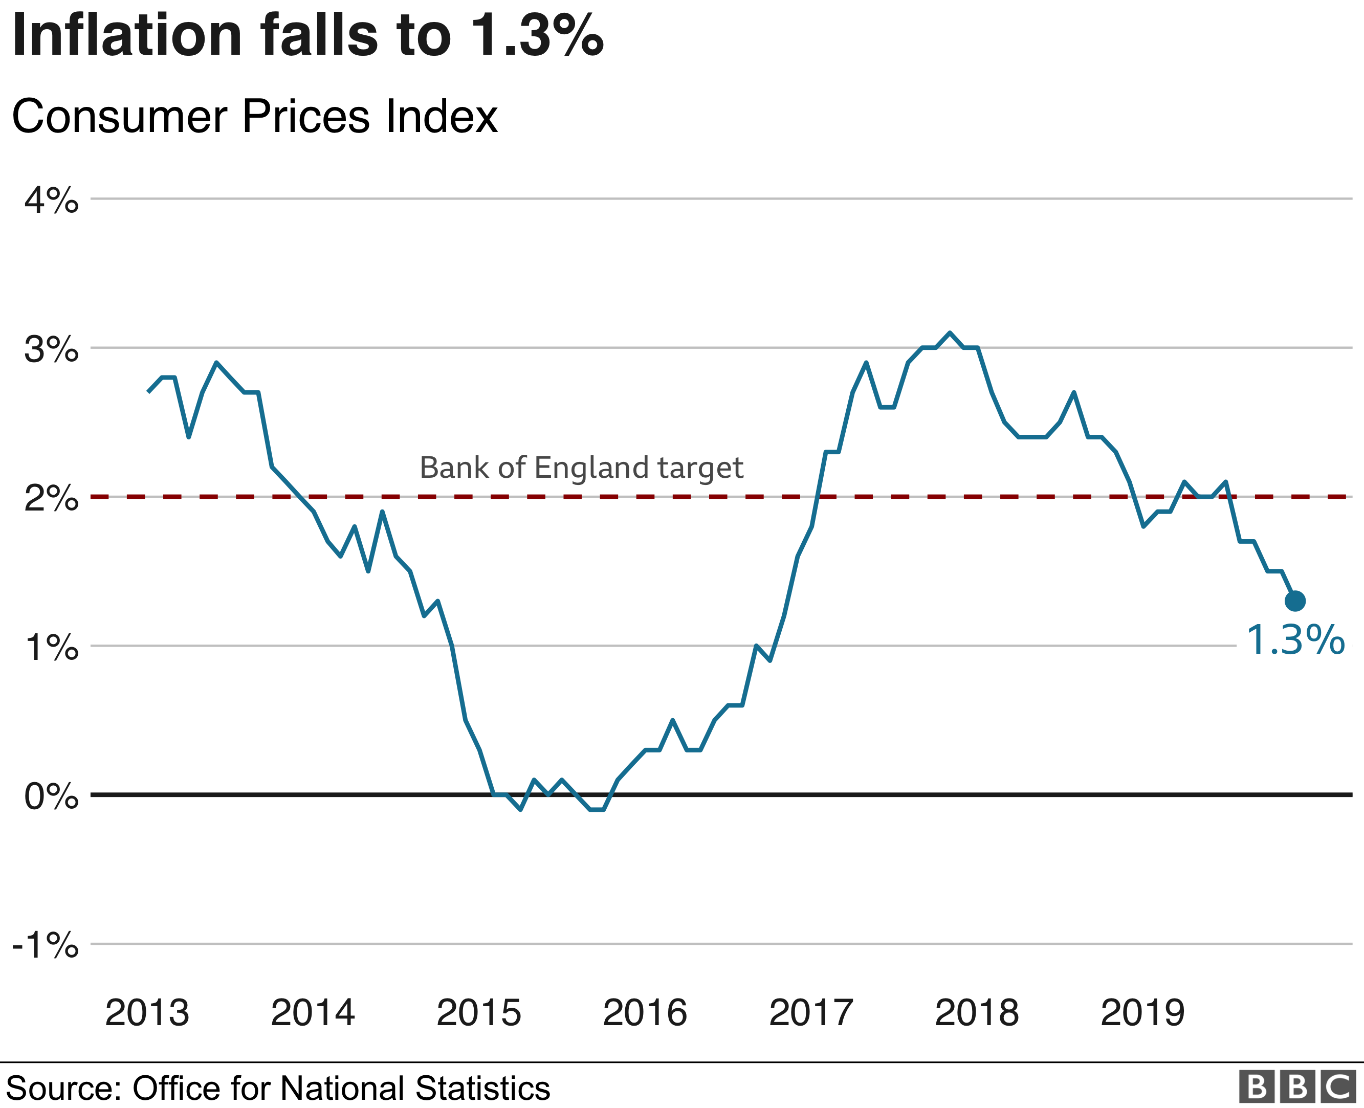

Slide 20
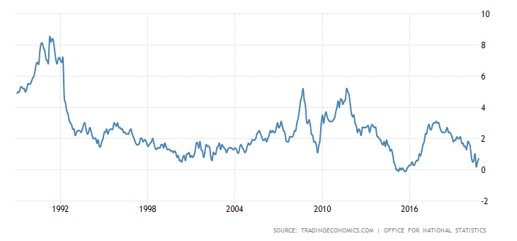
United Kingdom Inflation Rate

Slide 21
The Business Effects of Inflation
There are a number of possible effects that businesses may experience:
  Wage negotiation costs
  Menu costs
  “Shoe leather” costs
  Reduced purchasing power – lower demand
  Unemployment
  Uncertainty – may affect investment decisions
  International competitiveness may decrease
What is the current rate of inflation?

Slide 22

Exchange Rates
The exchange rate is:
E.g. £1 = US $1.6
The most commonly quoted rates are:
  £ / $ (Pound Sterling against US dollar)
  $ / ¥ (US dollar against Japanese Yen)
  £ / € (Pound Sterling against Euro)
  € / ¥ (Euro against Japanese Yen)
The price of one currency expressed in terms of another currency

Slide 23
The Effects of Exchange Rate Changes
Changes in the exchange rate can have very big effects upon businesses:
MADE IN THE UK
MADE IN THE USA
Do you benefit most from a strong (high value of £v$) or weak ER?
Describe the current value of the £ against the Euro and Dollar.
Why does the ER go up and down?
PRICE = £20,000
PRICE = $30,000
Original Exchange Rate
New Exchange Rate
£1 = $1.50
£1 = $2
British car sold in USA for:
$30,000 (£20,000 x 1.5)
British car sold in USA for:
$40,000 (£20,000 x 2)
American car sold in UK for:
£20,000 ($30,000 ÷ 1.5)
American car sold in UK for:
£15,000 ($30,000 ÷ 2)

Slide 24
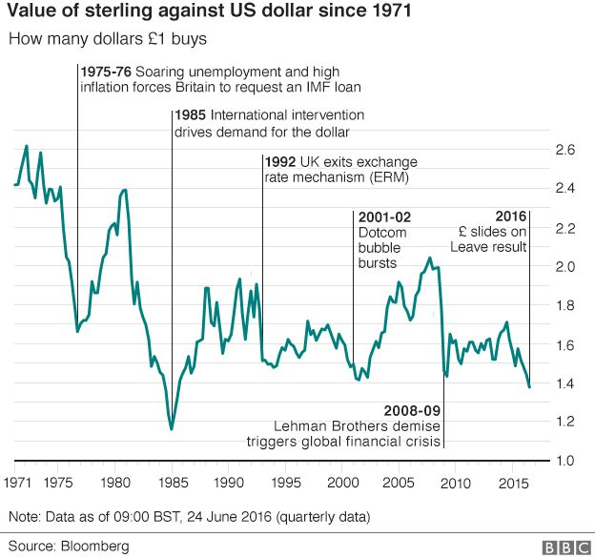
Value of The Pound
Use the chart below to:
Calculate the percentage drop in the value of the £ between 1975-76
Write a summary of the changes to the value of the £ since the 1970’s
% change = absolute change in the ER/original ER * 100
Data Source: www.statistics.gov.uk

Slide 25
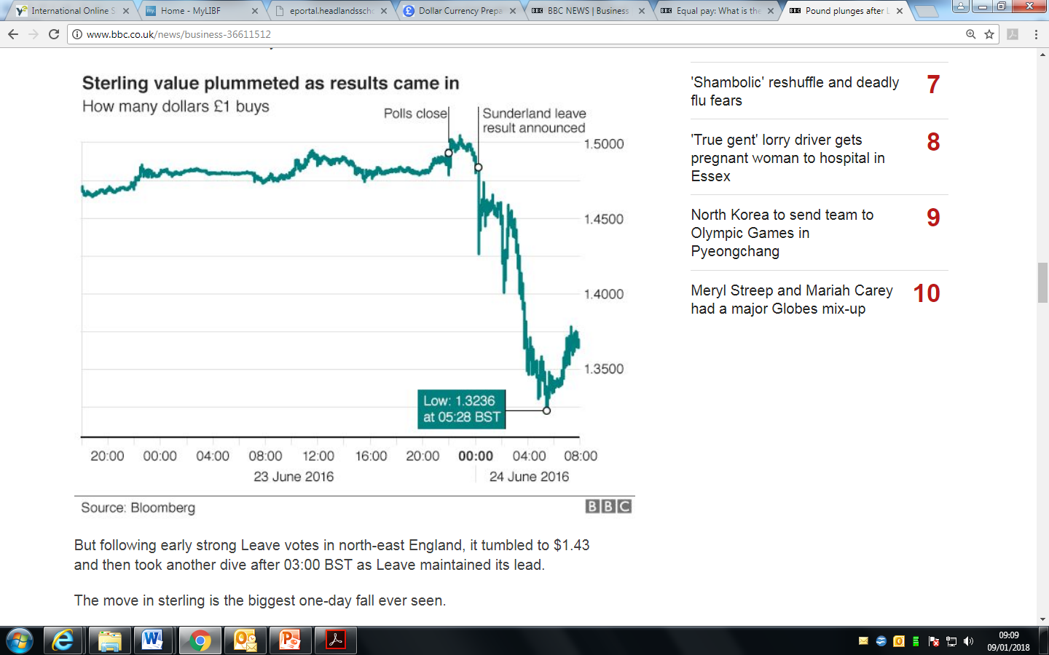
Use the chart below to:
Use the chart above to calculate the % drop in the value of the £ in terms of $.
Watch this video Link and summarise why the £ fell after the Brexit vote

Slide 26
How Exchange Rates Affect Businesses
The effect upon a business depends upon whether they buy from, or sell to, foreign firms
In general:
Increase in Value of the pound
Decrease in Value of the pound
Affect on Imports into the UK
Become cheaper so will increase
Become more expensive so will fall
Affect on Exports out
of the UK
Become more expensive so will fall
Become cheaper so will increase

Slide 27
Jaguar ER calculation
A Jaguar car retails in the UK for £60,000 and has done so for the last year!
The ER currently stands at £1 = $1.6
Six months ago the ER was £1 = $1.5
Calculate the price in dollars for the Jaguar car and then compare your answer with the price of six months ago!
  How do you think sales of this Jaguar in the USA will have been affected?
  Answer the last question again, but consider the fact that the Jaguar has a PED of -0.2! How will your answer change?
  In reality Jaguar will most likely choose to absorb ER movmeents and leave the price alone. Explain why a company like Jaguar would not constantly change the price in dollars, every time the £/$ ER changes!
  Do firms like fluctuating ER’s? How could your answer to this question affect whether the UK should join the Euro?

Slide 28
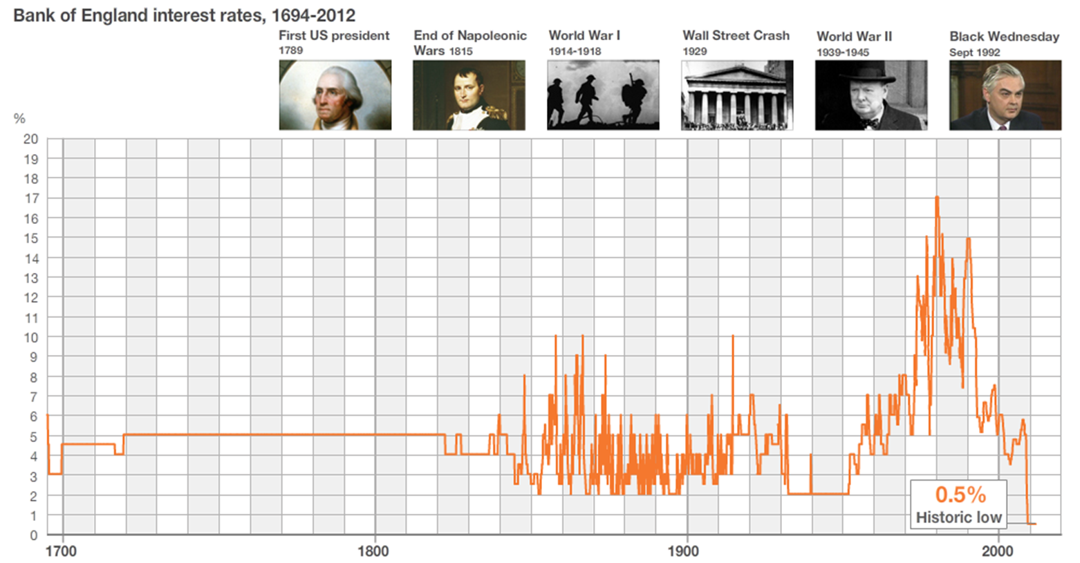
Interest rates over time
Summarise the change in IR’s over time
How do IR’s affect the economy?

Slide 29
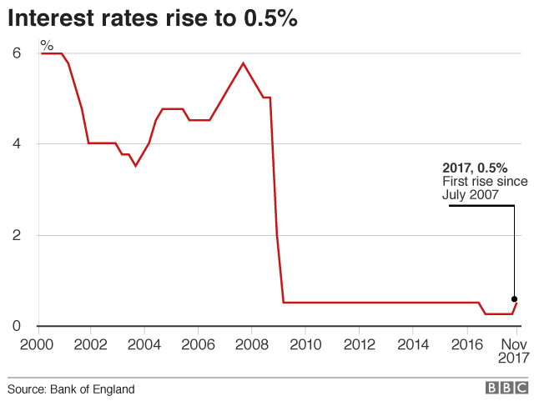
Recent UK IR’s
Explain why UK IR’s have remained so low for so long.
Describe how a return to `normal` interest rates will affect the UK economy.

Slide 30
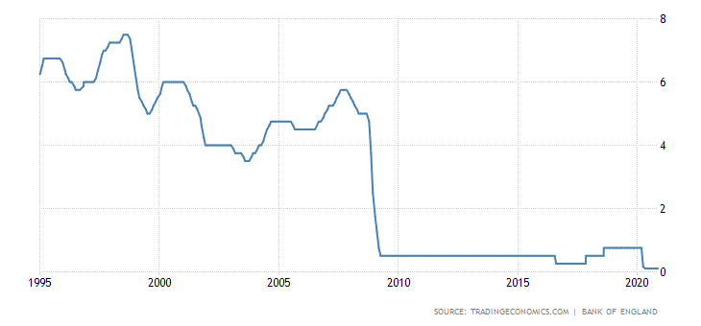
Explain why UK IR’s have fallen to 0.1%.
Describe how a return to `normal` interest rates will affect the UK economy.

Slide 31
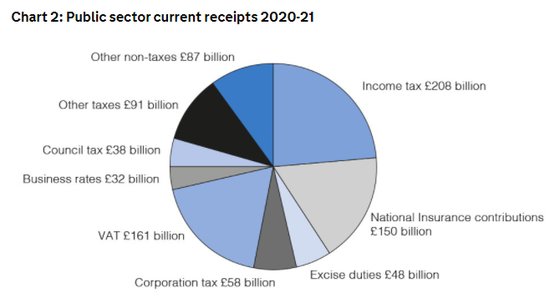

Slide 32
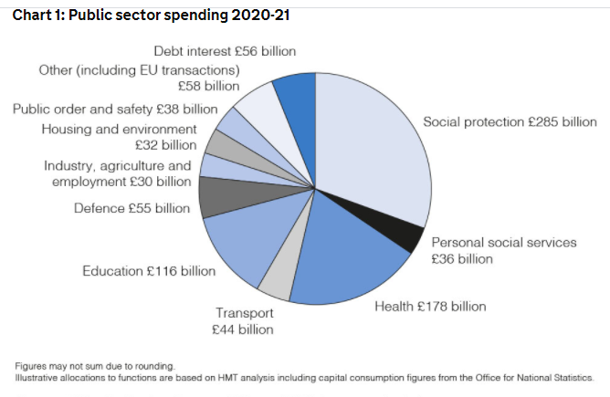

Slide 34
Plenary
Q&A session

