Slide 1



The BIG Idea
3.5.3 Human resources
Today we will:
Calculate and interpret the following to help make business decisions:
o labour productivity
o labour turnover and retention
o absenteeism
Notes:
Students identify key words to underline

Slide 2


Productivity & Efficiency
A business will want to operate as efficiently as possible
  Efficiency can be measured by calculating the productivity of a firm
Productivity can be defined as:
This is usually measured by comparing output to the number of workers, using the following formula:
“The amount that can be
produced with the
resources that are available”
Output per period
Productivity =
Number of employees per period

Slide 3



Factors That Affect Efficiency
To maximise efficiency a firm must have the correct mix of:
  Workers (labour)
  Machinery & equipment (capital)
A business will be more dependent on one of these:
Labour Intensive
Capital Intensive
Relatively few machines are needed
This is common…
  Where specialist skills are required
  In the service sector
The business relies more upon machinery
This is common…
  Where identical products are produced

Slide 4



Capital Or Labour Intensive?
There are a number of factors that will determine whether a business will be capital or labour intensive:
The Size of The Business
The Relative Costs of Inputs
The Product Or Service
Capital equipment can be expensive
Small firms may be unable to afford to buy machinery
  Even if they can afford it, they will have to calculate whether the cost can be justified
New technology is expensive
  It may be cheaper not to automate
Even if a job can be automated it may not be cost-effective
  This depends on the wage demands of staff
Products which can be mass produced will be capital-intensive
  E.g. Cars
Whilst custom-made products, and many services will be labour-intensive
  E.g. Hairdressing

Slide 5

Labour Turnover
Labour Turnover = | Number of Employees leaving in a Specific Time Period | x 100
 | Average Number of People Employed
Labour Turnover = | Number of Employees leaving in a Specific Time Period | x 100
 | Average Number of People Employed
Labour Turnover = | Number of Employees leaving in a Specific Time Period | x 100
 | Average Number of People Employed
This is the measure of how quickly the
staff in the workplace change
It is calculated using the formula:
  E.g. a business that has of its workers leave will have a labour turnover of:
Number of Employees leaving in a Specific Time Period
Labour Turnover =
x 100
Average Number of People Employed
8
200
Labour Turnover =
x 100
= 4%
8
200

Slide 6

What Is The Ideal Percentage?
The ideal percentage depends upon the:
  The level of unemployment in the region
  Whether staff are full or part-time
  The level of skills required by staff
Example figures, according to the Chartered Institute of Personnel and Development (CIPD), are:
Private
Sector
16.8%
Public
Sector
12.6%
Voluntary Sector
16.4%
Source: www.cipd.co.uk

Slide 7





Why Is Labour Turnover Important?
Labour Turnover Can Have Positive Impacts...
Labour Turnover Can Also Have Negative Impacts...
  New workers may be more enthusiastic
  A firm can employ staff who have the specific skills they require
  New staff may bring new ideas and new ways of working
  Recruiting new workers is expensive
  New staff will need training, which is costly
  It can have a negative impact on staff morale if lots of staff are leaving
So getting the balance of labour turnover right is vital

Slide 8
Consequences of high labour turnover
Negative effects
The time taken and cost of recruiting replacements
The cost of training replacements
The time taken for new recruits to settle and adopt the firms culture
The drop in productivity whilst the new worker learns the new ways of working
Positive effects
New workers can bring new ideas and enthusiasm to the firm
Workers with specific skills can be employed rather than having to train up existing workers from scratch
New ways of solving problems can be seen by workers with a different perspective – fresh pair of eyes

Slide 9

Voluntary Labour Turnover
Sometimes workers will leave a job voluntarily
This may be due to:
Finding Another Job
Volunteering For Redundancy
Retirement
This can be helpful to a business that is looking to decrease their labour costs
  Since they may not have to replace the staff that leave

Slide 10
Labour Retention
Labour Turnover = | Number of Employees leaving in a Specific Time Period | x 100
 | Average Number of People Employed
Labour Turnover = | Number of Employees leaving in a Specific Time Period | x 100
 | Average Number of People Employed
Labour Turnover = | Number of Employees leaving in a Specific Time Period | x 100
 | Average Number of People Employed
This is the measure of how quickly the
staff in the workplace change
It is calculated using the formula:
  E.g. a business that has of its workers stay will have a labour retention of :
Staff not leaving per year
Labour Retention =
x 100
Average Number of People Employed
196
200
Labour Retention =
x 100
= 98%
196
200

Slide 11
Labour Retention
A high level of retention means a low level of labour turnover. The figures are based on the same raw data, but perhaps a focus on retention helps managers realise the importance of looking after existing staff.
To avoid established staff leaving, job enrichment and fair treatment are key (in effect, bosses should follow Herzberg’s two factor theory).

Slide 12
Absenteeism
This is the measure of staff days absent per year (or staff absences as a percentage of the available working days):
It is calculated using the formula:
CIPD – average is 7.4 days absent per worker per year
Absenteeism is virtually unheard of in Japan.
Days absent per year
Absenteeism rate = x 100
Total number of working day

Slide 13
Absenteeism
Interpretation
Absenteeism implies something voluntary. A brilliant employee with elderly, sickly parents may have high absence levels, but still be invaluable.
Intervention
It could be argues that this is an old-fashioned measure. The key is whether an employee does their job well; if someone works twelve-hour days for a week and then takes a day off, are they really `absent`?

Slide 14
The BIG Idea
3.5.3 Human resources
Today we will:
b) Human resource strategies to increase productivity and retention and to reduce turnover and absenteeism:
o financial rewards
o employee share ownership
o consultation strategies
o empowerment strategies
Notes:
Students identify key words to underline

Slide 15
Financial rewards
Taylorite view – money motivates and workers are inherently work averse
Herzberg view – money has the power tom demotivate (hygiene factor) and has no power to motivate
Lloyds bank have paid out compensation of over £13.4 billion because of the PPI scandal. Beware of meddling with payment and rewards to staff – it can have unintended consequences

Slide 16
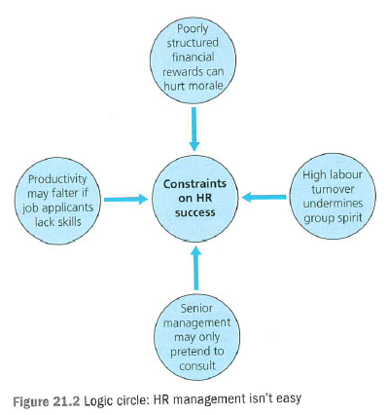

Slide 17
Employee share ownership
A programme in which a business distributes shares to its employees.
The key advantages of establishing an Employee Share Ownership Plan (ESOP) are:
Align employees’ interests with those of shareholders;
Recruit or retain key employees;
Lower the supervision required of employees;
Increase innovation;
Motivate employees to become more productive;
Improve the communication between employee and managers and increase cooperation;
Increase loyalty and reduce staff turnover;
Increase employee job satisfaction;

Slide 18
Empowerment strategies
Delegating power to employees so that they can make their own decisions.
Empowerment involves giving people greater control over their working lives.
Organising the labour force into empowered teams with a high degree of autonomy can achieve this. This means that employees plan their own work, take their own decisions and solve their own problems. Teams are set targets to achieve and may receive rewards for doing so. Empowered teams motivate through allowing people the opportunity to meet some of the higher needs as identified by Maslow or Herzberg's motivators.

Slide 19
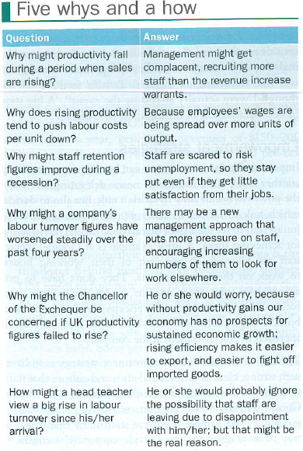

Slide 20
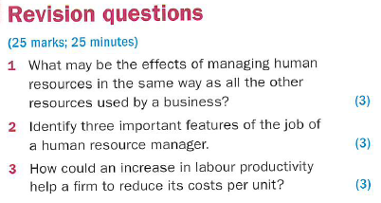
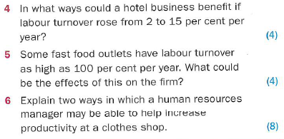

Slide 21
