Slide 1
Critical Path Analysis
Starter
Write down all of the steps involved in order to brew a pot of tea and serve one cup of tea!
How long will it take?

Slide 2
Learning Objectives
How to construct networks
Understand how CPA helps to manage projects

Slide 3
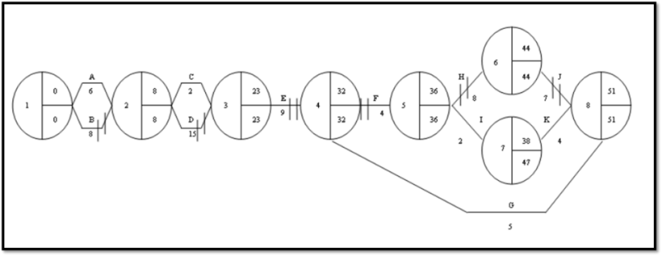

CPA Defined
CPA is a management tool which helps a business to identify how long a project will take and what the critical tasks in that project are
The diagrams are called network diagrams, as they show a network of tasks in a project
CPA Diagram looks like this
You do NOT have to draw a CPA diagram in your exam

Slide 4
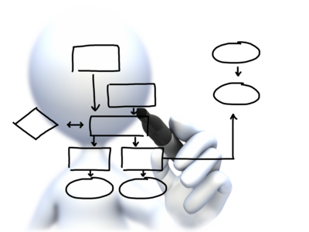

Network Analysis
Network Analysis, is a planning tool used to complete projects in the shortest time possible
  It is also known as Critical Path Analysis (CPA)
  It is particularly common in manufacturing and construction
It breaks a project down into a number of tasks, and looks at the dependency of each one
  E.g. when making a cup of coffee,
  some steps must be completed
  before others take place

Slide 5
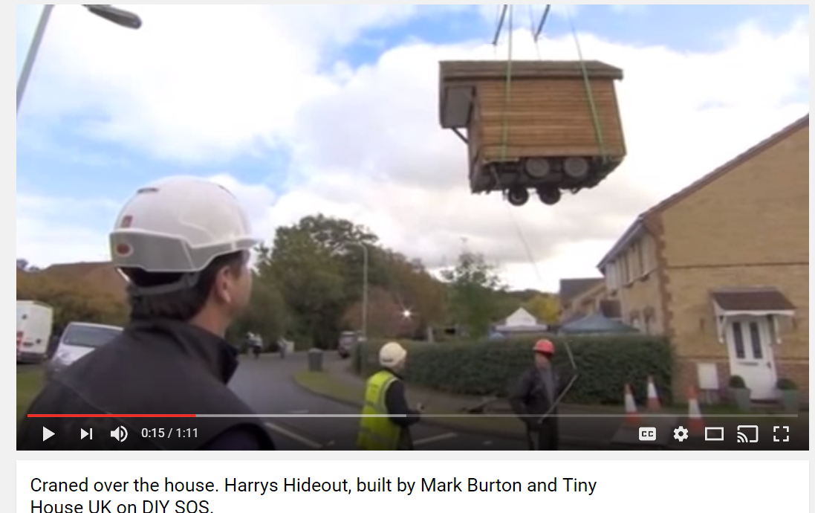
Uses of CPA
CPA can be used to schedule a building project, for example the roof is not the first thing to go on a house and the site may not have enough room for all the roof tiles at the start.
A building business would therefore schedule the tiles to be delivered when they are needed perhaps on week three when the roof goes on
Watch this DIY SOS video where a playhouse is delivered
here

Slide 6

Other uses of CPA
CPA can also be used:
  Launch a new product onto a market.
  A photo shoot of the new product would not happen on day 1 so a schedule would be useful so bookings can be made (see video)
  Installation of new technology in a business
  Renovation of old buildings
  Advertising campaigns
Quick video on a photo shoot of McD’s here

Slide 7
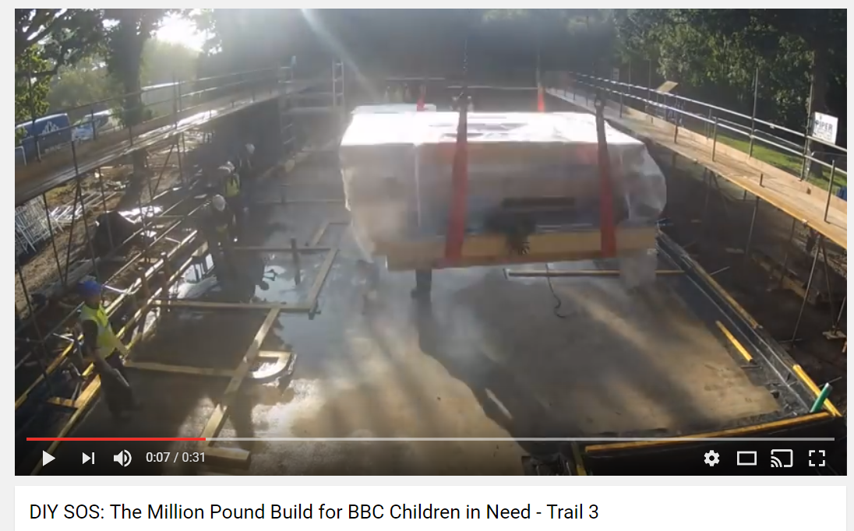
Benefits to a business of using CPA
Stakeholders will be able to see the total time frame for the project to be completed
Parallel activities can be scheduled, for example electricians can work on the lighting in the kitchen while the plasterers put plaster on the upstairs walls. This will save time on the project
Very useful for businesses in the FMCG (Fast Moving Consumer Goods) markets where speed is important
Useful to know when to deliver resources or arrange for labour to arrive e.g. can’t put a carpet in while painters are still working
Watch this time shift sequence of a house being built in DIY SOS here
Here is another clip, if you have time watch a full episode and write all the activities that happen

Slide 8

Components of a Network
A network consists of 2 things:
Activities
Nodes
    These require time and/or resources
    They are drawn as ARROWS from left to right
    The length of the arrow is NOT important
    E.g.:
    These represent the start and end of an activity
    They are represented by CIRCLES
    Every network MUST start and end with a node
    E.g.:

Slide 9
A Simple Network Diagram
Assume that a business wishes to undertake a project which involves opening a new store
Before it can do so it needs to:
  Obtain premises (Activity A – it will take 24 weeks)
  Carry out building work (Activity B – it will take 4 weeks)
A simple network may be drawn to illustrate this scenario:
A
B
24
4

Slide 10
Illustrating Simultaneous Activities
In reality some activities can be carried out simultaneously
Using the previous example:
  Assume that whilst the building work takes place the firm decides to recruit new staff for the store (Activity C – will take 5 weeks)
Try drawing a network using your instructions for making a cup of coffee
B
4
A
24
C
5

Slide 11
Developing The Network
There are a number of problems with our previous example:
  There is no way of identifying the nodes
  It doesn’t help us identify the crucial activities
In order to do this the nodes can be developed in order to show more information:
  Numbers are shown in the left-hand semi-circle of each node to identify them
  The right-hand quarters will be used to hold additional information
1

Slide 12

The Earliest Start Time
The main reason for drawing a network is to identify the critical activities
To do this we must calculate the
earliest time at which any given
activity can start
  This is called the Earliest Start
  Time (EST) of the activity
It is calculated using the following formula:
EST = EST of Previous activity + Duration of previous activity

Slide 13
Calculating The Earliest Start Time
This information is then placed in the top right-hand quarter of the node
The first node will ALWAYS
have an EST of zero
Using our first simple example, the EST for each activity would be calculated as follows:
0
EST goes in top right-hand quarter of the node
1
0
A
24
B
28
1
2
3
+
24
=
+
4
=

Slide 14
The EST and Simultaneous Activities
When there are simultaneous activities there may be more than one value for the EST
  Eg:
B
28
+
4
=
0
A
24
1
2
3
+
24
=
C
+
5
=
29
The project cannot continue until both Activities B and C are complete
So we must take the HIGHEST figure
  This means that the EST is 29 weeks
Which figure should be used?

Slide 15

Recap of The Earliest Start Time
The EST of the first activity is always ZERO
Calculate the EST by working left to right across a network
It is calculated using the formula:
When there are 2 simultaneous activities the
HIGHEST figure is used as the EST
EST = EST of previous activity + Duration of previous activity

Slide 16

The Latest Finishing Time
There is one final piece of information needed to complete a network diagram
To identify the CRITICAL activities we must also know the latest time at which any given activity must end
  This is called the Latest Finishing Time (LFT) of the activity
It is calculated by working
BACKWARDS across the network
using the following formula:
LFT = LFT at end of following activity - Duration of following activity

Slide 17
Calculating The Latest Finishing Time
This information is then placed in the bottom right-hand quarter of the node:
The first node will ALWAYS
have an LFT of zero
Using our first simple example, the LFT for each activity would be calculated as follows:
0
LFT goes in bottom right-hand quarter of the node
1
0
0
24
B
28
A
28
1
2
3
0
=
24
-
24
=
4
-
28
Since the earliest time this project can be finished is 28 weeks then this is also the latest we would like to finish the project.
As such the EST and LFT of the last node are ALWAYS the same

Slide 18
The LFT and Simultaneous Activities
When there are simultaneous activities there may be more than one value for the LFT
  Eg:
25
=
B
-
4
0
A
24
29
1
2
3
0
=
24
-
29
C
24
=
5
-
If Activity C starts on week 25 then the whole project cannot be completed by week 29
So we must take the LOWEST figure
  This means that the LFT is 24 weeks
Which figure should be used?

Slide 19

Recap of The Latest Finishing Time
The LFT of the last activity is always equal to its EST
The LFT of the first node is always ZERO
Calculate the LFT by working right to left across a
network
It is calculated using the formula:
When there are 2 simultaneous activities the LOWEST figure is used as the LFT
LFT = LFT at end of following activity - Duration of following activity

Slide 20

The Float
An activity without spare time is CRITICAL
Spare time is referred to as the FLOAT
There are 2 types of float, each with its own formula:
Edexcel do not assess Free Float
FREE FLOAT
This is the amount of spare time available for an activity without delaying the
NEXT ACTIVITY
TOTAL FLOAT
This is the amount of spare time available for an activity without delaying the
WHOLE PROJECT
Free Float =
EST at End of activity –
(EST at start + Activity Duration)
Total Float =
Activity’s LFT –
(Activity’s EST + Activity’s Duration)

Slide 21

Calculating The Free Float
The free and total float for our simple example would be:
B
4
0
A
24
29
1
2
3
0
24
24
29
C
5
Working Out
Activity | Duration (Weeks) | EST | LFT | Free Float | Total Float
A | 24 | 0 | 24
B | 4 | 24 | 29
C | 5 | 24 | 29
Free Float Activity A =
- (
+
) =
0
0
24
0
24
Free Float = EST at End of activity –
(EST at start + Duration of activity)

Slide 22
Calculating The Total Float
The free and total float for our simple example would be:
B
4
0
A
24
29
1
2
3
0
24
24
29
C
5
Working Out
Activity | Duration (Weeks) | EST | LFT | Free Float | Total Float
A | 24 | 0 | 24 | 0
B | 4 | 24 | 29
C | 5 | 24 | 29
Total Float Activity A =
Now Calculate the
Total Floats
for Activities B and C
- (
+
) =
0
0
24
0
24
1
1
Total Float = Activity’s LFT –
(Activity’s EST + Activity’s Duration)
0
0

Slide 23

What Does This Mean?
Activity | Duration (Weeks) | EST | LFT | Free Float | Total Float
A | 24 | 0 | 24 | 0 | 0
B | 4 | 24 | 29 | 1 | 1
C | 5 | 24 | 29 | 0 | 0
This data tells us that:
  Activity A is CRITICAL – any delay will hold up the project
  Activity B can be delayed 1 week without delaying the whole project
  That Activity C is CRITICAL – any delay will hold up the project

Slide 24

Identifying The Critical Path
The critical path identifies those activities that have no float time
It is usually identified on a diagram as follows:
B
4
0
A
24
29
1
2
3
0
24
29
24
C
5
Note:
A quick visual check can be made, since any node on the critical path should have equal EST and LFTs
However – this example shows that this method alone does not identify all the critical activities
Dotted Line used to identify CRITICAL PATH

Slide 25
Dummy Activities
A dummy activity is one that is created purely to illustrate dependency
  They are not labelled and take up no time
They are represented by a dotted arrow:
  So our previous diagram would be completed as follows:
A
C
2
4
4
E
1
4
5
1
B
D
Now complete the network, and identify the critical path
Dummy Activity
3
5
3

Slide 26


Advantages of Network Analysis
Using network analysis has a number of advantages:
It should improve efficiency and cash flow
  Since materials
  need only be
  ordered when they are needed
It requires
careful planning
  Which should mean that projects run smoothly
If problems occur the implications can be identified quickly
  This means informed decisions can be made

Slide 27

Disadvantages of Network Analysis
Using network analysis has a number of advantages:
The plan will only work if relevant staff have been consulted
  For example timescales need to
  be realistic
Diagrams can become unmanageable
  Although software can be used to manage projects
Gantt charts
tend to be
preferred
  Since they visually show a time-line of activities

Slide 28
Limitations of CPA
All the data in the network diagram is based on estimates and can quickly become inaccurate e.g. if the weather turns bad on a building project or suppliers fail to turn up with a delivery
The drawing up on a diagram is time consuming it may be quicker to get on with the project
The project may be simple and not require a diagram

Slide 29
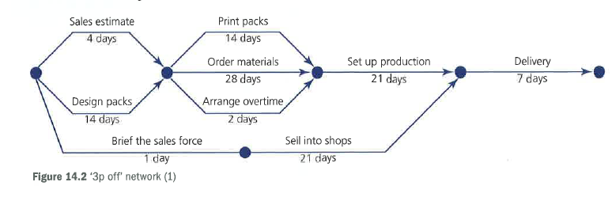

Slide 30
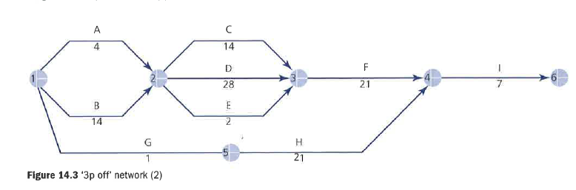

Slide 31
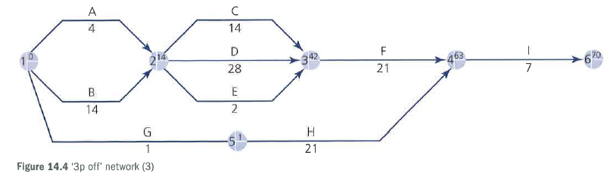

Slide 32
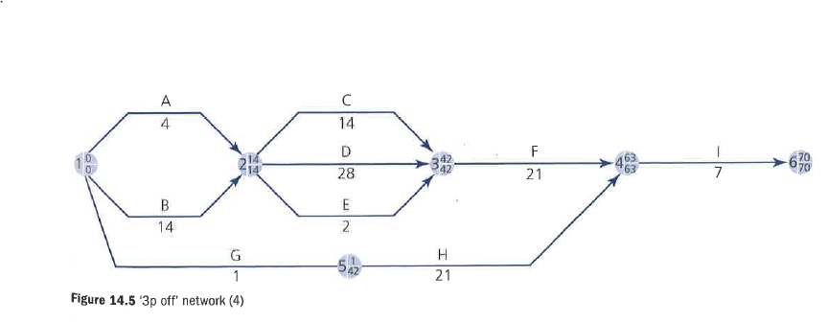

Slide 33
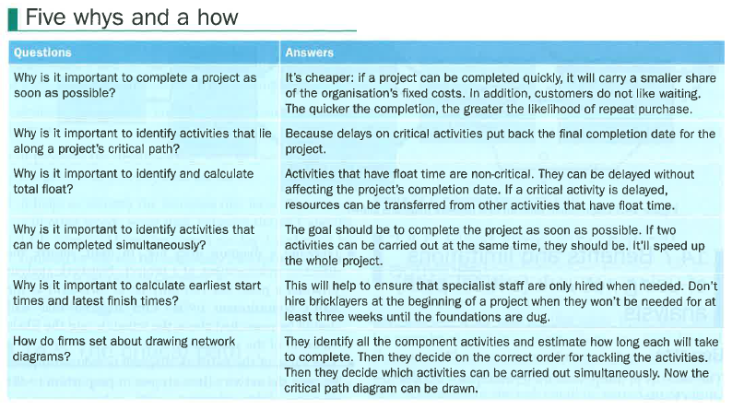

Slide 34
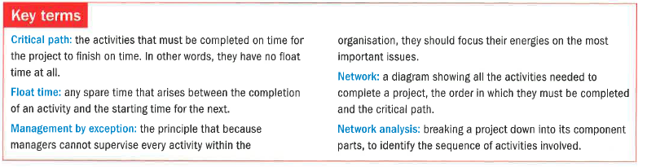

Slide 35
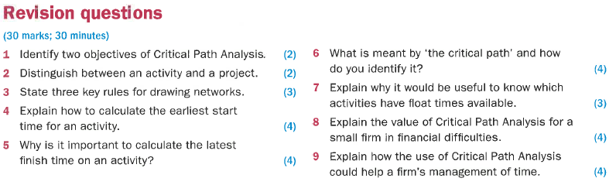

Slide 36

Sample Edexcel A2 questions

Slide 37
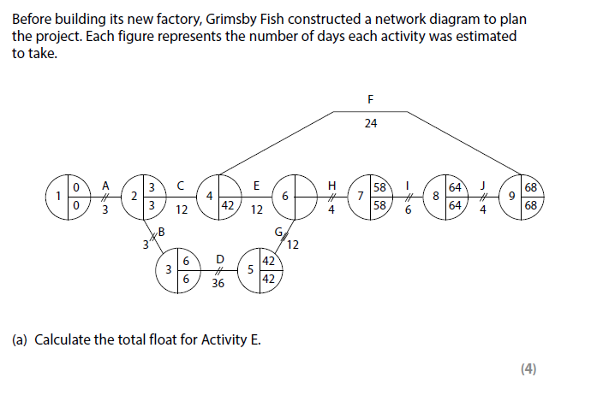
Case study and question 1

Slide 38
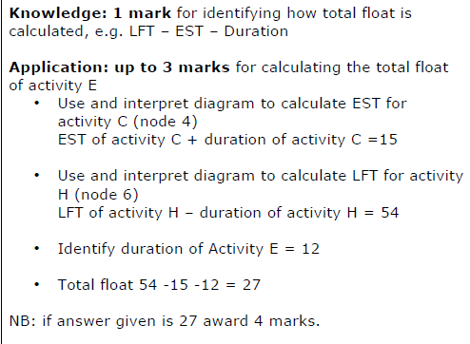
Answer sample question 1

Slide 39
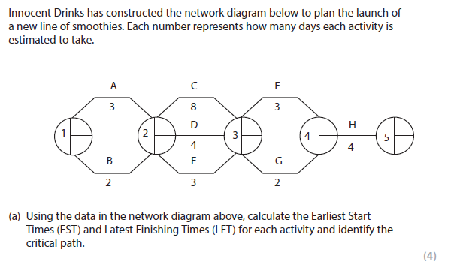
Case study and question 2

Slide 40
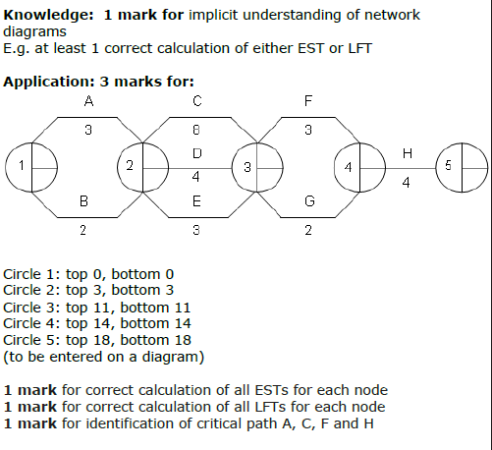
Answer sample question 2

Slide 41
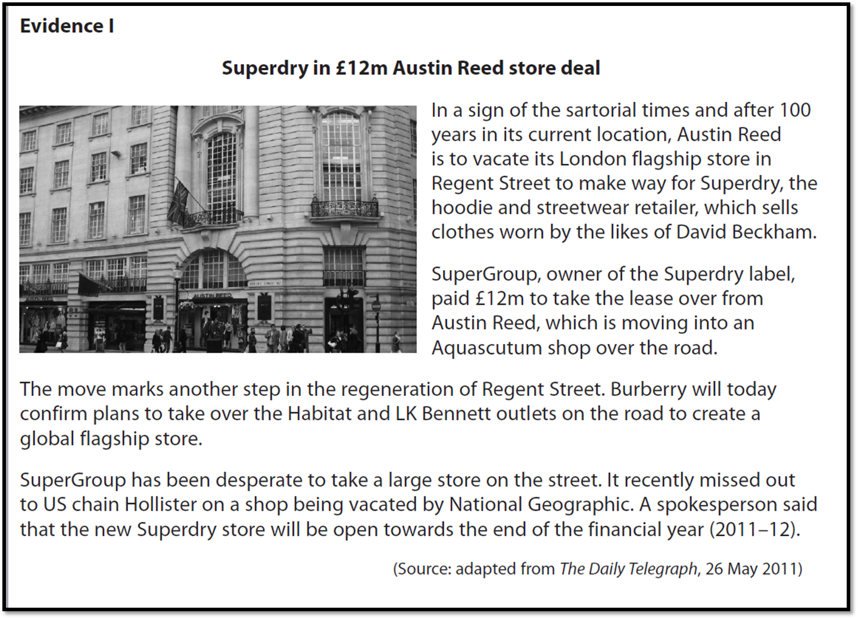
Case study for question 3

Slide 42
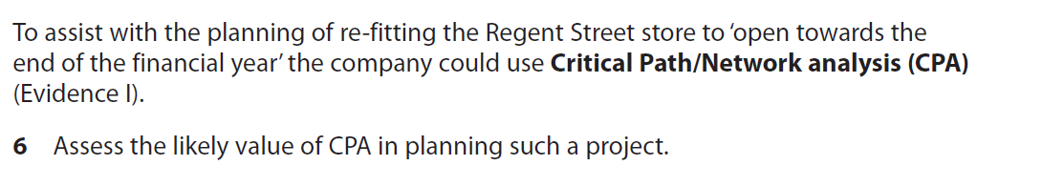
Sample question 3
[10]
Knowledge 2
Application 2
Analysis
3
Evaluation
3

Slide 43
Answer sample question 3
Uses of CPA to SuperDry
CPA can be used to schedule a range of activities to help them be completed in the shortest time possible
Some of its features include: activities; duration; float time etc.
The re-fit will include a range of activities e.g. change the flooring; paint the walls; decorate point of sale etc.
Activities such as update the electrics or change the lighting can be done at the same time
CPA helps with planning which is essential as SuperDry want the store to open as soon as possible
Other stakeholders such as suppliers of SuperDry stock can gain an understanding of the time frames involved and when they will be needed.
Limitations of CPA to SuperDry
The project is reasonably simple, so the time involved in creating the CPA may be wasted
CPA can’t always deal with unforeseen problems such as discovering structural problems with the building
SuperDry are experienced in opening new stores quickly and will be able to re-fit this store without the need for CPA
Conclusion
CPA could help with the various stages of the store refit, but compared to major building projects this is a simple task.
SuperDry wants to get the store trading as soon as possible so it is likely that they will do so without the need to CPA.

Slide 44
Glossary
Critical path analysis; this is a management tool that shows the total time that a project takes to complete
Earliest start time; the first day that the task can begin, when all tasks dependent on it are finished
Latest finish time; the latest the task can finish without delaying the whole project
Float time; free time in the network diagram calculated by LFT of the task – task length – EST of the task

