Slide 1



The BIG Idea
Market Research
Think about…
a) Product and market orientation
b) Primary and secondary market research data (quantitative and qualitative) used to:
identify and anticipate customer needs and wants
quantify likely demand
gain insight into consumer behaviour
c) Limitations of market research, sample size and bias
d) Use of ICT to support market research:
websites
social networking
databases
e) Market segmentation
Notes:
Students identify key words to underline

Slide 2
Market orientation
Definition - An approach that focus on reacting to customer needs and wants.
Effective marketing is usually based around an approach that is market orientated, rather than product orientated.
In a market orientated business, a mangers take into account the needs of the consumer before making any decision. They put the customers at the heart of any decision making process.
  A weakness in this approach occurs when a business focus too much on tweaking their product offering without improving the quality of their underlying products – think Rover cars.

Slide 3
Product Orientation
Definition - Where the business develops products based on what it is good at making or doing, rather than what a customer wants.
Some firms still use a product-orientated approach to marketing. This leads the firm to focus on what it does best; internal efficiency comes before consumer preferences. This approach may lead to:
  The hard sell – Commission based, large army of sales staff incentivised to achieve sales targets. Their job is to convince customers to buy what has already been made
  Cutting costs and prices – The business is likely to use price reductions and heavy promotion campaigns if sales are below expectations. Focus is on cutting costs in order to then be able to reduce prices without sacrificing profit margins.

Slide 4

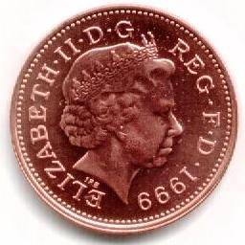
Finding Out What Consumers Want
In order to find out what consumers want firms will carry out MARKET RESEARCH
Market research can be defined as:
The information collected can be used to:
  Identify new business opportunities or ideas
  Identify patterns in consumer behaviour and forecast likely demand
  Identify the main competitors
“The systematic gathering, recording and analysis of data in order to better understand the behaviour of consumers”

Slide 5


Researching the Market
Market research can be carried out in 2 ways:
Methods of Market Research
PRIMARY
RESEARCH
SECONDARY
RESEARCH
Sometimes called FIELD research
This is new information that has been collected first-hand
It could be
  Collected by the firm
  Collected by specialist research companies
Sometimes called DESK research
This is information that has already been collected
It could be information
  From within the firm
  Obtained from outside the firm

Slide 6
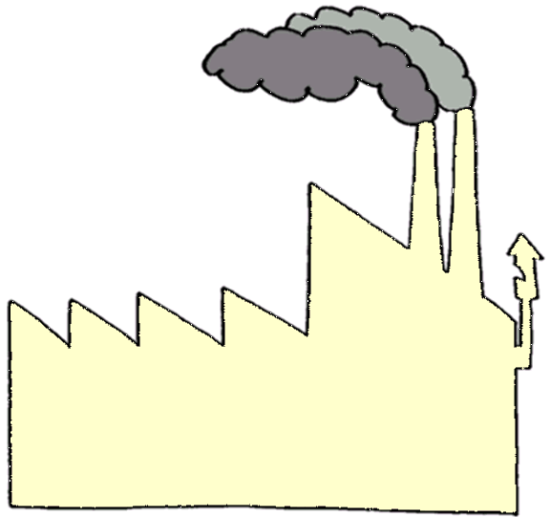
Secondary Research
Definition - Secondary market research uses data that already exists and has been collected by someone else for another purpose.
Sometimes called “desk research”
It can be obtained
from 2 sources:
Outside The Business
  Government statistics
  Commercial firms
    E.g. Mintel
  International publications
    E.g. World Bank
  Competitors annual reports
  The media
    E.g. newspapers
Inside The Business
  Existing research data
  Past promotional data
  Sales records
  Stock records
  Financial records
  Customer database

Slide 7
What are internal sources of secondary data?
Every department within an organisation will have its own records that represent a potential source of valuable data. For instance, records of past advertising campaigns within the marketing department can be compared with copies of invoices held in the sales department in order to judge their effectiveness and get ideas for future campaigns. Past sales figures can also be used to spot trends and forecast future figures.
The increasing availability and use of loyalty cards and big data has given businesses the chance to gather a wide range of valuable information on customer buying habits, allowing them to target promotional campaigns more effectively.
Internal sources of data should always be considered as a first line of enquiry for any investigation because they are usually the quickest, cheapest and most convenient source of information available. Internal data will also be exclusive to the organisation that generated it, so that rival firms will not have access to it.
However, internal data may be incomplete or out of date, and, if a project is new, there may be no relevant data at all. In such cases, an organisation may need to consider using external sources of secondary data.

Slide 8
What are external sources of secondary data?
There are several sources of existing data available from outside of the business that may be of value. These include:
Commercial market research organisations – including MINTEL, Keynote and Euromonitor
The Government – the much wider availability of open data from the government has significantly increased the availability of such data
Competitors – company reports and websites are easily accessible and contain a limited amount of information
Trade Publication
The general media

Slide 9
Primary Data
There are a number of ways in which primary data can be collected:
Obtaining Primary Data
Test
Marketing
Surveys
Observing
Questionnaires
Consumer Panels
Interviews
Electronic
(E.g. EPOS)
“Watching”
Postal
Face-to-Face
Telephone
Open Ended
Group Interviews

Slide 10
Primary Market Research
Primary market research is research data that is collected first-hand for a specific research purpose.
Examples of primary research methods
Common methods of obtaining primary market research include:
Focus groups
Interviews (online & in-person)
Surveys & questionnaires
Mystery shoppers
Product testing and product trial

Slide 11
Advantages and drawbacks of primary market research
Advantages
Directly focused on research objectives = fit for purpose
Tends to be more up-to-date than secondary research
Provides more detailed insights – particularly into customer views
Drawbacks
Time-consuming and often costly to obtain
Risk of survey bias – research samples may not be representative of the population

Slide 12
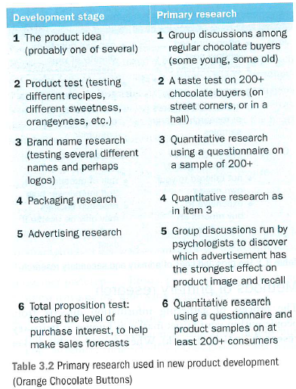

Slide 13
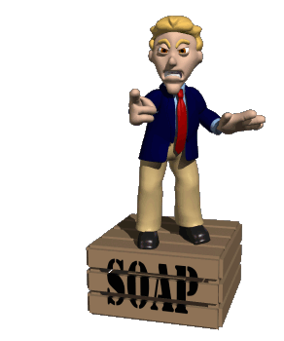
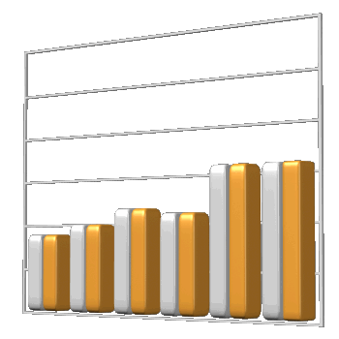
Using Primary Data
Primary research can be used to collect two different types of data:
QUANTITATIVE DATA
QUALITATIVE DATA
States statistical facts
Makes
numerical
analysis easy
Gives an insight
into the thoughts
and opinions of
people
Remember:
Quantitative data
is concerned with quantities
Remember:
Qualitative data
is concerned with the quality of opinions

Slide 14
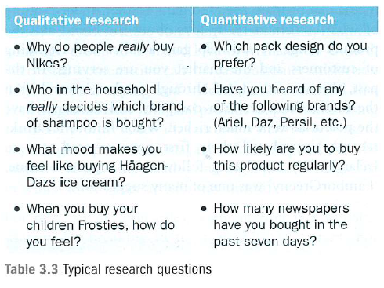

Slide 15

Carrying Out Primary Research
Primary research will be carried out by asking a sample of people
  It would be impossible to ask every prospective customer!
Sampling involves selecting a few people
to interview
  So it is important that they are representative
  of the whole market
Sampling methods can be split into 2 types:
  Probability Samples
  Non-probability Samples

Slide 16
Probability Samples
There are 4 types of probability samples:
Probability Sample
Description
Simple Random Sampling
Here every member of the population has an equal chance of being chosen
Systematic Random Sampling
With this method every nth member of the population is surveyed, e.g. every 10th
Stratified Random Sampling
This involves dividing the sample into market segments, based on existing knowledge
Cluster Sampling
This method splits the whole market into small areas, and sampling is carried out in those areas believed to be typical

Slide 17
Non-Probability Samples
There are 3 types of non-probability samples:
Non-Probability Sample
Description
Quota Sampling
A certain number of people with given characteristics will be interviewed
Convenience Sampling
Interviews anyone available
Judgement Sampling
This allows the interviewer to select people who they judge to be representative of the market

Slide 18
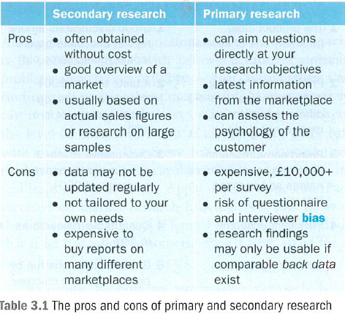

Slide 19
The Problems of Market Research
Market research can be invaluable
  By providing an insight into consumer behaviour
However, care must be used in order to ensure that…
  The most appropriate method of sampling is used
    An inappropriate sampling method could provide misleading information
  An appropriate sample size is used
    If only a small sample size is used then results are unlikely to be representative of the whole market
  Bias is avoided
    The way that data is collected may give bias results
    The way that data is analysed can also give a biased view

Slide 20
The use of IT to support market research
Websites
Many websites automatically generate customer questionnaires. They might target everyone through the home page or the focus on a subgroup. This may look like free research, but who answers the questions raised? This can be very time consuming and it could be biased towards those with more time on their hands.

Slide 21
The use of IT to support market research
The use of social media
Social media provide the interactivity that may help to develop a relationship between the business and its customers. Social media can provide a way to gain a fuller understanding of what customers really love about the brand and product range.

Slide 22
The use of IT to support market research
Databases
Almost 75% of supermarket shopping was done with the use of a `Loyalty Card`. This provide a retailer with a multi-million user database, which can be interrogated to find out answers to quantitative questions, such as what percentage of purchases of Lynx are among households with boys under 12?

Slide 23
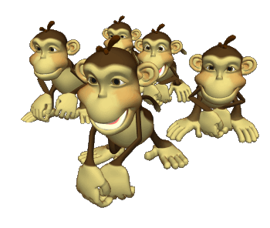

Market Segmentation
Definition - The process of dividing a market into smaller sections which contain customers with similar needs and wants.
Most businesses will break a market into smaller manageable chunks, called segments
This means grouping consumers with similar characteristics together
For example:
  The market for music could be segmented in various ways, including:
    Age – e.g. teenagers have different tastes to 40 year olds
    Behaviour – e.g. some buy CDs while others will download

Slide 24
Why segment the market?
Why do businesses need to segment their markets? Because customers differ in the…
Benefits they want
Amount they are able to or willing to pay
Media (e.g. television, newspapers, and magazines) they see
Quantities they buy
Time and place that they buy

Slide 25
Why segment the market?
Better matching of customer needs | Customer needs differ. Creating separate products for each segment makes sense
Enhanced profits for business | Customers have different disposable incomes and vary in how sensitive they are to price. By segmenting markets, businesses can raise average prices and subsequently enhance profits
Better opportunities for growth | Market segmentation can build sales. For example, customers can be encouraged to "trade-up" after being sold an introductory, lower-priced product
Retain more customers | By marketing products that appeal to customers at different stages of their life ("life-cycle"), a business can retain customers who might otherwise switch to competing products and brands.
Target marketing communications | Businesses need to deliver their marketing message to a relevant customer audience. By segmenting markets, the target customer can be reached more often and at lower cost
Gain share of the market segment | Through careful segmentation and targeting, businesses can often achieve competitive production and marketing costs and become the preferred choice of customers and distributors

Slide 26
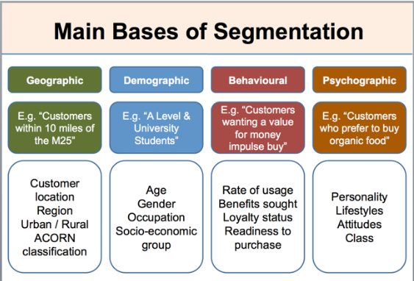

Slide 27

Segmenting The Market
  There are a number of ways in which this can be done:
    Geographic Segmentation
        based on geographic patterns
    Demographic Segmentation
        age, gender, income etc
    Psychographic Segmentation
        social class
    Behaviouristic Segmentation
        behaviour patterns

Slide 28
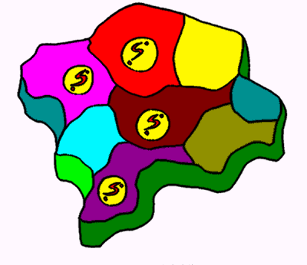
Geographic Segmentation
This is a simple form of segmentation based on geographical patterns
This could compare:
  spending levels
  income levels
  employment levels
  buying habits
e.g. “oatcakes” are popular in Stoke-on-Trent, whilst “battered Mars Bars” are popular in the South Birmingham area

Slide 29
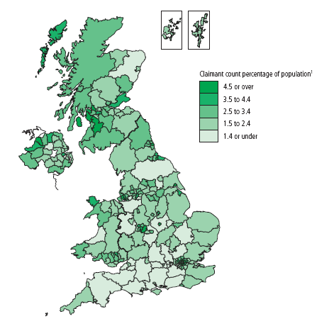
Using Geographic Segmentation
This map is taken from Regional Trends
The dark areas represent areas where the “claimant count of unemployment” is low
  How could this information be used by businesses?
  Which type of businesses might find this information most useful?
Claimant Count Rate
Source: Regional Trends: Statistics.gov.uk

Slide 30
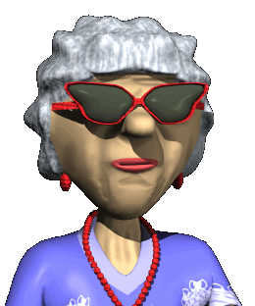

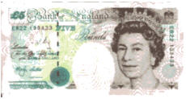
Demographic Segmentation
This refers to ways of separating people according to their characteristics
There are 3 main ways
  Age
    People of different ages buy different products!
  Gender
    Men & women behave differently, and buy different things
    According to research men are more likely to buy products that are in green, blue or black packaging!
  Income
    People with different disposable income levels will purchase different products, even within the same brand
    That is why car manufacturers produce top-of-the-range and basic models

Slide 31
Psychographic Segmentation (1)
This separates households according to their social class, life-style and/or personality
Socio-economic groups can be used to do this:
Class Name | Social Status | Occupation of Head of Household | % of Population
A | Upper middle | Higher managerial, administrative or professional | 3
B | Middle | Intermediate managerial, administrative or professional | 14
C1 | Lower middle | Supervisors or clerical, junior managerial, administrative or professional | 27
C2 | Skilled working | Skilled manual workers | 25
D | Working | Semiskilled and unskilled workers | 19
E | Those at lowest levels of subsistence | Pensioners, widows, casual or lower-grade workers | 12

Slide 32
Psychographic Segmentation (2)
Socio-economic groups must be used with care since:
  They refer to the head of household
  They DO NOT refer to income levels
    E.g. there are a number of very wealthy OAPs in the UK!
      (and there are a number of poor teachers!)
    Therefore it is possible to be rich, and be classed in group E
  They make assumptions about typical lifestyles of each group
Of course, socio-economic groups are not the only way to segment a market psychographically

Slide 33

Behaviouristic Segmentation
This considers consumer behaviour patterns, including:
  What people buy
  How often people buy
  How loyal customers are to certain brands
The introduction and use of loyalty cards has made this much easier for firms to do

Slide 34
