Slide 1
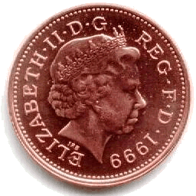
Mass Vs Niche Marketing
I’m in a
I’m in a
Mass
Market
Niche
Market
Targets a very small segment of a market
E.g.
Local restaurants
Sales will be lower, but prices will be higher
Appeals to the whole market
E.g.
Pepsi
It requires high sales volumes and low prices

Slide 2
Advantages & Disadvantages of Operating in a Mass Market
Operating in a mass market has a number of advantages and disadvantages:
Advantages
Disadvantages
Able to benefit from Economies of Scale
Increased competition
Less risky – since business is not dependent upon one small segment of a market
Difficult to appeal to individual consumers
Sales revenues are usually higher
Fixed capital costs are usually high – due to the need for large factories and expensive machinery

Slide 3
Advantages & Disadvantages of Operating in a Niche Market
Operating in a niche market has a number of advantages and disadvantages:
Advantages
Disadvantages
Less competition
Products can be tailor-made to meet the needs of a customer, e.g wedding cakes
There are fewer potential customers!
Profits are likely to be lower whilst prices will be higher
Less likely to be left with out-dated stock since fewer units are produced at a time
If too successful the niche might be targeted by bigger competitors

