Slide 1
Desmond Doss
A pacifist’s tale
Key Question: What are the arguments for & against pacifism?
Notes:
This is a true story. This PowerPoint is designed to go with CAREFULLY SELECTED scenes from the film Hacksaw Ridge. Warning: the full film is rated 15 and contains gory images. It may not be suitable for sensitive viewers.

Slide 2
Learning outcomes
All: will be able to explain what is pacifism;
Many: you will be able to explain difficulties of putting non-violence into practice;
Some: will be able to answer an exam question on this with 8/12 or higher.

Slide 3
Scenes from the film Hacksaw Ridge

Slide 4
Desmond fights Hal
What Bible teaching is mentioned here?
Notes:
The boys fight and Desmond nearly kills his brother. The commandment, ‘Thou shalt not kill.’ is featured on the wall.

Slide 5
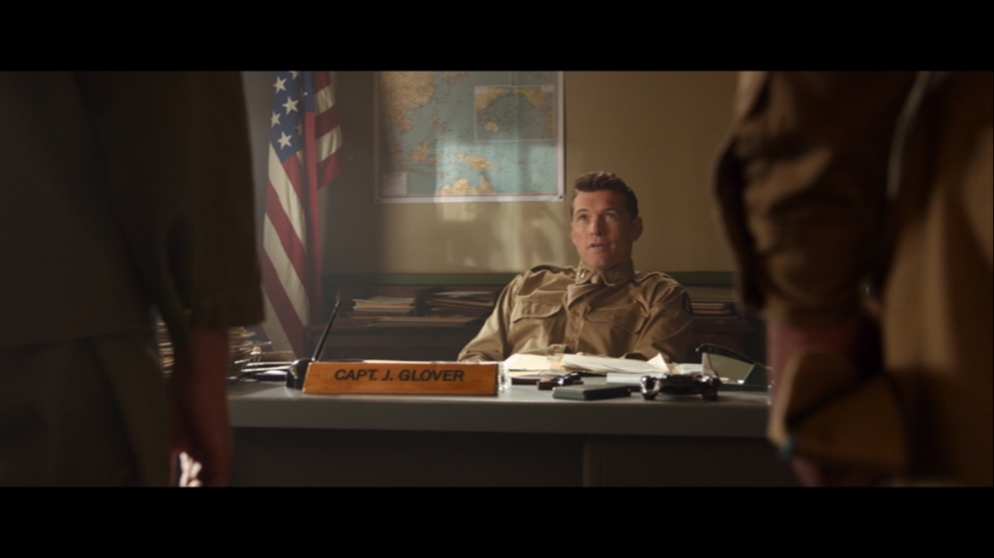
Conscientious objector
2. Why is Desmond mocked by Captain Glover?
3. What two reasons does Sarge give why Doss is wrong?
Notes:
2. The Japanese will not avoid attacking on a Saturday to fit in with Desmond Doss. Doss joined the army; there is ‘quiet a lot of killing’ in war. 3. Doss is failing to protect women and children. People will die because of his lack of fighting. These scenes are more-or-less true.

Slide 6
Confrontation with Smiddy
What Bible teaching does Smiddy mention?
Notes:
Jesus teaches that when someone strikes you on one cheek, turn the other cheek rather than fighting back. (Overcome evil with good.) Smiddy is a composite character who reflects the true attitudes of Doss’s fellow soldiers. They hated him.

Slide 7
Section 8 interview
What Bible teaching does Desmond mention here?
Notes:
‘Love one another as I have loved you.’ This scene is true.

Slide 8
The court martial
4. Give one reason against Doss and one in his defence.
Notes:
Disobeying orders; Doss has a sense of moral superiority; In a world where people are tearing one another apart Doss wants to save lives. (The trial scene did not happen but the reasons given in court are things Doss actually said. He was threatened with court martial but his dad did bring evidence to the army that the President had ordered pacifists should be allowed to be medics without weapons.)

Slide 9
Scene in a crater
5. What personal reason does Desmond give Smiddy why he won’t touch a weapon?
Notes:
His father used to beat his mother and Desmond grabbed a gun and nearly killed him. He promised God he would never touch a gun again. (In reality, his father was going to shoot his uncle when his mum grabbed the gun and gave it to Desmond to hide.)

Slide 10
Underground scene
6. What Bible teaching does he demonstrate by his behaviour here?
Notes:
‘Love your enemies.’ This bit is probably true.

Slide 11
The rescued
Notes:
Question 7 on the sheet.

Slide 12
The honour
Notes:
Question 8 on the sheet.

Slide 13
The exam question
‘Pacifism cannot work in the real world.’ Do you agree?
[12 marks]

