Slide 1
The Dharma
Focus.
What is the Dharma (Dhamma) and why is important for Buddhists?
To begin... Starter questions.
Key terms... Note down the key terms on page 16 of the text book. Also check you have all the key terms from the previous pages of this chapter of the text book.

Slide 2
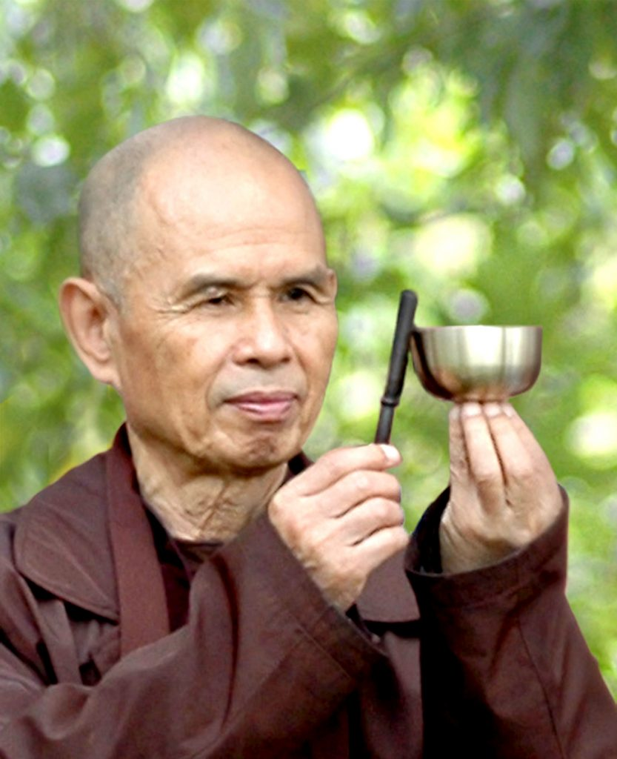
The Dharma
What is the Dharma? (page 16 of the text book)
Note down the first two sentences of Thich Nhat
Hanh’s quotation about Buddha Dharma.
2. What is he suggesting about the Dharma?
3. Explain what the Dharma is. Include examples in your answer.
4. Explain two reasons why the Dharma is important for Buddhists.

Slide 3
The Dharma
The Dharma as a refuge. (pages 16 & 17 of the text book)
What are the three refuges (Triple Refuge). What are they also known as?
2. Explain what it means to ‘go for refuge’ and what it means
particularly for Buddhists.
3. Explain two reasons why the Buddha could be said to be the most
important of the Triple Refuge.
4. Explain two reasons why the Dharma could be said to be the most
important of the Triple Refuge.
5. Explain two reasons why the sangha could be said to be the most
important of the Triple Refuge.
.

Slide 4
The Dharma
Reflect…
Explain under what circumstances might a Buddhist go for refuge in the Triple Refuge.
Reflect…
Buddha taught his followers that they shouldn’t blindly accept his teachings but test and question them. Explain why you think this was. What might be the advantages and disadvantages of this.

