Slide 1
Creation Theories
Focus.
What do science and religion say about the creation of the universe?
To begin...

Slide 2
Creation Theories
Explain…
1. …briefly, the Big Bang theory and the evidence for it.
2. … briefly the Steady State theory.
… why most scientists now dismiss the steady state
theory.

Slide 3
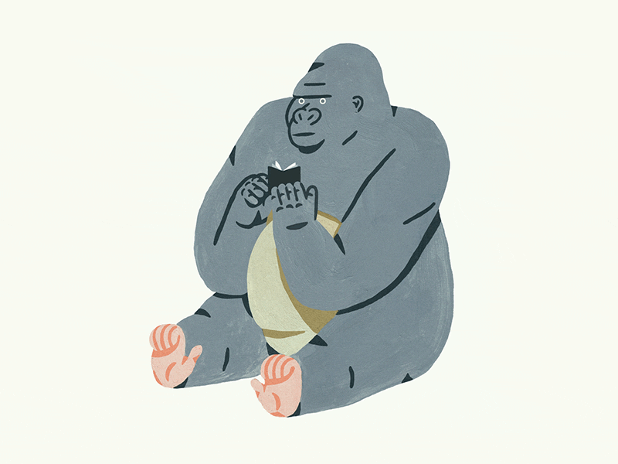
Creation Theories
Explain…
… the main points of the theory of Intelligent Design. Include evidence and examples and make sure you refer to ‘irreducible complexity’ in your explanation
… some of the main issues with intelligent design as an explanation for the creation of the universe
… the strengths and weaknesses of ID.
https://www.youtube.com/watch?v=DZ9uMb8GqNY

Slide 4
Creation Theories
Explain…
… briefly, the main points of each of the two
creation stories in the Bible.
… briefly, what creationism is.
… the strengths and weakness of creationism. Make
sure you include examples and reference to
scientific theories.
… some of the issues raised for Christians in the
light of the belief that God created the earth and
modern scientific advances. Refer to liberal
Christians and fundamentalist Christians.

Slide 5
Creation Theories
Explain…
… briefly, the cosmic constant.
… the main strength of this theory.
… briefly, the main points of the theory of evolution.
… how different Christians (liberals and
fundamentalists) might respond to the theory of
evolution.
… the main points of Lovelock’s Gaia hypothesis.
… the main strengths and weaknesses of the Gaia
hypothesis. Include examples and reference to
Christian beliefs.

Slide 6
Creation Theories
Exam questions.
1. Examine the grounds for religious beliefs. (8 marks)
2. Evaluate the validity of miracles. (9 marks)
Evaluate the strengths and weaknesses of religious beliefs about the creation of the earth. (30 marks)

