Slide 1
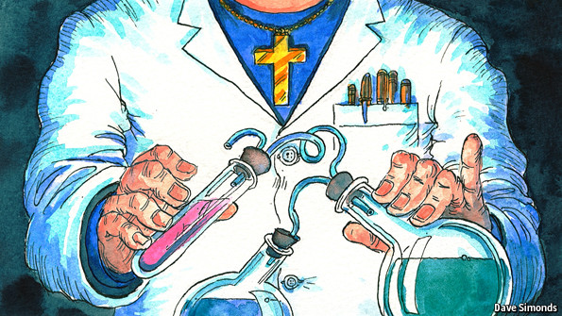
Religion and Science
Focus.
What is truth?
To begin...
Watch the video and answer the questions.
Why do some people believe a belief in God is incompatible with being a scientist?
How can a scientist believe in God?
What is the God Mayim believe in like?
Give examples of the spiritual aspects of life Mayim attributes to God.
What benefits does religion give Mayim in her life?
Can science teach morals and boundaries?
https://www.youtube.com/watch?v=qZh1MrDHLoY

Slide 2
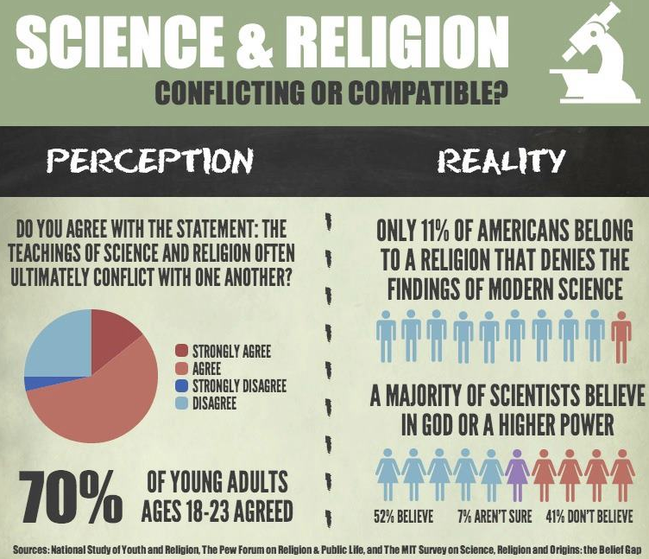
Given that the perception seems to be that science and religion are incompatible, give some examples of these perceived conflicts.

Slide 3
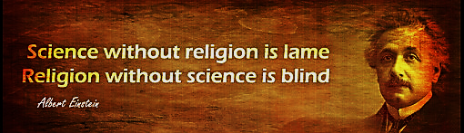
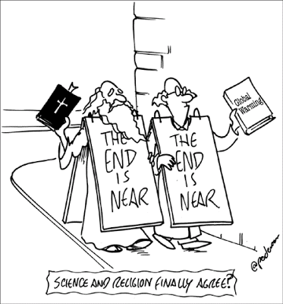
Religion and Science
One of the most famous scientists of all time, Albert Einstein, was a theist – he was Jewish.
Bearing in mind his comment above, explain why religion is sometimes necessary when new scientific discoveries are made. Include examples in your answer.

Slide 4
Religion and Science
Investigation – 3 groups.
Each group with complete a simple investigation following one of the methods as outlined on the sheet.
Talk to other people in the group to do your
investigation and use any other knowledge you have.
Note down your findings.
As a whole group collectively discuss all your findings.
Can we come to any conclusions?

Slide 5
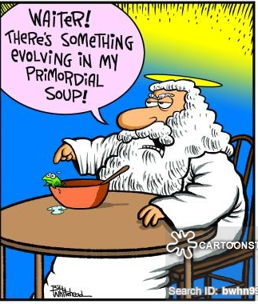
Religion and Science
Questions.
Explain, with examples how our perceptions of ‘truth’ can be affected.
2. Explain, with examples how one’s background and upbringing can affect what a person believes to be true.
3. Explain, with examples, the following causes of belief; (a) fear; (b) wishful thinking; and (c) the need for security.
4. Explain, with examples why our inherited beliefs may change or develop.
5. Explain, with examples why, if investigated, inherited beliefs my be solidified.

Slide 6
Religion and Science
Things to do;
Give an example of a ‘truth’ – scientific or historical. Explain
why we have this ‘truth’ (referring to direct, indirect and
cumulative evidence.
2. Explain why this example may not be
considered an ‘absolute truth’.

Slide 7
Religion and Science
Explain…
Explain, with an example how evidence can be used to find religious truths.
2. Explain, with examples why looking for
religious truths is different, but also in
some ways similar, to looking for
scientific truths.
Explain with examples how religious
truth can be proven and why this can be
similar to how scientific or historical
truths can be proven.

