Slide 1
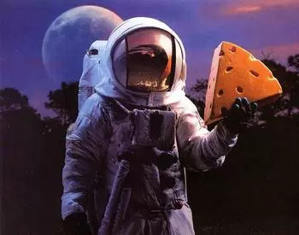
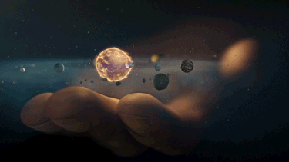
Religion and Science
Focus.
How do we prove things are true?
Starter – How would you go about proving the following?
Dinosaurs existed
The moon is made of cheese
God created the universe

Slide 2
Religion and Science
Things to do – a few reminders!
Sort the pictures and add captions to briefly re-tell the first
Biblical Creation story.
2. Using the diagram briefly explain the Big Bang Theory.
3. Explain different Christian attitudes to the Creation Story.
How can the Creation Story and the
Big Bang Theory be compatible?
5. What do Buddhists say about Creation?

Slide 3
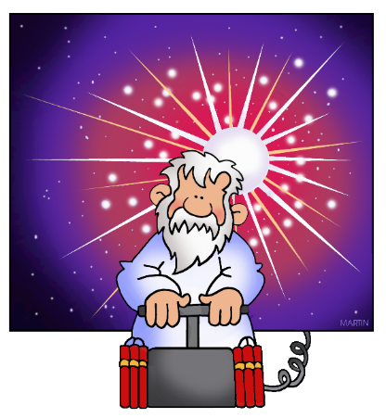
Religion and Science
Evaluate.
‘The Genesis creation story and the Big Bang theory cannot both
be true.’ Assess this view.
Make sure you explain several reasons for both sides of the argument, avoiding a ‘for and against’ approach in favour of a discussion approach (ifs, buts and howevers).

