Slide 1
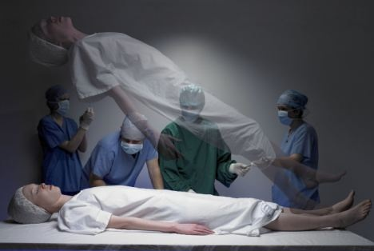
Near Death Experiences
Focus…
Do NDEs prove life after death and the existence of God?
To begin… Watch the videos and answer the questions.
https://www.youtube.com/watch?v=9f76C0eNcjc
https://www.youtube.com/watch?v=UAnySx2lHC8
Next … Compare the two experiences. What are the similarities? Are there any differences?

Slide 2
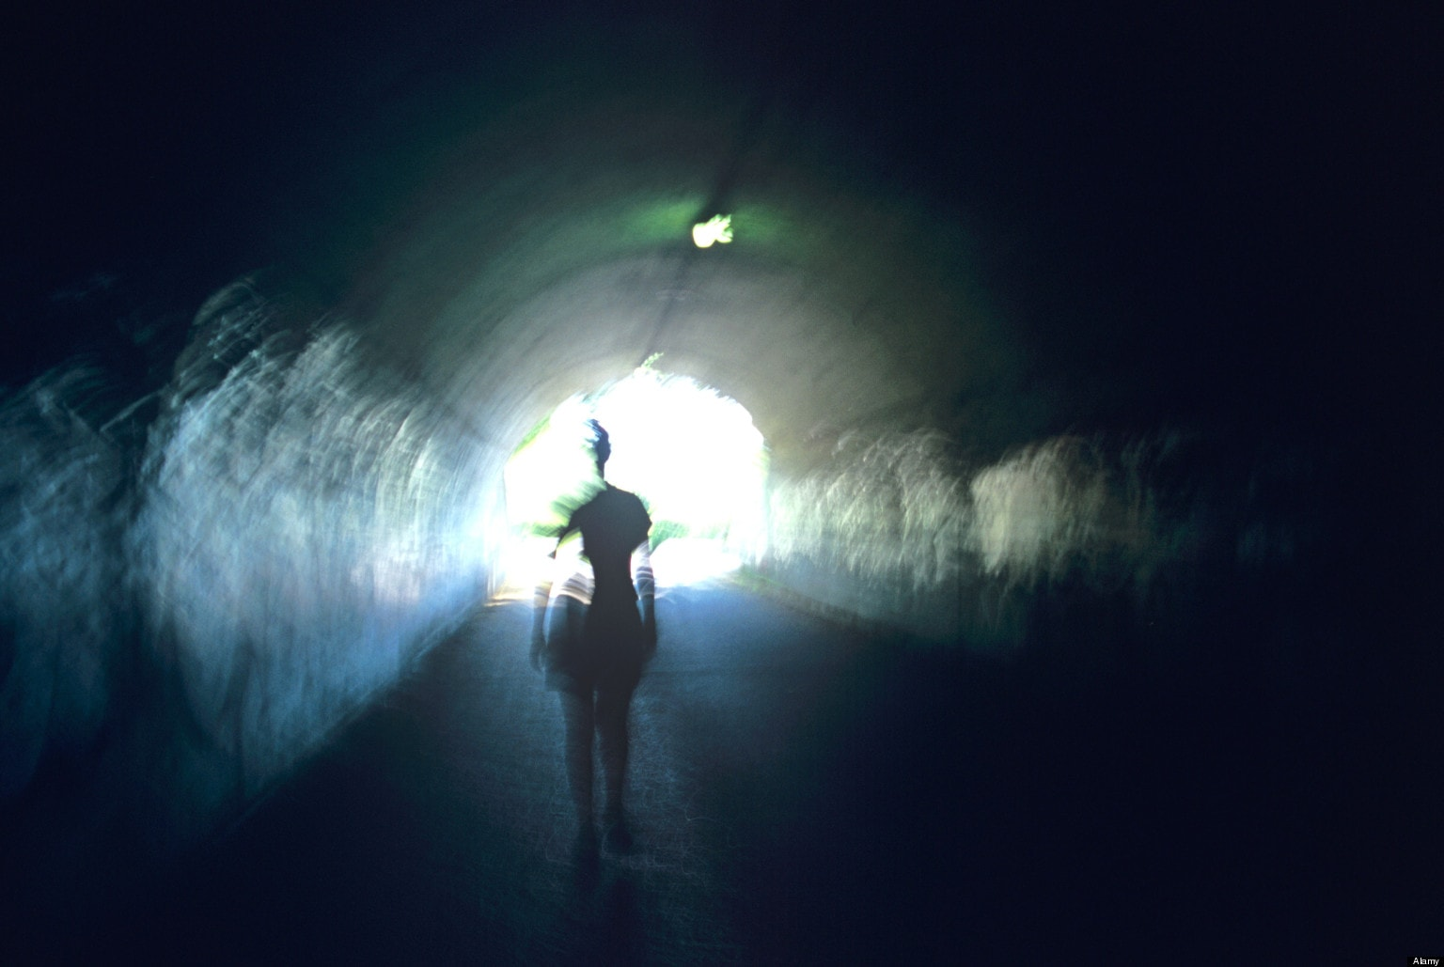
Near Death Experiences
Evaluate … Do these experiences prove that God exists?
Use evidence from the examples to argue both points of view.

Slide 3
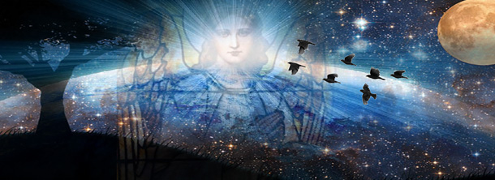
Near Death Experiences
Read about NDEs and answer the following questions.
a) Explain what a near death experience is.
b) Why might culture affect the NDE a person has?
c) How have NDEs been disputed?
d) Explain some of the counter arguments to the scientific explanations of NDEs.
https://www.youtube.com/watch?v=-CJSTMxGuBA

Slide 4
Near Death Experiences
Read the Jeanette’s account of an NDE then answer the following questions.
Are there any of the common elements of NDEs present in Jeanette’s story? If there
are note them down with examples from the text.
b) Are there any similarities with what the New Testament says about resurrection in
Jeanette’s story? If there are note them down with examples from the text linked to an
example from the New Testament.
c) Why do you think Jeanette ‘saw’ Jesus?
If you were a sceptic of NDE’s how might you explain what happened to Jeanette? Think
of as many possibilities as you can and bear in mind what had happened to Jeanette
that year.
Explain why Jeanette thought her daughter did not come back, giving examples from
the text.
f) Explain why Jeanette did come back, giving her reasons from the text.

Slide 5
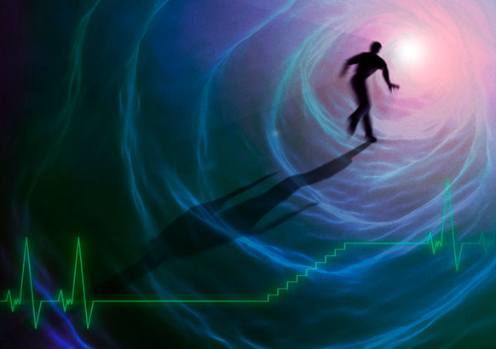
Near Death
Experiences
Read about the research into NDEs.
Why do you think some people experience Heaven
in an NDE and others, Hell?
Do you think a person’s beliefs have anything to
do with whether they have an NDE or not or the
contents of the NDE? Explain your answer.
Evaluate – How far can NDEs prove the existence of
an afterlife?
Answer this question using evidence from the information given, the videos and the research.

