Slide 1
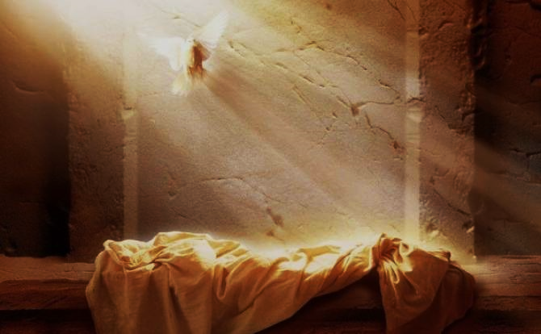
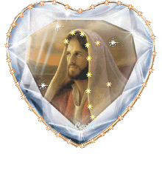
Resurrection
Focus: What do Christians believe about resurrection?
To begin: Explain the meaning of St Teresa’s quotation on life after death.
Definition: Resurrection - belief that God will restore the dead in bodily form to eternal life.

Slide 2
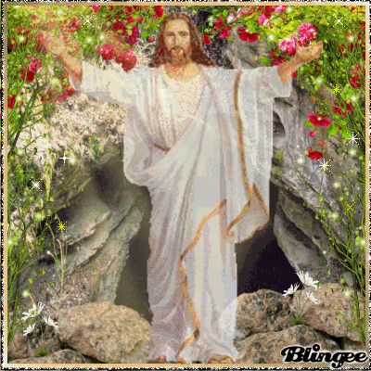
Resurrection
Research...
Look up and note down the following references;
John 6:48 – 54
John 11:25
Explain what these quotations say about the nature of resurrection.
Questions...
What does the Old Testament suggest about body and soul?
What does this mean for life after death?
Which religions originally had these beliefs about body and soul?
Why is the resurrection of Jesus important for Christians?
1 Corinthians 15:52
1 Corinthians 15:16

Slide 3
Resurrection
Research...
Look up and note down the following reference;
1 Corinthians 15:35-8
Explain what these quotations say about the nature of resurrection.
Questions...
Explain some of the reasons why a bodily resurrection is problematic.
How does Christ ‘live’ today?
Explain what St. Teresa of Avila says about this.

Slide 4
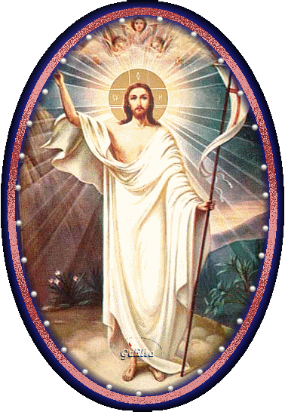
Resurrection
Research:
Look up and note down - John 5:24; 1 John 5:11-12;
Romans 6:9-12; Colossians 2:12-13.
Review:
Explore ideas in the New Testament about life after death.

Slide 5
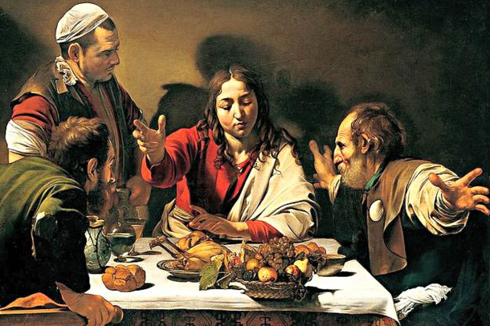
Resurrection
Part 2 (The Return)
Focus...
Is there any evidence for resurrection?
To begin...
Who is the person in the centre of the picture?
What are the expressions of the people at the table?
Why do you think have these expressions?
Research...
Look up and note down the Bible passage; Luke 24:30-31 and John 20:24-29. Could this be evidence of resurrection? What are the problems with this ‘evidence’?

Slide 6
Resurrection - Part 2 (The Return)
Research...
Look up and note down the following reference;
o Luke 24:30-31
o John 20:24-29
Note down a summary of these passages and highlight a quotation that could be used as evidence of Jesus’ resurrection.

Slide 7
Resurrection - Part 2 (The Return)
Explain...
1. Note down the quotations on the previous page. How might these be further
‘proof’ of Jesus’ resurrection?
2. Write an explanation linking these quotations with religious experiences
and proof of God’s existence.
Why do beliefs about the nature of God suggest theists should have no
problem accepting the idea of resurrection?

Slide 8
Resurrection - Part 2 (The Return)
Explain...
1. Explain what the resurrections means for Christians today and why it is
important for Christians.
2. Use quotations and examples to explain different beliefs about the
nature of resurrection in Christianity.
Exam question…
Assess beliefs about a bodily
resurrection. (12)

