Slide 1
The Replica Theory –
John Hick
Focus: What was Hick’s theory about life after death?
Replica theory: notion that one can die in one body and continue to live in a different body while being the same person, including after death.
To begin: Watch the video and answer the questions:
https://www.youtube.com/watch?v=XnrLpL3Wtl4

Slide 2
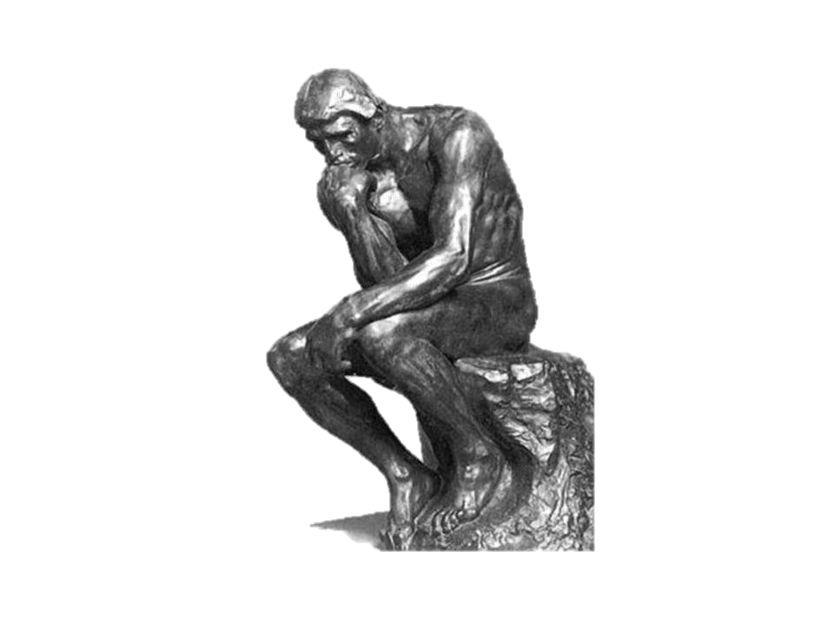
The Replica Theory – John Hick
Read and answer...
Would it be of any consolation to a dying person to know that an exact replica of themselves were to appear somewhere else, the instant they died? Explain your answer.
What criteria could be used to show the individuality of identical twins?
Note down a summary of Hick’s theory (in bullet point or diagram form if you wish).
What is your opinion of Hick’s theory? Explain your answer.
How have other philosophers criticised the replica theory?

Slide 3
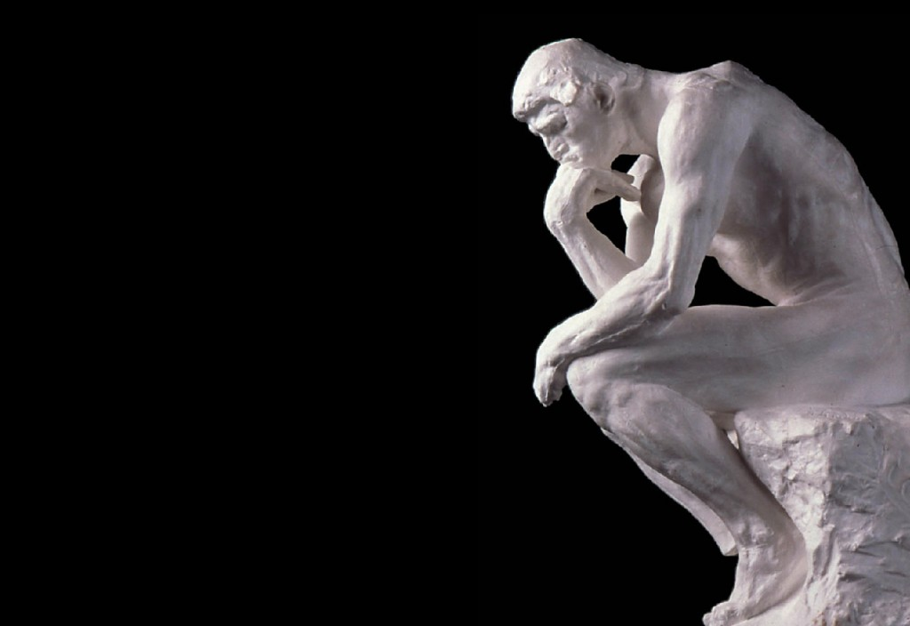
The Replica Theory –
John Hick
Explain....
Would it be of any consolation to a dying person to know that an exact replica of themselves were to appear somewhere else, the instant they died? Explain your answer.
What criteria could be used to show the individuality of identical twins?
Note down a summary of Hick’s theory (in bullet point or diagram form if you wish).
What is your opinion of Hick’s theory? Explain your answer.
How have other philosophers criticised the replica theory?

Slide 4
The Replica Theory – John Hick
Evaluate the strengths and weaknesses of the belief in immortality of the soul and reincarnation.
In your response to this question, you must include how developments in Philosophy of Religion have been influenced by one of the following:
• Religion and Ethics
• New Testament Studies
• the study of a religion. (30)

