Slide 1
Rebirth & Reincarnation
Focus;
Why are rebirth and reincarnation not the same thing?
To begin… recap;
https://create.kahoot.it/create#/edit/7e98be91-04ec-4dcb-9526-b6fceb0eefad/done

Slide 2
Rebirth & Reincarnation
Explain & Think…
o Explain the Buddhist belief of rebirth. Use a quotation
from Sogyal Rinpoche in your answer.
o Explain the main differences between rebirth and
reincarnation. Use a quotation from Damien Keown in your
answer.
o What are the strengths and weaknesses in the idea of rebirth?
Draw up a table and note down your ideas.

Slide 3
Rebirth & Reincarnation
Definitions…
o Note down definitions for the following terms;
rebirth: reincarnation
Explain....
Use a quotation from the ‘Questions of King Milinda’ to explain how there can be rebirth without the transmigration of a soul.
2. Use a quotation and an analogy from the ‘Questions of
King Milinda’ to explain whether the person who is reborn is
the same as the one who died.

Slide 4
Rebirth & Reincarnation
Explain....
Write down the quotation from the Bhagavad Gita and explain its meaning in relation to reincarnation.
2. Use a diagram to explain the Hindu beliefs about the reincarnation
process. Make sure you refer to atman and samsara in your
explanation.
3. What happens when an individual achieves moksha?
4. Note down definitions for the following key terms:
atman; samsara; Brahman; Bhagavad Gita.

Slide 5
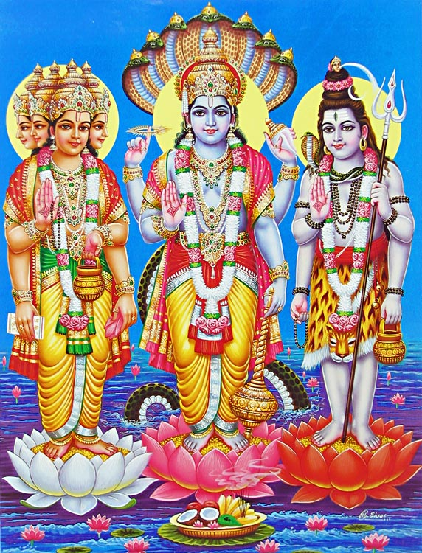
Rebirth & Reincarnation
1. Explain the meaning of dharma for Hindus.
2. Briefly explain the caste system.
3. How do (i) dharma and (ii) karma affect reincarnation.
4. What is moksha and how can it be attained?
5. Note down definitions for the following key terms:
dharma; karma; moksha; caste system.
Who are the gods in the picture on the right?
What are they each gods of?
How does this link to reincarnation and the cyclical nature of life in Hinduism?

Slide 6
Rebirth & Reincarnation
Explain....
11. Explain briefly the main parts of a Hindu funeral, particularly those that link to the
release of the soul.
12. Explain why the funeral rituals are important for reincarnation.
https://www.youtube.com/watch?v=lwjmJtBphwc
Exam Question;
Explore ideas about reincarnation in one religion. (8 marks)

