Slide 1
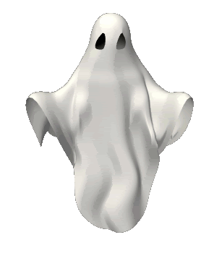
Immortality of the Soul
Focus;
What is meant by immortality of the soul?
To begin…
Note down as many ideas as you can think of about the afterlife.
Highlight any of these ideas that involve the existence of a soul.
What is ‘the soul’? Note down your ideas.
Notes:
Animated, overlapping color bars
(Advanced)
To reproduce the shape effects on this slide, do the following:
On the Home tab, in the Slides group, click Layout, and then click Blank.
On the Home tab, in the Drawing group, click Shapes, and then under Rectangles, select Rectangle (first option from the left). On the slide, drag to draw the first rectangle.
Select the rectangle. Under Drawing Tools, on the Format tab, in the Size group do the following:
In the Shape Height box enter 0.86”.
In the Shape Width box enter 10.5”.
Under Drawing Tools, on the Format tab, in the Shape Styles group, click the Format Shape dialog box launcher. In the Format Shape dialog box in the left pane, click Fill. In the Fill pane, click Solid fill, and then do the following:
Click the button next to Color, and click More Colors. In the Colors dialog box, on the Custom tab, enter values for Red: 86, Green: 113, Blue: 118.
In the Transparency box, enter 40%.
Also in the Format Shape dialog box, in the left pane click Line Color, and then in the Line Color pane click No line. Click Close.
Right-click the rectangle and click Copy. On the Home tab, in the Clipboard group, click Paste, and then click Use Destination Theme.
Select the duplicate rectangle. Under Drawing Tools, on the Format tab, in the Size group do the following:
In the Shape Height box enter 0.86”.
In the Shape Width box enter 4.96”.
Under Drawing Tools, on the Format tab, in the Shape Styles group, click the Format Shape dialog box launcher. In the Format Shape dialog box, in the left pane, click Fill. In the Fill pane, select Solid fill, and then click the button next to Color and then under Theme Colors select Red, Accent 2, Darker 50% (sixth row, sixth option from the left). In the Transparency box, enter 40%.
Press and hold SHIFT and select both rectangles. On the Home tab, in the Drawing group, click Arrange, point to Align, and then click Align to Slide, then do the following:
Click Arrange, point to Align, and click Align Center.
Click Arrange, point to Align, and click Align Middle.
To create the animation effects for this slide, do the following:
(Note: For this animation effect, the first (largest, blue) rectangle remains stationary on the slide.)
Select the second rectangle (smaller, red).
On the Animations tab, in the Animation group, in the effects gallery, click Lines, then click Effect Options and then click Right.
On the slide, drag the motion path end point (red arrow) beyond the right edge of the slide. Drag the motion path starting point (green arrow) beyond the left edge of the slide.
On the Animations tab, in the Timing group, in the Duration box, type in 3.55
On the Animations tab, in the Advanced Animation group, click Animation Pane.
In the Animation Pane, click the arrow at the motion path animation effect, and then click Start With Previous.
Click again the arrow next to the motion path animation effect, and click Effect Options. In the Right dialog box, do the following:
On the Effect tab, under Settings, select the Auto-Reverse check box.
On the Timing tab, in the Repeat box, select Until End of Slide.
Click OK.
To add more colors and animated effects to the line, do the following:
Right-click the second (small, red) rectangle and click Copy. On the Home tab, in the Clipboard group, click Paste, and then click Use Destination Theme. Move this rectangle so it is not on top of those already created, so it can be more easily worked on. Repeat this step three more times until you have added four more rectangles, for a total of six.
Select the third rectangle. (In the Animation Pane, of the five rectangles listed, this should select the second rectangle.) Under Drawing Tools, on the Format tab, in the Size group do the following:
In the Shape Height box enter 0.86”.
In the Shape Width box enter 3.16”.
Under Drawing Tools, on the Format tab, in the Shape Styles group, click the Format Shape dialog box launcher. In the Format Shape dialog box in the left pane, click Fill. In the Fill pane, click Solid fill, and then do the following:
Click the button next to Color, and click More Colors. In the Colors dialog box, on the Custom tab, enter values for Red: 79, Green: 129, Blue: 189.
In the Transparency box, enter 40%.
On the Animations tab, in the Timing group, in the Duration box, enter 3.1.
In the Animation Pane, click the arrow at the motion path animation effect, and then click Start With Previous.
Click again the arrow next to the motion path animation effect, and click Effect Options. In the Right dialog box, do the following:
On the Effect tab, under Settings, select Auto-Reverse.
On the Timing tab, in the Repeat box, click Until End of Slide.
Click OK.
On the slide, position the third rectangle on the first (and longest) rectangle lining up the top and bottom edges.
To add color, size and timing to the fourth, animated rectangle, do the following:
Select the fourth rectangle. (In the Animation Pane, of the five rectangles listed, this should select the third rectangle.) Under Drawing Tools, on the Format tab, in the Size group do the following:
In the Shape Height box enter 0.86”.
In the Shape Width box enter 1.68”.
Under Drawing Tools, on the Format tab, in the Shape Styles group, click the Format Shape dialog box launcher. In the Format Shape dialog box in the left pane, click Fill. In the Fill pane, click Solid fill, and then do the following:
Click the button next to Color, and then under Theme Colors click Olive Green, Accent 3, Darker 50% (sixth row, seventh option from the left).
In the Transparency box, enter 40%.
On the Animations tab, in the Timing group, in the Duration box, enter 3.95.
In the Animation Pane, click the arrow at the motion path animation effect, and then click Start With Previous.
Click again the arrow next to the motion path animation effect, and click Effect Options. In the Right dialog box, do the following:
On the Effect tab, under Settings, select Auto-Reverse.
On the Timing tab, in the Repeat box, click Until End of Slide.
Click OK.
On the slide, position the fourth rectangle on the first (and longest) rectangle lining up the top and bottom edges.
To add color, size, and timing to the fifth, animated rectangle, do the following:
Select the fifth rectangle. (In the Animation Pane, of the five rectangles listed, this should select the fourth rectangle.) Under Drawing Tools, on the Format tab, in the Size group do the following:
In the Shape Height box enter 0.86”.
In the Shape Width box enter 1.68”.
Under Drawing Tools, on the Format tab, in the Shape Styles group, click the Format Shape dialog box launcher. In the Format Shape dialog box in the left pane, click Fill. In the Fill pane, click Solid fill, and then do the following:
Click the button next to Color, and click More Colors. In the Colors dialog box, on the Custom tab, enter values for Red: 127, Green: 140, Blue: 60.
In the Transparency box, enter 40%.
On the Animations tab, in the Timing group, in the Duration box, enter 5.3.
In the Animation Pane, click the arrow at the motion path animation effect, and then click Start With Previous.
Click again the arrow next to the motion path animation effect, and click Effect Options. In the Right dialog box, do the following:
On the Effect tab, under Settings, select Auto-Reverse.
On the Timing tab, in the Repeat box, click Until End of Slide.
Click OK.
On the slide, position the fifth rectangle on the first (and longest) rectangle lining up the top and bottom edges.
To add color, size, and timing to the sixth, animated rectangle, do the following:
Select the sixth rectangle. (In the Animation Pane, of the five rectangles listed, this should select the fifth rectangle.) Under Drawing Tools, on the Format tab, in the Size group do the following:
In the Shape Height box enter 0.86”.
In the Shape Width box enter .98”.
Under Drawing Tools, on the Format tab, in the Shape Styles group, click the Format Shape dialog box launcher. In the Format Shape dialog box in the left pane, click Fill. In the Fill pane, click Solid fill, and then do the following:
Click the button next to Color, and then under Theme Colors click Olive Green, Accent 3, Darker 25% (fifth row, seventh option from the left).
In the Transparency box, enter 40%.
On the Animations tab, in the Timing group, in the Duration box, enter 4.2.
In the Animation Pane, click the arrow at the motion path animation effect, and then click Start With Previous.
Click again the arrow next to the motion path animation effect, and click Effect Options. In the Right dialog box, do the following:
On the Effect tab, under Settings, select Auto-Reverse.
On the Timing tab, in the Repeat box, click Until End of Slide.
Click OK.
On the slide, position the sixth rectangle on the first (and longest) rectangle lining up the top and bottom edges.
To reproduce the background effects on this slide, do the following:
Right-click the slide background area, and then click Format Background. In the Format Background dialog box, click Fill in the left pane, select Gradient fill in the right pane, and then do the following:
In the Type list, select Radial.
Click the button next to Direction, and then click From Center (third option from the left).
Under Gradient stops, click Add or Remove until two stops appear in the drop-down list.
Under Gradient stops, customize the gradient stops as follows:
Click the left gradient stop slider and then do the following:
In the Position box, enter 40%.
Click the button next to Color, and then under Theme Colors click Black, Text 1, Lighter 50% (second row, second option from the left).
Click the right gradient stop slider and then do the following:
In the Position box, enter 100%.
Click the button next to Color, and then under Theme Colors click Black, Text 1. (first row, second option from the left).
Click Close.

Slide 2
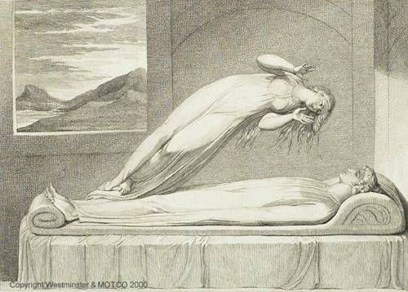
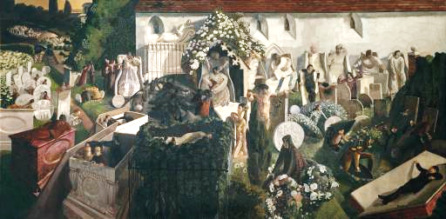
Immortality of the Soul
Spot the difference…!?
Both of these art works show images of life after death.
What are the key differences in the ideas about life after death shown in the pictures?
Soul Leaving the Body (1808) – William Blake (1757–1827)
The Resurrection, Cookham, 1924
Stanley Spencer (1891 – 1959)

Slide 3
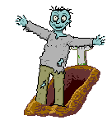
Immortality
What is death?
What is immortality?
If there is eternal life, is there such a thing as death?
If death is the end of this life, what is the ‘next’ life like?
If death leads to another life could this mean when that life ends there is another life? Could this go on into infinity?
If there is eternal life, where is this going to be?
Does how we live affect our next life?
What part of us goes on to the next life?
Do we get a new body in the next life?
Is life after death just wishful thinking?
If immortality is real, at what point after death does this occur?
In small groups, discuss and note down ideas in response to these questions. Give reasons for your ideas and add more questions if you like.

Slide 4
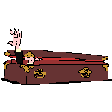
Immortality
Definitions;
Write the definitions for the following key terms;
Soul Materialism dualism
Materialism & Dualism
Explain what (a) materialists and (b) dualists believe about the nature of human beings.
Explain the affect that (a) materialism and (b) dualism has on beliefs about the afterlife.

Slide 5
Immortality
Review – Evaluate...
Evaluate the ideas of materialism and dualism as ‘evidence’ or denial of immortality of the soul and an afterlife.

