Slide 1
Mackie on Evil & the Existence of God - Anthology
To begin… reminders;
What is evil? Explain and give three examples.
What is suffering? Explain and give two examples of moral evil and two examples of natural evil.
What is a theodicy? Give three examples from different philosophers.

Slide 2
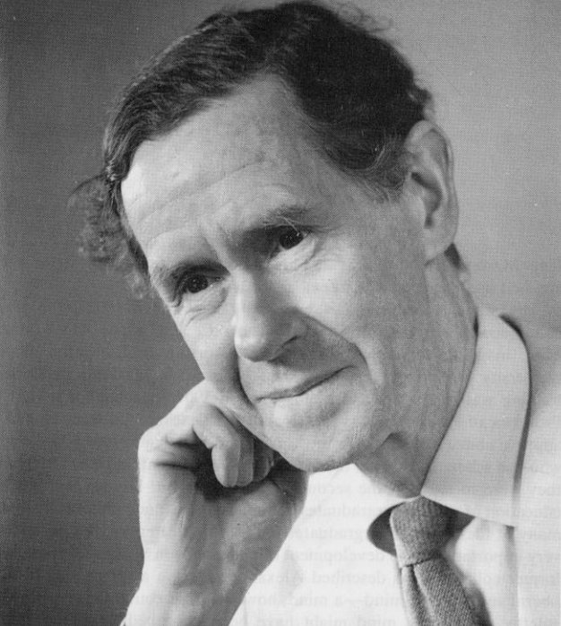
Mackie on Evil & the Existence of God - Anthology
Some background…
Mackie was well known for vigorously defending atheism, and also arguing that the problem of evil made untenable the main monotheistic religions. He particularly criticised the free will defence . He argued that the idea of human free will is no defence for those who wish to believe in an omnicompetent being in the face of evil and suffering, as such a being could have given us both free will and moral perfection, thus resulting in us choosing the good in every situation. In 1955 he published "Evil and Omnipotence", summarizing his view that the simultaneous existence of evil and an all-powerful, all-knowing and all-good God was "positively irrational".

Slide 3
Mackie on Evil & the Existence of God - Anthology
To summarise …

Slide 4
Mackie on Evil & the Existence of God - Anthology
…and now;
Read the anthology and highlight the following in different colours using a key;
Arguments against the existence of God.
Arguments for the existence of God.
Definitions/descriptions.
…then;
Complete the A3 sheet noting down key points of the discussion.

Slide 5
Mackie on Evil & the Existence of God - Anthology
Exam questions;
3(a) Clarify the ideas illustrated in this passage about the
problem of evil.
You must refer to the passage in your response.
3(b) Analyse the responses illustrated in this passage
about the problem of evil.

Slide 6
Mackie on Evil & the Existence of God - Anthology
‘The problem of evil, in the sense in which I shall be using the phrase, is a
problem only for someone who believes that there is a God who is both omnipotent
and wholly good. And it is a logical problem, the problem of clarifying and
reconciling a number of beliefs: it is not a scientific problem that might be solved
by further observations, or a practical problem that might be solved by a decision
or an action. These points are obvious; I mention them only because they are
sometimes ignored by theologians, who sometimes parry a statement of the
problem with such remarks as ‘Well, can you solve the problem yourself?’ or ‘This is a mystery which may be revealed to us later’ or ‘Evil is something to be faced and overcome, not to be merely discussed.’

