Slide 1
Religious Experience – Anthology
Copleston & Russell Debate
Focus;
Do religious experiences prove that God exists?
To begin… recap;

Slide 2
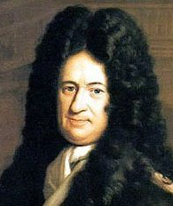
Anthology - Copleston & Russell Debate
Some context – Principle of Sufficient Reason;
In order to understand the debate between Copleston and Russell it helps to be aware of Leibniz’s Principle of Sufficient reason;
‘In virtue of which we hold that o fact could ever be true of or existent, nor statement correct, unless there were a sufficient reason why it was thus and not otherwise.’
What is the meaning of Leibniz’s statement?

Slide 3
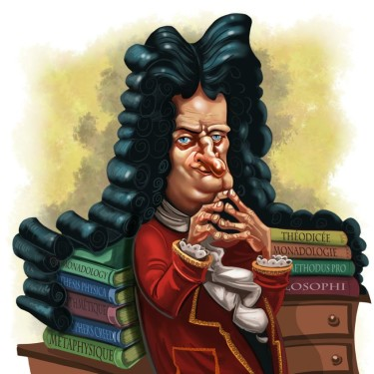
Anthology - Copleston & Russell Debate
Principle of Sufficient Reason;
‘In virtue of which we hold that o fact could ever be true of or existent, nor statement correct, unless there were a sufficient reason why it was thus and not otherwise.’
Simply – no fact could ever be true unless there
were a sufficient reason why it was true.
Leibniz is saying that you should be able to give a believable, good reason/explanation of why something is, in order to have a sufficient explanation.

Slide 4
Anthology - Copleston & Russell Debate
Principle of Sufficient Reason;
Leibniz’s idea does seem to make sense.
Are there any issues with the idea of Sufficient Reason?
How do we know when we have Sufficient Reason?
Is it enough to know how something came into existence? We also like to know why…

Slide 5
Anthology - Copleston & Russell Debate
Things to do;
Read through this part of the anthology.
As you are reading highlight the following (use a key);
You may also wish to highlight reasons and evidence (although you will
find lots of crossovers)
3. Look up definitions for, and note down, any key terms
you are not sure of.
For the existence of God
Against the existence of God
Examples and comparisons
Definitions of REs.

Slide 6
Anthology - Copleston & Russell Debate
Things to do;
On the large sheet you will be given complete all the tasks;
Note down Russell and Copleston’s main viewpoints on REs as an argument for the existence of God.
Note down the main reasons they each have for their viewpoints.
Note down the evidence they each put forward.
Write down any questions or issues you have or are raised about the contents of the debate.
Note down the strengths and weaknesses of both Russell and Copleston’s arguments.
Evaluate – who wins the debate (if anyone?) explain your reasons.

Slide 7
Anthology - Copleston & Russell Debate
More things to do;
Make links between some elements of the debate and;
(a) Philosopher’s views
(b) Principles of verification of Religious Experiences
(c) Examples

Slide 8
Anthology - Copleston & Russell Debate
3(a) Clarify the ideas illustrated in this passage about the veracity
of Religious experience.
You must refer to the passage in your response. (10)
3(b) Analyse the extent to which Copleston’s arguments suggest
that religious experiences can be used to prove the
existence of God. (20)
In Q3b, reference should be made
to other parts of the Copleston/Russell
debate as well as other evidence, e.g.
other philosophers and examples.

Slide 9
Anthology - Copleston & Russell Debate
RELIGIOUS EXPERIENCE
Copleston: … Well, perhaps I might say a word about religious experience, and then we can go on to moral experience. I don't regard religious experience as a strict proof of the existence of God, so the character of the discussion changes somewhat, but I think it's true to say that the best explanation of it is the existence of God. By religious experience I don't mean simply feeling good. I mean a loving, but unclear, awareness of some object which irresistibly seems to the experiencer as something transcending the self, something transcending all the normal objects of experience, something which cannot be pictured or conceptualized, but of the reality of which doubt is impossible – at least during the experience. I should claim that cannot be explained adequately and without residue, simply subjectively. The actual basic experience at any rate is most easily explained on the hypotheses that there is actually some objective cause of that experience.

