Slide 1
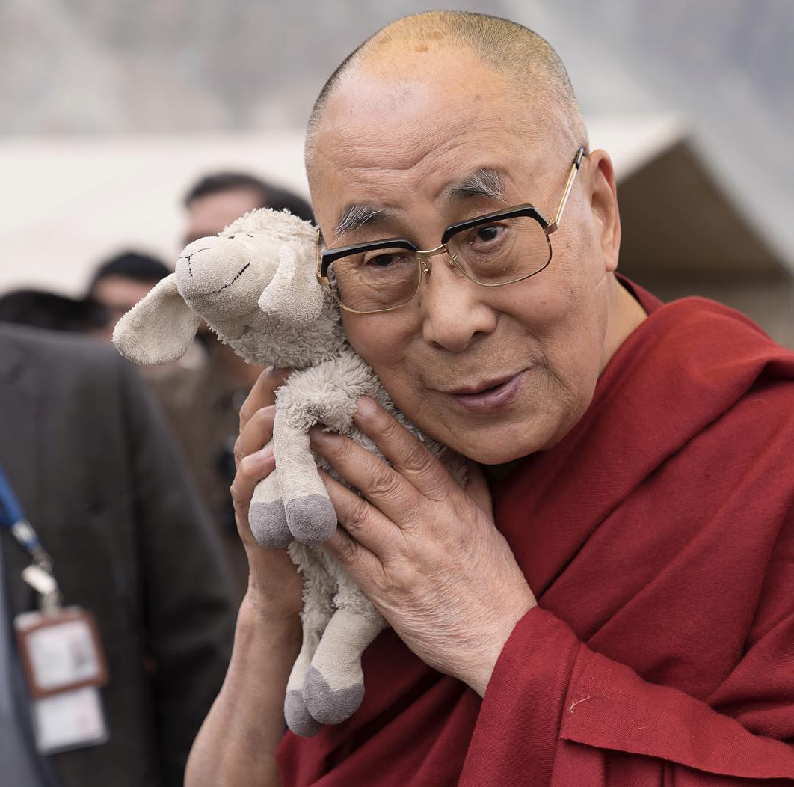
Towards the true kinship of faiths
What does the Dalai Lama say is central to all religions? Give examples.
What is the ‘balance’ required to achieve religious coexistence?
Why do you think ‘promotion of understanding among the world’s religions’ is important?
What, according to the Dalai Lama is the solution to the world’s problems?
What is the basis of ‘peaceful coexistence’?
How can we prevent disagreement ending up in conflict?
What is the advice the Dalai Lama gives to religious believers in order to gain a ‘kinship of faiths’?
What might be the consequences of failing to live in ‘peaceful coexistence’?
Use a quotation that illustrates that Buddhists should desire coexistence.

