Slide 1
Ahimsa
The interpretation and application of ahimsa
for a Buddhist in the modern world.
To begin… Write down the first of the 5 precepts.
Explain three ways in which Buddhists put this into practice.
Explain links to other parts of the Eightfold Path, e.g. Right Livelihood.
I.L… Below is a link to a talk given by the Dalai Lama. It is 96 minutes in full, so there is no time to watch it in the lesson. However, it would be a very good idea to look at it, skipping to the bits that are focussed on ahimsa.
http://meridian-trust.org/video/ahimsa-indias-contribution-to-the-world-h-h-the-dalai-lama/

Slide 2
Ahimsa
Read anthology pages 141 – 142. T. Bhikkhu; The Warrior.
What does the warrior think may happen to one who has been slain in battle?
What is ‘the Blessed One’s’ response to the warrior’s question?
What does the warrior decide after hearing the Blessed One’s response?

Slide 3
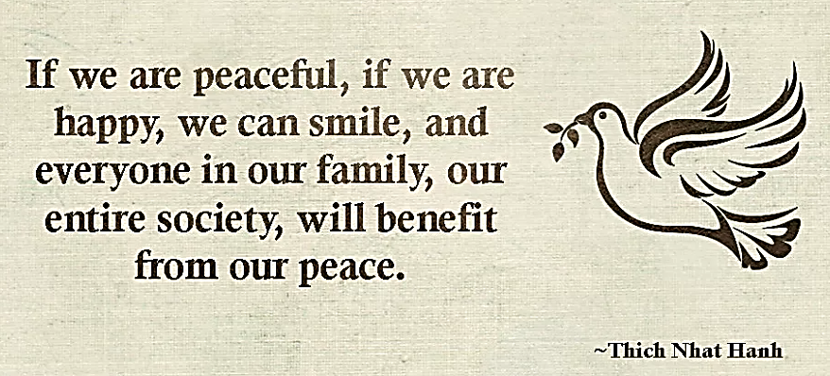
Ahimsa
Things to do - Research:
Find out more about ‘Engaged Buddhism’ and the work of Thich Nhat Hanh. Particularly focus on where he has peacefully campaigned against war and violence and helped people who are suffering due to the violence of others.
Things to do – Make links;
Explain links between ‘Engaged Buddhism’ and Buddhist teachings. Focus on teachings that underpin and support Engaged Buddhism.

