Slide 1
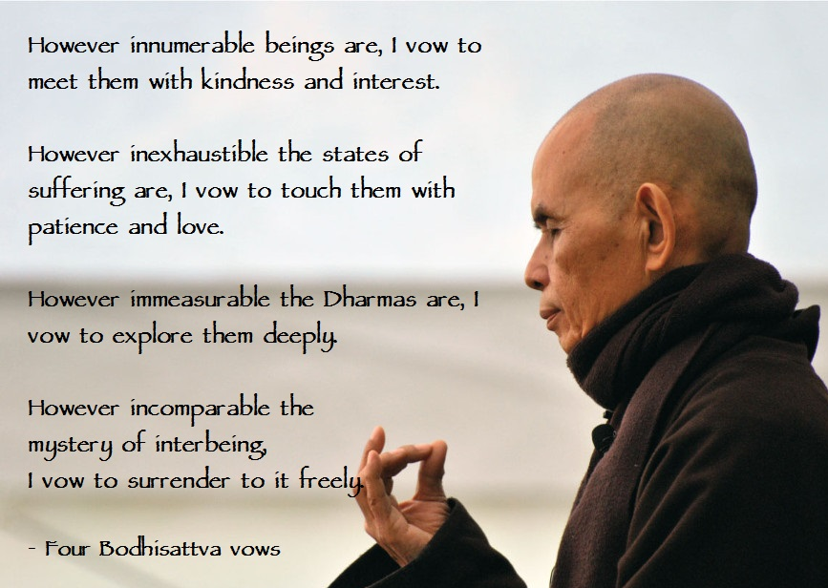
The Bodhisattva
Focus of the lesson…
What do different Buddhists
believe about Bodhisattvas?
To begin…
What is an arhat?
What is a Bodhisattva?
Explain differences in what Mahayana Buddhists and Theravada Buddhists believe about these two ideas.

Slide 2
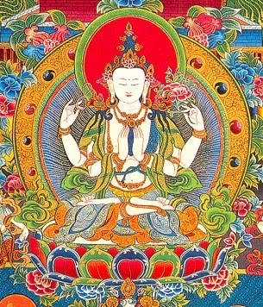
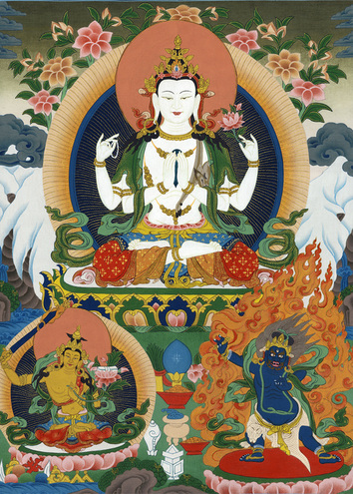
The Bodhisattva
Things to do… the basics.
1. How does a person become a Bodhisattva?
2. Note down the Six perfections of a Bodhisattva.
3. What is the difference between ‘earthly’ and ‘transcendent’ Bodhisattvas?
Things to do… the anthology pages 126.
According to Basham, what is the key difference between Mahayana and
Theravada Buddhism?
2. What is a Bodhisattva and what is their aim? Include a quotation.
3. What is the Mahayana point of view on Bodhisattvas?
4. Note down some of the main qualities of a Bodhisattva.

Slide 3
The Bodhisattva
Things to do… the anthology pages 126 - 128.
5. According to some Mahayana teachers, why was the Theravada belief of
arhatship selfish? Include a quotation.
6. What is a ‘private Buddha’?
7. Explain an analogy to suggest why being a Bodhisattva is preferable to
being an arhat.
8. Explain links between the Bodhisattva ideal and the Christianity.
9. Give possible reasons for these links.
10. From the passages on pages 127 & 128, note down some examples
of how Bodhisattva’s show determination. Show links to
two of the six perfections.

Slide 4
The Bodhisattva
Things to do… the anthology pages 128 - 132.
11. According to Shantideva what are some of the hindrances to enlightenment?
12. What does Shantideva then go on to pledge a Bodhisattva will resolve to do?
13. What does he say a Bodhisattva must bring to ‘fruition’?
14. Note down some similarities and differences between the Buddhist and
Christian stories of the Lost Son.
15. Account for some of the differences in the stories.
16. What does the man (son) realise on reaching the highest stage of
self-development?

Slide 5
b) Mahayana Buddhism: the doctrine as found in the Lotus Sutra, including beliefs about wisdom, liberation, loving-kindness and skilful means. c) The stages and perfections of the Bodhisattva path, including their place in particular traditions. d) Debates such as the context of this belief system in Theravada Buddhism, together with issues, including transfer of karmic merit.

