Slide 1
Ch’an/Zen Buddhism
Focus:
What is Ch’an/Zen Buddhism?
Explain...
1. …the origins of Ch’an/Zen Buddhism. Make sure you refer to ‘special
transmission’ in your answer.
2. … how Ch’an began in China and how the character of Bodhidharma
affected its development.
3. … how the 6th Patriarch was chosen (include a quotation) and what this
shows about the nature of Ch’an Buddhism.

Slide 2
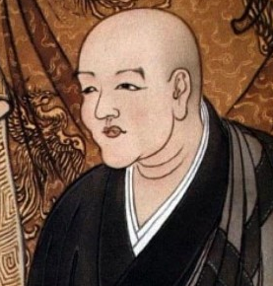
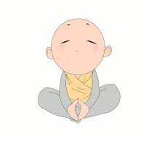
Ch’an/Zen Buddhism
Explain...
…how Soto and Rinzai Buddhism developed.
2. … some of the key differences in these two Zen schools.
Read about Meditation in Zen and Pure Land Buddhism...
For each tradition explain why meditation is important and the aims of meditation.
Also for each tradition (including both schools of Zen Buddhism)
explain the nature of the meditation practice.

Slide 3
Ch’an/Zen Buddhism
Exam questions...
1. Explore the ways to liberation taught by Pure Land and Zen Buddhism. (8)
In your answer refer to the different Zen schools, and different types of meditation in these school. For Pure Land, make sure you refer to Amida/Amitabha Buddha and also True Pure Land.
Explain the concept of Sukhavati, remembering that this isn’t liberation, but a quicker/easier path to liberation (enlightenment).
2. Assess whether or not Pure Land and Zen Buddhist teachings and beliefs
are opposed to each other. (12)
Make sure the focus is on ‘assessment’. You will need to refer to some beliefs, but don’t explain them in detail. Focus on the ‘ifs’, ‘buts’ and ‘howevers’

