Slide 1
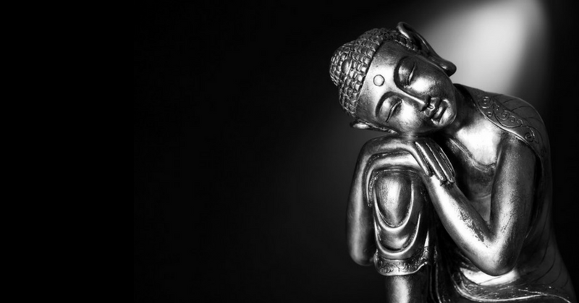
Pure Land Buddhism
Focus;
What is Pure Land Buddhism?
To begin… Recap quiz!
Buddhism ;
1. Note.
2. Briefly.

Slide 2
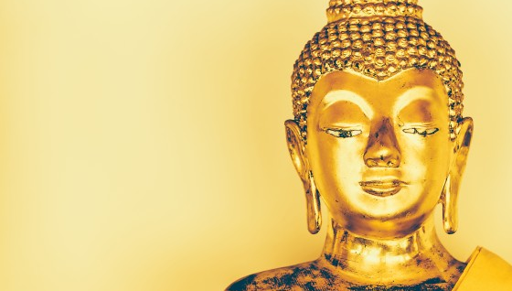
Pure Land Buddhism
Buddhism ;
1. Explain the basis of Pure Land
Buddhism. Refer to the tradition it
emerged from and where it began.
2. Explain the nature of the Pure Land
include a quotation in your answer.
3. Explain how the Pure Land can be reached.
4. How is Pure Land different from other
forms of Buddhism?
5. Explain why Pure Land gained popular appeal.

Slide 3
Pure Land Buddhism
Buddhism ;
1. Is it fair that a murderer could
meditate on Amitabha’s name
and gain salvation in Sukhavati.
Should everyone be given the same
chance to achieve enlightenment
regardless of what they have done?
Explain reasons for your answer.
2. Briefly.

Slide 4
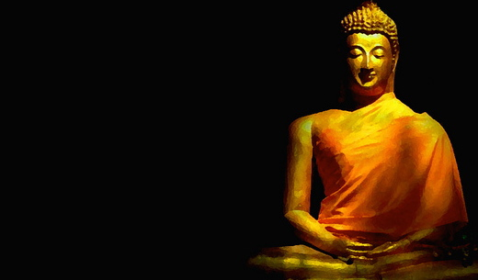
Pure Land Buddhism
Pure Land in Japan;
1. Explain how Pure Land began in Japan.
2. Explain how Pure Land developed and
evolved in Japan.
Exam question;
To what extent could it be argued that Pure Land does not follow the main principles of the Buddha’s teaching?

