Slide 1
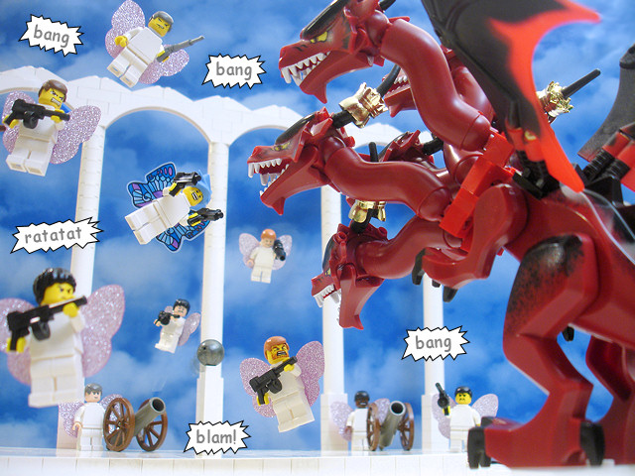
Explanations for the Origins of
Evil and Suffering
Focus.
What did Augustine say about the origins of suffering and evil?
To begin...
Explain two religious ideas about the origins of evil.
Genesis 3:6-23 (include the punishments men and women were given for disobeying God) + Revelation 12:7-12.

Slide 2
Explanations for the Origins of
Evil and Suffering
Explain...
What did Augustine say were the origins of evil?
How do the punishments given to man and woman because of their disobedience God, cause suffering?
3. Why did Augustine say human suffering is deserved?
Give an example.
4. How does Augustine explain natural evil?

Slide 3
Explanations for the Origins of
Evil and Suffering
Explain...
Summarise Augustine’s soul-deciding theodicy.
Why does Augustine say God has a right not to intervene to end suffering and evil?
Briefly explain Augustine’s aesthetics argument.

