Slide 1
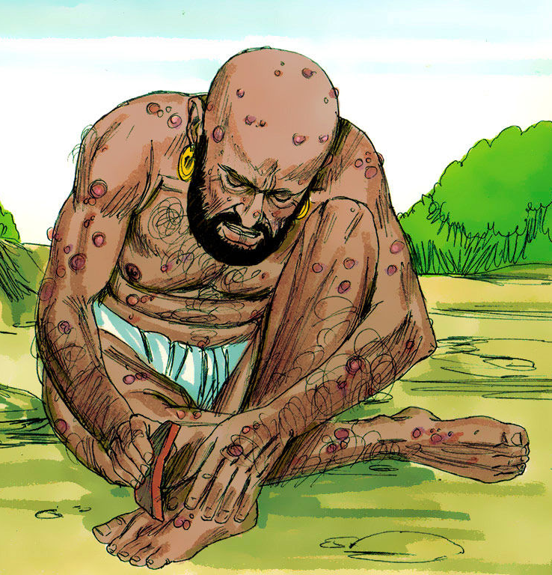
The Evidential Problem of Evil
Focus of the lesson…
How is evidence of suffering and evil used to argue against the existence of the God of classical theism?
To Begin…Note down
One Biblical man who suffered
Two types of suffering
Three causes of suffering according to Buddhism
Four examples of suffering (including two famous events)
Five ‘qualities’ of God.

Slide 2
The Evidential Problem of Evil
Explain…
Explain the evidential problem of evil, referring to William Rowe.
Explain your own examples of unnecessary suffering explaining why this suggests the God of classical theism does not exist.
Is there ever a point to suffering? Explain with examples, suggesting how theists might respond to Hume and Rowes’ arguments that suffering and evil suggest God does not exist.

Slide 3
The Evidential Problem of Evil
Explain…
On your key terms sheet note down the definition of the word
theodicy.
Explain the basis of and the two main assumptions of
Augustine’s theodicy on evil.
Suffering is often seen as a punishment for sin. Use a Biblical
quotation to explain the origins of this form of suffering.

Slide 4
The Evidential Problem of Evil
Explain...
What is a theodicy? Write down a definition on your key terms sheet.
Note down the basis of Augustine’s theodicy.
Explain why Augustin claimed that personal evil is inevitable.

