Slide 1
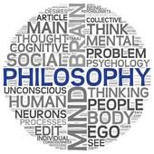
Religious Experience
Summary
Focus of the lesson…
What should I know about religious experiences?
To begin…
Check the contents list on the front of your booklets; Note down one thing you have learnt about each of these headings.

Slide 2
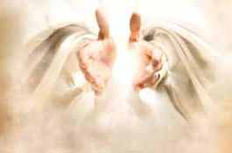
Religious Experience Summary
Contents:
What are religious experiences?
Types of religious experience.
Verification of religious experience.
Can religious experiences prove that God exists?
William James on religious experience.
Other philosophers’ views on religious experience.
Freud and Marx on religious experience.
Arguments for and against religious experience as proof of the existence of God.

Slide 3
Religious Experience Summary
Revision…
Create a revision document on religious experiences.
Use the contents headings as subheadings.
You can prepare your revision guide in any way you like – leaflet; power point, video etc.

Slide 4
Religious Experience Summary
Exam Question…
Analyse the success of religious experiences as proof of God’s existence. (20 marks - 5 marks AO1, 15 marks AO2 )
The focus of this essay is to suggest how far religious experiences can ‘prove’ God’s existence.
You need to refer to what different philosophers have said
Different types of religious experience
Use examples to ‘prove’ your points.

Slide 5
Religious Experience Essay
Introduction
Individual
(nature of these could mean unverifiable)
Group
(nature of these could mean more believable)
Examples
(Toronto Blessing;
Pentecost)
Examples
(St Teresa;
Muhammad)
Make sure your points clearly refer to the question
Individual & Group
(Lourdes, St Bernadette + Miracles)
Use quotations where appropriate
Types
(conversion; revelation; mediated) +examples
Evaluate/ Conclusion
(based on your evidence sum up how effective REs are at proving God’s existence)
Philosophers for
(James; Swinburne; Otto; Persinger)
Results
(life-changing, positive etc) +examples
Philosophers against
(Freud; Dawkins)

