Slide 1
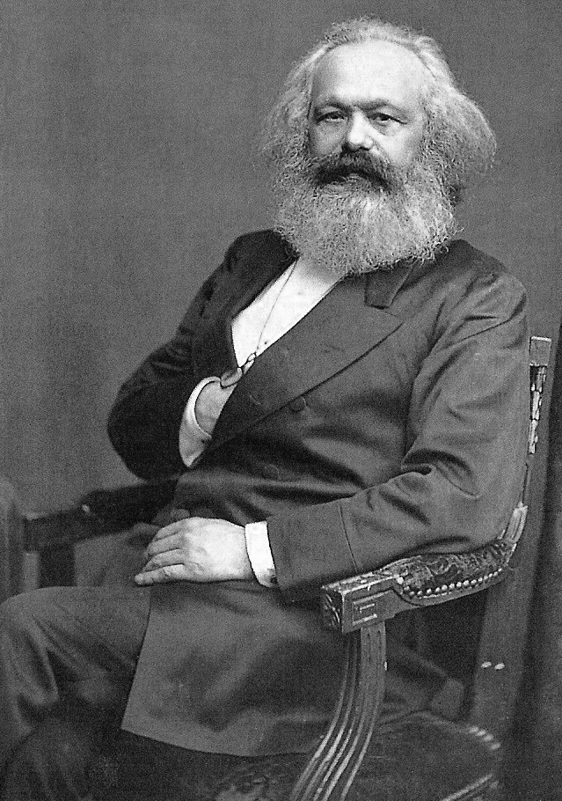
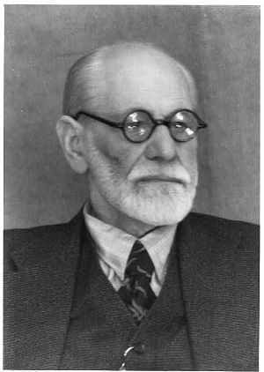
Philosopher’s Views on
Religious Experience – Freud & Marx.
Focus of the lesson…
What did Freud & Marx say about religious experiences?
To begin…
Quiz time.

Slide 2
Philosopher’s Views on
Religious Experience – Freud & Marx.
Explain....
Explain why Freud thought why religious experiences were not evidence for the existence of God.
Why do you think Marx described religion and ‘the opium of the people.’
What does this suggest about Marx’ beliefs about the validity of
religious experiences and the existence of God?

Slide 3
Philosopher’s Views on
Religious Experience – Freud & Marx.
Summing up...
Read and then summarise arguments for and against religious experience as proof of the existence of God.
Add arguments of your own from what you have learnt and from other philosophical opinions.

Slide 4
Philosopher’s Views on
Religious Experience – Freud & Marx.
Exam Question…
Assess the strengths of the argument from religious experience for the existence of God. (9 marks) (AO1 – 3marks; AO2 6 Marks)

