Slide 1
Philosopher’s Views on
Religious Experience - 2.
Focus of the lesson…
What do philosophers say about religious experiences?
To begin…
Key term crossword?
I.L…
Complete exam question.

Slide 2
Philosopher’s Views on
Religious Experience - 2.
Rudolph Otto...
Why did Otto coin the expression of the ‘numinous’?
b) Explain Otto’s idea of ‘The Holy Other’.
Explain the tremendum and mysterium components of the numinous experience.
Look up Exodus 3:6. Explain how Moses’ experience illustrates
Otto’s theories.
e) What does Otto’s term ‘divination’ mean?
Explain how a religious experience can be mystical and numinous, and
how this can mean religious experiences can apply to any religion.
i) Use Otto’s arguments to suggest that God exists.

Slide 3
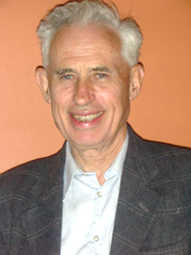
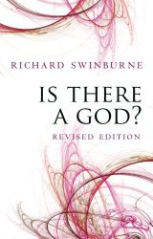
Philosopher’s Views on
Religious Experience - 2.
Richard Swinburne.
Explain how Swinburne categorises religious experiences.
b) Outline Swinburne’s two principles in support of religious
experiences.
c) Explain how Swinburne’s arguments could lead to proof that
God exists.
d) Suggest criticisms for Swinburne’s arguments.

Slide 4
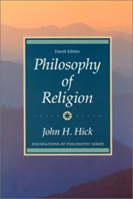
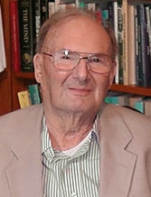
Philosopher’s Views on
Religious Experience - 2.
John Hick.
Explain how Hick suggests religious knowledge is gained.
Use a quotation from Hick’s publication, ‘Faith and Knowledge’, to make an argument for God’s existence.
Summarise the basis of Hick’s argument for religious experience.

Slide 5
Philosopher’s Views on
Religious Experience - 2.
Michael Persinger.
Explain the purpose of the ‘God Helmet’.
b) What did Persinger claim were the results of the
God Helmet experiments?
c) Explain how Persinger suggests religious
experiences could be a result of seismic faults.
d) Suggest some criticisms of Persinger’s theories.

Slide 6
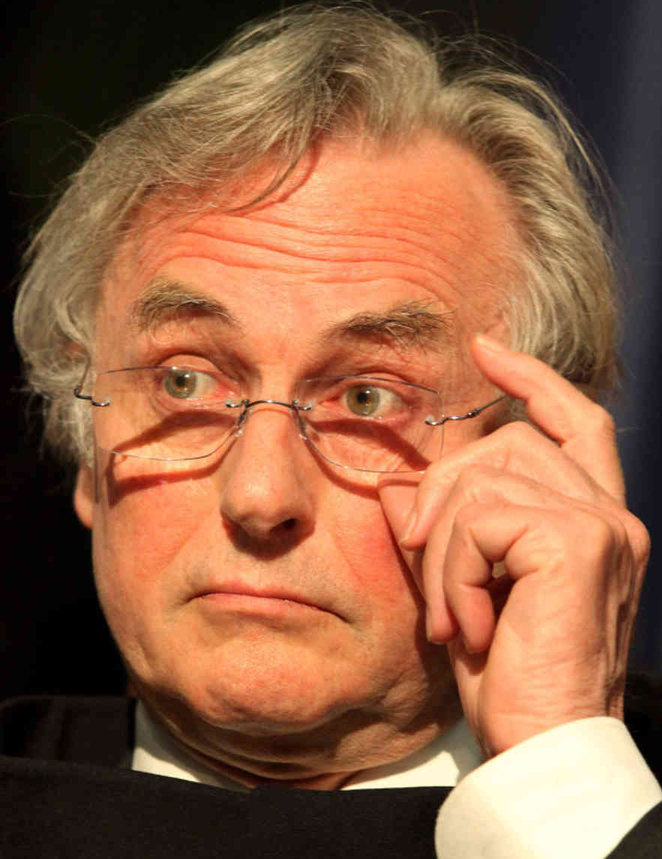
Philosopher’s Views on
Religious Experience - 2.
Task sixteen.
Explain why Dawkins says religious experiences are not a real phenomenon and how this leads to a belief that God does not exist.
b) What are some of the criticisms of Dawkins
arguments?

Slide 7
Philosopher’s Views on
Religious Experience - 2.
Exam Question…
Explore key ideas about the nature of religious experience. 8 marks AO1
AO1 is for candidates to demonstrate knowledge, understanding and specialist language and terminology when responding to the question.
Candidates may refer to the following.
• Some transient experiences may have life-long effects and be regarded as religious.
• Some of these experiences may be public and appear to be unusual experiences believed
to be created by God.
• Some may be private, which may be expressed in normal language, but others may be
more difficult to express in words.
• An example of ineffable experiences may be seen in mysticism. • Some religious
experiences may be what Otto referred to as numinous (the wholly other). (8)

