Slide 1
Philosopher’s Views on
Religious Experience.
Focus of the lesson…
What did William James say about religious experiences?
To begin…
Volunteers needed to play ‘Splat’!

Slide 2
Philosopher’s Views on
Religious Experience.
Apply…
Apply James’ existential and value judgements to one of the religious experiences we have looked at.
Does considering these judgements help to ‘prove’ a religious experience or the existence of God? Explain your answer with evidence.

Slide 3
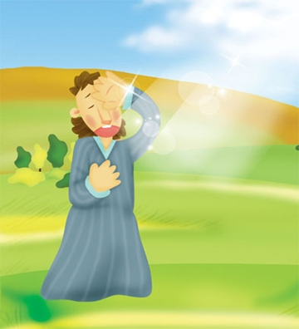
Philosopher’s Views on Religious Experience.
Explain...
Explain the meaning of James’ terms; existential judgements and value/spiritual judgements.
What was James saying about how we should view someone’s claim that they have had a religious experience?
Medical Materialism is an approach to medical science to aims to classify everything in physical terms.
How do you think a ‘medical materialist’ would explain
the experience of St. Paul on the road to Damascus?

Slide 4
Philosopher’s Views on Religious Experience.
Apply and assess...
Consider any powerful emotion – love, hate, joy, jealousy. These feeling often seem irrational or illogical.
a) Do we accept the reality and results of these feelings? Why do you think this is, or, is not the case?
b) How can such a consideration help in an assessment of religious experience as evidence for the existence of God?
c) How might a prior belief in God affect your understanding of an apparent religious experience?

Slide 5
Philosopher’s Views on Religious Experience.
Verify and explain...
a) If someone said to you ‘I know God exists because I have seen him’, you would naturally be suspicious. What questions might you ask the person to try to validate their experience?
b) Explain how James argued against those who claimed that religious experiences could not be authentic because there are many different religions? What are the implications of this?

Slide 6
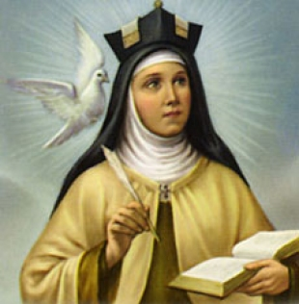
Philosopher’s Views on Religious Experience.
Read and answer...
How might an atheist interpret the testimony that someone had
had a religious experience?
b) Explain James’ main conclusions that religious experiences were
potential evidence for the existence of God.
c) Why did James say it was acceptable to use emotions and
feelings as evidence of religious experience?
d) How did James dispute the idea that science cannot be used
when considering religious experiences?
e) What affect did James claim religious experiences have
on peoples’ lives?
f) How might this suggest proof of God’s existence?

Slide 7
Philosopher’s Views
on Religious Experience.
Review…
Sum up James’ indications for religious experience using the mnemonic PINT.

