Slide 1
Religious Experience
As an Argument for the Existence of God.
Focus of the lesson…
Can religious experiences prove the existence of God?
To begin…
Review Quiz…
http://www.teachers-direct.co.uk/resources/quiz-busters/quiz-busters-game.aspx?game_id=145408
Can religious experiences prove that God exists?
Read the information and explain an answer to the above question including an example in your answer.

Slide 2
Religious Experience
As an Argument for the Existence of God.
Explain…
Explain, with an example how religious experiences could prove that God exists.
Complete…
Read the different examples of religious experiences. Choose 3 of the examples to complete a table giving brief descriptions, useful quotations and evidence for proving the existence of God.
Compare…
Make comparisons (common elements + differences) in each of the experiences you have focussed on.

Slide 3
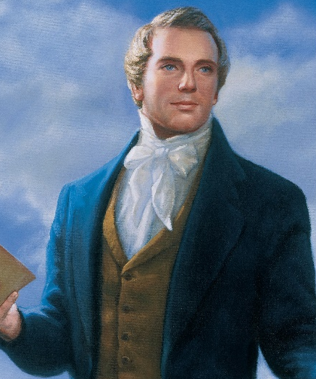
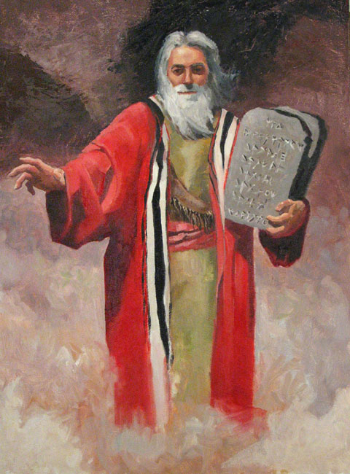
Religious Experience
As an Argument for the Existence of God.
Review & I.L.
Review what you have learnt so far.
Find another example of a religious experience from any religion. Very briefly explain what happened, the difference it made to people’s lives and evaluate how far the experience proves that God exists.
Some ideas

