Slide 1
A Level Philosophy of Religion
Focus of the lesson...
What is philosophy of religion?
To begin...
Watch the video clip and answer the questions (on a sheet).
https://www.youtube.com/watch?v=DX3NcZyOjgA&index=36&list=PLgB8P45yU0Gm58-Gq7fTM-IQIxq-Q0Gnk

Slide 2
A Level Philosophy of Religion
What does the exam involve?
3 exam papers – Philosophy of Religion; Religion & Ethics; Buddhism.
Each paper has the same format;
Students answer all questions in Section A, Section B and Section C.
Section A Two extended-response questions (8 + 12 marks).
Section B One two-part essay question (10 + 20 marks) on an excerpt, from the extracts list (these are found in the A Level Religious Studies Anthology on Edexcel website). You will not take the anthology into the examination. Relevant extracts will be printed in the examination paper.
Section C One extended essay question (30 marks).

Slide 3
The Nature of Religious Experience
What is Religious Experience?
Write down two statements about anything that you believe to be true as a result of your own experience.
Would you be as happy to believe the statements if you had not had the experience but heard about it from someone else? Explain your answer.
What do you think might affect your decision whether or not to believe something others might not believe.
U2 are the greatest live band
Yes/no/perhaps…
Bias… beliefs… etc…?

Slide 4
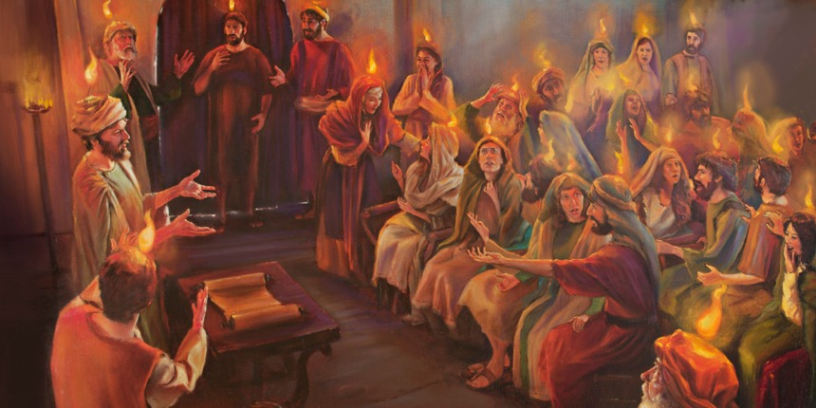
The Nature of Religious Experience
How is a religious experience different to any other experience?
This might seem like an obvious question but you do need to be able to recognise when an experience is a religious experience.
Explain your answer to the question. Use examples in your answer.

Slide 5
The Nature of Religious Experience
An example of a religious experience...
Read Acts 2 (abridged) and answer the questions.
https://www.youtube.com/watch?v=xtokHQOmFu0
What is a religious experience?
Write a definition from what you have learnt in the lesson today.

