Slide 1
Jhana (Dhyana) Meditation
Key Question.
How is Jhana meditation different from other forms of Buddhist meditation?
To begin... Recap - 3-2-1
3 reasons why Buddhists meditate
2 types of meditation
1 benefit for anyone of regular meditation

Slide 2
Jhana (Dhyana) Meditation
In the outline of the ladder note down and very briefly explain each of the nine levels of jhanas starting from the bottom.
Explain what the Jhanas are and how they link to meditation.
How are the jhanic states reached through meditation?
How might being able to witness your past lives through the highest jhanic states be an advantage?
What is one-pointed concentration?
Explain the differences between contemplative and concentration meditation.
Give an example of how contemplative meditation can work in practice.
Explain how concentration meditation works and how it can be practiced.

Slide 3
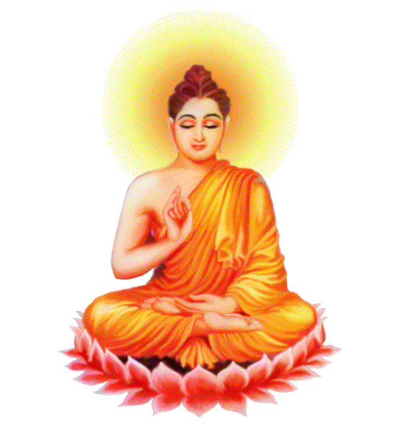
Jhana (Dhyana) Meditation
Note down each of the five hindrances and explain how
each can hinder meditation.
And finally…
https://play.kahoot.it/#/?quizId=cdd25501-7b64-47b4-9d7d-7920c4f4bc9c

